Slide 1


LEVERAGING DATA FOR PROACTIVE HOMELESSNESS PREVENTION
Presented by:
ArpitShivam Pandey
Jayesh Pandey
Abhay Maurya

Slide 2

PROBLEM STATEMENT
Our project aims to create a data-driven platform for preventing homelessness. By analyzing economic factors, health determinants, and eviction trends, we'll predict individuals at risk. Key focuses include efficient data integration and cleaning, using machine learning for predictive modeling, geospatial analysis for community targeting, and designing a scalable, user-friendly platform. Additionally, we'll incorporate real-time feedback loops for dynamic intervention recommendations.

Slide 3
VISUALIZATION
In our initial phase, we've developed a comprehensive Power BI dashboard to analyze the extent of governmental support for homelessness aid across rural and urban areas in India. This dashboard integrates data from various sources, including government reports and surveys, to provide insights into the effectiveness of state-level initiatives. Our focus is to identify states that are efficiently utilizing resources to address homelessness and those requiring more targeted interventions. Through this analysis, we aim to pave the way for evidence-based policymaking and resource allocation in the realm of homelessness prevention and support.

Slide 4
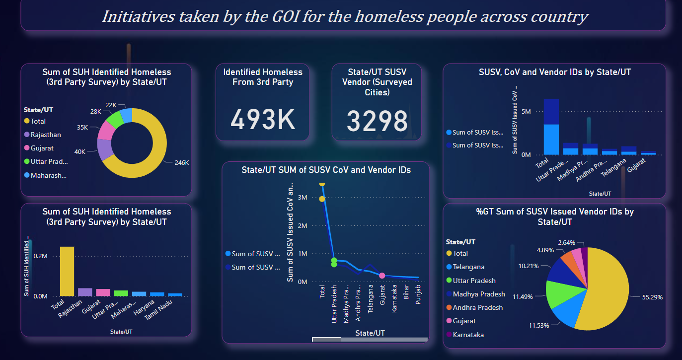
DASHBOARD

Slide 5
SOCIOECONOMIC CLASSIFICATION PREDICTION
Our next step involves the development of a sophisticated machine learning application aimed at predicting individuals' socioeconomic status based on key parameters such as age, sex, BMI, children, smoker status, medical expenses, salary, and financial difference. Through multiclass classification techniques, we've categorized individuals into lower class, middle class, and upper class. Specifically, a classification value of 2 denotes financial stability indicating membership in the upper class, while a value of 0 signifies economic vulnerability characteristic of the lower class; a value of 1 designates individuals belonging to the middle class. By employing this predictive model, we can better understand the socioeconomic landscape and tailor interventions accordingly to address disparities and provide targeted support where needed.

Slide 6
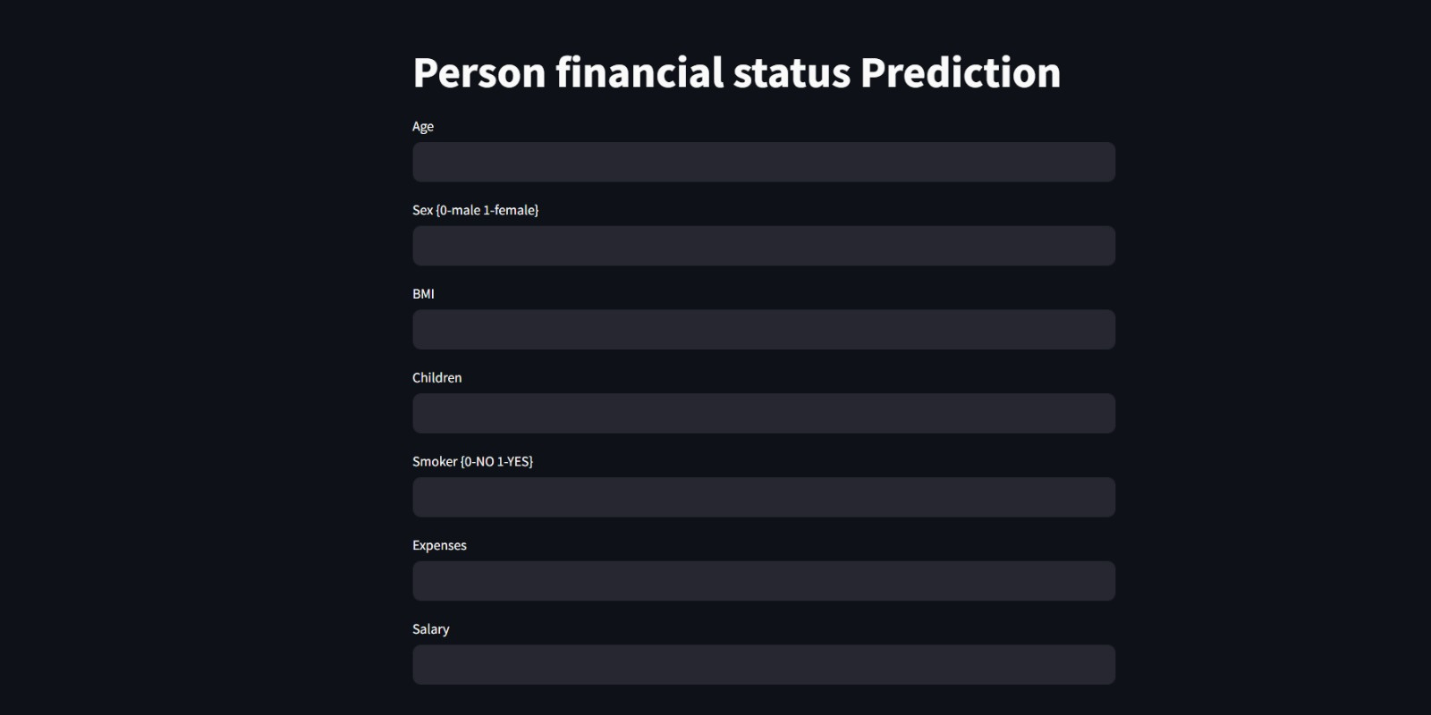

Slide 7
Data-Driven Consultancy
Following our predictive modeling phase, we transition into offering personalized consultancy services to individuals based on their socioeconomic status and aspirations. We gather pertinent data including salary, expenses, home value, prospective years to purchase a house, occupation, skills, and health conditions. Leveraging our advanced model, which incorporates Recurrent Neural Networks (RNN), Natural Language Toolkit (NLTK), Rectified Linear Units (ReLU), and other critical components, we provide tailored consultancy through a seven-step process. This approach ensures that individuals receive comprehensive guidance and support in navigating their financial journey towards improved socioeconomic standing and enhanced quality of life.

Slide 8
INSIGHTFUL SUMMARIZATION
In the subsequent stage, we utilize advanced text processing techniques, employing the Newspaper module and TextBlob, to generate concise summaries of the output derived from our consultancy module. By leveraging these tools, we distill complex information into digestible insights, facilitating clearer understanding and decision-making for our clients. Additionally, our system incorporates custom-built algorithms to enhance summarization accuracy and relevance. This streamlined approach ensures that individuals receive actionable recommendations derived from their personalized consultancy sessions, empowering them to make informed choices and progress towards their socioeconomic goals with confidence.

Slide 9
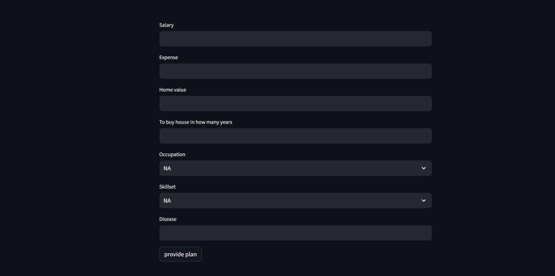

Slide 10

THANK YOU

