Slide 1



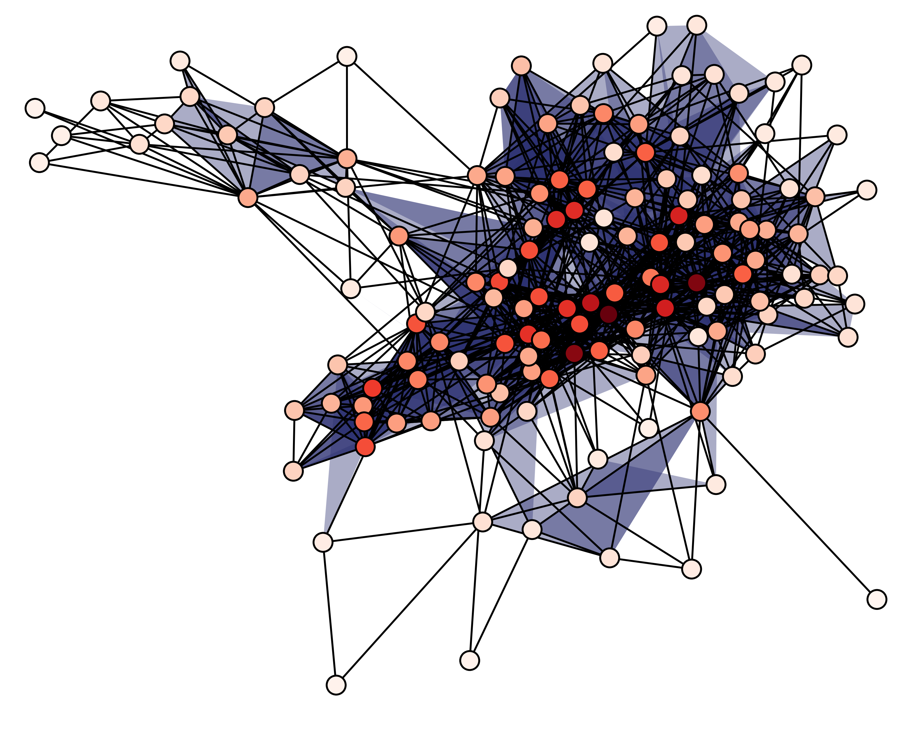


In this lab, WE BELIEVE
SCIENCE
is real
LOVE
is love
BLACK
lives matter
FEMINISM
is for everyone
NETWORKS
are cool
IMMIGRANTS
are welcome

