Slide 1


DoConnect
Name : Abhay Rana

Slide 2
Table of contents
01
04
05
02
03
Introduction
Process Logic
05
Data Dictionary
ER - Diagram
System Requirement Specification
Data Flow Diagram
06

Slide 3
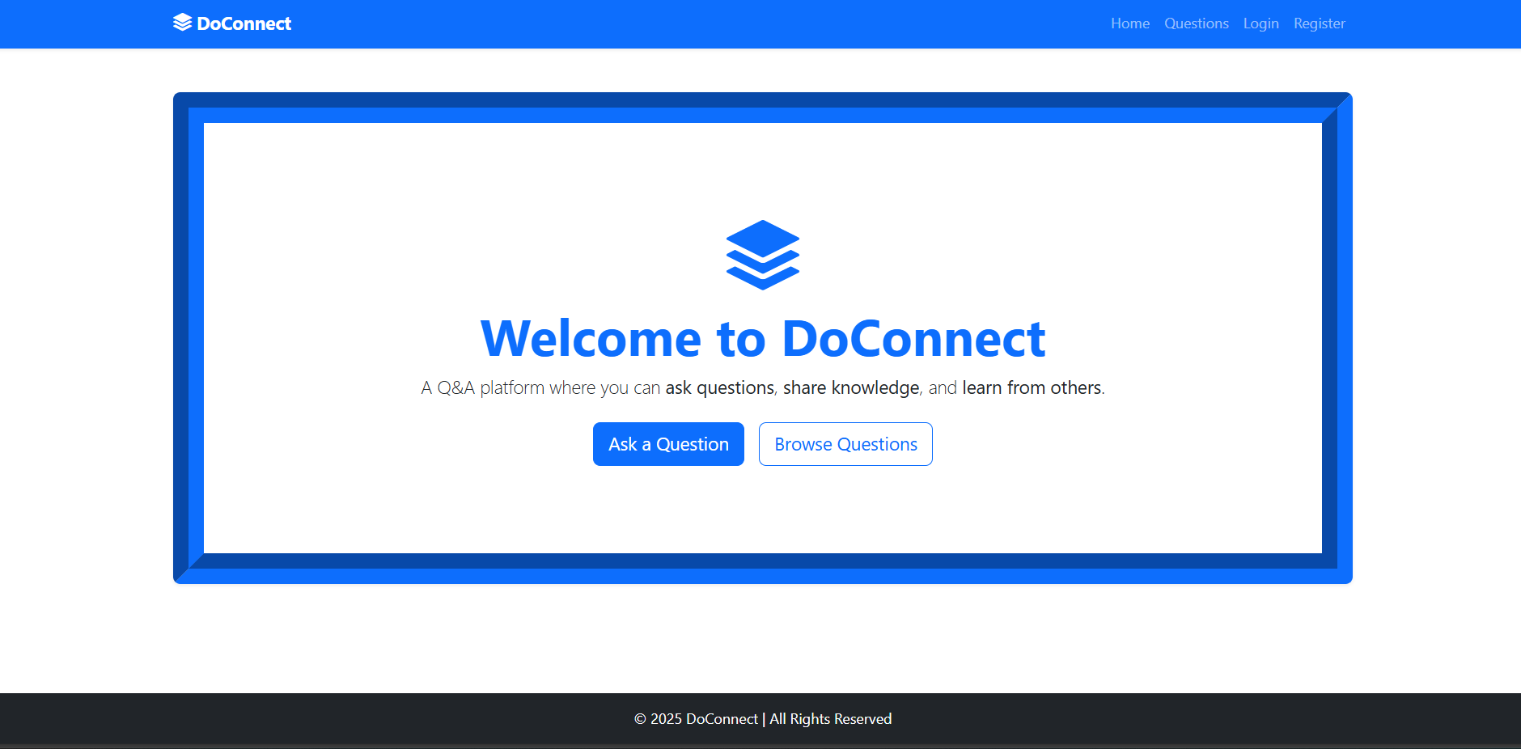
01
Introduction

Slide 4

Introduction
DoConnect is a Q&A discussion platform.
It allows users to ask questions, answer queries, and engage in knowledge sharing.
It provides authentication, role-based access (user/admin)

Slide 5

ER Diagram
02

Slide 6
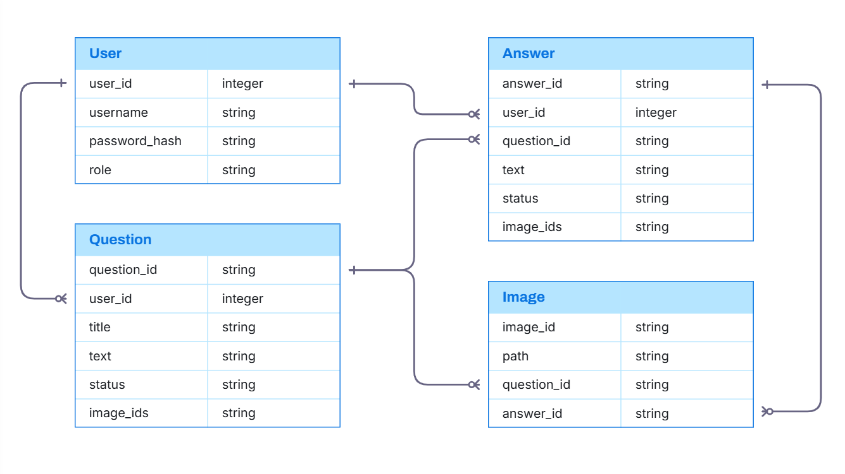
ER Diagram Sheet
1-N
1-N
1-N
1-N
1-N

Slide 7

SRS
03

Slide 8
Software Requirement Specification
Software Requirements
Hardware Requirements
Frontend : Angular
Backend : ASP .Net Core
Database : SQLServer (SMSS)
Hosting : Localhost
Processor : Minimum Intel Core i5
RAM : Minimum 4GB
OS : Win XP/7/8/10/11, macOS, Linux
Web Browser : Google Chrome, Mozilla Firefox, Microsoft Edge, Safari, etc.

Slide 9

04
Process Logic

Slide 10
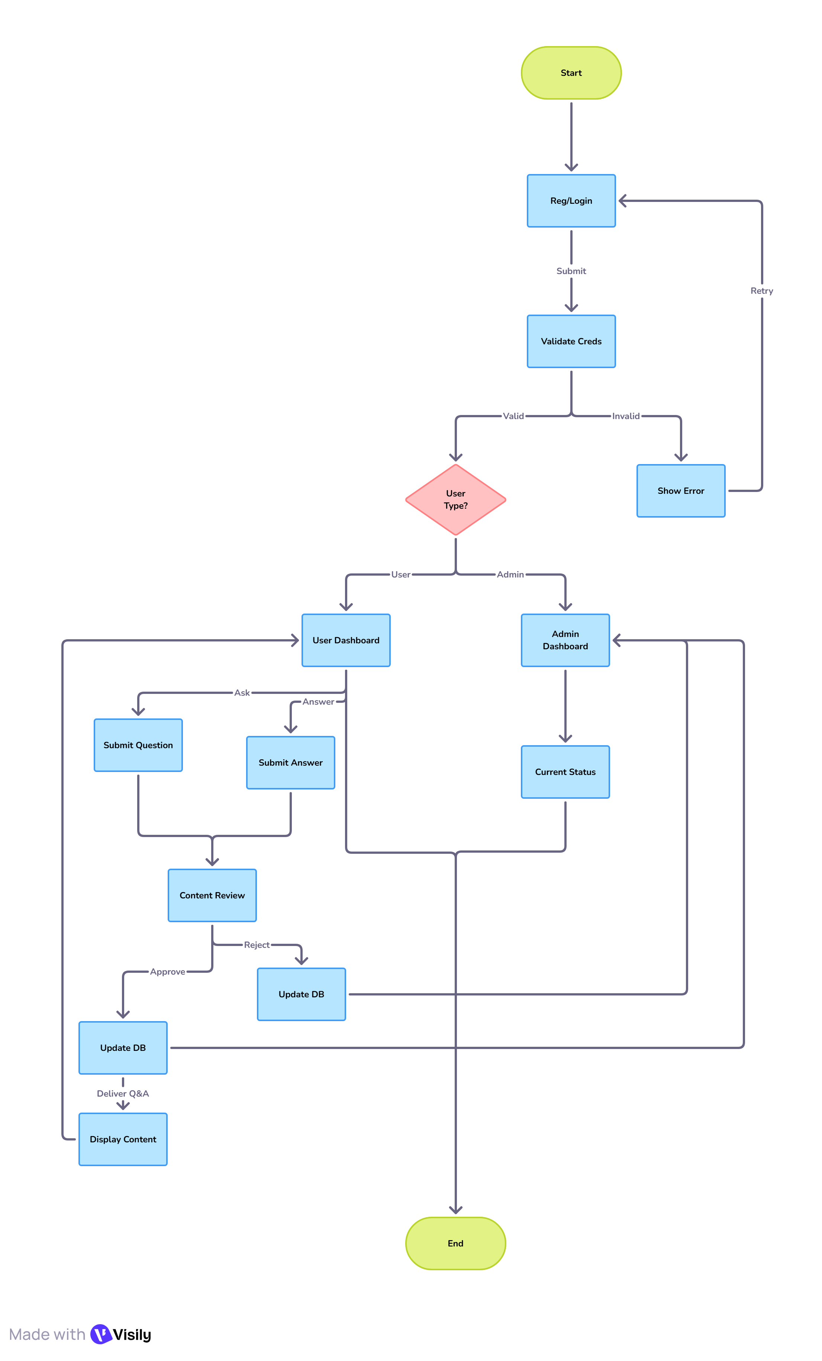
Process Logic

Slide 11
DFD
05

Slide 12
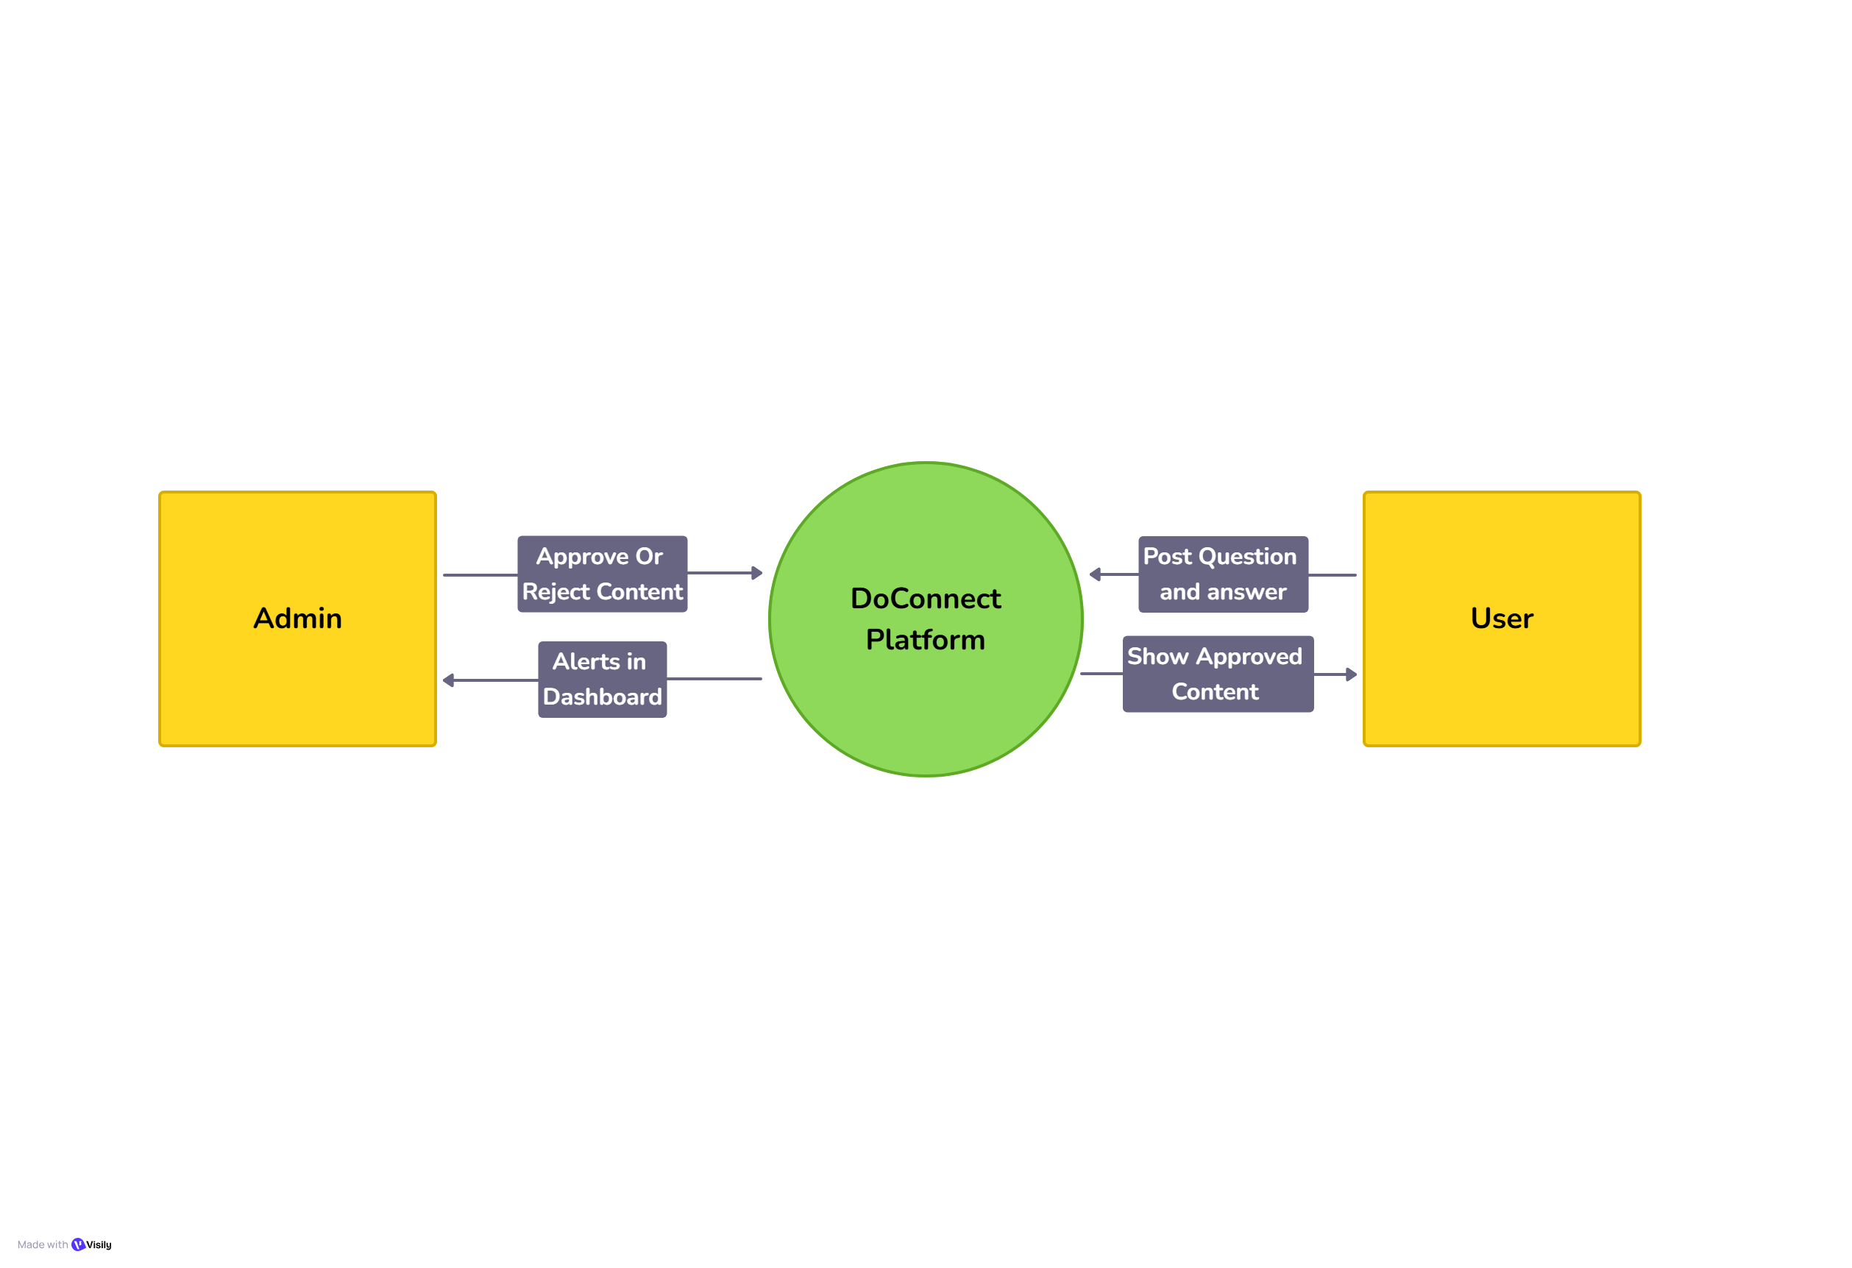
DFD
Level 0

Slide 13
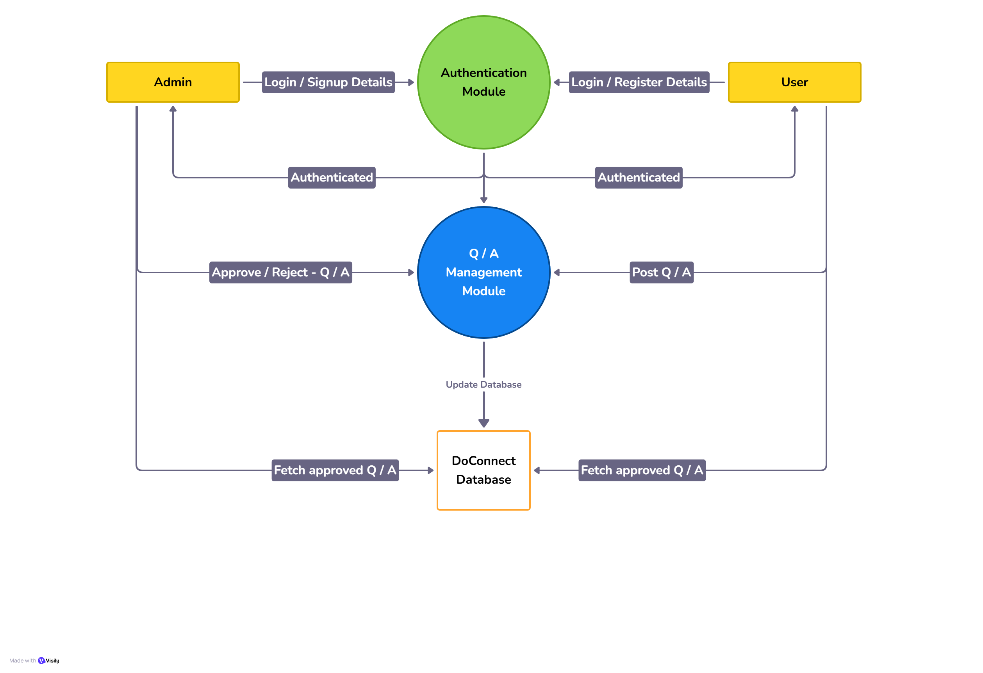
DFD
Level 1

Slide 14

06
UI Interface

Slide 15
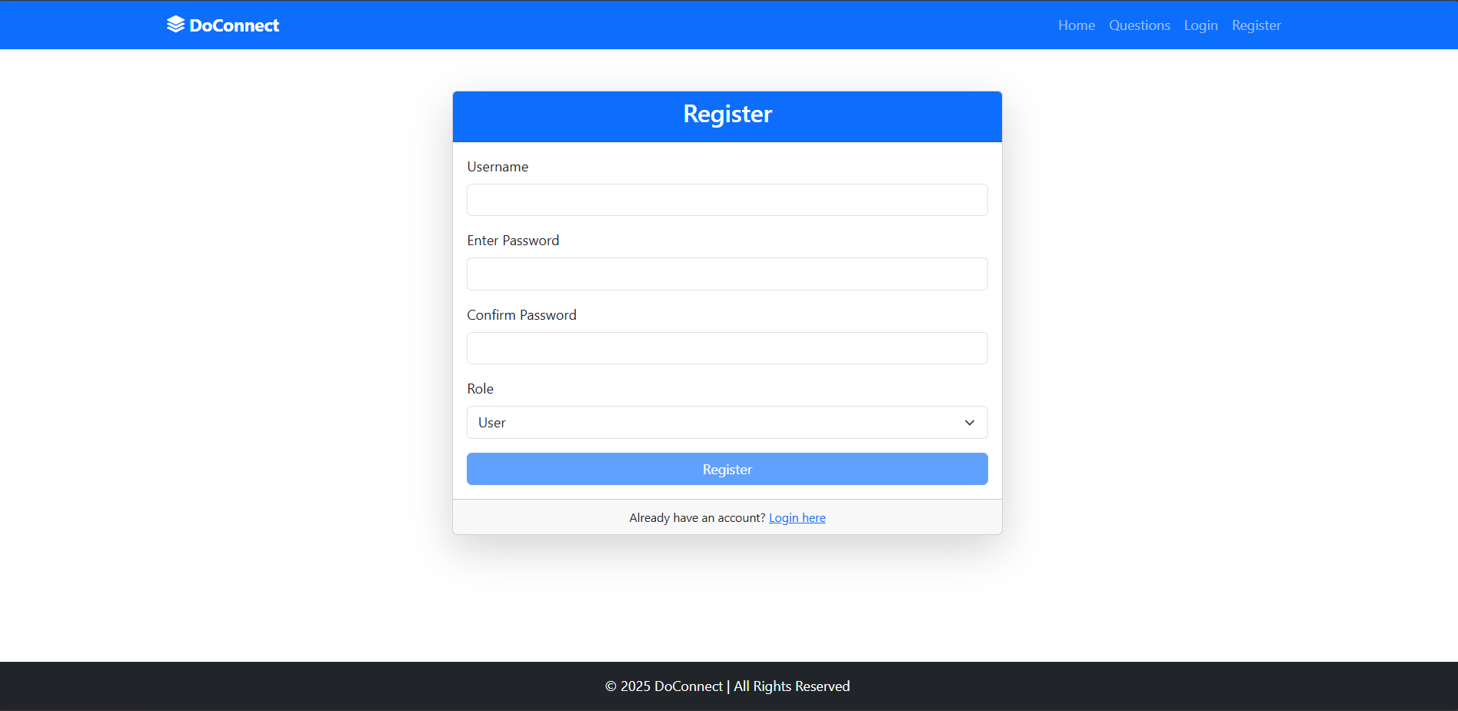
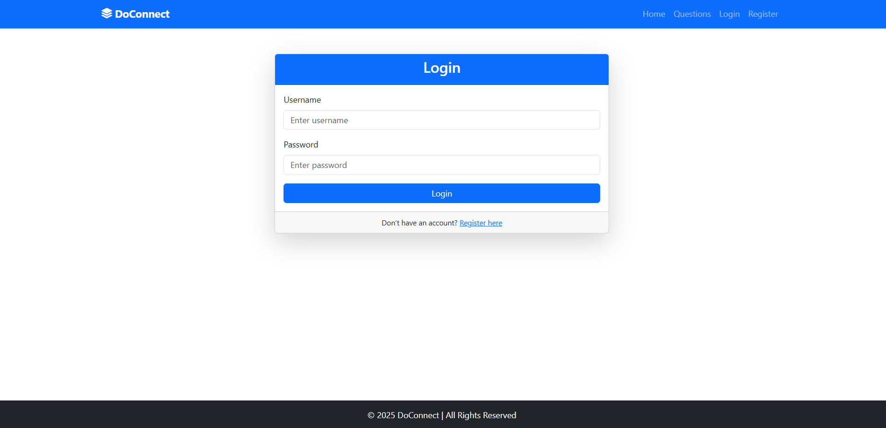
Interface
Welcome Page
Register Page
Login Page
Welcome page gives a brief intro to the new user.
Registration dashboard for both user and admin.
Login dashboard for both user and admin.

Slide 16
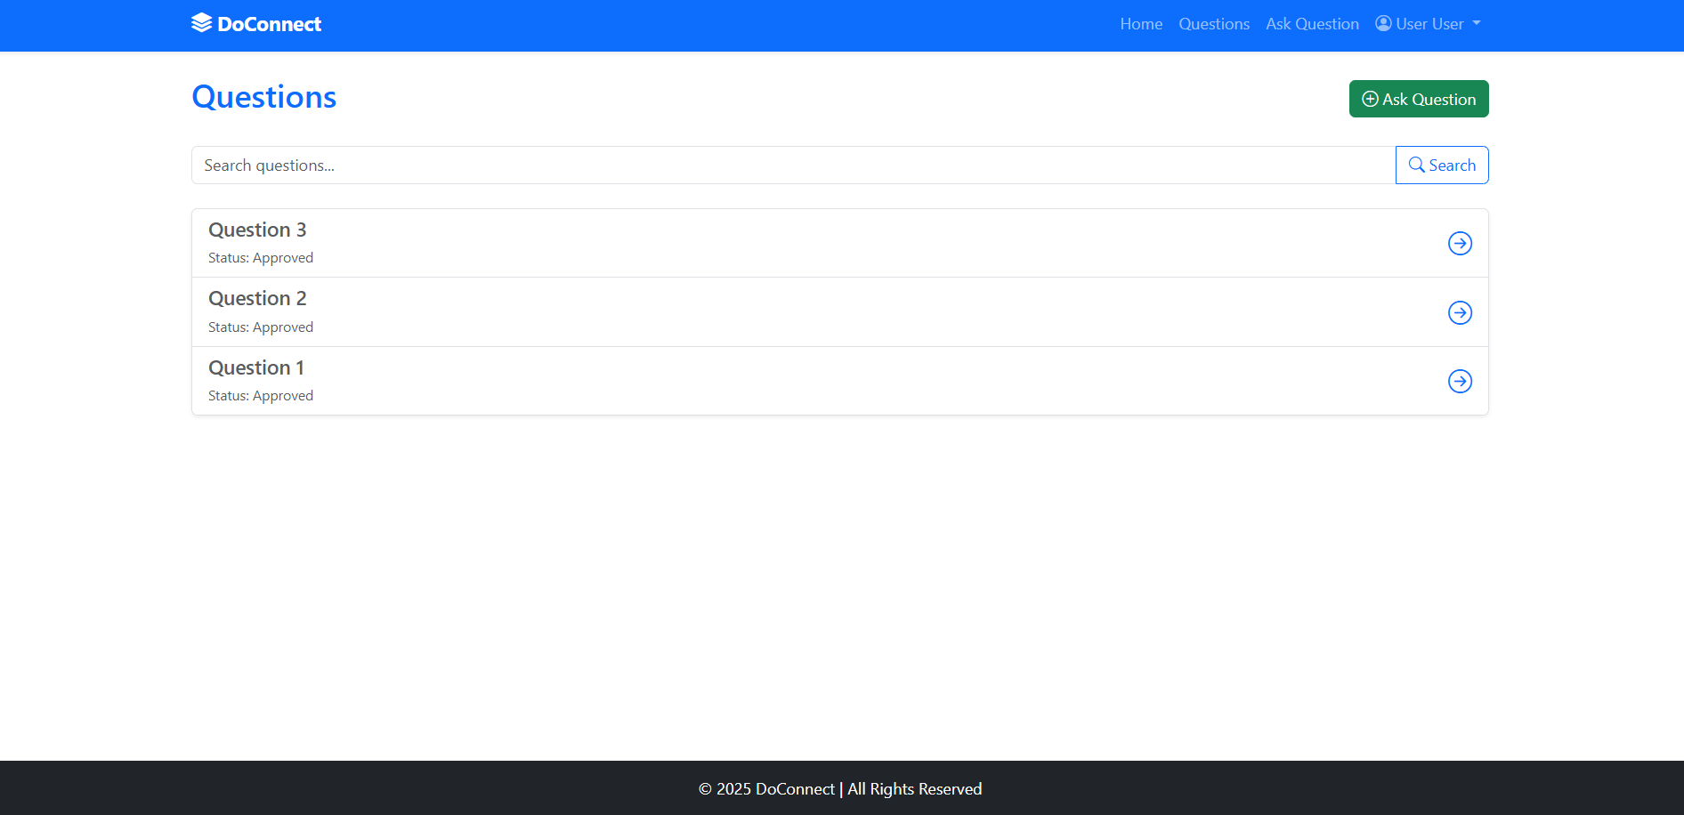
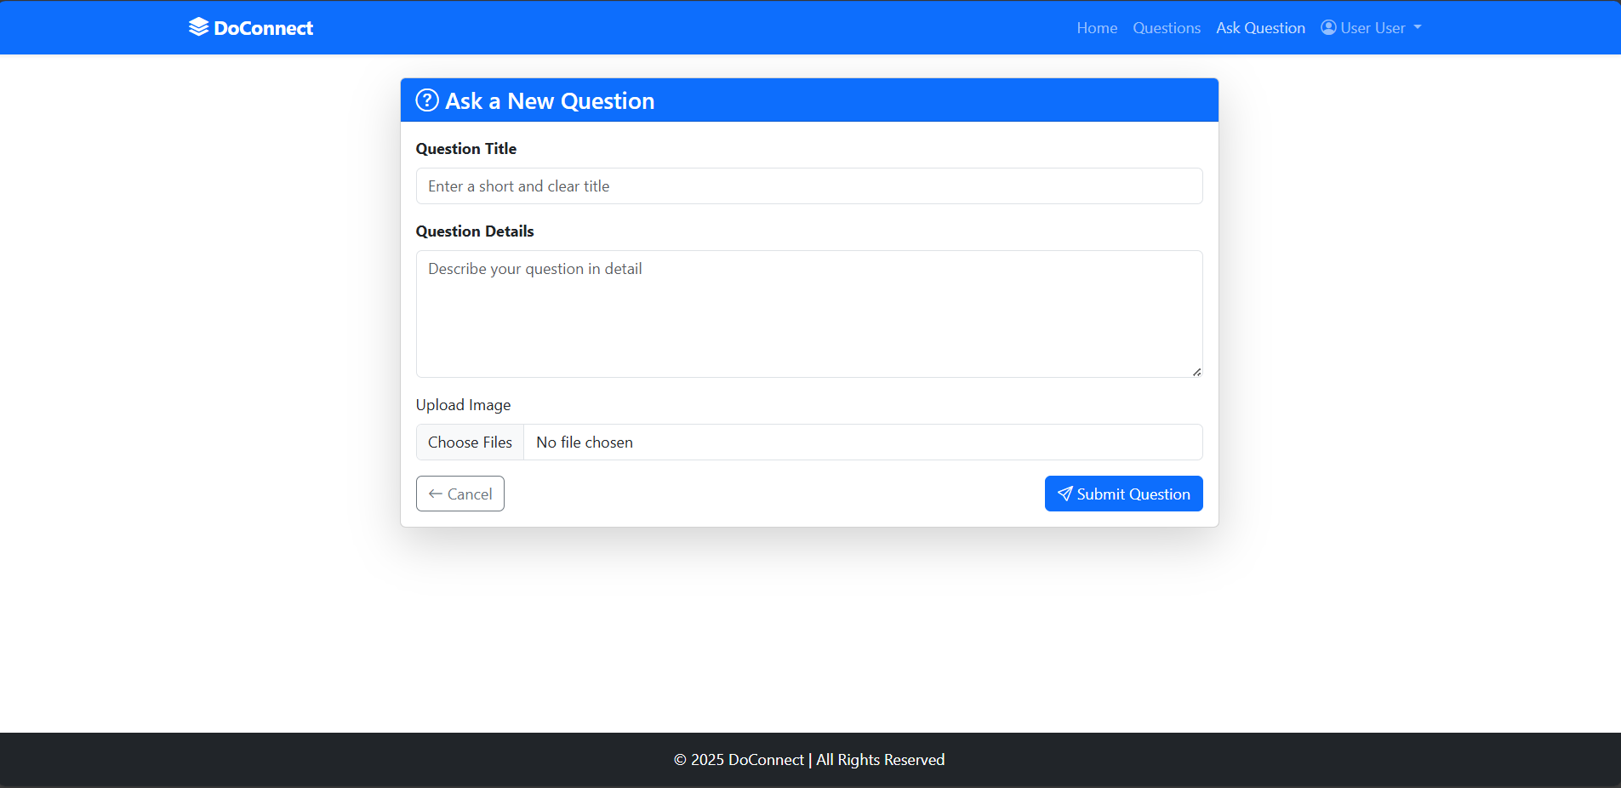
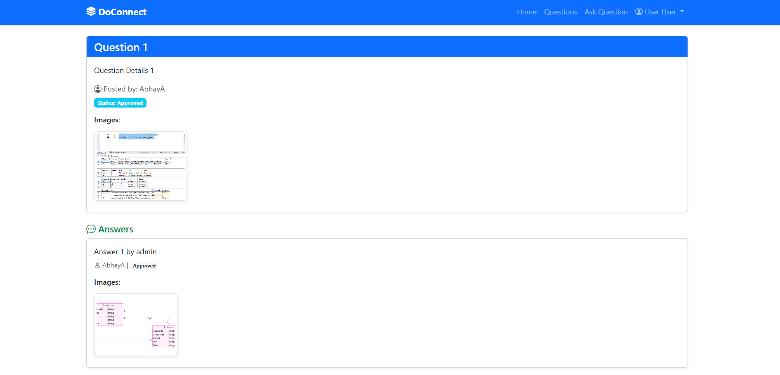
Interface
Question List Page
Ask Question Page
Question Details Page
It include list of all the the test that have been given by student
It helps the teacher to create test very fastly for conducting test
It include list of all the test that have been created by teacher

Slide 17
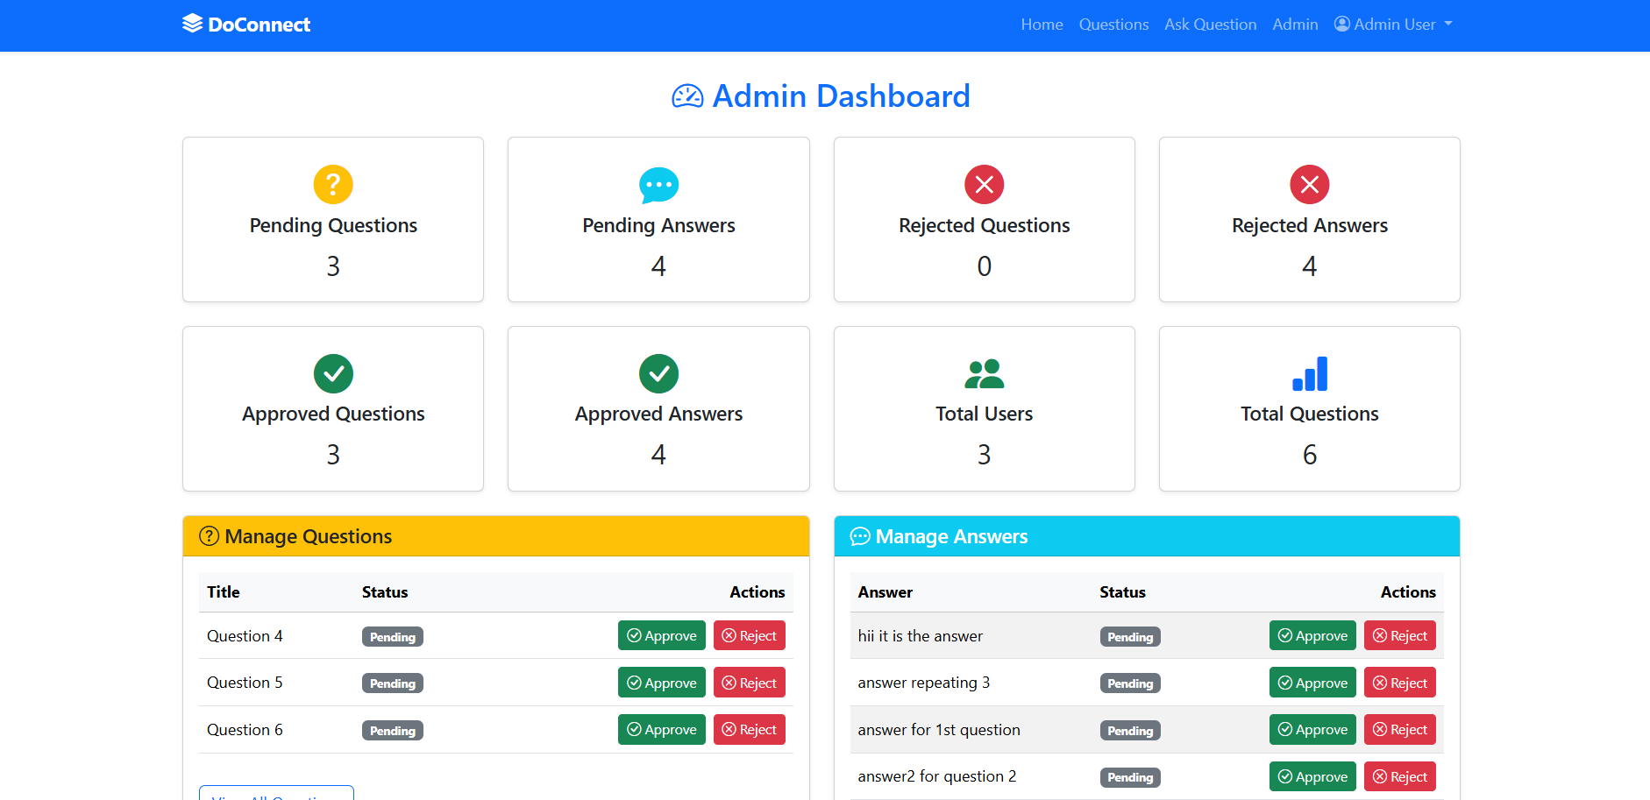
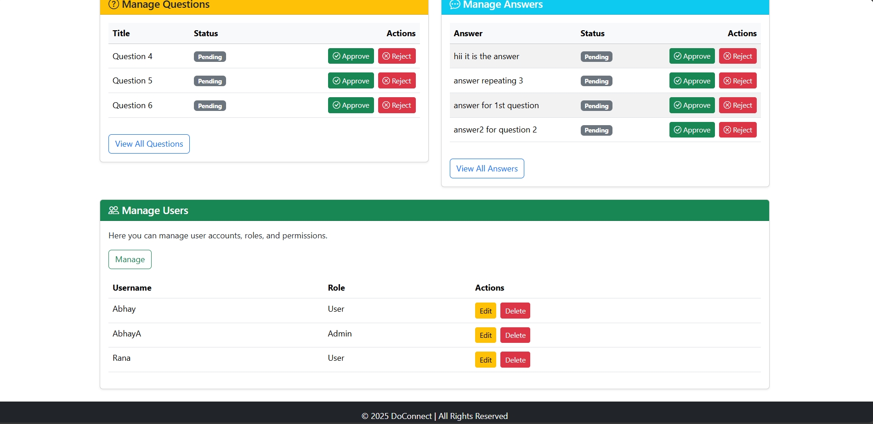
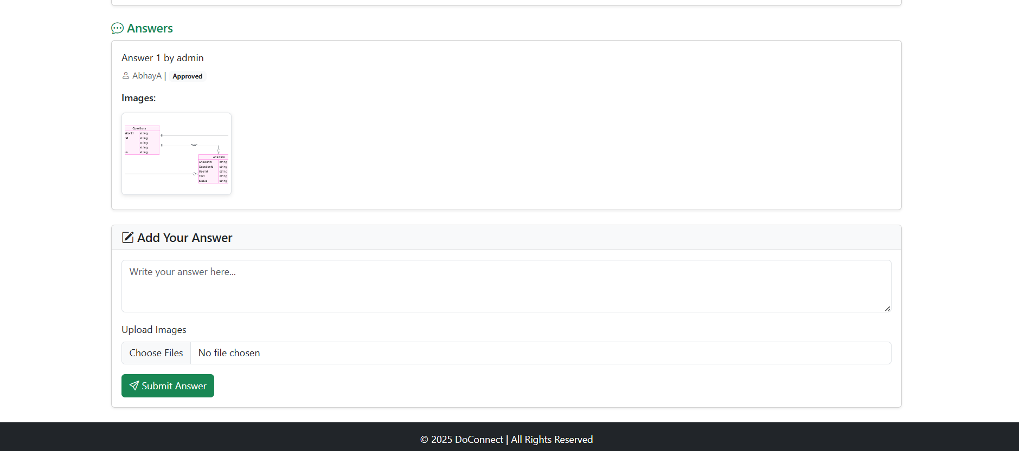
Interface
Admin Dashboard
Admin front Page
Answer Submit Page
It include list of all the the information of the question and user
It helps in submission of answer for approval.

Slide 18

Thanks!!!

