Slide 1
Causal Modelling in R
Assignment for Coursera’s A Crash Course in Causality: Inferring Causal Effects from Observational Data course.
Propensity Score Matching

Slide 2
Background
Dataset: Lalonde Dataset
Methods: Propensity score matching approach (1:1 matching)
Libraries Used: tableone, matching, MatchIt, gtools
Problem: Estimate the true impact of a job training program on earnings of the participants in the year 1978
Total Participants: 614 (429 in control, 185 in treatment)
8 variables (excluding treatment)

Slide 3
Hypothesis
Null Hypothesis: The job training program does not impact participant’s income.
Alternative Hypothesis: The job training program results in statistically significant difference in the 1978 mean earnings between the treated and control groups.

Slide 4
Descriptive statistics for confounders
Stratified by treatment variable (treat)
 | Control (0) |  | Treatment (1)
n | 429 |  | 185
Variable name | mean | SD | Mean | SD | SMD
age | 28.03 | 10.79 | 25.82 | 7.16 | 0.242
educ | 10.24 | 2.86 | 10.35 | 2.01 | 0.045
black | 0.20 | 0.40 | 0.84 | 0.36 | 1.668
hispan | 0.14 | 0.35 | 0.06 | 0.24 | 0.277
married | 0.51 | 0.50 | 0.19 | 0.39 | 0.719
nodegree | 0.60 | 0.49 | 0.71 | 0.46 | 0.235
re74 | 5619.24 | 6788.75 | 2095.57 | 4886.62 | 0.596
re75 | 2466.48 | 3292.00 | 1532.06 | 3219.25 | 0.287

Slide 5
Naïve treatment effect
Naïve treatment effect = Treated – Control
The average 1978 earnings for those who participated in the training program - The average 1978 earnings for those who did not receive training.
re78 (treated) – re78 (control)
$6,349.14 - $6,984.17 = -$635.03

Slide 6
Logistic regression to find propensity scores
General linear model used
Treat ~ age+educ+black+hispan+married+nodegree+re74+re75
Variable | Estimate | Std. Error | z value | Pr(>|z|) | Significance
(Intercept) | -4.729e+00 | 1.017e+00 | -4.649 | 3.33e-06 | ***
age | 1.578e-02 | 1.358e-02 | 1.162 | 0.24521
educ | 1.613e-01 | 6.513e-02 | 2.477 | 0.01325 | *
black | 3.065e+00 | 2.865e-01 | 10.699 | < 2e-16 | ***
hispan | 9.836e-01 | 4.257e-01 | 2.311 | 0.02084 | *
married | -8.321e-01 | 2.903e-01 | -2.866 | 0.00415 | **
nodegree | 7.073e-01 | 3.377e-01 | 2.095 | 0.03620 | *
re74 | -7.178e-05 | 2.875e-05 | -2.497 | 0.01253 | *
re75 | 5.345e-05 | 4.635e-05 | 1.153 | 0.24884
Note: Significance levels: *** p<0.001; ** p<0.01; * p<0.05

Slide 7
Greedy matching
Summary of Balance for All Data:
Variable | Means Treated | Means Control | Std. Mean Diff. | Var. Ratio | eCDF Mean | eCDF Max
distance | 0.5774 | 0.1822 | 1.7941 | 0.9211 | 0.3774 | 0.6444
age | 25.8162 | 28.0303 | -0.3094 | 0.4400 | 0.0813 | 0.1577
educ | 10.3459 | 10.2354 | 0.0550 | 0.4959 | 0.0347 | 0.1114
black | 0.8432 | 0.2028 | 1.7615 | . | 0.6404 | 0.6404
hispan | 0.0595 | 0.1422 | -0.3498 | . | 0.0827 | 0.0827
married | 0.1892 | 0.5128 | -0.8263 | . | 0.3236 | 0.3236
nodegree | 0.7081 | 0.5967 | 0.2450 | . | 0.1114 | 0.1114
re74 | 2095.5737 | 5619.2365 | -0.7211 | 0.5181 | 0.2248 | 0.4470
re75 | 1532.0553 | 2466.4844 | -0.2903 | 0.9563 | 0.1342 | 0.2876

Slide 8
Greedy matching
Summary of balance for matched data
Variable | Means Treated | Means Control | Std. Mean Diff. | Var. Ratio | eCDF Mean | eCDF Max
distance | 0.5774 | 0.3629 | 0.9739 | 0.7566 | 0.1321 | 0.4216
age | 25.8162 | 25.3027 | 0.0718 | 0.4568 | 0.0847 | 0.2541
educ | 10.3459 | 10.6054 | -0.1290 | 0.5721 | 0.0239 | 0.0757
black | 0.8432 | 0.4703 | 1.0259 | . | 0.3730 | 0.3730
hispan | 0.0595 | 0.2162 | -0.6629 | . | 0.1568 | 0.1568
married | 0.1892 | 0.2108 | -0.0552 | . | 0.0216 | 0.0216
nodegree | 0.7081 | 0.6378 | 0.1546 | . | 0.0703 | 0.0703
re74 | 2095.5737 | 2342.1076 | -0.0505 | 1.3289 | 0.0469 | 0.2757
re75 | 1532.0553 | 1614.7451 | -0.0257 | 1.4956 | 0.0452 | 0.2054

Slide 9
Assessing standardised pair distance and balance of participants between groups after matching.
Variable | Std. Pair Dist.
distance | 0.9740
age | 1.3938
educ | 1.2474
black | 1.0259
hispan | 1.0743
married | 0.8281
nodegree | 1.0106
re74 | 0.7965
re75 | 0.7381
 | Control | Treated
All | 429 | 185
Matched | 185 | 185
Unmatched | 244 | 0
Discarded | 0 | 0

Slide 10
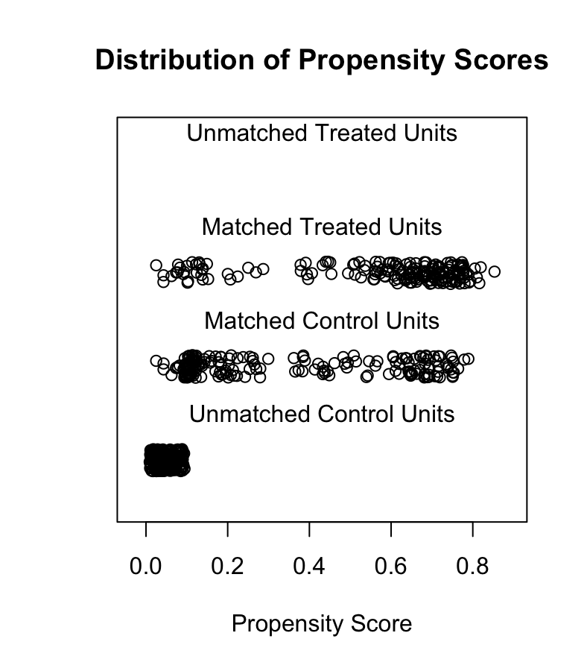
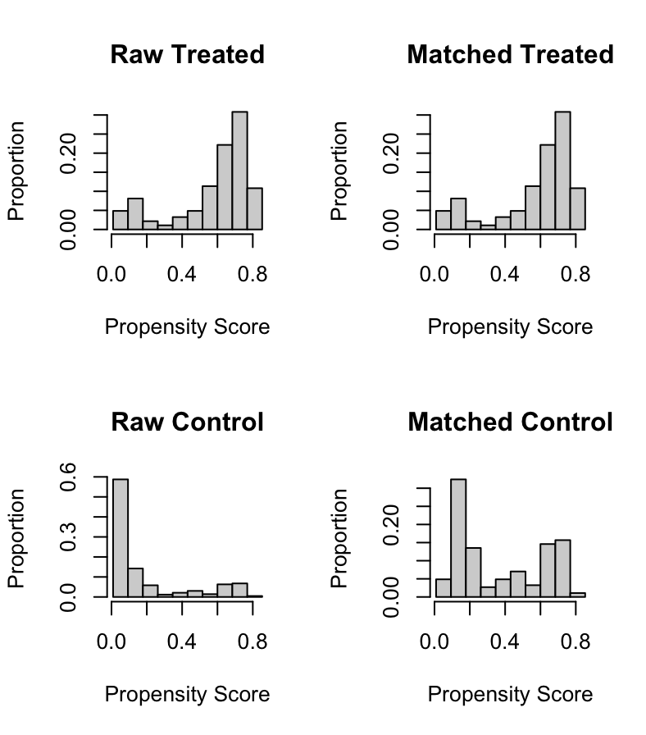
Plots for propensity scores

Slide 11
Paired t test after greedy matching
Average Treatment Effect (ATE): $894.37
Test Statistic (t): 1.1866
Degrees of Freedom : 184
P-Value: 0.2369
95% Confidence Interval
While the job training program resulted in a positive average increase of $894.37 in earnings, the result is not statistically significant (p>0.05). We fail to reject the null hypothesis.

Slide 12
Logit Matching without using caliper
 | Control (n=185) |  | Treated (n=185)
Variable | Mean | Control | Mean (n=185) | Treated | SMD
age | 25.12 | 10.38 | 25.82 | 7.16 | 0.078
educ | 10.62 | 2.65 | 10.35 | 2.01 | 0.115
black | 0.47 | 0.50 | 0.84 | 0.36 | 0.852
hispan | 0.22 | 0.42 | 0.06 | 0.24 | 0.479
married | 0.21 | 0.41 | 0.19 | 0.39 | 0.041
nodegree | 0.64 | 0.48 | 0.71 | 0.46 | 0.150
re74 | 2487.32 | 4351.92 | 2095.57 | 4886.62 | 0.085
re75 | 1645.03 | 2682.85 | 1532.06 | 3219.25 | 0.038

Slide 13
Logit matching summary
 | Control | Treated
All | 429 | 185
Matched | 185 | 185
Unmatched | 244 | 0
Discarded | 0 | 0

Slide 14
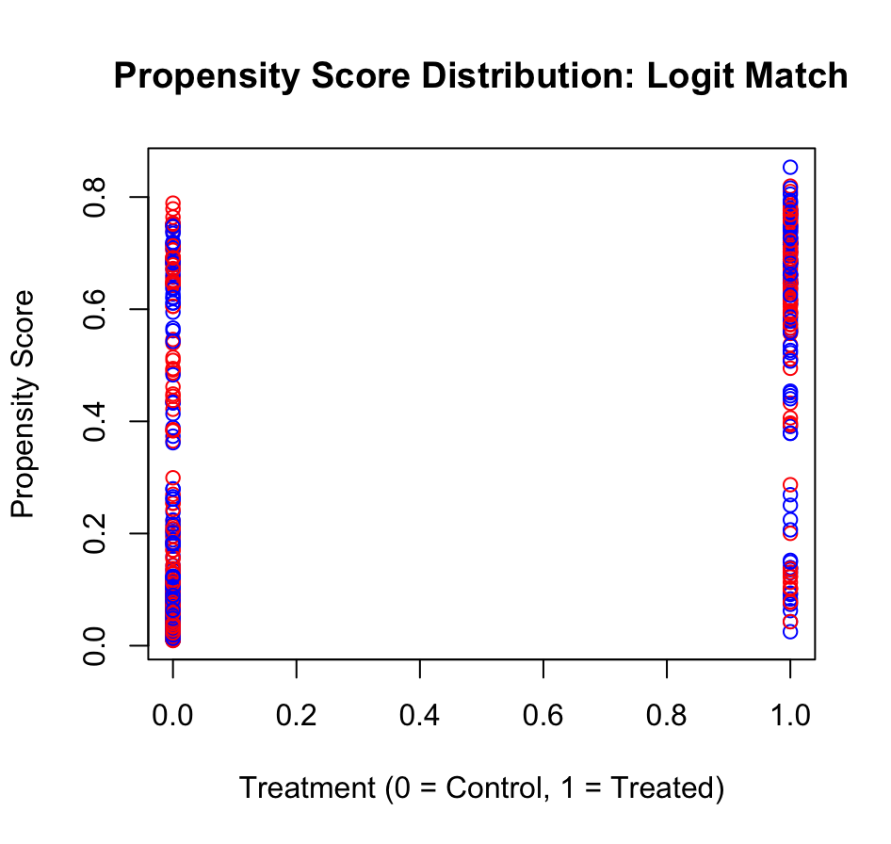
Logit matching plot

Slide 15
Paired t test after logit matching
Average Treatment Effect (ATE): $736.79
Test Statistic (t): 1.035
Degrees of Freedom : 184
P-Value: 0.301
95% Confidence Interval
While the job training program resulted in a positive average increase of $736.79 in earnings, the result is not statistically significant (p>0.05). We fail to reject the null hypothesis.

Slide 16
Logit Matching using a caliper of 0.1
 | Control (n=111) |  | Treated (n=111)
Variable | Mean | Control SD | Mean | Treated SD | SMD
age | 26.54 | 11.04 | 26.03 | 6.92 | 0.056
educ | 10.50 | 2.65 | 10.27 | 2.30 | 0.094
black | 0.72 | 0.45 | 0.74 | 0.44 | 0.040
hispan | 0.13 | 0.33 | 0.10 | 0.30 | 0.085
married | 0.25 | 0.44 | 0.23 | 0.43 | 0.042
nodegree | 0.61 | 0.49 | 0.65 | 0.48 | 0.074
re74 | 2664.85 | 4579.29 | 2238.16 | 5722.69 | 0.082
re75 | 1828.77 | 2836.86 | 1088.15 | 2637.34 | 0.270

Slide 17
Logit matching with caliper 0.1 summary
 | Control | Treated
All | 429 | 185
Matched | 111 | 111
Unmatched | 318 | 74
Discarded | 0 | 0

Slide 18
Paired t test after logit matching with caliper of 0.1
Average Treatment Effect (ATE): $1079.39
Test Statistic (t): 1.182
Degrees of Freedom : 110
P-Value: 0.239
95% Confidence Interval
While the job training program resulted in a positive average increase of $1079.39 in earnings, the result is not statistically significant (p>0.05). We fail to reject the null hypothesis.

