Slide 1
Inverse Probability of Treatment Weighting (IPTW) Analysis
Assignment for Coursera’s A Crash Course in Causality: Inferring Causal Effects from Observational Data course.

Slide 2
Background
Dataset: Lalonde Dataset
Methods: Inverse Probability of Treatment Weighting (IPTW) using Propensity Scores
Libraries Used: tableone, ipw, survey, matching, MatchIt
Problem: Estimate the true impact of a job training program on earnings of the participants in the year 1978
Total Participants: 614 (429 in control, 185 in treatment)
8 variables (excluding treatment)

Slide 3
Hypothesis
Null Hypothesis: The job training program does not impact participant’s income.
Alternative Hypothesis: The job training program results in statistically significant difference in the 1978 mean earnings between the treated and control groups.

Slide 4
Weighting Approach
Treated subjects weighted by 1/PS
Control subjects weighted by 1/(1−PS).

Slide 5
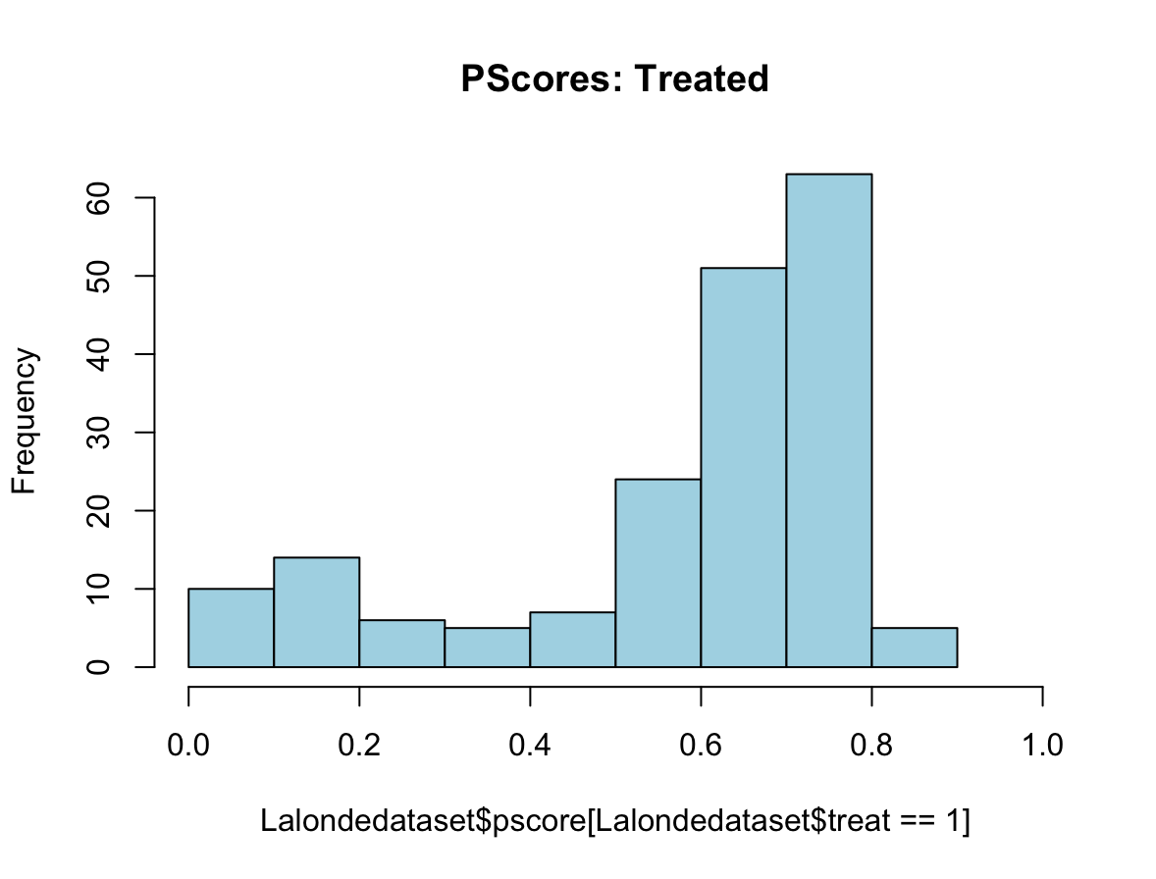
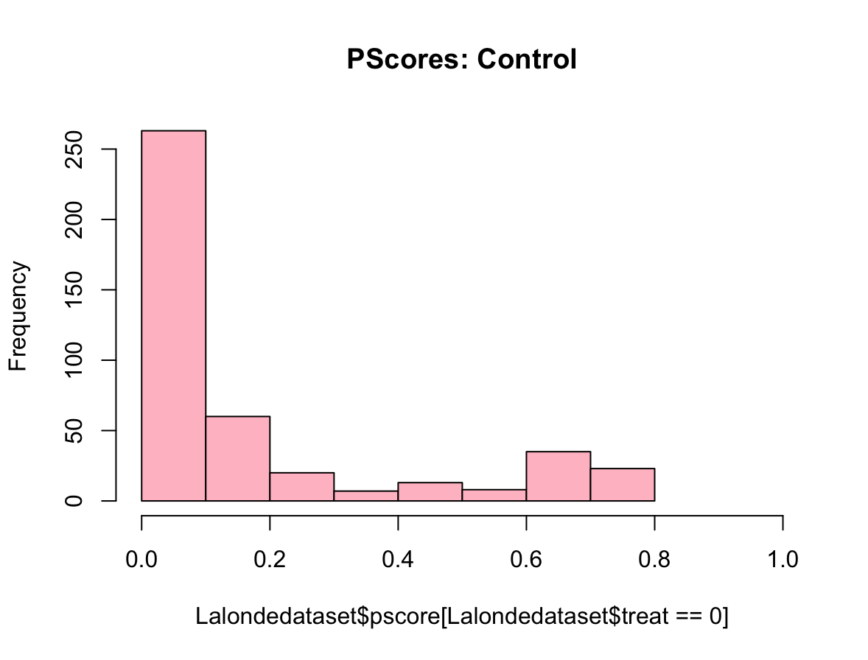
Distribution of propensity scores for treated and control groups
GLM: treat ~ age + educ + black + hispan + married + nodegree + re74 + re75

Slide 6
Summary of IPTW weights
Statistic | Value
Minimum | 1.009
1st Quartile | 1.052
Median | 1.170
Mean | 1.905
3rd Quartile | 1.623
Maximum | 40.077

Slide 7
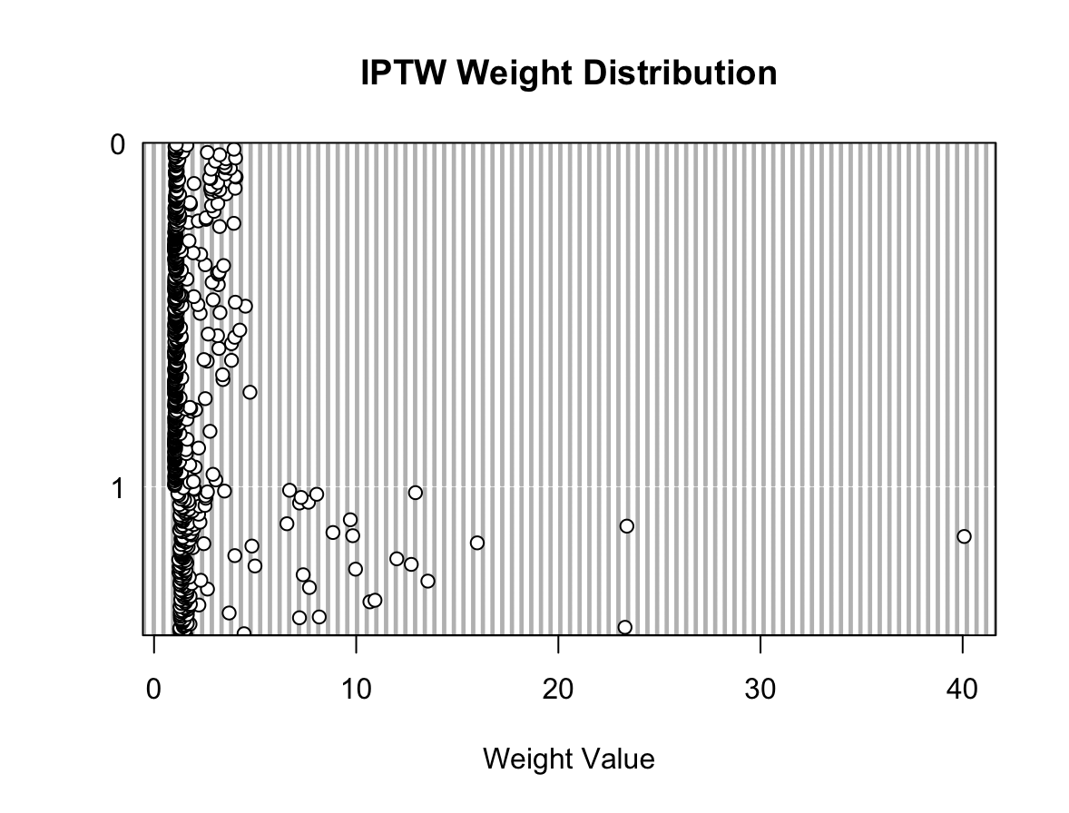
Distribution of weights

Slide 8
Standardised mean differences
 | Control |  | Treated
n (Pseudo-population) | 616 |  | 553
Variable | Mean | SD | Mean | SD | SMD
age | 27.10 | 10.80 | 25.57 | 6.53 | 0.172
educ | 10.29 | 2.74 | 10.61 | 2.05 | 0.132
black | 0.40 | 0.49 | 0.45 | 0.50 | 0.101
hispan | 0.12 | 0.32 | 0.12 | 0.33 | 0.014
married | 0.41 | 0.49 | 0.31 | 0.47 | 0.197
nodegree | 0.62 | 0.48 | 0.57 | 0.50 | 0.112
re74 | 4552.74 | 6337.09 | 2932.18 | 5709.42 | 0.269
re75 | 2172.04 | 3160.14 | 1658.07 | 3072.89 | 0.165

Slide 9
Average causal effect without truncation
Average Causal Effect (ACE): $224.68
Test Statistic (t): 0.247
P-Value: 0.805
Confidence Interval: 95%
While the job training program resulted in a positive average increase of $224.68 in earnings, the result is not statistically significant (p = 0.805). We fail to reject the null hypothesis

Slide 10
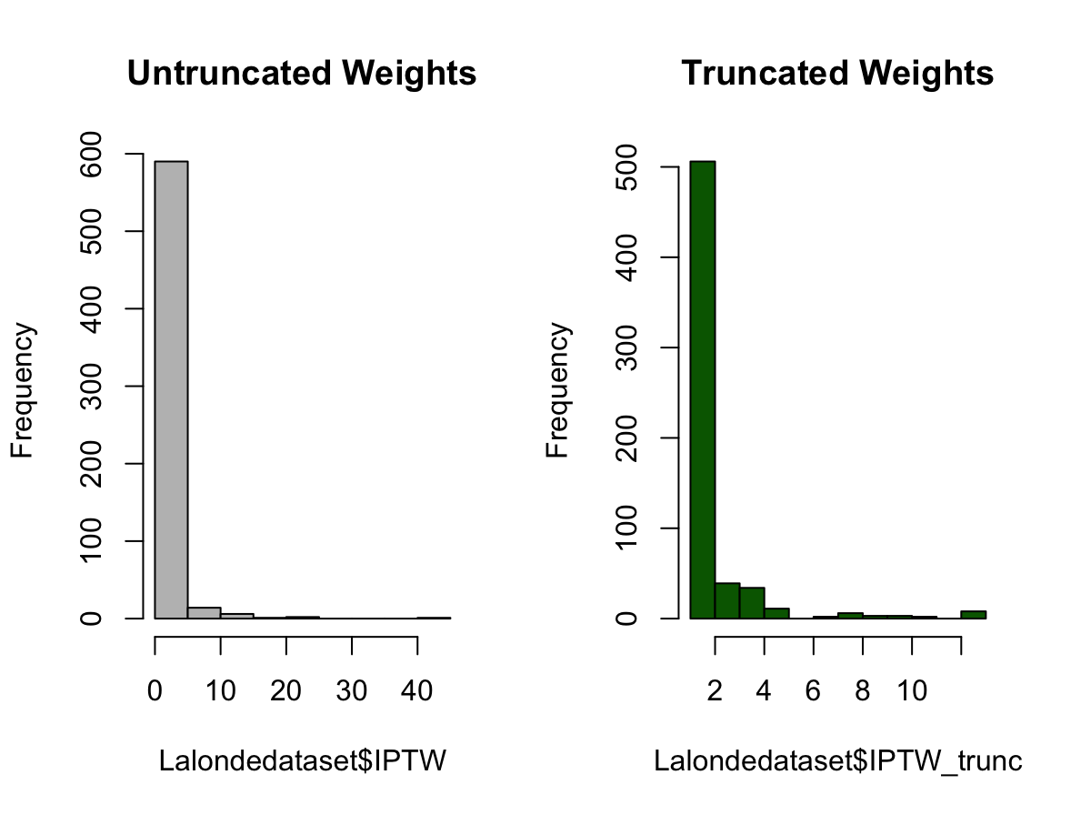
Comparison of untruncated and truncated weights at 1st and 99th percentile

Slide 11
Average causal effect after truncation of 1st and the 99th percentile
Average Causal Effect (ACE): $486.93
Test Statistic (t): 0.605
P-Value: 0.545
Confidence Interval: 95%
While the job training program resulted in a positive average increase of $486.93 in earnings, the result is not statistically significant (p = 0.545). We fail to reject the null hypothesis

