Slide 1
Google Maps Business Analysis Dashboard
Analysis of Cafes, Gyms & Salons in Chandigarh
Internship Project – Week 3
Submitted by:
Abhay Joshi

Slide 2
Project Overview
This project analyzes local businesses listed on Google Maps in Chandigarh.
The study focuses on three business categories: Cafes, Gyms, and Salons.
The objective is to evaluate businesses based on website availability, customer ratings, review counts, and business opportunities.
The collected data was cleaned and analyzed using Microsoft Excel and Power BI.
An interactive dashboard was developed to generate meaningful business insights and recommendations.

Slide 3
Dataset Overview
Dataset Summary
Total Businesses Analyzed: 60
Location: Chandigarh
Business Categories: Cafes, Gyms, Salons
Data Source: Google Maps
Tools Used: Microsoft Excel & Power BI
Dataset Attributes
• Business Name • Category • Area • Rating • Reviews • Website • Phone • Address • Opportunity
Category | Businesses
Cafe | 20
Gym | 20
Salon | 20

Slide 4
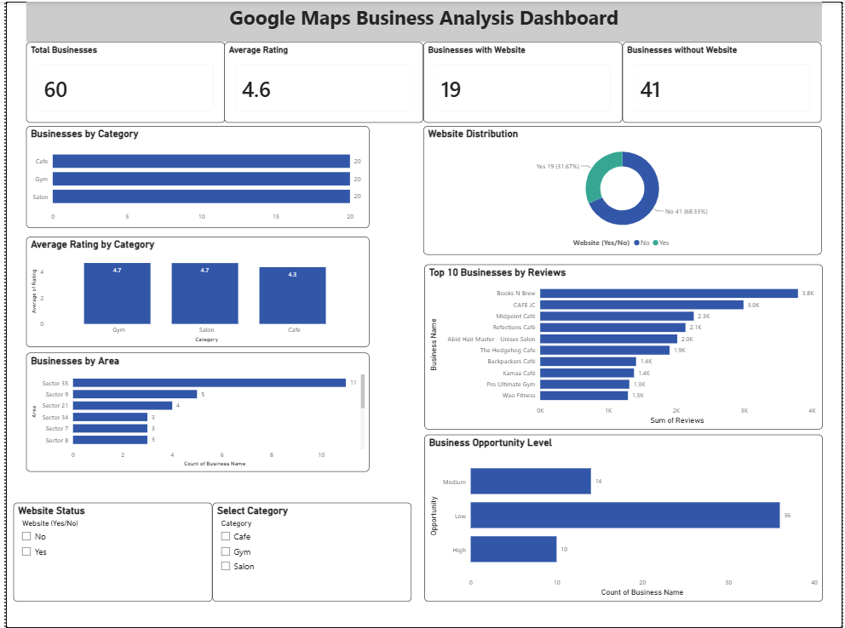
Power BI Dashboard

Slide 5
Key Insights
60 local businesses across Cafes, Gyms, and Salons were analyzed using Google Maps data.
A considerable number of businesses do not have a dedicated website, indicating opportunities to strengthen their digital presence.
Gyms recorded the highest average customer ratings, reflecting strong customer satisfaction.
Businesses with higher review counts generally have greater visibility and customer engagement.
The Business Opportunity Analysis identified several businesses that could benefit from establishing or improving their online presence.
The interactive dashboard enables users to compare categories and explore business information using filters.

Slide 6
Business Recommendations
Develop a professional website to improve credibility and make it easier for customers to find business information.
Strengthen digital marketing efforts by maintaining an active online presence and regularly updating business details.
Optimize Google Business Profiles with accurate contact information, operating hours, and high-quality photos.
Engage with customers by responding to reviews and encouraging satisfied customers to leave feedback.
Prioritize businesses with High and Medium Opportunity levels for digital transformation initiatives to improve customer reach and business growth.

Slide 7
Conclusion
This project successfully analyzed the digital presence of Cafes, Gyms, and Salons in Chandigarh using Google Maps data.
By utilizing Microsoft Excel and Power BI, an interactive dashboard was developed to visualize business information, compare categories, and identify growth opportunities. The insights generated from this analysis can help businesses strengthen their online presence and support better decision-making.
"Data-driven insights help businesses make smarter digital decisions."

Slide 8
Thank You!

