Slide 1
Student Performance Prediction using Machine Learning
Internship Week 4 – Predictive Analytics System
Prepared by:
Abhay Joshi
ReadyNest Internship Program

Slide 2
Project Objective & Dataset
Objective
Build a predictive analytics system to predict student GPA.
Analyze factors affecting academic performance.
Apply machine learning techniques for prediction.
Evaluate the model using performance metrics.
Dataset Information
Source: Student Performance Dataset
Total Records: 2,392
Target Variable: GPA
Features Used: 12
Model: Linear Regression

Slide 3
Methodology
Dataset Collection
Data Preprocessing
Exploratory Data Analysis (EDA)
Feature Selection
Train-Test Split (80:20)
Linear Regression Model
Prediction
Model Evaluation

Slide 4
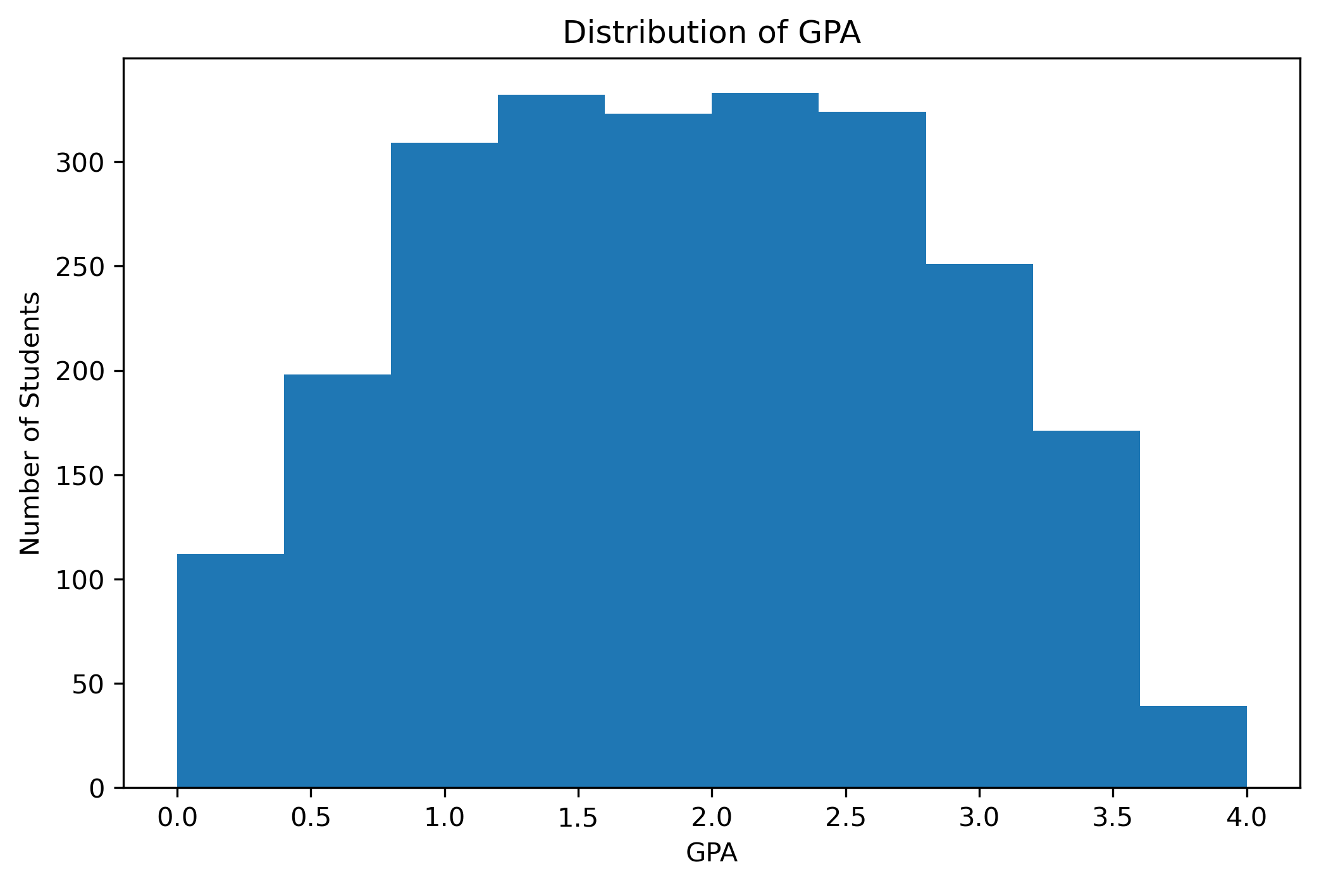
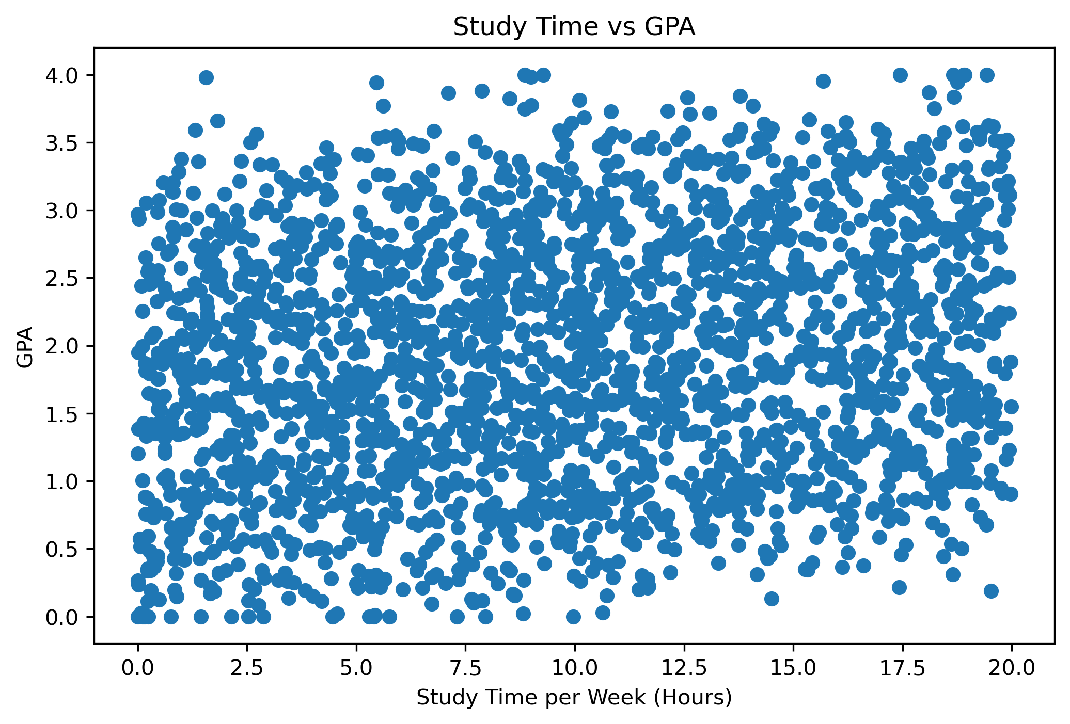
Exploratory Data Analysis (EDA)
GPA Distribution
Study Time vs GPA

Slide 5
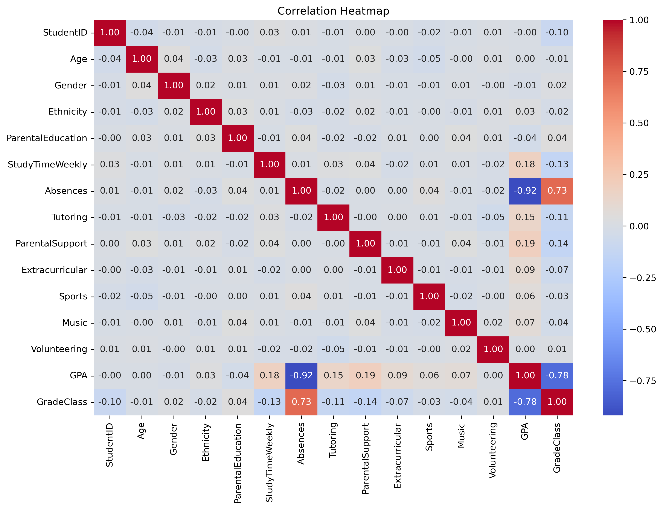
Correlation Analysis
Key Observations:
The heatmap shows the correlation between all numerical features.
Study time and parental support show a positive relationship with GPA.
Absences have a negative relationship with GPA.
The heatmap helped identify important features for model building.

Slide 6
Machine Learning Model
Input Features
Train-Test Split (80:20)
Linear Regression Model
Model Training
Prediction of GPA
Model Details:
Linear Regression
80% Training Data
20% Testing Data
Target: GPA
Scikit-learn

Slide 7
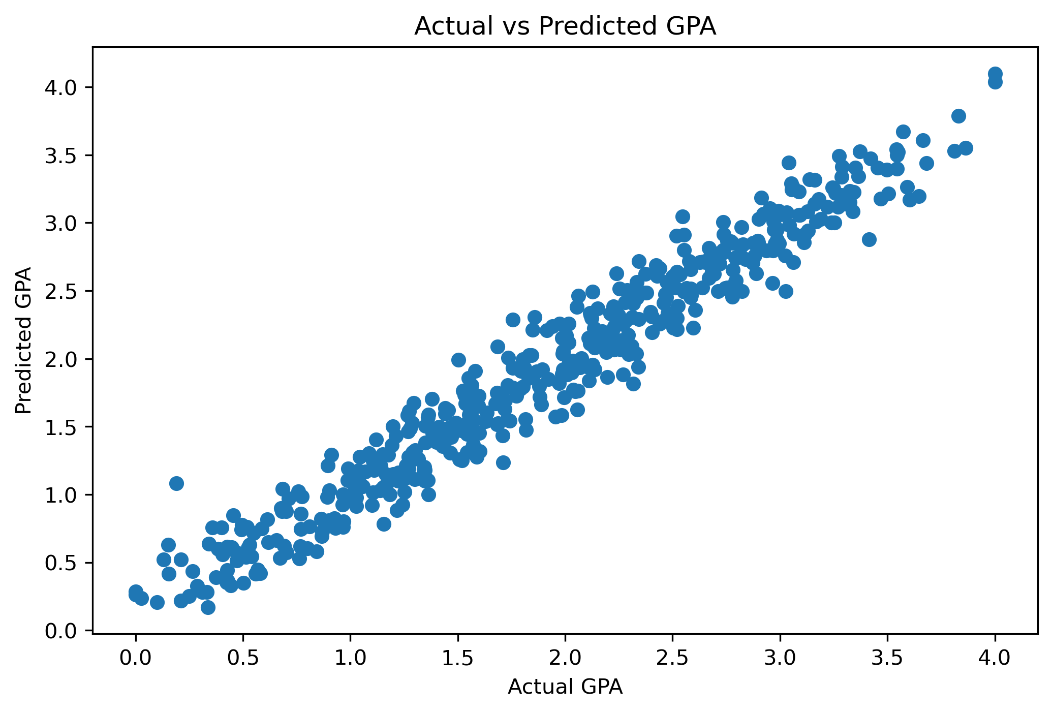
Model Performance
Evaluation Metrics:
Metric | Value
Mean Absolute Error (MAE) | 0.1553
Mean Squared Error (MSE) | 0.0387
R² Score | 0.9532

Slide 8
Conclusion & Future Scope
Conclusion:
Successfully developed a predictive analytics system using Linear Regression.
Performed data preprocessing and exploratory data analysis.
Achieved excellent model performance with an R² Score of 0.9532.
Demonstrated how machine learning can predict student academic performance.
Future Scope:
Compare multiple machine learning algorithms.
Use larger and more diverse datasets.
Develop a web application for GPA prediction.
Continuously improve the model using new student data.

Slide 9
Thank You

