Slide 1

DS-303
Introduction to
machine learning
Group Project

Slide 2
Problem Statement :
The handwritten digits are not always of the same size, width, orientation and justified to margins as they differ from writing of person to person, so the general problem would be while classifying the digits due to the similarity between digits such as 1 and 7, 5 and 6, 3 and 8, 2 and 5, 2 and 7, etc. This problem is faced more when many people write a single digit with a variety of different handwriting. Lastly, the uniqueness and variety in the handwriting of different individuals also influence the formation and appearance of the digits. Now we introduce the concepts and algorithms of deep learning and machine learning.

Slide 3
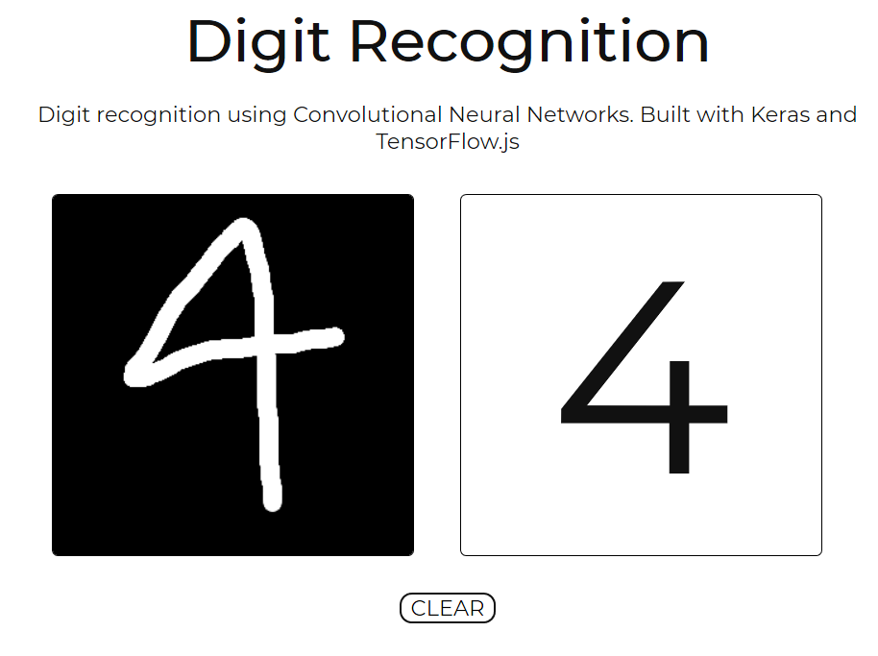
Background
There have been many handwriting recognition systems available in the market. There are two distinct handwriting recognition domains; online and offline, which are differentiated by the nature of their input signals. Mobile communication systems such as Personal Digital Assistant (PDA), electronic pad and smart-phone have online handwriting recognition interface integrated in them.

Slide 4
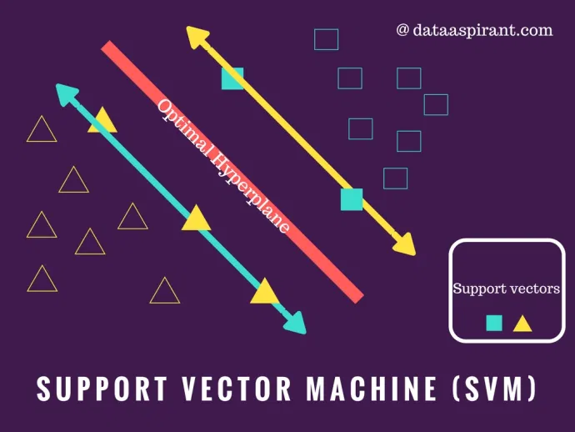
SVMs - Support Vector Machines
SVMs are learning systems that
Use a hypothesis space of linear functions
Use kernel functions in a high dimensional feature space.
Trained with a learning algorithm from optimization theory - Lagrange
Implements a learning bias derived from statistical learning theory - Generalization

Slide 5
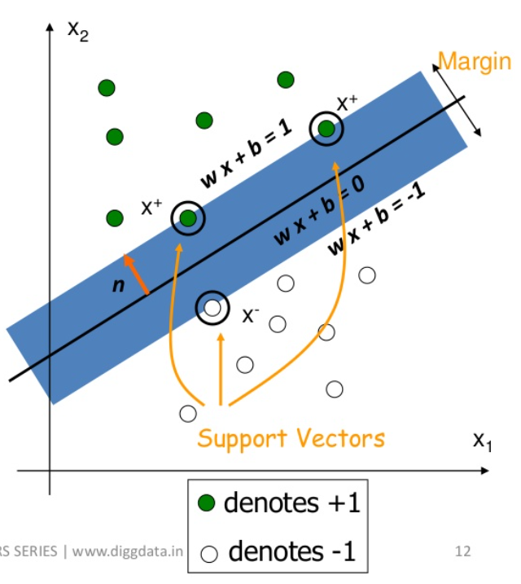
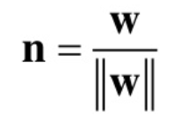


Support vectors- Data points of different classes closest to optimal hyperplane.
Concept of SVM - Finding a hyperplane that separates the classes and has the maximum margin between supports vectors of different class.
Equation of hyperplane- g(x) = wx + b
Normal vector to hyperplane-
Classifier is constructed as follow-
Can be combined into

Slide 6
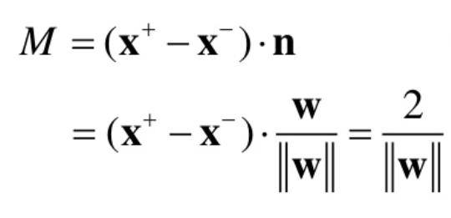
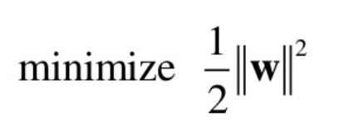

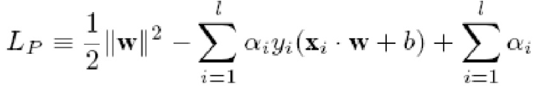
The margin width is
For maximum margin we need to with constrain
Applying lagrangian method, we need to maximize the

Slide 7



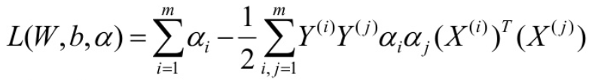

If we set derivatives of w.r.t w, b to 0, we obtain :
1.
2.
If we substitute the above into the equation for and obtain “Dual Formulation of linear SVM”
Maximize
w.r.t. 𝜶_{i}
Subject to constraints
With 𝜶_{i} > 0

Slide 8
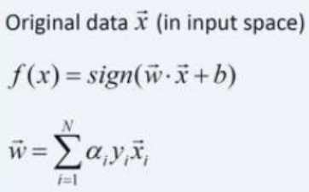
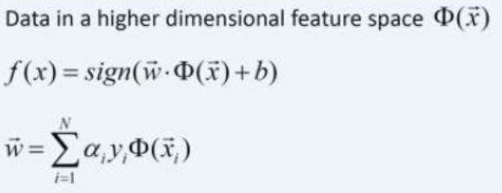
Kernel trick
Kernel method in SVM is used when we encounter nonlinear classification.
It involves nonlinear transformation of data into higher dimensional feature space and detects optimal solution in the kernel feature space.

