Slide 1

DS-303
Introduction to
machine learning
Group Project

Slide 2
Problem Statement :
The handwritten digits are not always of the same size, width, orientation and justified to margins as they differ from writing of person to person, so the general problem would be while classifying the digits due to the similarity between digits such as 1 and 7, 5 and 6, 3 and 8, 2 and 5, 2 and 7, etc. Lastly, the uniqueness and variety in the handwriting of different individuals also influence the formation and appearance of the digits.
Now we introduce the concepts and algorithms of deep learning and machine learning. We will primarily using SVM classification method.

Slide 3
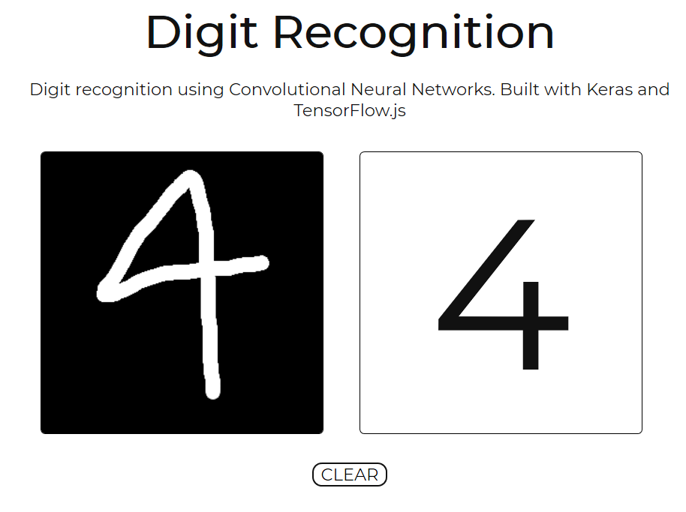
Background
There have been many handwriting recognition systems available in the market. There are two distinct handwriting recognition domains; online and offline, which are differentiated by the nature of their input signals. Mobile communication systems such as Personal Digital Assistant (PDA), electronic pad and smart-phone have online handwriting recognition interface integrated in them. Our model is based on offline mode primarily

Slide 4
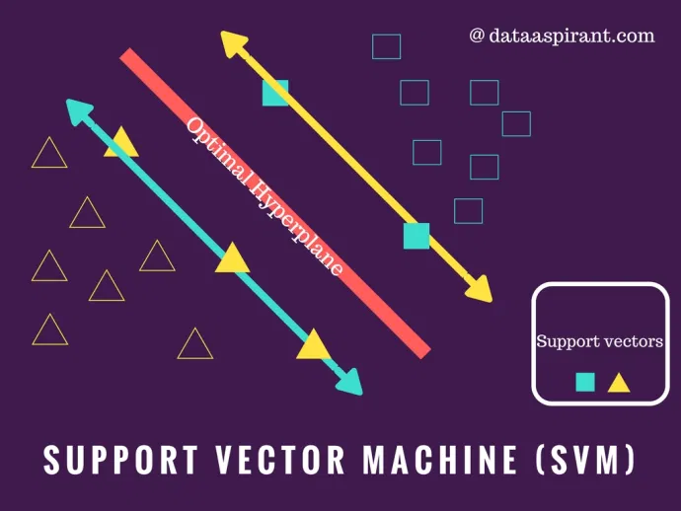
SVMs - Support Vector Machines
SVMs are learning systems that
Use a hypothesis space of linear functions
Use kernel functions in a high dimensional feature space.
Trained with a learning algorithm from optimization theory - Lagrange
Implements a learning bias derived from statistical learning theory - Generalization

Slide 5
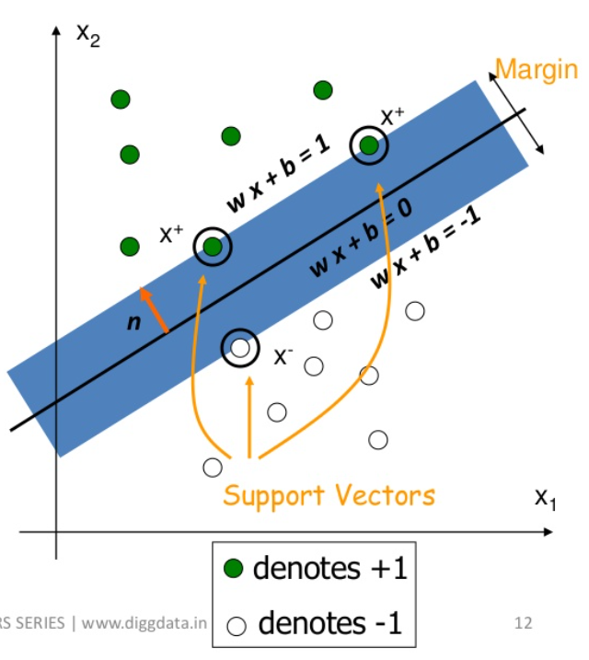
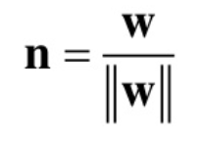


Support vectors- Data points of different classes closest to optimal hyperplane.
Concept of SVM - Finding a hyperplane that separates the classes and has the maximum margin between supports vectors of different class.
Equation of hyperplane- g(x) = wx + b
Normal vector to hyperplane-
Classifier is constructed as follow-
Can be combined into

Slide 6
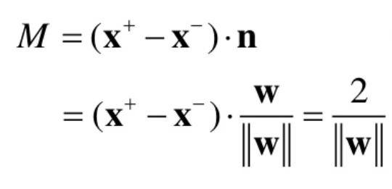
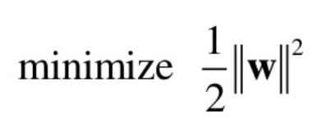

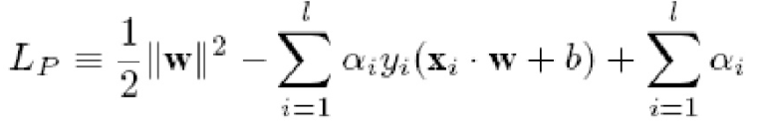
The margin width is
For maximum margin we need to with constrain
Applying lagrangian method, we need to maximize the

Slide 7



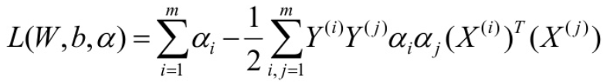

If we set derivatives of w.r.t w, b to 0, we obtain :
1.
2.
If we substitute the above into the equation for and obtain “Dual Formulation of linear SVM”
Maximize
w.r.t. 𝜶_{i}
Subject to constraints
With 𝜶_{i} > 0

Slide 8
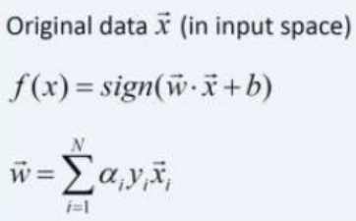
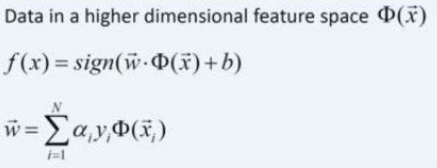
Kernel trick
Kernel method in SVM is used when we encounter nonlinear classification.
It involves nonlinear transformation of data into higher dimensional feature space and detects optimal solution in the kernel feature space.

Slide 9
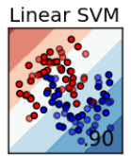
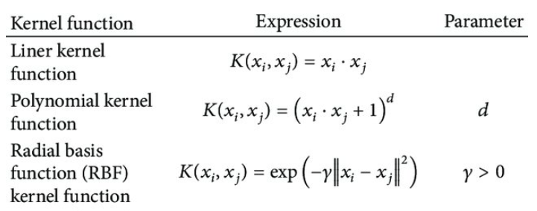
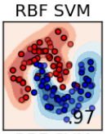
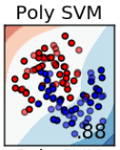
Types Of Kernel Functions

Slide 10
Details of Implementation
The data-set is based on gray-scale images of handwritten digits and, each image is 28 pixel in height and 28 pixel in width. Each pixel has a number associated with it, where 0 represents a dark pixel and, 255 represents a white pixel. Both the train and test data-set have 785 columns where, ‘label’ column represents the handwritten digit and remaining 784 columns represent the (28, 28) pixel values.
Made a counter plot to look at the distribution of data.
First column correspond to the number, other columns contains pixel values(0 to 255).

Slide 11
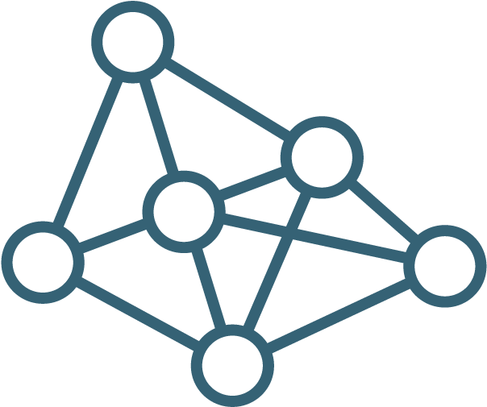
The 10000 data points were split into 8000 training and 2000 testing data points on random distribution.
Then we normalize the data using standardscaler function.
Used svc classifier with different kernel to train the model.
Got highest accuracy in rbf kernel.
Constructed a confusion matrix to get an idea btw the predicted values and the true values
Finally printed out the accuracy of the model on testing data

Slide 12
Results
The results below are primarily based on the 10000 samples of the MNIST dataset. Divided the dataset into train-test ratio of 4:1 and trained the SVM model using different kernels and compared the performance to select the optimum one.

Slide 13
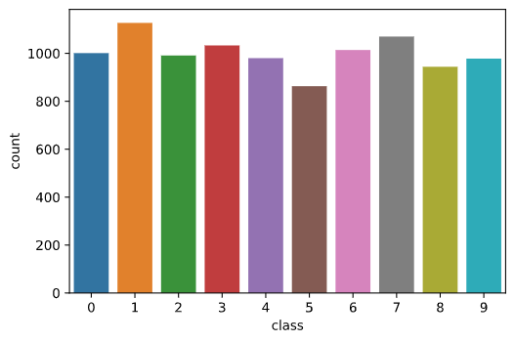
Firstly analysed the 10000 samples of the dataset as below:

Slide 14
Trained the model on 8000 training samples and tested it on 2000 testing samples and got RBF to be the optimum kernel function for the classification
Kernel | Accuracy
Linear | 92%
Polynomial | 96%
Radial Basis Function (RBF) | 97%

Slide 15
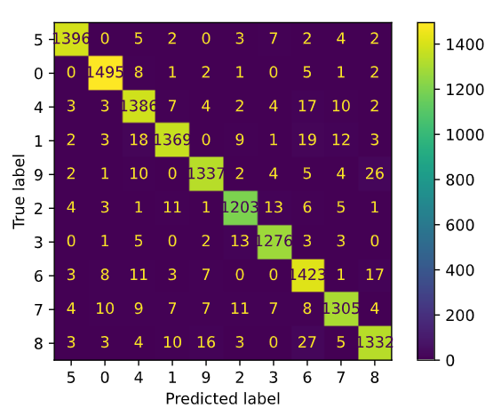
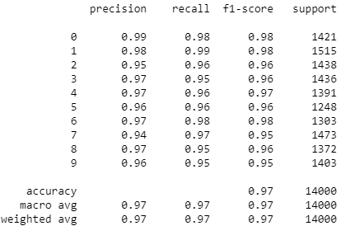
Considering RBF kernel the confusion matrix and statistics are :

Slide 16
Analysis
As we can infer from the confusion matrix that 26 times 9 was labeled as 8 and 16 times 8 as 9, this could be due the fact that while writing in-closed loop of 9 kind of comes near to look similar to 8.
We can observe similar trend with 6 and 8, were 27 times 8 was recognized as 6 and 17 times 6 as 8, again due to the resemblance between them.
But as we see form the accuracy obtained these misclassifications can be ignored.

Slide 17

Contributions from each member
Abhay Kadapa 190020055 Explaining the maths behind the model and drafting the presentation
Karan Chouhan 190110036 Coding the model and compiling the results
Rhythm Shah 190110074 Coding the model and compiling the analysis and details of implementations

