Slide 1
RECOMMENDATION SYSTEM USING YELP DATASET
ABHAY KASTURIA
ADITYA PRIYADARSHI
GAUTAM VASHISHT
VARUN NANDU
XINGXING LIU

Slide 2
outline
Introduction
Data Preprocessing
Methods
Evaluation and results

Slide 3
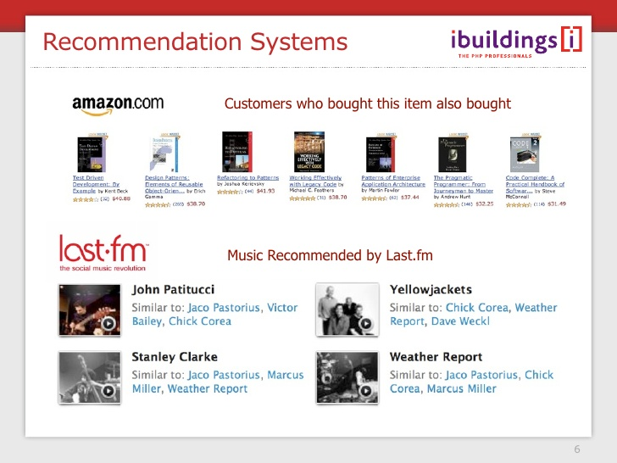
introduction
Recommendation System
What? Why?

Slide 4
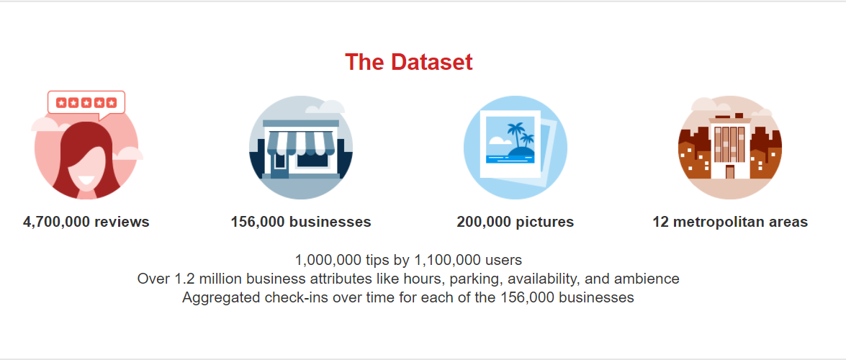
PROJECT
Use yelp dataset to recommend relevant businesses to users
Based on the activity of users on yelp
Activty = reviews given by user to business
Evaluate several data mining methodologies used for recommendations

Slide 5
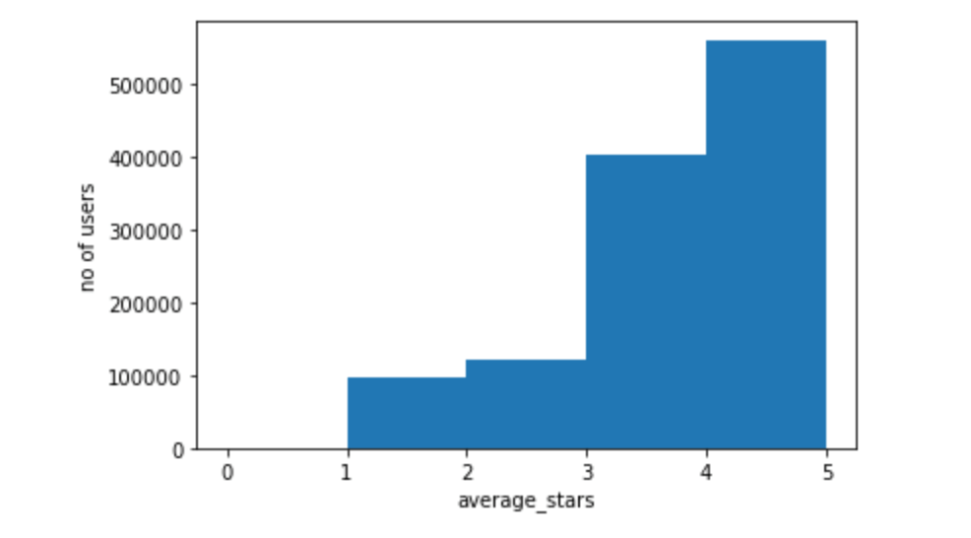
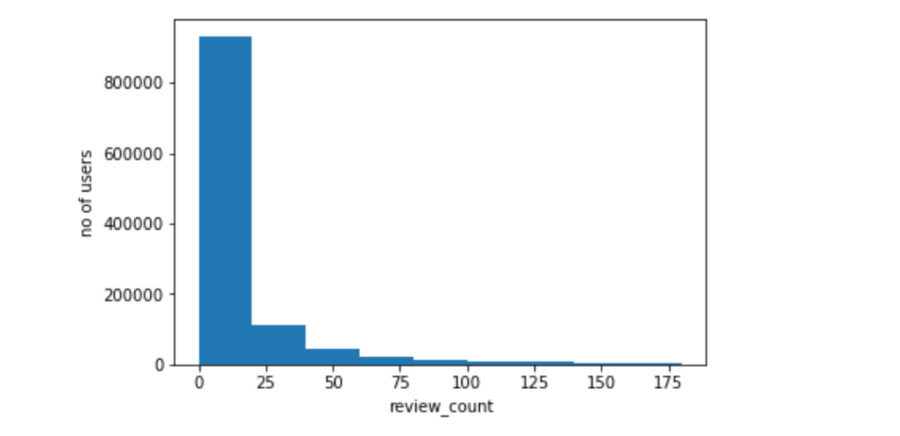
Basic Data Analysis
Average Star Ratings
Average #Reviews

Slide 6
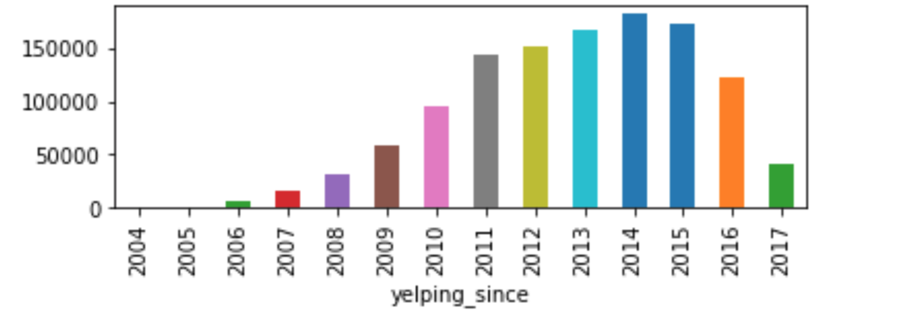
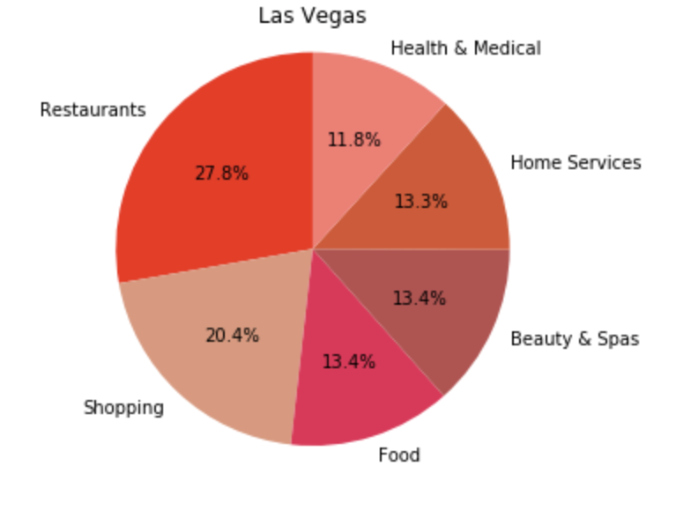
Basic Data Analysis
User Growth
Popular Categories in Las Vegas

Slide 7
Data PREPROCESSING
Data Filtering:
Users with reviews >= 20 ~20K records
Business with Category = Restaurant ~ 48K records
Data Transformation:
UserId and BusinessId mapped to serial numbers
Data Division:
Based on time
Training data – Reviews before 2015 ~ 900K
Testing data – Reviews in and after 2015 ~ 19K
Testing data review categorization - Positive(>3.7), Negative(<2.6), Neutral(rest)

Slide 8
METHODS
Clustering
Agglomerative
Collaborative filtering
User – User similarity based
Matrix factorization
Deep Learning

Slide 9
Clustering - Approach
Assumptions – UserID, Location and Type Of Business
User preference vector of top 15 categories based on rating – what if no rating?
Business vector – must contain 3 of top 15 categories.
Use agglomerative Hierarchical clustering to cluster users

Slide 10
Clustering - RECOMMENDATIONS

Slide 11
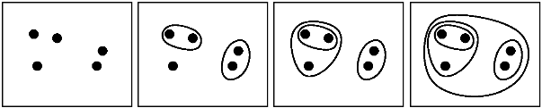
Agglomerative Hierarchical clustering
Number Of Clusters?

Slide 12
Recommend businesses
Calculate average preference vector
Calculate dot product with each business vector
Sort the businesses based on decreasing value of the above dot product
Take out first 20 businesses as your top recommendations

Slide 13
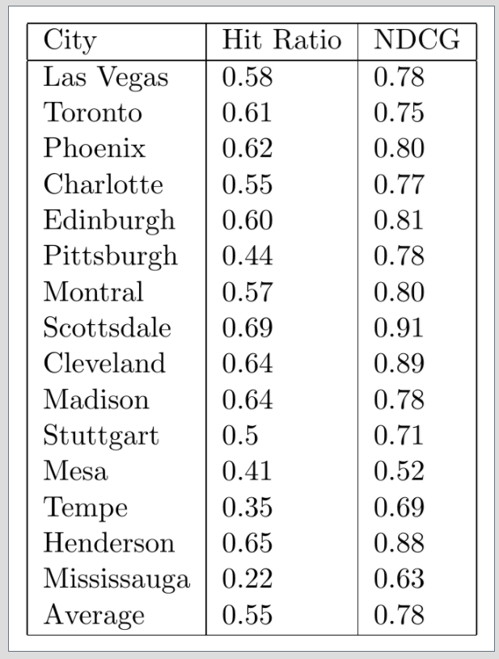
CLUSTERING - RESULTS
Hit ratio
Positive(>3.7), Negative(<2.6), Neutral(rest)
Normalized discounted cumulative gain (NDCG)

Slide 14
User-user based collaborative filtering
Created Utility matrix for users vs business filled with rating
Centralized each rating vector of user to mean zero
Replace the missing values with zero
Averaged rating value would be 0, positive or negative where 0 represents mean rating or missing ratings and positive represents higher ratings than mean rating

Slide 15

Rating prediction
Prediction for user I for business k is given by the formula above.
Predicted the ratings that user will give to the new business
Find top k similar users which have already rated the item ‘I’ and returned the weighted averaged of ratings with weight as similarity

Slide 16
Recommending top 10 business to user
Predict rating for business for the user which one have not used yet
Sort the array on basis of rating
Return the top 10 business

Slide 17

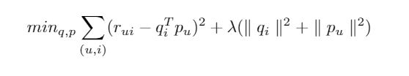
collaborative filtering MATRIX FACTORIZATION using ALS
Q – vector of business and p- vector of users
Predicted the ratings based on the dot product of the user and the business vector
Both q and p are unknowns, Equation is not convex.
ALS fixes one and optimizes the other and rotate between fixing the q and fixing the p. Thus, the name – Alternating Least Squares.
This ensures that each step decreases equation until convergence.

Slide 18
collaborative filtering MATRIX FACTORIZATION using ALS
Parameters for ALS:
Lambda - Regularization Parameter
Iterations – Max If Convergence not reached
Rank - the number of features to use (aka the number of latent factors).
Parameters for our ALS model:
Lambda = 0.15
Iterations = 20 (Slow computers)
Rank = 100 (Low Memory Computers)

Slide 19
collaborative filtering MATRIX FACTORIZATION using ALS
RESULTS:
 | MSE - Training | MSE - Testing
Non-Reg | 0.02 | 2.2
Reg | 0.04 | 1.4
 | Hit Ratio(Threshold = 1.5)
Reg | 0.77

Slide 20

Deep Learning - APPROACH
Uses multi-layer perceptron (MLP) to learn user-item interaction
Uses implicit feedback rather than explicit reviews

Slide 21
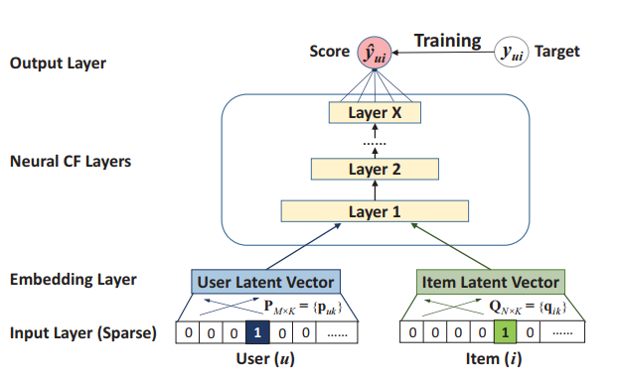
Deep Learning - ARCHITECTURE

Slide 22
Deep Learning - RESULTS
Trained model using 4 hidden layers with [64,32,16,8] factors.
Used hit ratio and ndcg to measure quality
Best model – hit ratio (0.8197) and NDCG (0.6220)

Slide 23
Conclusion
 | Hit Ratio
CF - ALS | 0.77
DNN | 0.81
Clustering(avg across cities) | 0.55
We see that DNN gives us the best Hit Ratio

Slide 24
FUTURE WORKS
Utilize textual and image based data to help improve the recommendations.
Utilize hybrid recommendation system techniques to use user behaviour and user characteristics(demographics of users) to improve recommendations.

