Slide 1
RECOMMENDATION SYSTEM YELP DATASET
- VARUN NANDU, ADITYA PRIYADARSHI, XINGXING LIU,
ABHAY KASTURIA AND GAUTAM VASHISHT

Slide 2
outline
Introduction
Dataset used and its preprocessing
Clustering
Collaborative filtering
Multi layer perceptron
Evaluation and results

Slide 3
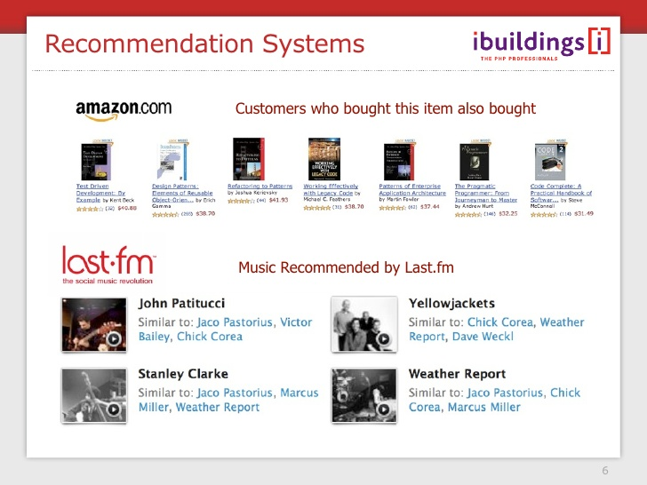
introduction
What is recommendation system and why we use it

Slide 4
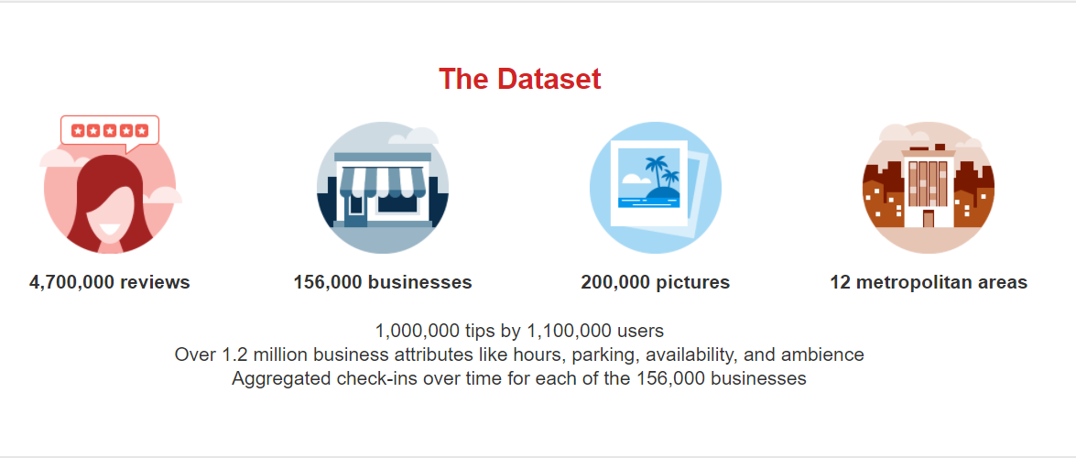
Yelp dataset and its features

Slide 5
Data Pre-processing
Filter Businesses by category (only restaurant category select) – 48, 349
Filter users by review count (Min Review : 20) – 19, 771
Divide reviews into training and test set – 9,08,436 Training and 19,771 Test

Slide 6
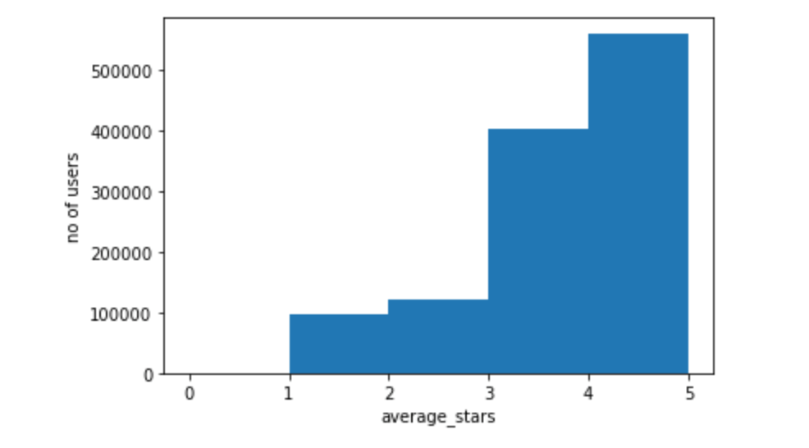
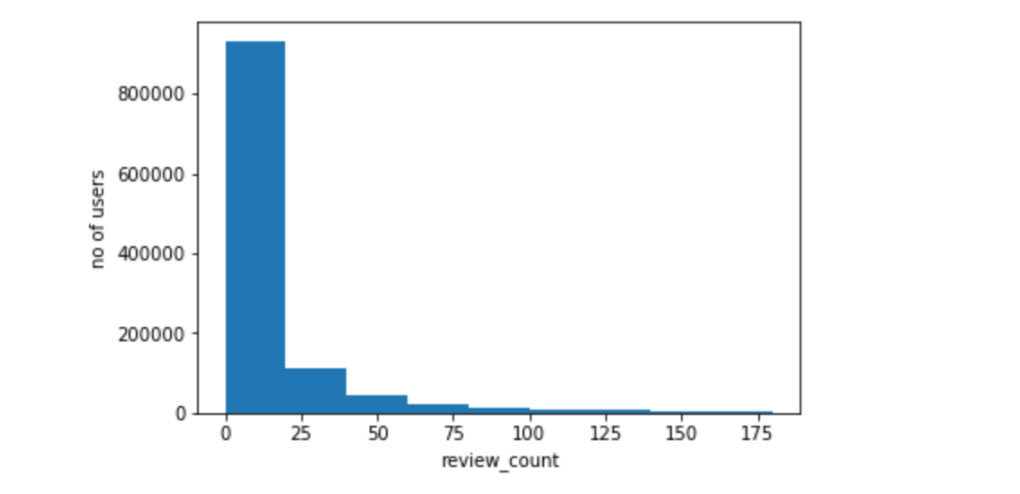
Dataset Analysis
rating per user
Review count per user

Slide 7
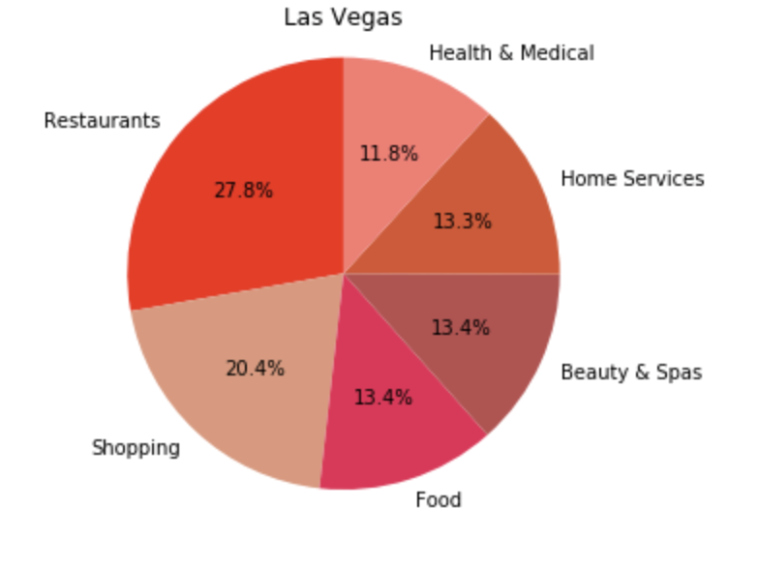
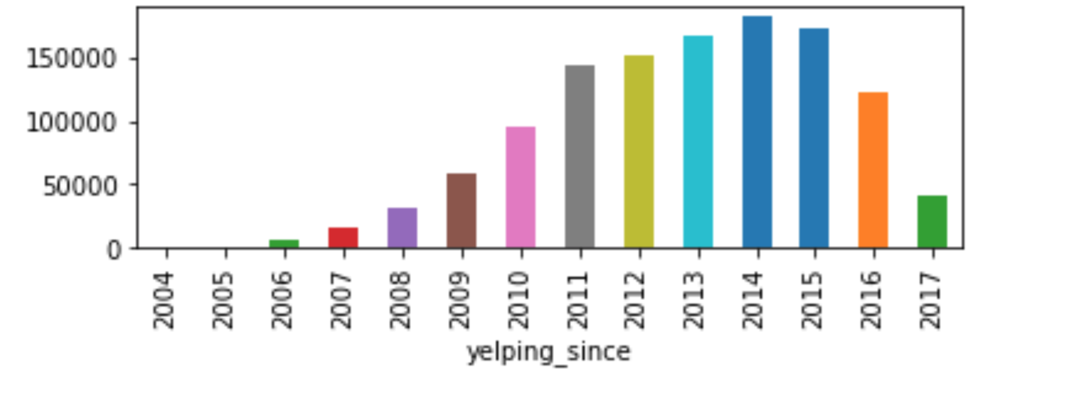
Dataset Analysis
Top category in popular city like las vegas
Yelp user growth

Slide 8
clustering
Assumptions – UserID, Location and Type Of Business
User preference vector of top 15 categories based on rating – what if no rating?
Business vector – must contain 3 of top 15 categories.
Use agglomerative Hierarchical clustering to cluster users

Slide 9
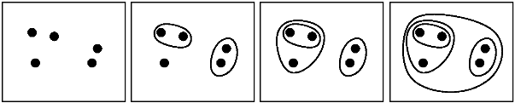
Agglomerative Hierarchical clustering
Number Of Clusters?

Slide 10
Recommend businesses
Calculate average preference vector
Calculate dot product with each business vector
Sort the businesses based on decreasing value of the above dot product
Take out first 20 businesses as your top recommendations

Slide 11
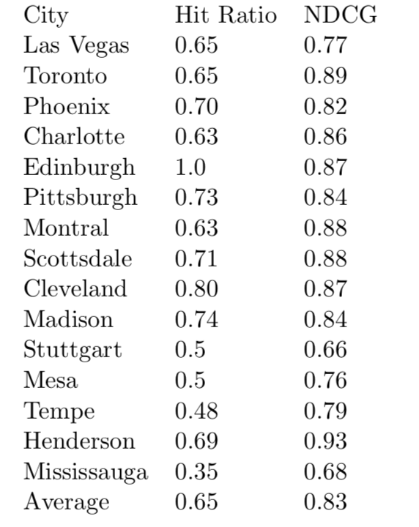
Evaluation and results of clustering based recommendation
Hit ratio
Normalized discounted cumulative gain (NDCG)

Slide 12

Deep Learning based approach
Uses multi-layer perceptron (MLP) to learn user-item interaction
Uses implicit feedback rather than explicit reviews

Slide 13

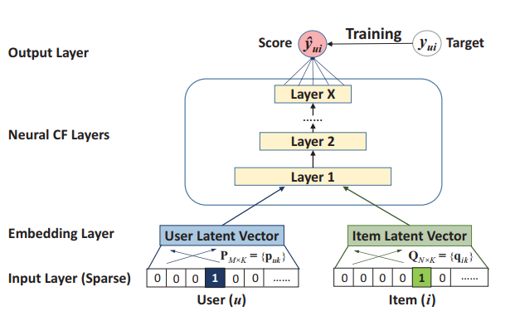
Model architecture

Slide 14
Evaluation (DNN Method)
Trained model using 4 hidden layers with [64,32,16,8] factors.
Used hit ratio and ndcg to measure quality
Best model – hit ratio (0.8197) and NDCG (0.6220)

