Slide 1
RECOMMENDATION SYSTEM YELP DATASET
- VARUN NANDU, ADITYA PRIYADARSHI, XINGXING LIU,
ABHAY KASTURIA AND GAUTAM VASHISHT

Slide 2
outline
Introduction
Dataset used and its preprocessing
Clustering
Collaborative filtering
Multi layer perceptron
Evaluation and results

Slide 3
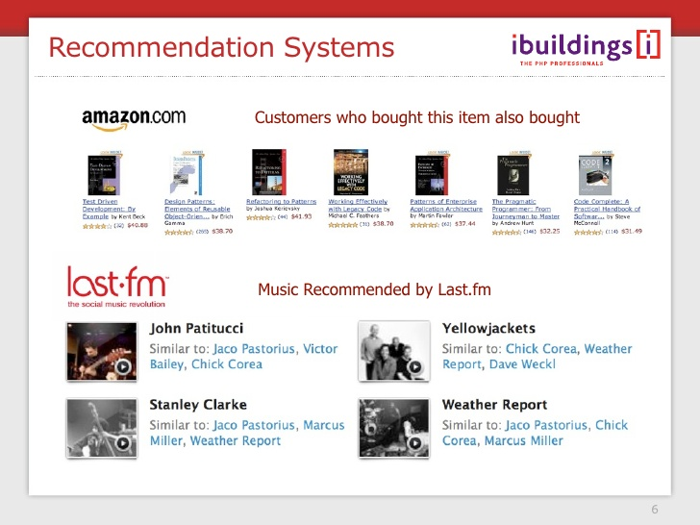
introduction
What is recommendation system and why we use it

Slide 4
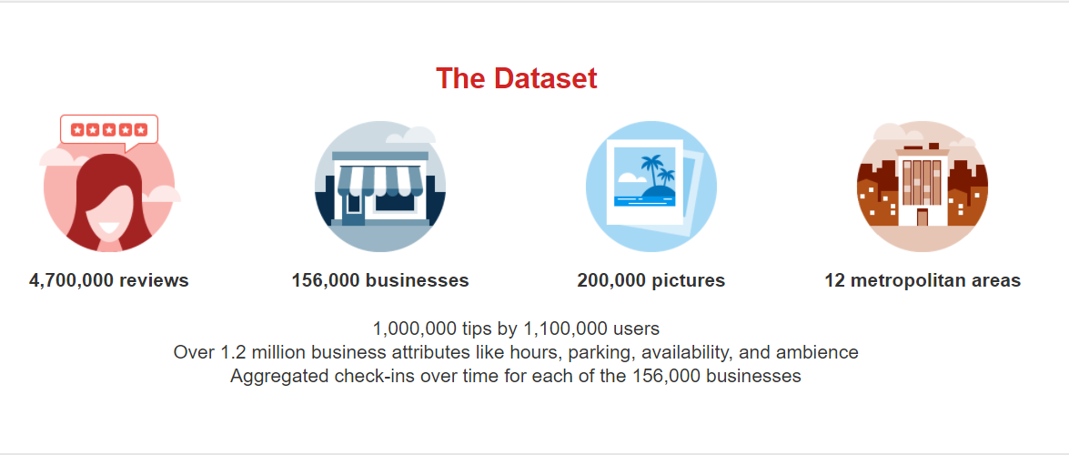
Yelp dataset and its features

Slide 5
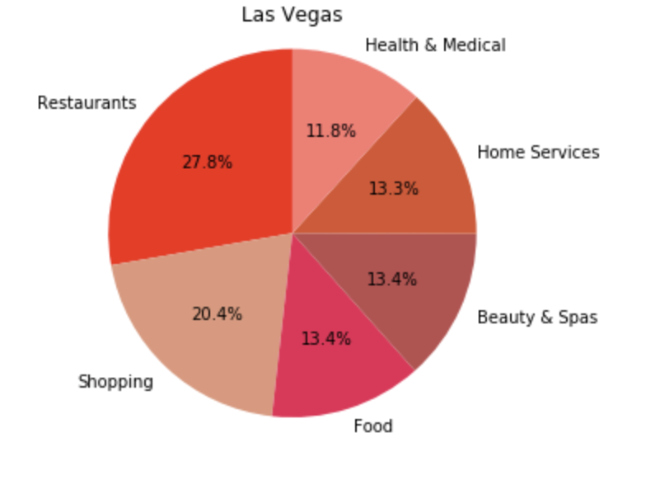
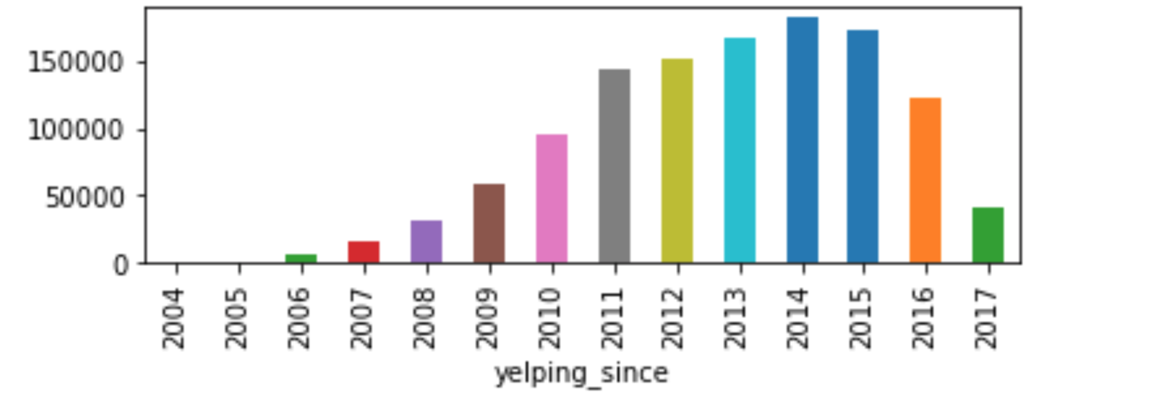
Dataset Preprocessing
Division of testing and training data
Top cities
Top businesses

Slide 6
clustering
Assumptions – UserID, Location and Type Of Business
User preference vector of top 15 categories based on rating – what if no rating?
Business vector – must contain 3 of top 15 categories.
Use agglomerative Hierarchical clustering to cluster users

Slide 7
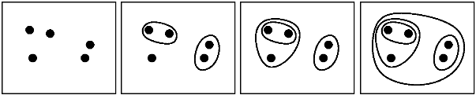
Agglomerative Hierarchical clustering
Number Of Clusters?

Slide 8
Recommend businesses
Calculate average preference vector
Calculate dot product with each business vector
Sort the businesses based on decreasing value of the above dot product
Take out first 20 businesses as your top recommendations

Slide 9
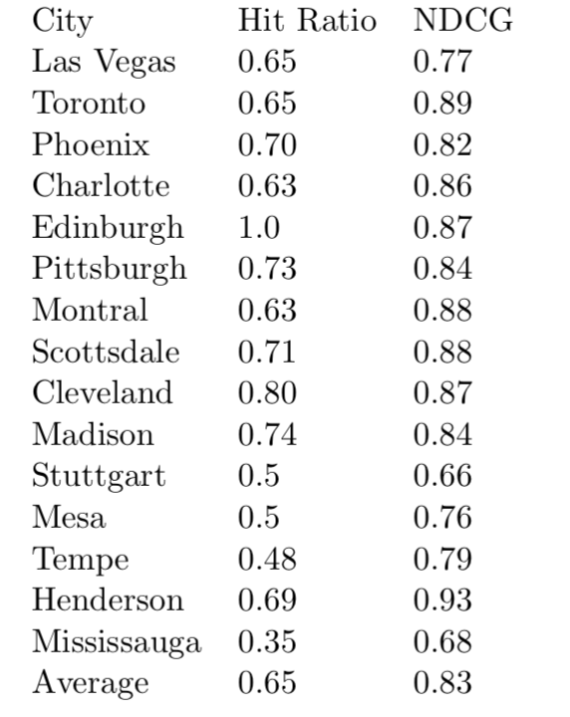
Evaluation and results of clustering based recommendation
Hit ratio
Normalized discounted cumulative gain (NDCG)

