Slide 1
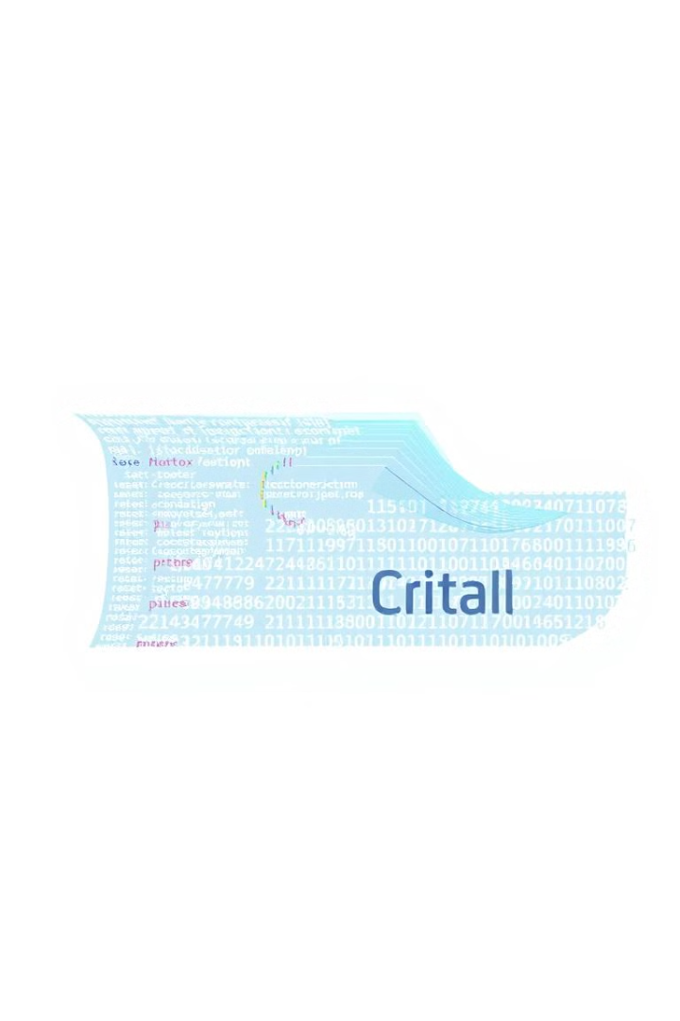

Compiler Design & Working
This presentation will explore the design and implementation of a compiler, focusing on the key components and design choices that contribute to its functionality.
by Abhay Narayan Bairagi

Slide 2
Compiler Purpose: Translating Code
Input
Output
The compiler takes source code written in a custom language as input.
It produces assembly code for a hypothetical CPU architecture as output.

Slide 3

Lexical Analysis: Breaking Down Code
The lexer breaks down the source code into tokens, which are the smallest units of meaningful code. It handles keywords, identifiers, numbers, and operators.
Manual Tokenization
Efficient Token Management
The lexer class uses simple character-by-character parsing, skipping whitespace and identifying patterns like keywords and operators.
The getNextToken method handles both character traversal and token generation dynamically, ensuring that tokens are produced as needed.

Slide 4
Syntax Analysis: Building the AST
The parser takes tokens from the lexer and builds an Abstract Syntax Tree (AST) based on the grammar of the language.
Recursive Descent Parsing
Error Handling
This technique is used where each function in the parser corresponds to a non-terminal in the grammar.
Errors like missing semicolons or unclosed parentheses are thrown as exceptions, ensuring robustness.

Slide 5
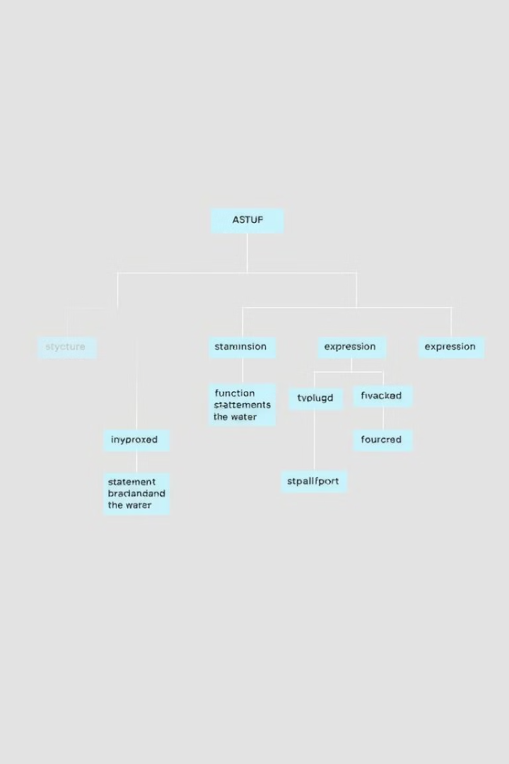
Abstract Syntax Tree: Representing Structure
The AST represents the logical structure of the program, reflecting the source code’s syntax in a hierarchical manner.
Node-based Structure
Specific Nodes for Operations
Each class like Expression and Statement inherits from ASTNode, representing different parts of the program.
For example, BinaryOp represents binary operations, and Assignment represents variable assignments.

Slide 6
Code Generation: From AST to Assembly
The code generator converts the AST into assembly.
Register Allocation
Assembly Code Emission
A register is assigned dynamically using getNewRegister().
Assembly instructions are generated based on the AST structure, using methods like emit to produce output.

Slide 7
Program Flow: Example
This example demonstrates the compiler's process, from input code to generated assembly code.
Input Code
int x = 5;
int y = x + 10;
if (y == 15) {
x = y;
}
AST Structure
Block → VarDeclaration → Assignment BinaryOp (x + 10)
If → BinaryOp (y == 15) → Assignment (x = y)
1
2
3
4
Tokenized Code
Generated Assembly Code
[TOKEN_INT, "int"], [TOKEN_IDENTIFIER, "x"], [TOKEN_ASSIGN, "="], [TOKEN_NUMBER, "5"]
[TOKEN_INT, "int"], [TOKEN_IDENTIFIER, "y"], [TOKEN_ASSIGN, "="], [TOKEN_IDENTIFIER, "x"], [TOKEN_PLUS, "+"], [TOKEN_NUMBER, "10"]
[TOKEN_IF, "if"], [TOKEN_LPAREN, "("], [TOKEN_IDENTIFIER, "y"], [TOKEN_EQUAL, "=="], [TOKEN_NUMBER, "15"], [TOKEN_RPAREN, ")"]
[TOKEN_LBRACE, "{"], [TOKEN_IDENTIFIER, "x"], [TOKEN_ASSIGN, "="], [TOKEN_IDENTIFIER, "y"], [TOKEN_RBRACE, "}"]
.section .data
x: .word 0
y: .word 0
.section .text
_start:
MOV R0, #5
STR R0, [x]
MOV R0, [x]
MOV R1, #10
ADD R2, R0, R1
STR R2, [y]
LDR R3, [y]
CMP R3, #15
BNE L1
LDR R4, [y]
STR R4, [x]
L1:
MOV R7, #1
MOV R0, #0
SWI 0

Slide 8




Conclusion: Advantages and Future Enhancements
The compiler's modular design, thorough error handling, and potential for optimization and future enhancements make it a valuable tool for software development.
Modular Design
Error Handling
Future Enhancements
Each component is responsible for a specific task, making the system easy to maintain and extend.
Thorough error checking at each stage ensures that invalid code is caught early.
The generated assembly code can be optimized for performance. Adding more control structures and data types could enhance the compiler.

