Slide 1
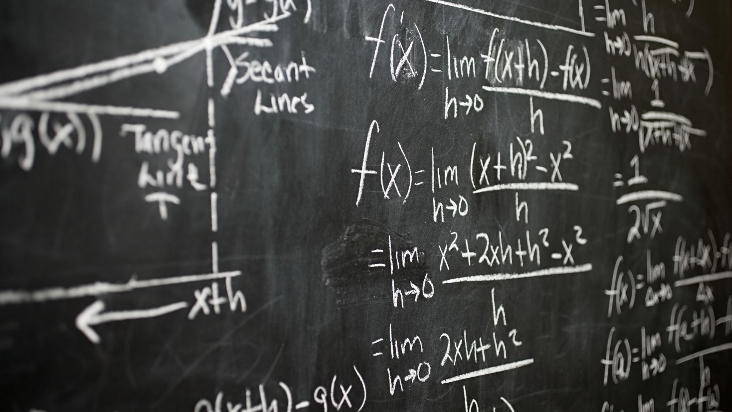
Mathematics for intelligent systems-3
Assignment 1

Slide 2
Eigen values and Eigen Vectors
Geometric Definition
Eigen Equation
Arithmetic Multiplicity and Geometric Multiplicity

Slide 3















Slide 4
















Slide 5
















