Slide 1
SHRI G. S. INSTITUTE OF TECHNOLOGY & SCIENCE, INDORE
DEPARTMENT OF COMPUTER ENGG. | B.Tech III Year Mini Project Proposal (2025–26 SEM A)
Confidence AI
AI-Driven Personality Development & Placement Practice App
A multimodal web platform analyzing video posture, facial warmth, and speech pace for campus placement readiness.
Student Details (Candidates)
Project Supervision & Department
• Project Batch: B.Tech Computer Engineering (Semester 5 / SEM A)
• Student 1: Abhay Randa (Enrollment No. 0801CS221004)
• Student 2: Team Member 2 (Enrollment No. 0801CS221xxx)
• Class: B.Tech III Year, Session: 2025–2026
• Project Supervisor / Faculty Guide: Department of Computer Engg.
• Designation: Assistant Professor / Associate Professor
• Department: Department of Computer Engg., S.G.S.I.T.S., Indore
• Course: Mini Project (Subject Code: CO3xxxx / SEM A)
Key Implementation Technologies in Workspace:
Frontend: React 18, Three.js 3D Avatar | Backend: FastAPI & Python | Vision & Audio: OpenCV, OpenAI Whisper | Database: SQLite

Slide 2
PREAMBLE | OVERVIEW (PAGE 1 OF 2)
SGSITS COMPUTER ENGG. | MINI PROJECT 2025-26 SEM A
PREAMBLE: BACKGROUND, MOTIVATION & STUDENT NEEDS
Why placement interview preparation requires automated, private, and objective feedback.
1. Project Background
2. Student Motivation
3. Critical Needs Addressed
• Campus placement drives are the defining milestone for B.Tech engineering undergraduates.
• Corporate recruiters evaluate candidates within the first 60 seconds of interaction.
• Beyond coding skills, recruiters assess vocal clarity, posture, eye engagement, and confidence.
• Most college students never receive formal, personal communication coaching during their degree.
• Interview Fear & Hesitation: Talented students fail placements simply because their hands shake or voice trembles.
• Fear of Peer Judgment: Practicing in front of classmates causes social anxiety and embarrassment.
• Need for a Safe Space: Students need a judgment-free personal tool to rehearse answers at 11 PM in their hostel rooms.
• Confidence is Trainable: Speaking clearly is a learnable skill if given honest, continuous measurement.
• Affordable Practice: Professional coaching costs Rs. 5,000–15,000; students need a free, web-based tool.
• Zero Extra Hardware: Must run on standard college laptop webcams and microphones.
• Immediate Guidance: Get instant feedback right after a 90-second answer without waiting for an instructor.
• Systematic Tracking: Record progress over weeks so students can visibly watch their delivery improve.
DEPARTMENT OF COMPUTER ENGG. — B.Tech III Year
Slide 2 of 16
Shri G.S. Institute of Tech. & Science, Indore

Slide 3
PREAMBLE | OVERVIEW (PAGE 2 OF 2)
SGSITS COMPUTER ENGG. | MINI PROJECT 2025-26 SEM A
PREAMBLE: TECHNOLOGIES USED, IMPACT & CORE GOALS
How modern web and AI technologies come together to solve personality development challenges.
Technologies Used & Rationale
Expected Impact & Core Vision
• Frontend (React 18): Fast, reactive user interface with webcam capture and session dashboards.
• Backend (FastAPI & Python 3.10): High-speed asynchronous REST API handling video uploads and calculations.
• Computer Vision (OpenCV): Detects face alignment, centering, and smiling percentage across video frames.
• Speech Processing (OpenAI Whisper): Transcribes audio into text, calculates Words Per Minute (WPM), and counts filler words ('um', 'uh').
• AI Coach (Gemini API & Fallback): Provides friendly, non-judgmental advice tailored to interview questions.
• Database (SQLite): Lightweight, local relational storage for user accounts, session history, and metrics.
• Democratic Access: Brings interview coaching to every engineering student at S.G.S.I.T.S. without financial barrier.
• Objective vs Subjective: Replaces polite 'you did fine' from friends with exact WPM and filler tallies.
• Stress Reduction: Built-in 4-7-8 breathing exercises and mindset challenges actively lower interview anxiety.
• Measurable Improvement: Enables college placement cells to recommend guided digital practice before drive season.
• Scalable Architecture: Easily hostable on college servers or accessible online from any modern web browser.
DEPARTMENT OF COMPUTER ENGG. — B.Tech III Year
Slide 3 of 16
Shri G.S. Institute of Tech. & Science, Indore

Slide 4
PROBLEM STATEMENT
SGSITS COMPUTER ENGG. | MINI PROJECT 2025-26 SEM A
PROBLEM STATEMENT: THE ISSUE BEING ADDRESSED
Why traditional student practice methods fail and create placement interview hurdles.
Core Problem Statement:
“Engineering students lack accessible, objective, and judgment-free mechanisms to identify and correct communication flaws before placement interviews.”
1. Unconscious Flaws
2. Mirror Practice Fails
3. Social & Cost Barriers
• Filler Word Repetition: Students say 'um', 'like', 'basically', and 'you know' without realizing it.
• Erratic Speaking Pace: Rushing through technical answers (>165 WPM) or freezing up under pressure.
• Closed Body Posture: Slouching, avoiding camera gaze, or displaying a tense, flat expression.
• No Objective Measurement: A mirror cannot count words per minute or tally filler occurrences.
• Unnatural Eye Contact: Looking into your own eyes in a mirror is not equivalent to looking into an interviewer's lens.
• Zero Audio Feedback: A mirror cannot transcribe your speech or score articulation clarity.
• Fear of Classmate Ridicule: Shy students avoid mock interviews because they fear looking foolish.
• Biased Peer Feedback: Friends say 'you sounded fine' just to avoid hurting feelings.
• Prohibitive Coaching Fees: High institute costs mean the average student gets zero practice before the real drive.
DEPARTMENT OF COMPUTER ENGG. — B.Tech III Year
Slide 4 of 16
Shri G.S. Institute of Tech. & Science, Indore

Slide 5
OBJECTIVES
SGSITS COMPUTER ENGG. | MINI PROJECT 2025-26 SEM A
PROJECT OBJECTIVES: MAIN & SPECIFIC GOALS
Clear, measurable engineering objectives defined for the Mini Project.
Main Project Objective
Specific Technical Goals
Primary Goal:
To design and implement a web-based, automated multimodal coaching application that evaluates video body language and speech delivery in real-time, outputting an objective 0–100% confidence score with targeted micro-drills.
• Goal 1 (Vision Pipeline): Use OpenCV to track face framing, head straightness, and smile percentage frame-by-frame.
• Goal 2 (Speech Pipeline): Use OpenAI Whisper to transcribe audio, compute speaking speed (Words Per Minute), and detect filler words.
• Goal 3 (Scoring Algorithm): Develop a weighted 7-parameter formula calculating an overall Confidence Score (0–100%).
• Goal 4 (Interactive AI Coach): Provide 1-click advice chips and conversational tips using Gemini API with rule-based fallback.
• Goal 5 (Practice Tools): Build an interactive 3D avatar practice companion and anxiety-reducing 4-7-8 breathing exercises.
• Goal 6 (Session Storage): Implement SQLite database with user auth and progress history tracking over time.
• Accessibility: 100% web-based; operates straight in Google Chrome or Edge.
• Hardware Independence: Standard laptop webcam and internal microphone.
• Privacy: Practice answers are processed locally/privately with zero peer judgment.
• Latency: Generate comprehensive feedback within 5–10 seconds of recording.
DEPARTMENT OF COMPUTER ENGG. — B.Tech III Year
Slide 5 of 16
Shri G.S. Institute of Tech. & Science, Indore

Slide 6
LITERATURE REVIEW (PAGE 1 OF 3)
SGSITS COMPUTER ENGG. | MINI PROJECT 2025-26 SEM A
LITERATURE REVIEW: EXISTING STUDIES & TOOLS
Survey of automated communication coaching research and existing commercial tools.
1. Multimodal Coaching Systems
2. Speech & ASR Advances
3. Computer Vision in EdTech
• Prior Work: MIT Media Lab (MACH - My Automated Conversation Coach, 2013) demonstrated that computer agents could help people improve social communication.
• Key Finding: Users practicing with automated systems showed measurable reduction in nervousness and increased speech fluency.
• Constraint of Early Work: Required high-end laboratory setups, specialized sensors, and proprietary hardware unavailable to college students.
• Prior Work: Radford et al. (OpenAI Whisper, 2022) established robust open-source speech recognition with timestamped word segments.
• Key Finding: Highly accurate ASR allows exact computation of speaking speed (WPM) and precise filler word tracking ('um', 'uh', 'you know').
• Advantage: Open-source models can run locally or via API without ongoing subscription fees.
• Prior Work: OpenCV Haar Cascades and MediaPipe frameworks made real-time face detection and pose estimation accessible in consumer browsers.
• Key Finding: Detecting facial framing, smile frequency, and posture orientation correlates strongly with human perception of speaker confidence.
• Practicality: Lightweight enough to execute on student laptops with zero GPU dependency.
DEPARTMENT OF COMPUTER ENGG. — B.Tech III Year
Slide 6 of 16
Shri G.S. Institute of Tech. & Science, Indore

Slide 7
LITERATURE REVIEW (PAGE 2 OF 3)
SGSITS COMPUTER ENGG. | MINI PROJECT 2025-26 SEM A
LITERATURE REVIEW: LIMITATIONS OF CURRENT SOLUTIONS
Why existing commercial platforms and traditional methods fail college students.
1. Commercial AI Speech Tools
2. Asynchronous Interview Bots
3. Campus Training Reality
• Examples: Yoodli, Poised, Orai, Speeko.
• Heavy Paywalls: Cost $12–$25 per month, which Indian college students cannot afford.
• Enterprise Focused: Tailored for corporate executives giving board presentations, not campus technical HR rounds.
• Closed Source: Algorithms and data models cannot be inspected, adapted, or extended for academic research.
• Examples: HireVue, Talview, modern screening platforms.
• Evaluative, Not Educational: Designed to filter candidates out for companies, not to coach or improve the candidate.
• Black-Box Scoring: Candidates receive no explanation of why they were rejected or what habits to fix.
• High Stress: Increases candidate anxiety rather than offering a safe, repeatable sandbox.
• Limited Faculty Time: One placement officer cannot hold individual 30-minute mock interviews for 500+ students.
• One-Off Sessions: Students get at most 1 mock interview before real campus placement season begins.
• No Muscle Memory: Building speaking confidence requires dozens of short 2-minute daily attempts, not a single annual seminar.
DEPARTMENT OF COMPUTER ENGG. — B.Tech III Year
Slide 7 of 16
Shri G.S. Institute of Tech. & Science, Indore

Slide 8
LITERATURE REVIEW (PAGE 3 OF 3)
SGSITS COMPUTER ENGG. | MINI PROJECT 2025-26 SEM A
LITERATURE REVIEW: COMPARATIVE MATRIX & PROPOSED SOLUTION
Structured comparison demonstrating how Confidence AI addresses existing gaps.
How Confidence AI Fills the Gap
• Confidence AI bridges the divide between costly commercial software and ineffective mirror practice by offering a 100% free, open-source, dual-stream web coach specifically tuned for campus placement interview rounds.
Table: Feature Comparison Matrix
Evaluation Metric | Mirror Practice | Peer Mock Interview | Commercial Tools | Confidence AI (Ours)
Speaking Pace (WPM) | Cannot measure | Vague estimation | Available behind paywall | Automated WPM calculation
Filler Word Tracking | Zero tracking | Often missed by friends | Paid tier only | Instant count ('um', 'uh', 'like')
Face & Posture Analysis | Unreliable self-gaze | Inconsistent feedback | Video disabled in many | OpenCV vision frame analysis
Cost & Accessibility | Free, but useless | Free, but irregular | Paid ($15–$25/month) | 100% Free & Open-Source
DEPARTMENT OF COMPUTER ENGG. — B.Tech III Year
Slide 8 of 16
Shri G.S. Institute of Tech. & Science, Indore

Slide 9
METHODOLOGY
SGSITS COMPUTER ENGG. | MINI PROJECT 2025-26 SEM A
METHODOLOGY: SYSTEM ARCHITECTURE & EXECUTION FLOW
Technical methodology showing how data moves from user webcam to AI scoring and output.
Step 1: Client Ingestion (React 18 Frontend)
• • Student selects practice question or self-introduction prompt.
• • Records 1 to 2 minute webcam video directly in browser (MediaRecorder API) or uploads pre-recorded .mp4/.webm file.
• • Sends multi-part video payload to FastAPI backend via asynchronous POST /analyze request.
⬇ REST API /analyze (FastAPI on Port 8000) ⬇
Step 2: Dual-Stream Analysis Pipeline (Python Backend)
Visual Stream (OpenCV Haar Cascades)
• Face Detection & Centering • Smile Expression Detection
• Head Straightness • Upright Posture Stability
Audio Stream (MoviePy + OpenAI Whisper)
• Audio Track Separation (.wav) • Speech-to-Text Transcription
• Filler Word Frequency Count • Words Per Minute (WPM) Pace
⬇ Weighted Scoring Formula & SQLite Persistence ⬇
Step 3: Confidence Scoring & Actionable Output
• • Computes Composite Score (0.16·Face + 0.12·Posture + 0.10·Smile + 0.22·Speech + 0.18·Eye + Penalties) ➔ Stored in SQLite ➔ Dashboard Display
DEPARTMENT OF COMPUTER ENGG. — B.Tech III Year
Slide 9 of 16
Shri G.S. Institute of Tech. & Science, Indore

Slide 10
WORK PLAN (PAGE 1 OF 3)
SGSITS COMPUTER ENGG. | MINI PROJECT 2025-26 SEM A
WORK PLAN: TEAM WORK DISTRIBUTION & MODULE BREAKDOWN
Clear division of engineering responsibilities among project team members.
Module 1: Frontend & UI/UX
Module 2: Backend & Database
Module 3: AI & Analytics Pipeline
• Assigned to: Lead Frontend Engineer (Student 1)
• Key Deliverables:
• • React 18 SPA Architecture & Route Setup
• • Webcam Recording Interface via MediaRecorder
• • Student Analytics Dashboard with Chart.js radar & ring charts
• • Three.js 3D VRM Interactive Avatar Coach
• • Learning Resource Center (4-7-8 Breathing Drill & Mindset Guide)
• Status: Fully Integrated & Operational
• Assigned to: Backend Systems Engineer (Student 2)
• Key Deliverables:
• • FastAPI Server Configuration with Uvicorn
• • User Authentication (Argon2 Hashed Passwords & OTP support)
• • SQLite Database Schema (users & analysis_results tables)
• • REST API Endpoints: /signup, /login, /analyze, /dashboard
• • Multi-turn Gemini AI Coaching Integration (/coaching/chat)
• Status: Completed & Verified on Port 8000
• Assigned to: AI & Vision Specialist (Team / Abhay)
• Key Deliverables:
• • OpenCV Video Stream Analysis (Face & Smile Cascades)
• • MoviePy Audio Demuxing & Normalization
• • OpenAI Whisper Speech-to-Text & WPM Calculation
• • Filler Word Dictionary Scanning ('um', 'uh', 'like')
• • Composite Scoring Formulation & Penalty Engine
• Status: Tested on Real 90s Sessions (Score 78.5%)
DEPARTMENT OF COMPUTER ENGG. — B.Tech III Year
Slide 10 of 16
Shri G.S. Institute of Tech. & Science, Indore

Slide 11
WORK PLAN (PAGE 2 OF 3)
SGSITS COMPUTER ENGG. | MINI PROJECT 2025-26 SEM A
WORK PLAN: SEMESTER TIMELINE & GANTT CHART DIAGRAM
Visual 16-week project execution timeline for B.Tech III Year Mini Project (2025–26 SEM A).
Figure: 16-Week Project Gantt Chart Diagram (SEM A)
Project Phase | Key Activities / Deliverables | Timeline | Target Milestones | Current Status
Phase 1: Planning & Literature Survey | Problem formulation, SRS, feasibility study, literature comparison | Weeks 1–3 (July/Aug) | Proposal Approved | Completed (100%)
Phase 2: UI & Architecture Design | Wireframing, React frontend layout, database schema definition | Weeks 4–6 (Aug) | Architecture Finalized | Completed (100%)
Phase 3: Backend & Vision Core | FastAPI endpoints setup, OpenCV face & smile cascade integration | Weeks 7–9 (Sept) | Vision Pipeline Working | Completed (100%)
Phase 4: Speech & Scoring Engine | Whisper ASR setup, WPM pace calculator, weighted scoring algorithm | Weeks 10–12 (Sept/Oct) | Scoring Engine Operational | Completed (100%)
Phase 5: Avatar & AI Coaching | Three.js 3D avatar integration, Gemini AI chat & breathing exercises | Weeks 13–14 (Oct) | Full Integration Demo | Completed (100%)
Phase 6: Testing & Evaluation | Mock interview tests, metrics verification in SQLite, proposal defense | Weeks 15–16 (Nov) | Final Proposal Submission | Verified & Ready
DEPARTMENT OF COMPUTER ENGG. — B.Tech III Year
Slide 11 of 16
Shri G.S. Institute of Tech. & Science, Indore

Slide 12
WORK PLAN (PAGE 3 OF 3)
SGSITS COMPUTER ENGG. | MINI PROJECT 2025-26 SEM A
WORK PLAN: MILESTONES ACHIEVED & VERIFIED PROGRESS
Tangible implementation progress and experimental verification already completed in the workspace.
Milestones Accomplished Checklist
Real Session Verification (confidence.db)
• ✅ Requirement Analysis & SRS Completed: Project scope, user stories, and rubric compliance confirmed.
• ✅ Full-Stack Architecture Implemented: React 18 client seamlessly talking to FastAPI backend on port 8000.
• ✅ Dual-Stream Processing Verified: OpenCV frame sampling + Whisper audio ASR executing in sequence.
• ✅ Composite Scoring Formula Calibrated: 7-factor weights with penalty deduction logic validated.
• ✅ Interactive Avatar & Mindset Drills Added: Three.js 3D coach and 4-7-8 breathing circle functioning.
• ✅ Database Persistence Active: SQLite database (confidence.db) created with 17 registered users.
Verified Test Result: 78.51% Confidence Score
Actual Database Record ID #2 | 90-Second Mock Answer
• Face Framing Visibility: 100% (Face perfectly centered in webcam)
• Smile Percentage: 64.09% (Warm, natural facial expressions)
• Posture Alignment: 100% (Upright and steady throughout speech)
• Speaking Pace: 95.0 WPM (Calm and deliberate delivery)
• Filler Word Count: 0 (Zero 'um', 'uh', or 'like' hesitations)
• Speech Score: 99.0 / 100 (High clarity, articulate delivery)
DEPARTMENT OF COMPUTER ENGG. — B.Tech III Year
Slide 12 of 16
Shri G.S. Institute of Tech. & Science, Indore

Slide 13
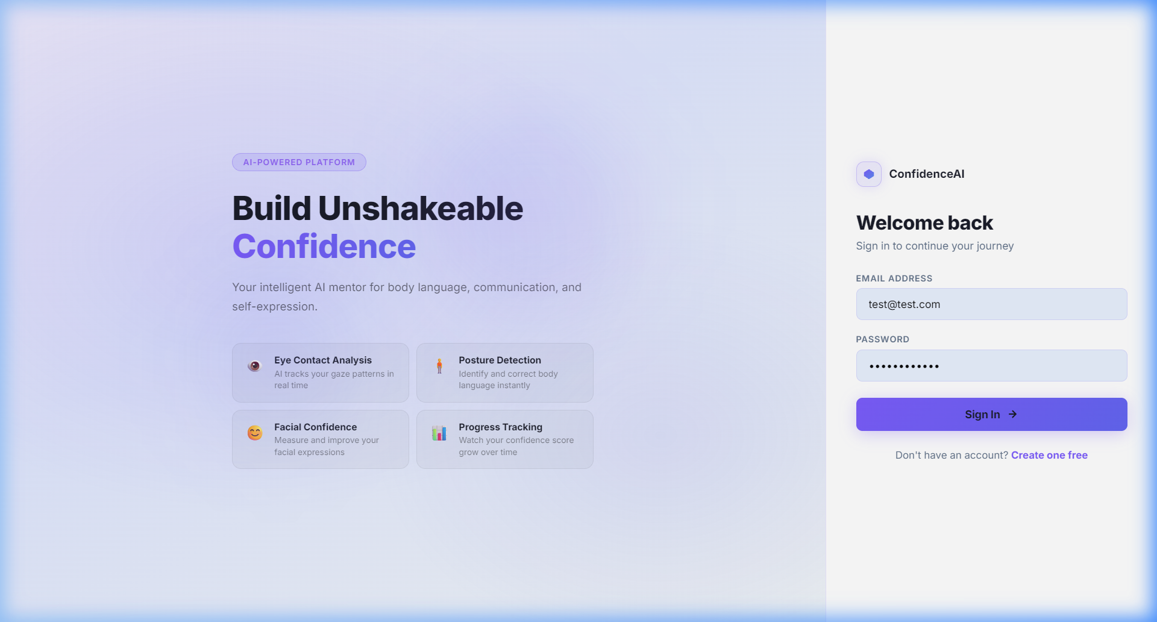
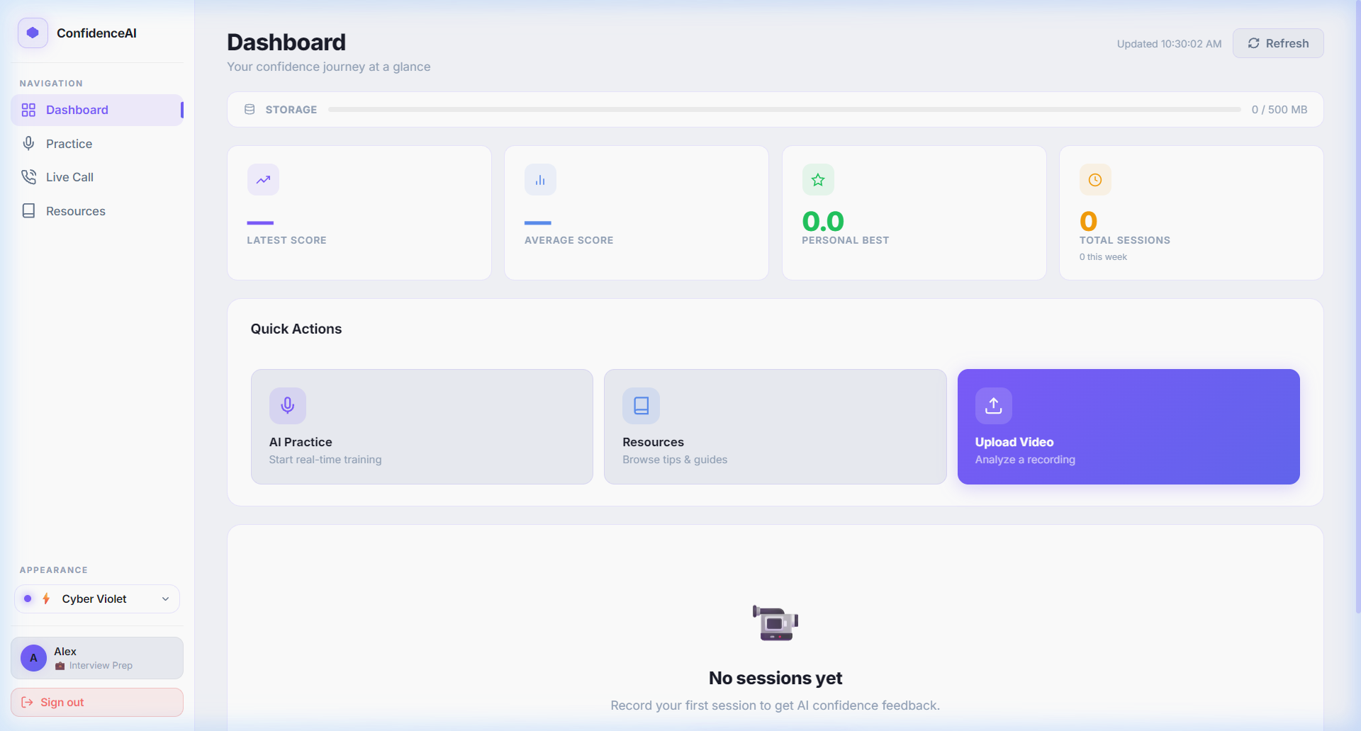
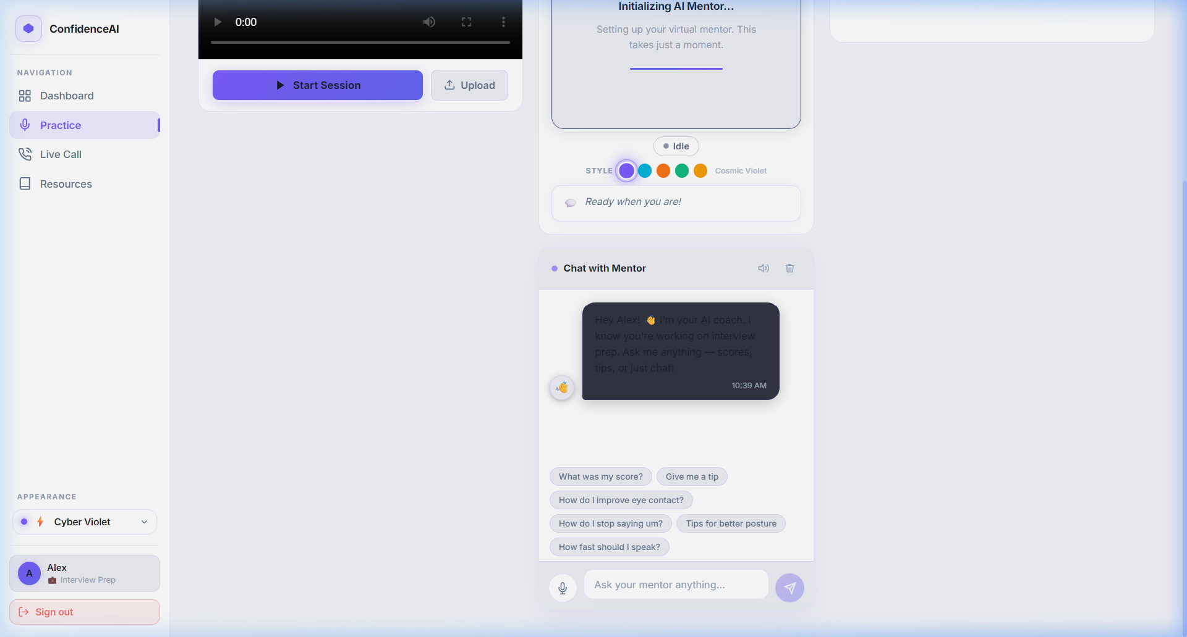
EXPECTED OUTCOMES
SGSITS COMPUTER ENGG. | MINI PROJECT 2025-26 SEM A
EXPECTED OUTCOMES & WORKING DELIVERABLES
Tangible deliverables and actual user interface screenshots from the working prototype.
Deliverable 1: Auth & Landing
Deliverable 2: Student Dashboard
Deliverable 3: AI Practice Coach
• Distraction-free welcome screen with quick onboarding.
• Highlights facial confidence, eye contact, and posture.
• Secure email signup with Argon2 encryption.
• Session history overview and personal best score tracker.
• Local storage monitor for recorded video answers.
• 1-click launch for live practice and mindset modules.
• Live webcam recording box with upload fallback.
• Dual-stream analysis output in under 10 seconds.
• Integrated Gemini AI mentor chat with 1-click advice.
DEPARTMENT OF COMPUTER ENGG. — B.Tech III Year
Slide 13 of 16
Shri G.S. Institute of Tech. & Science, Indore

Slide 14
PROJECT BUDGET
SGSITS COMPUTER ENGG. | MINI PROJECT 2025-26 SEM A
BUDGET ESTIMATION & RESOURCE REQUIREMENTS
Financial feasibility analysis demonstrating zero-cost open-source deployment for students.
Detailed Cost Estimation Table
Financial Justification
Item / Component | Technology / Specification | Type | Cost (INR)
Client & Web Interface | React 18, HTML5, Vanilla CSS | Open-Source | Rs. 0.00
Backend Web Framework | FastAPI & Python 3.10+ (Uvicorn) | Open-Source | Rs. 0.00
Vision & Face Analytics | OpenCV (Haar Cascade Classifiers) | Open-Source | Rs. 0.00
Speech Recognition (ASR) | OpenAI Whisper ('base' model) | Open-Source | Rs. 0.00
Database & Storage | SQLite 3.x with SQLAlchemy ORM | Local / Free | Rs. 0.00
• Zero Financial Burden: 100% composed of open-source frameworks without commercial licensing.
• No Specialized Hardware: Works on the existing college laptops and consumer webcams students already own.
• Local Execution: Whisper and OpenCV run locally on consumer CPU, eliminating expensive GPU cloud billing.
• Extensible for College: The Department of Computer Engg. can deploy the application on college intranet at zero ongoing cost.
• Total Project Cost: Rs. 0.00 (Completely feasible for B.Tech Mini Project).
DEPARTMENT OF COMPUTER ENGG. — B.Tech III Year
Slide 14 of 16
Shri G.S. Institute of Tech. & Science, Indore

Slide 15
REFERENCES
SGSITS COMPUTER ENGG. | MINI PROJECT 2025-26 SEM A
REFERENCES: SOURCE MATERIALS & PRIOR WORK
Academic literature, open-source software citations, and technical standards (IEEE style).
Academic Papers & Literature (IEEE)
Technical Documentation & College Rubric
• [1] M. E. Hoque, M. Courgeon, J. C. Martin, B. Mutlu, and R. W. Picard, 'MACH: My Automated Conversation Coach,' in Proc. ACM Int. Joint Conf. Pervasive and Ubiquitous Computing (UbiComp), 2013, pp. 697–706.
• [2] A. Radford, J. W. Kim, T. Xu, G. Brockman, C. McLeavey, and I. Sutskever, 'Robust Speech Recognition via Large-Scale Weak Supervision' (Whisper), OpenAI arXiv preprint arXiv:2212.04356, 2022.
• [3] G. Bradski, 'The OpenCV Library,' Dr. Dobb's Journal of Software Tools, vol. 25, no. 11, pp. 120–125, 2000.
• [4] R. Ramírez, N. Palomares, and M. G. Pardo, 'Multimodal Automated Feedback for Public Speaking: A Review,' IEEE Transactions on Learning Technologies, vol. 14, no. 3, pp. 312–326, 2021.
• [5] S. Tiangolo, 'FastAPI Framework Documentation: Interactive API Building with Python 3.8+,' 2019. [Online: https://fastapi.tiangolo.com]
• [6] Meta Open Source, 'React 18: A JavaScript Library for Building User Interfaces,' 2022. [Online: https://react.dev]
• [7] SQLite Development Team, 'SQLite Database Engine: Embedded Relational Database,' 2023. [Online: https://sqlite.org]
• [8] Department of Computer Engineering, 'Rubric for B.Tech Mini Project Proposal Template For Mini Project 2025-26 SEM A,' Shri G. S. Institute of Technology & Science, Indore, 2025.
DEPARTMENT OF COMPUTER ENGG. — B.Tech III Year
Slide 15 of 16
Shri G.S. Institute of Tech. & Science, Indore

Slide 16
UNDERTAKING & VERIFICATION
SGSITS COMPUTER ENGG. | MINI PROJECT 2025-26 SEM A
STUDENT UNDERTAKING & SUPERVISOR SIGNATURE SECTION
Formal statement of originality, commitment, and faculty verification as mandated by the rubric.
Student Undertaking (Statement of Originality)
Supervisor / Faculty Verification & Approval
“We hereby declare that this Mini Project Proposal titled 'Confidence AI' is our authentic and original work. The features, architecture, methodology, and timeline presented represent genuine engineering effort developed under the guidance of our project supervisor. We commit to fulfilling all deliverables adhering to S.G.S.I.T.S. academic integrity standards.”
“I have reviewed the Mini Project Proposal for 'Confidence AI' submitted by the B.Tech III Year students. The problem statement, literature survey, methodology, work plan, and deliverables satisfy the academic requirements of Mini Project 2025-26 SEM A. The proposal is recommended for approval.”
Candidate Signatures & Details
Faculty Guide & Department Approval
• Student 1: Abhay Randa (0801CS221004) — Signature: ____________________
• Student 2: Team Member 2 (0801CS221xxx) — Signature: ____________________
• Branch: Computer Engineering | Class: B.Tech III Year, SEM A
• Date of Proposal Defense: ____________________
• Project Supervisor Signature: ___________________________________
• Faculty Guide Name: ___________________________________________
• Designation: Assistant Professor / Associate Professor, Computer Engg.
• Head of Department (Computer Engg.): ___________________________
DEPARTMENT OF COMPUTER ENGG. — B.Tech III Year
Slide 16 of 16
Shri G.S. Institute of Tech. & Science, Indore

