Slide 1
Crime Rate Prediction Using ML
Submitted By: Abhay Rautela
University Roll No: 2018059
Submitted To: Ms. Sonali
Designation: Assistant Professor, GEHU

Slide 2
INTRODUCTION
Crime is an act that is prohibited by law and is punishable by a fine, imprisonment, or other legal action.
Crime prediction is significant to determine increase or decrease in crime rate from preceding years.
Sophisticated ML algorithms and data-driven methods can be used to identify patterns in data to detect and predict criminal activities.
It can also be used to create predictive models that identify the likelihood of a certain crime occurring in a particular area or time frame.
Using machine learning, law enforcement professionals can gain insight into criminal behavior, enabling them to better detect and prevent crime

Slide 3
THE DATASET
The dataset is prepared manually based on the publication available on the National Crime Rate Bureau (NCRB) official website.
The data provides statistics on the number of crimes committed in 19 Indian metropolitan cities during the year 2014 to 2021.
It includes statistics on 10 different categories of crime, including murder, kidnapping, crime against women, crime against children, crime committed by juveniles, crime against senior citizens, crime against SC, crime against ST, economic offences and cyber crimes.

Slide 4
ALGORITHM – RANDOM FOREST
Random Forest is an ensemble learning technique that combines multiple decision trees to generate a more accurate prediction.
It is a versatile and powerful algorithm used in a wide variety of applications.
The algorithm can be illustrated as follows:
Begin with a dataset of observations and their associated labels.
Randomly select ‘k’ features from the dataset.
For each of the ‘k’ features, choose the best split point.
Create a tree using the chosen split points.
Repeat steps 2-4 for each of the ‘k’ features.
Combine the trees to form a forest.
Use the forest to make predictions on new data.
Calculate the accuracy of the predictions.

Slide 5
PROPOSED SYSTEM
Data Preprocessing: The data is prepared in the correct format for analysis. Some columns are removed or transformed, and label encoding is used to convert the categorical data into numeric for better prediction.
Random Sampling: After feature selection, the data has been splitted into two parts: training data (70%) and testing data (30%).
Model Creation: The model algorithms are imported from sklearn. The dataset has been analyzed using five different models: support vector machine, nearest neighbor, decision tree, random forest, and neural network.
Model Selection: Based on the defined goals and model performance, random forest model has been selected.
Model Deployment: The model has been deployed for prediction using flask web technology.

Slide 6
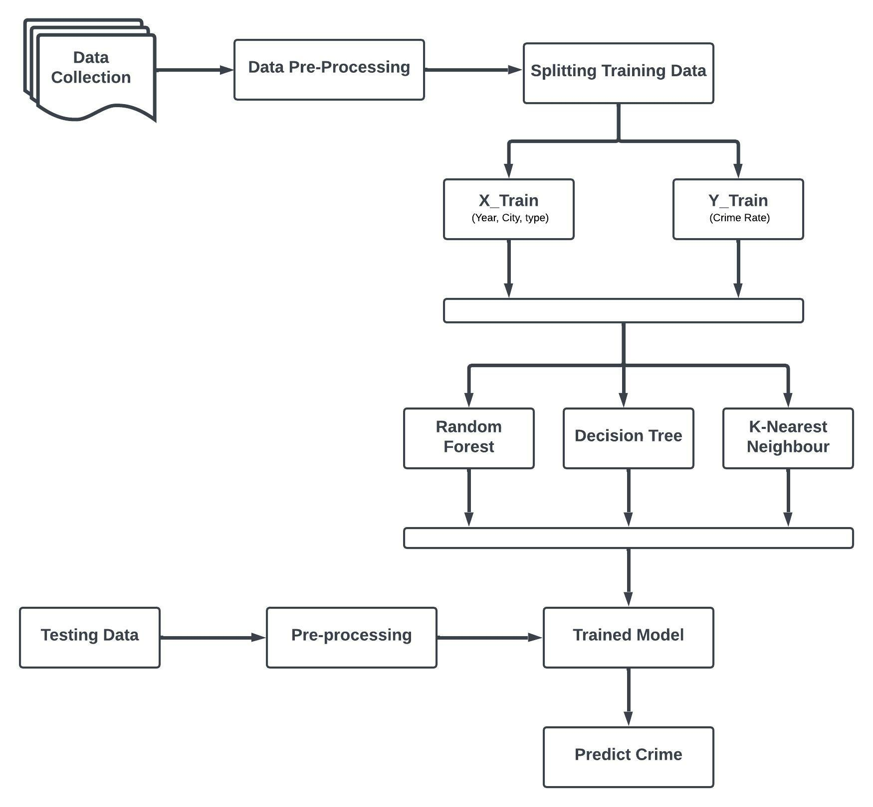
SYSTEM ARCHITECTURE

Slide 7
RESULTS & DISCUSSION
The Random Forest Regression model demonstrates the best accuracy in predicting test data among the five selected models.
The model predicts the crime rate with an accuracy of 93.20% on the testing data.
The accuracy results obtained after testing are listed below:
Algorithm | Mean Absolute Error | Mean Squared Error | R2 Score
Support Vector Machine | 10.3204 | 371.7907 | 0.17886
K-Nearest Neighbor | 6.58181 | 140.8179 | 0.55349
Neural Networks MLPRegressor | 12.4248 | 307.5506 | 0.24823
Decision Tree Regressor | 2.89024 | 34.95932 | 0.88915
Random Forest Regressor | 2.49143 | 21.43956 | 0.93201

Slide 8
CONCLUSION
Crime rate prediction has become an important tool for law enforcement agencies to help them focus their resources in high-crime areas.
By focusing their resources in the right areas, police officers can help reduce the overall crime rate in a community.
As a result of machine learning technology, finding relationships and patterns between various data has become easier.
The model prediction of crime rate and data visualization helps in analysis of data set and prediction of crimes.
The model helped in understanding different crime datasets that can be used in implementing the factors that can help in keeping society safe.

Slide 9

THANK YOU

