Slide 1

Real Estate Property Analytics and Price Prediction System
A Machine Learning & Data Analytics-Based Project
Presenter: Abhay Singh
Enrollment ID: 08117702023
Guide: MS. Shalini Bhartiya

Slide 2

Why Real Estate Analytics Matters
The Challenge
Our Solution
The real estate market faces significant challenges: property buyers struggle with price uncertainty, lack access to transparent insights, and rely on intuition rather than data-driven decisions. Without analytical tools, buyers make costly mistakes and sellers miss opportunities.
This project integrates data scraping, machine learning, interactive visualization, and intelligent recommendations into one unified platform. We predict prices accurately, reveal market patterns, and suggest ideal properties tailored to each buyer's unique preferences.

Slide 3




Project Objectives
Predict Prices
Visualize Trends
Build accurate machine learning models to forecast property prices based on key features and market conditions.
Create interactive dashboards revealing market insights, price distributions, and geographic patterns across regions.
Recommend Properties
User-Friendly Dashboard
Deliver personalized property suggestions matching buyer preferences using advanced similarity scoring algorithms.
Develop an intuitive Streamlit interface enabling buyers and agents to access predictions and insights instantly.

Slide 4

The Problem We're Solving
Price Uncertainty
Property values fluctuate based on complex market factors that buyers cannot easily assess or predict independently.
Lack of Transparency
Buyers lack access to clear, data-backed insights about fair pricing, neighborhood trends, and property value drivers.
No Personalization
Current systems offer generic listings without intelligent recommendations tailored to individual buyer requirements and preferences.
Manual Decision-Making
Real estate decisions rely on intuition and agent advice rather than quantitative analysis and predictive intelligence.

Slide 5






Our Integrated Solution
A unified platform combining data collection, machine learning, advanced analytics, and intelligent recommendations into one seamless ecosystem.
Data Processing
Recommendations
Data Input
ML Models
Analytics
Each module works together to transform raw real estate data into actionable insights and personalized recommendations for users.

Slide 6
Complete System Architecture
01
02
03
Data Scraper
Data Cleaner
Exploratory Analysis
Collects property listings, prices, and features from online real estate platforms automatically.
Removes duplicates, handles missing values, and standardizes data formats for consistency.
Analyzes distributions, correlations, and patterns to understand data characteristics deeply.
04
05
06
Feature Engineering
Model Training
Optimization
Creates meaningful features and transforms raw variables into predictive inputs for models.
Trains multiple regression models using processed features on historical price data.
Tunes hyperparameters to maximize model accuracy and generalization performance.
07
Streamlit & AWS Deployment
Deploys the complete system as an interactive web application for end-user access.

Slide 7
Three Core Modules
Module
Core Functionality
Price Prediction
Employs advanced machine learning regression models (Linear Regression, Random Forest, XGBoost) to forecast property prices based on features like location, size, amenities, and market conditions. Delivers accurate price estimates for user-specified property characteristics.
Analytics & Visualization
Provides interactive dashboards displaying market trends, price distributions, geographic heatmaps, and comparative insights. Users filter data by city, furnishing type, bedrooms, and other criteria using Plotly, Matplotlib, and Seaborn visualizations.
Recommendation System
Uses cosine similarity and adjustable weighted algorithms to match properties with buyer preferences. Suggests best-fit apartments based on pricing, location proximity, amenities, and includes a "Find Nearby Apartments" feature for location-based discovery.

Slide 8
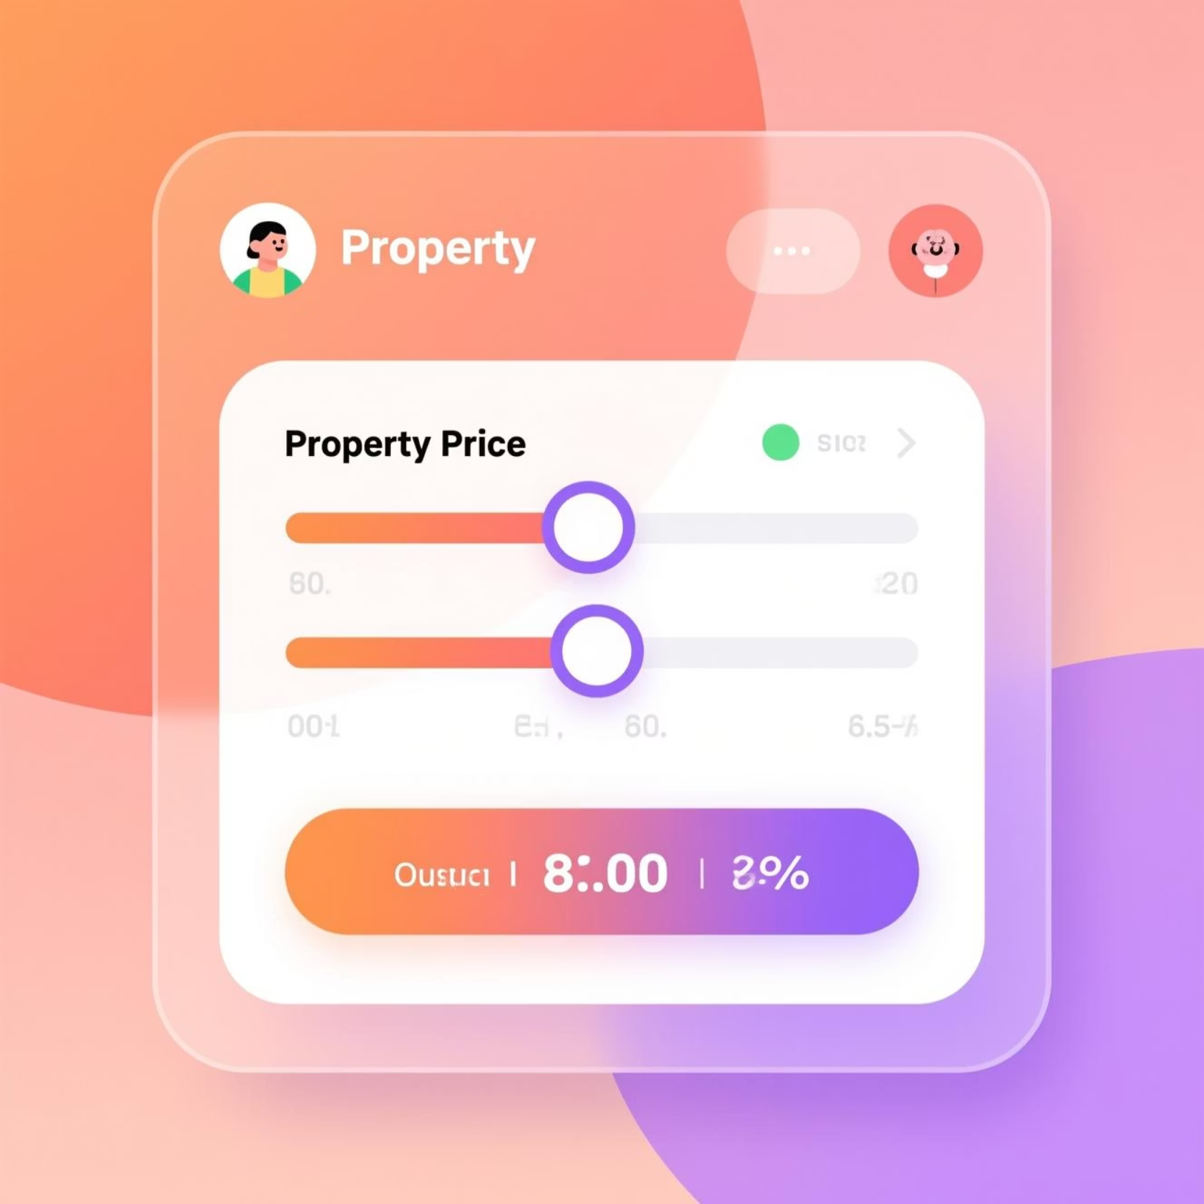
Module 1: Property Price Prediction
Machine Learning Models
Linear Regression: Establishes baseline relationships between features and prices.
Random Forest: Captures non-linear patterns and feature interactions effectively.
XGBoost: Delivers superior predictive accuracy through gradient boosting optimization.
Performance Metrics
R² Score: Measures explained variance in predictions.
RMSE: Quantifies average prediction error in currency units.

Slide 9

Module 2: Analytics & Visualization
Interactive Visualization Capabilities: The analytics module presents comprehensive market insights through dynamic charts and graphs. Users explore price distributions across properties, analyze geographic patterns through location-based visualizations, and track market trends over time.
Smart Filtering
Advanced Visualizations
Market Intelligence
Filter properties by city, furnishing type, bedroom count, price range, and amenities to isolate relevant market segments.
Leverages Plotly for interactive charts, Matplotlib for statistical plots, and Seaborn for correlation heatmaps.
Reveals price drivers, neighborhood comparisons, and emerging trends to inform strategic property decisions.

Slide 10


Module 3: Property Recommendation Engine
An intelligent recommendation system leveraging cosine similarity and weighted scoring algorithms to match buyers with ideal properties.
Cosine Similarity Algorithm
Adjustable Weight Scoring
Compares user preferences against property features, quantifying similarity to identify best matches.
Allows customization of importance levels for pricing, location proximity, facilities, and other criteria.
Geographic Proximity Search
Personalized Suggestions
The "Find Nearby Apartments" feature discovers properties within specified distance radius from desired locations.
Delivers ranked property recommendations ranked by match score, presenting the most suitable options first.

Slide 11
Technology Stack
Category
Tools Used
Language
Python
Framework
Streamlit, Beautiful Soup, TF-IDF, NLTK
Libraries
Pandas, NumPy, Scikit-learn, XGBoost, Plotly, Seaborn, Matplotlib
Optimization
Optuna, Pandas-Profiling, SHAP, Statsmodel
Deployment
Streamlit Cloud , Amazon Web services(EC2, S3)

Slide 12
Conclusion & Future Scope
Project Achievements
Provided user-friendly dashboard for decision-making
Project achieved accurate price prediction and useful analytics
Demonstrated strong ML integration in real estate domain
Future Scope
Add real-time API-based data updates
Implement deep learning models for prediction
Enable geo-spatial visualization using maps
Build mobile application support

