Slide 1
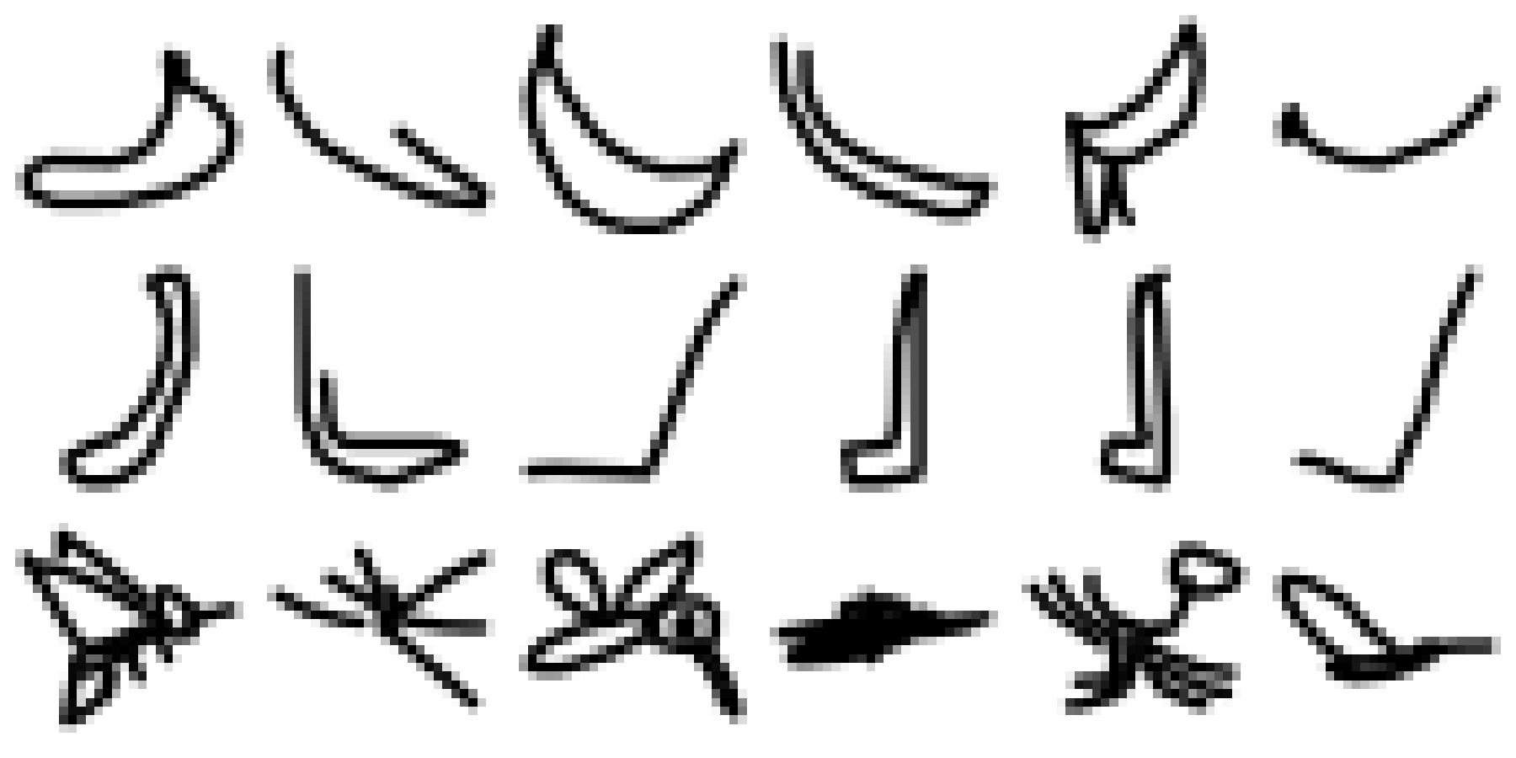
UE24CS352A · MACHINE LEARNING · MINI-PROJECT
Recognising Doodles: Banana, Hockey Stick or Mosquito?
Logistic Regression vs. SVM kernels vs. a CNN on Google Quick, Draw! sketches
banana · hockey stick · mosquito
[A-18] · [Abhay TS, PES1UG24AM008] · [Avyukt Ranjan, PES1UG24AM060]
Notes:
Introduce the team and the one-line problem: classify 28x28 hand-drawn sketches into three classes and compare classical ML against a CNN.

Slide 2
The problem: name the doodle from 784 pixels
Goal
Classify a 28 × 28 grayscale sketch as banana, hockey stick or mosquito, and compare classical ML with deep learning.
Why it is hard
Sketches are noisy, drawn at different scales and angles. A banana and a hockey stick are both elongated curves, so they are easy to confuse.
What we compare
Logistic regression, four SVM kernels (linear, RBF, polynomial, sigmoid) and a two-block CNN.
3
classes
60,000
images used
28×28
pixels each
Notes:
Problem statement. Replace/confirm wording against the numbered problem statement on the master list.

Slide 3
Dataset: 20,000 Quick, Draw! sketches per class
Three .npy arrays, uint8 28×28 grayscale; pixels not binarised
Available: 307,936 banana, 130,110 hockey stick, 123,029 mosquito
Used: first 20,000 of each, giving a perfectly balanced 60,000
Stratified split, seed 42: 48,000 train / 6,000 validation / 6,000 test
Rows: banana, hockey stick, mosquito (6 random drawings each)
Notes:
Balanced classes mean accuracy is a fair headline metric. We also report macro precision, recall and F1.

Slide 4
Approach: one shared pipeline for every model
1
2
3
4
5
Load
Balance
Split
Scale
Train & test
3 .npy files, check shape (N, 28, 28)
Take 20,000 drawings per class
80/10/10 stratified, seed 42
[0,1] for LR and CNN; [-1,1] for SVM
Fit on train, score on held-out test
The test partition is untouched until the final evaluation, and pixel scaling is fixed (not learned), so nothing leaks from test data.
Notes:
Stress that all six models share exactly the same split so scores are directly comparable.

Slide 5
Classical models: logistic regression and SVMs
Logistic Regression
SVM Linear
SVM RBF
Multinomial, lbfgs, 100 iterations, inputs in [0,1]
kernel = linear, 500 iteration cap
kernel = rbf, gamma = 1.0, 500 iteration cap
SVM Polynomial
SVM Sigmoid
All SVMs use inputs scaled to [-1, 1]. No hyperparameter tuning was done.
degree 5, coef0 = 1.0, 500 iteration cap
coef0 = 1.0, 500 iteration cap
Notes:
SVMs hit the 500-iteration cap in every case, so their ranking reflects this capped, untuned setup.

Slide 6
The CNN: two convolution blocks and a classifier
Input
Conv 3×3 + ReLU
MaxPool 2
Conv 3×3 + ReLU
MaxPool 2
Flatten + FC 128
FC output
›
›
›
›
›
›
1×28×28
32 maps
14×14
64 maps
7×7
3,136 → 128
3 classes
Adam
Batch size 64
20 epochs
learning rate 0.001
shuffled each epoch
cross-entropy loss
Notes:
Training loss fell from 0.3047 (epoch 1) to 0.0100 (epoch 20). No validation curves were tracked, so overfitting was not measured directly.

Slide 7
Results: the CNN is clearly the most accurate
95.0%
CNN accuracy and macro-F1 0.950
+11.7 points over logistic regression
RBF is the best SVM at 80.2%
Linear and sigmoid SVMs stay below 46%
Notes:
Accuracy ranking: CNN 0.9500, LR 0.8335, SVM RBF 0.8023, Poly 0.6793, Sigmoid 0.4573, Linear 0.4308. Macro-F1 ranking differs only at the bottom (linear 0.4352 vs sigmoid 0.3908).

Slide 8
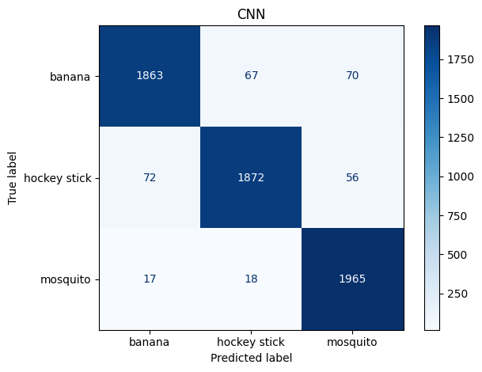
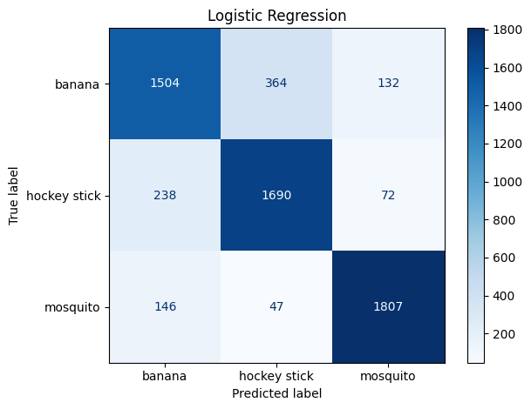
Most errors: banana vs hockey stick
CNN: banana ↔ hockey stick confused 67 and 72 times; mosquito 1,965 / 2,000 correct
Logistic regression: the same pair confused 364 and 238 times; mosquito 1,807 / 2,000 correct
Notes:
Rows are true classes, columns are predicted classes. Mosquito is the most distinctive shape; the CNN roughly cuts the banana/hockey-stick confusion by 5x vs logistic regression.

Slide 9
Accuracy costs time: CNN took ~11 min to train
Model | Accuracy (%) | Macro-F1 | Train (s) | Test inference (s)
CNN | 95.00 | 0.950 | 679.5 | 4.48
Logistic Regression | 83.35 | 0.833 | 14.8 | 0.03
SVM RBF | 80.23 | 0.803 | 43.2 | 3.76
SVM Polynomial | 67.93 | 0.688 | 39.2 | 4.94
SVM Sigmoid | 45.73 | 0.391 | 44.2 | 2.94
SVM Linear | 43.08 | 0.435 | 37.9 | 3.28
Logistic regression is the pragmatic baseline: 83% accuracy in 15 seconds with near-instant inference. The CNN is the best model when accuracy matters. Timings are CPU-only and machine dependent.
Notes:
Inference time is for the full 6,000-image test set. CNN training: 20 epochs, 679.45 s.

Slide 10
Conclusions and limitations
What we found
Caveats and next steps
CNN wins on every metric (95.0% accuracy)
Spatial features beat raw-pixel models on sketches
RBF is the only SVM kernel competitive with logistic regression
Banana vs hockey stick is the hardest pair
SVMs hit the 500-iteration cap and were untuned
No validation curves, so overfitting is unmeasured
Transfer learning not run: pretrained weights are outside the three allowed inputs
Next: tune SVMs, add augmentation and early stopping
Notes:
Be upfront about limitations; the panel usually asks about the SVM iteration cap and the missing validation tracking.

Slide 11
Thank you
GitHub: https://github.com/AbhayTS1011/ML-MINI-PROJECT

