Slide 1
Chapter 1: Introduction

Slide 2
Chapter 1: Introduction
What Operating Systems Do
Operating-System Structure
Operating-System Operations

Slide 3
What is an Operating System?
A program that acts as an intermediary between a user of a computer and the computer hardware
Operating system goals:
Execute user programs and make solving user problems easier
Make the computer system convenient to use
Use the computer hardware in an efficient manner

Slide 4
Computer System Structure
Computer system can be divided into four components:
Hardware – provides basic computing resources
CPU, memory, I/O devices
Operating system
Controls and coordinates use of hardware among various applications and users
Application programs – define the ways in which the system resources are used to solve the computing problems of the users
Word processors, compilers, web browsers, database systems, video games
Users
People, machines, other computers

Slide 5
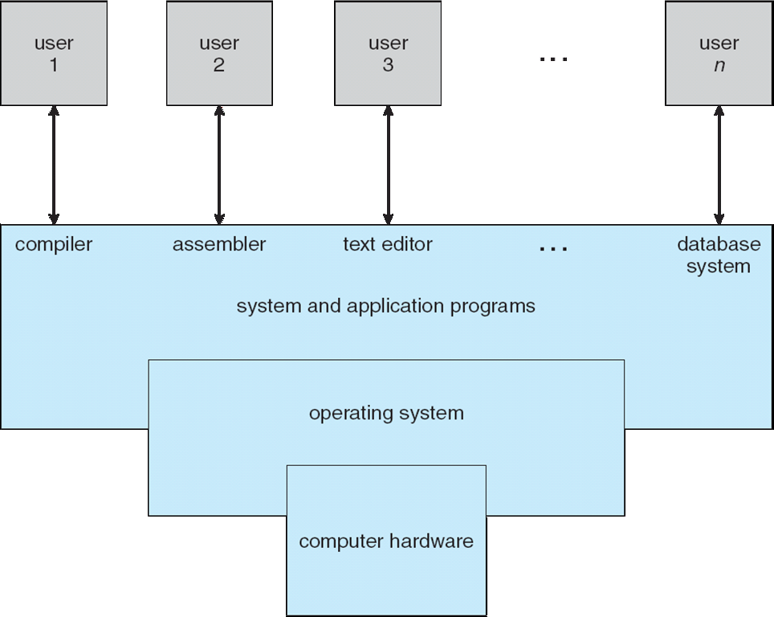
Four Components of a Computer System

Slide 6
What Operating Systems Do
Depends on the point of view
Users want convenience, ease of use and good performance
Don’t care about resource utilization
But shared computer such as mainframe or minicomputer must keep all users happy
Users of dedicate systems such as workstations have dedicated resources but frequently use shared resources from servers
Handheld computers are resource poor, optimized for usability and battery life
Some computers have little or no user interface, such as embedded computers in devices and automobiles

Slide 7
Operating System Definition
OS is a resource allocator
Manages all resources
Decides between conflicting requests for efficient and fair resource use
OS is a control program
Controls execution of programs to prevent errors and improper use of the computer

Slide 8
Operating System Definition (Cont.)
No universally accepted definition
“Everything a vendor ships when you order an operating system” is a good approximation
But varies wildly
“The one program running at all times on the computer” is the kernel.
Everything else is either
a system program (ships with the operating system) , or
an application program.

Slide 9
Operating System Structure
Multiprogramming (Batch system) needed for efficiency
Single user cannot keep CPU and I/O devices busy at all times
Multiprogramming organizes jobs (code and data) so CPU always has one to execute
A subset of total jobs in system is kept in memory
One job selected and run via job scheduling
When it has to wait (for I/O for example), OS switches to another job
Timesharing (multitasking) is logical extension in which CPU switches jobs so frequently that users can interact with each job while it is running, creating interactive computing
Response time should be < 1 second
Each user has at least one program executing in memory process
If several jobs ready to run at the same time  CPU scheduling
If processes don’t fit in memory, swapping moves them in and out to run
Virtual memory allows execution of processes not completely in memory

Slide 10
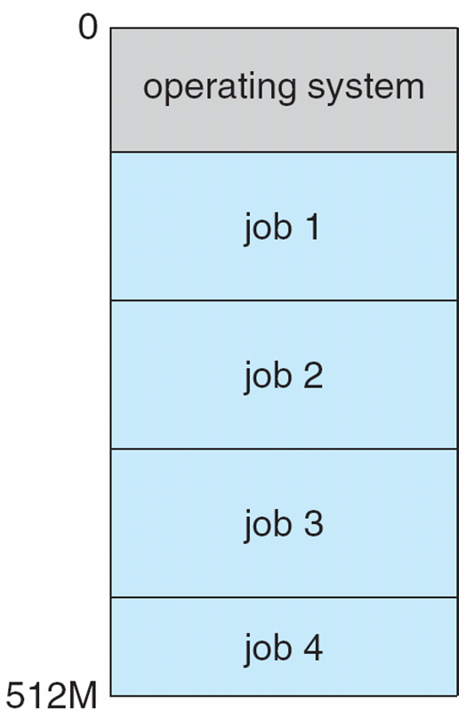
Memory Layout for Multiprogrammed System

Slide 11
Operating-System Operations
Interrupt driven (hardware and software)
Hardware interrupt by one of the devices
Software interrupt (exception or trap):
Software error (e.g., division by zero)
Request for operating system service
Other process problems include infinite loop, processes modifying each other or the operating system

Slide 12
Operating-System Operations (cont.)
Dual-mode operation allows OS to protect itself and other system components
User mode and kernel mode
Mode bit provided by hardware
Provides ability to distinguish when system is running user code or kernel code
Some instructions designated as privileged, only executable in kernel mode
System call changes mode to kernel, return from call resets it to user
Increasingly CPUs support multi-mode operations
i.e. virtual machine manager (VMM) mode for guest VMs

Slide 13
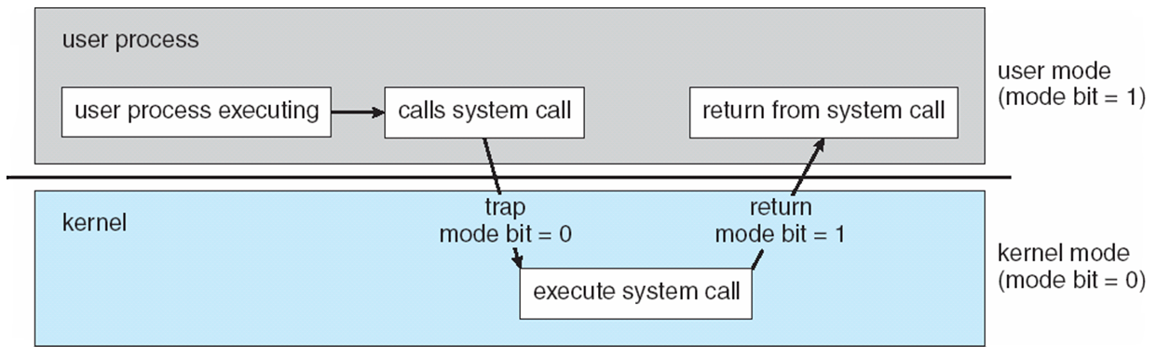
Transition from User to Kernel Mode
Timer to prevent infinite loop / process hogging resources
Timer is set to interrupt the computer after some time period
Keep a counter that is decremented by the physical clock.
Operating system set the counter (privileged instruction)
When counter zero generate an interrupt
Set up before scheduling process to regain control or terminate program that exceeds allotted time

