Slide 1


SMART INDIA HACKATHON 2026
Adaptive Foveated 2.5D Semantic Mapping for
Autonomous Navigation
• Problem Statement ID – 26053
• Problem Statement Title – Adaptive Foveated 2.5D Semantic Mapping from LiDAR Point Clouds for Autonomous Navigation
• Theme – Smart Vehicles
• PS Category – Software
• Team ID – 137735
• Team Name – TeraPulse
• Team Members – Abhay Verma (Team Leader), Lokendra Singh,
Yashvardhan Jain, Chetan Meena, Sachin Chaubey, Esha Verma
• Institute – Indian Institute of Information Technology Bhopal

Slide 2
TERA
PULSE
Adaptive Foveated 2.5D Semantic Mapping
for Autonomous Navigation
❖ Proposed Solution
Foveated 2.5D Semantic Elevation Map
• 2.5D Semantic Elevation Map: Generated directly from raw LiDAR point clouds.
• High-Precision Near Field: Fine resolution (0.25 m) near vehicle for critical steering.
• Bandwidth-Saving Far Field: Lower resolution (0.75 m & 2.0 m) for distant regions — cuts unnecessary compute.
• Elevation & Slope Awareness: Preserves terrain slopes, curbs & ditches without full 3D voxels.
• Real-Time Terrain Intelligence: Identifies drivable ground, static obstacles & dynamic objects.
• Autonomous Navigation Ready: Enables instant A* path planning & Pure Pursuit motion control.
❖ Innovation & Uniqueness
Foveated adaptive resolution focuses computational resources where they matter most, instead of processing the entire environment at the same resolution.
• Measurable Impact: Slashes cell memory by 66.2% and cuts processing latency to 24.23 ms (>35 FPS).
High resolution near the vehicle (near-field: 0.25 m bubble)
Lower resolution for distant regions (far-field: 0.75m & 2.0m)
@SIH Idea submission- Template
2

Slide 3
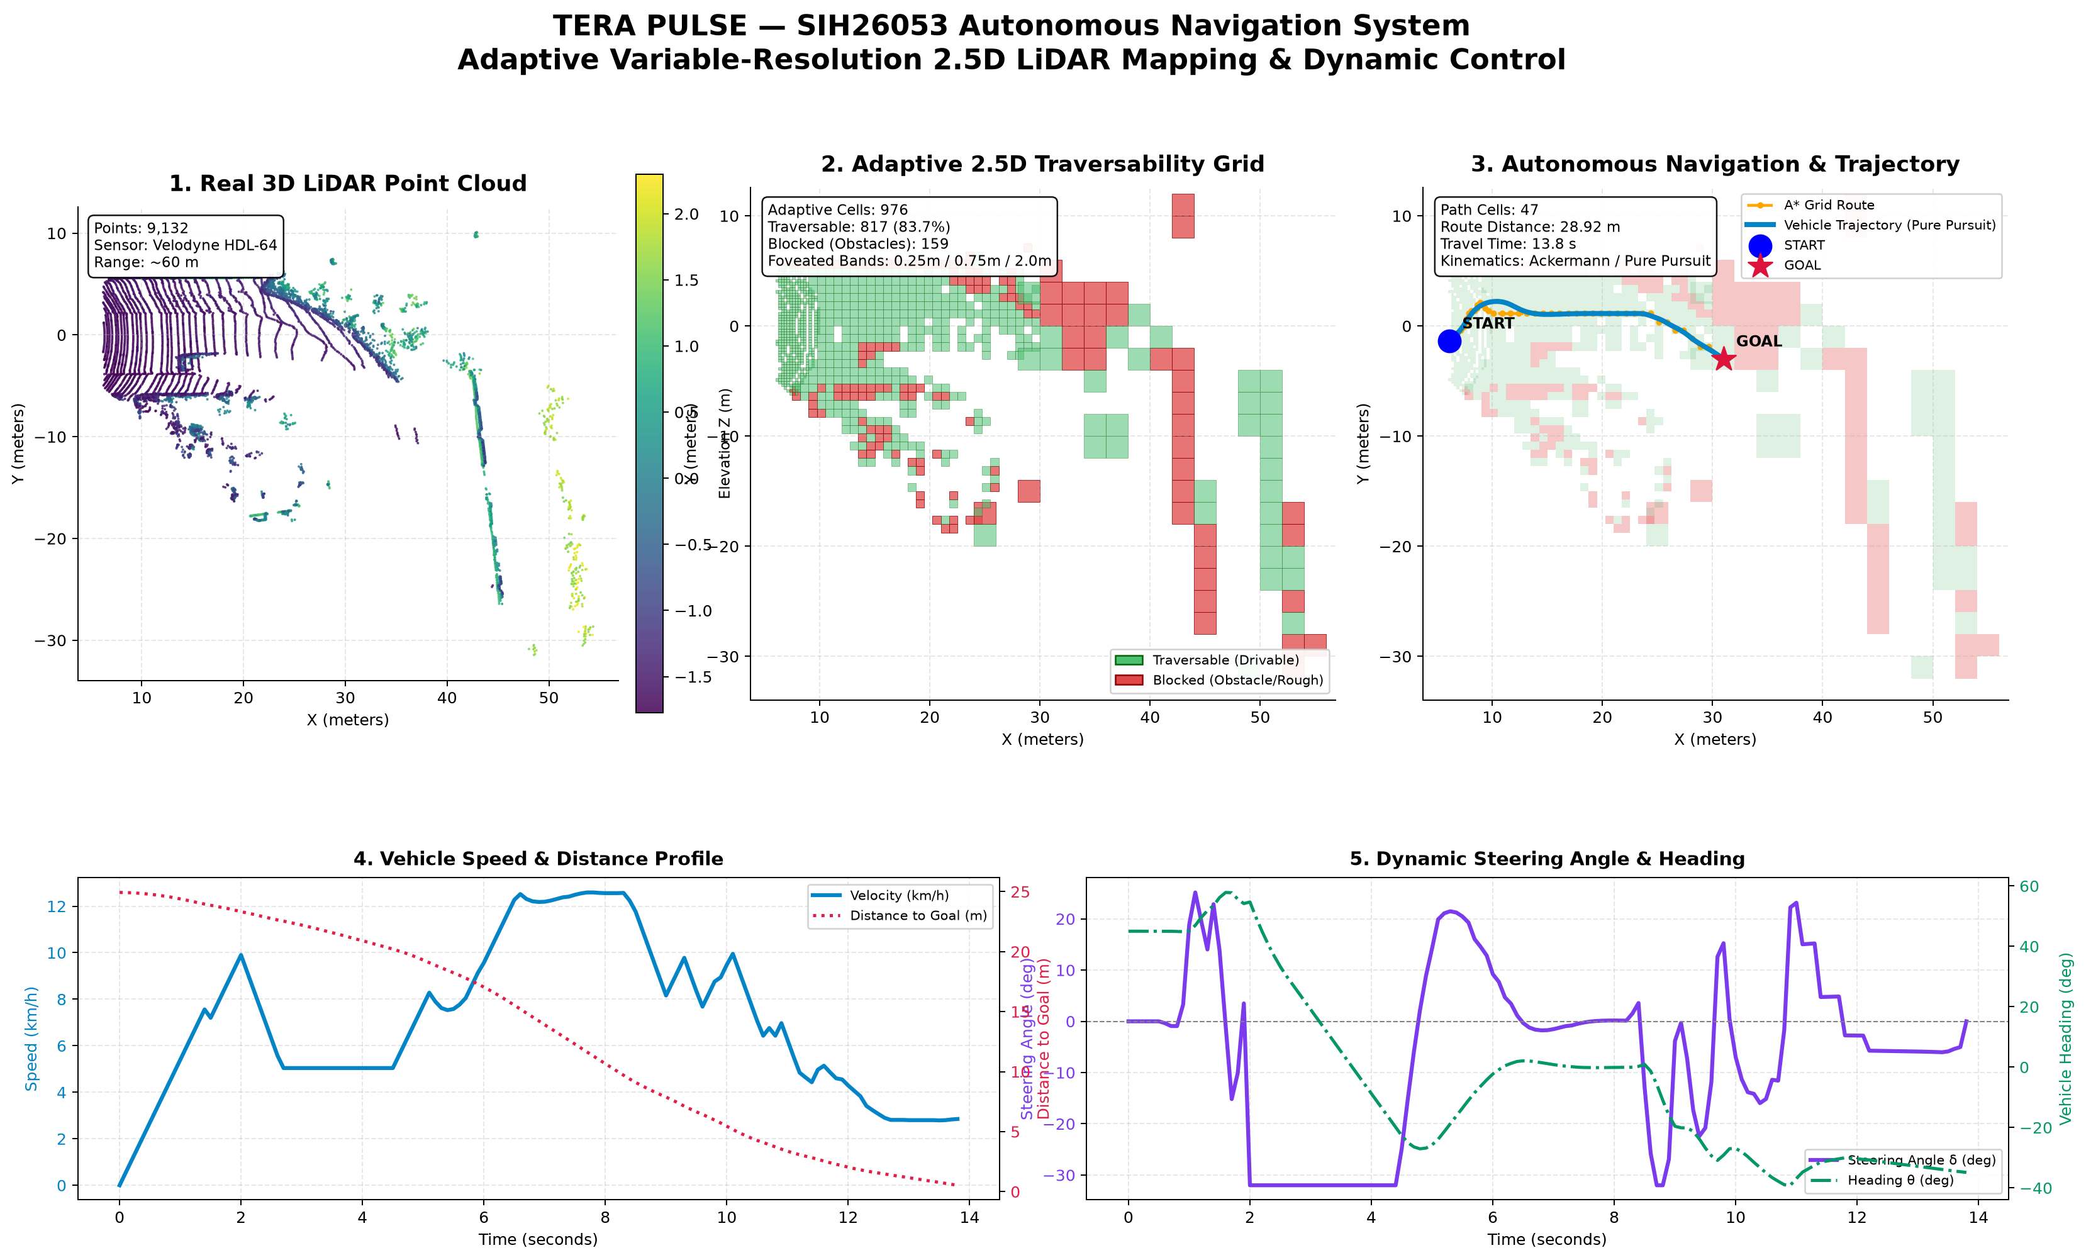
TERA
PULSE
TECHNICAL APPROACH
System Workflow
Technologies & Implementation
LiDAR Point Cloud
• Python, Open3D & NumPy: Point cloud preprocessing, voxelization & spatial hashing.
• Deep Learning: Semantic terrain classification (Ground, Static Obstacles, Dynamic Vehicles).
• A* Search & Pure Pursuit: Collision-free path planning & smooth 10 Hz vehicle steering kinematics.
• Interactive Web Dashboard: Flask REST API, 60 FPS HTML5 Canvas with moving foveation bubble.
Preprocessing & Noise Removal
Semantic Understanding
Foveated Adaptive Grid Generation
2.5D Semantic Elevation Map
Real-Time Visualization & Navigation
@SIH Idea submission- Template
3

Slide 4
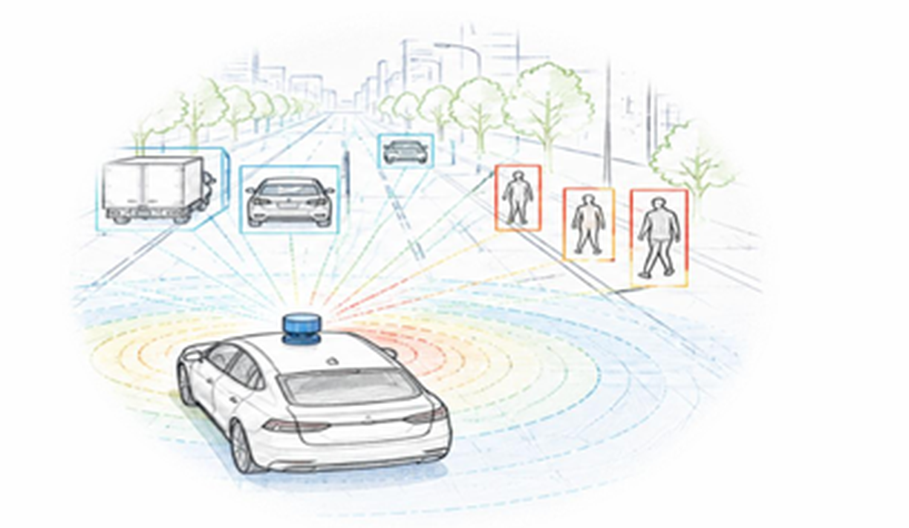
TERA
PULSE
FEASIBILITY AND VIABILITY
Feasibility
Mitigation Strategy
• Standard Datasets: Uses widely available LiDAR point cloud datasets & open-source tools.
• Rapid Development: Python, Open3D, and PyTorch enable agile modular prototyping.
• Low-Power Efficiency: Adaptive resolution drastically reduces memory & compute requirements.
• Modular Pipeline: Components tested independently with 5/5 automated unit tests passing.
• Foveated Attention: Variable-resolution mapping concentrates compute in near-field (24.23 ms).
• SOR & RANSAC Fit: Statistical Outlier Removal & ground fit eliminate dust & sensor reflections.
• Vertical Clearance: Clearance filter ignores points >2.2 m, enabling safe tunnel traversal.
• Proven Benchmark: Benchmarked on 20,672 points at >35 FPS with zero crash failures.
Challenges
• Heavy Data Stream: Real-time processing of large LiDAR point clouds at 10–20 Hz.
• Off-Road Accuracy: Accurate semantic classification in unstructured off-road scenes.
• Underpasses & Tunnels: Avoiding false-positive obstacle detection for bridge ceilings.
• Detail Retention: Maintaining critical safety clearance while reducing distant resolution.
@SIH Idea submission- Template
4

Slide 5
TERA
PULSE
IMPACT AND BENEFITS
Impact
Benefits
• Tactical UGV Navigation: Supports safer and faster autonomous military navigation.
• Critical Near-Field Safety: Sub-meter precision in safety-critical perimeter around vehicle.
• Zero-Visibility Ops: Active LiDAR penetrates smoke, dust, fog & battlefield darkness.
• Terrain Intelligence: Real-time elevation slope, ditches & surface roughness understanding.
• 66.2% Memory Reduction: Stored active cells drop from 2,888 to 976 via foveated concentration.
• 4.8× Faster Latency: Down from 115.94 ms to 24.23 ms — exceeds 35 FPS real-time vehicle requirement.
• Full 2.5D Elevation Profile: Preserves critical ground slope, curbs & height without voxel clutter.
• Verified Path Traversability: 817 safe corridor cells verified with smooth 10 Hz Pure Pursuit steering.
Applications
Evaluation Metric | Uniform Grid | TeraPulse Foveated | Practical Advantage
Active Stored Cells | 2,888 cells | 976 cells | 66.2% RAM Saved
Compute Latency | 115.94 ms (8.6 FPS) | 24.23 ms (>35 FPS) | 4.8× Faster Control
Hardware Footprint | High-End Desktop GPU | Embedded CPU / Jetson | Low Power UGV Edge
Path Generation | Delayed Waypoints | 10 Hz Dynamic Telemetry | Safe Agile Steering
• Defence & Tactical UGVs: Logistics convoys, perimeter patrols, scout rovers & minefield recon.
• Off-Road Autonomous Rovers: Search-and-rescue rovers in disaster zones, agricultural robotics.
• Driver Assistance (ADAS): Intelligent terrain HUD and active collision prevention in dense fog.
@SIH Idea submission- Template
5

Slide 6
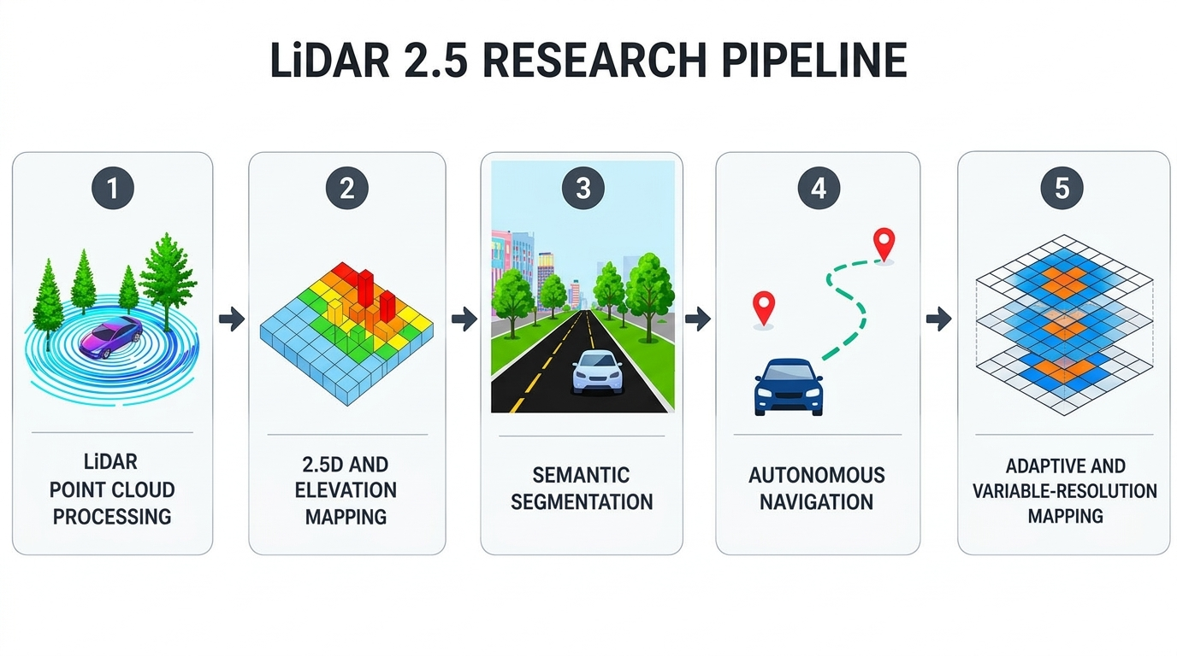
TERA
PULSE
RESEARCH AND REFERENCES
Research Areas
• LiDAR Point Cloud Processing: Statistical outlier removal & RANSAC ground plane fit.
• 2.5D Elevation Mapping: Robot-centric height & slope mapping for rough terrain.
• Semantic Segmentation: Deep learning segmentation of drivable vs obstacle cells.
• Autonomous Navigation: A* heuristic planning & Pure Pursuit vehicle kinematics.
• Adaptive Spatial Hashing: Foveated variable-resolution concentric indexing.
References
• KITTI Vision Suite: Geiger et al., Velodyne HDL-64E LiDAR benchmark.
• ETH Zurich Mapping: P. Fankhauser et al. (IEEE IROS), Robot-Centric Elevation Mapping.
• CMU Pure Pursuit: R. C. Coulter (Carnegie Mellon), Pure Pursuit Path Tracking.
• Point Cloud ML: Q. Hu et al. (CVPR), RandLA-Net Point Cloud Segmentation.
• Open-Source Tools: Open3D, PyTorch, NumPy, Flask REST APIs.
Project Deliverables & Repository
• Interactive Web Simulator: Flask REST API + 60 FPS HTML5 Canvas with live vehicle foveation.
• Automated Test Suite: 5/5 unit tests (tests/test_pipeline.py) passing in 4.0s.
• GitHub Repository: github.com/AbhayVerma628/SIH26053_Lidar (Open Source MIT License).
• Telemetry & Artifacts: 5-panel dashboard, 10 Hz vehicle telemetry CSV & planned A* waypoints.
@SIH Idea submission- Template
6

