Slide 1
Sales Dashboard
PivotTable Source & Structure Walkthrough
Project by Abhay Wable

Slide 2
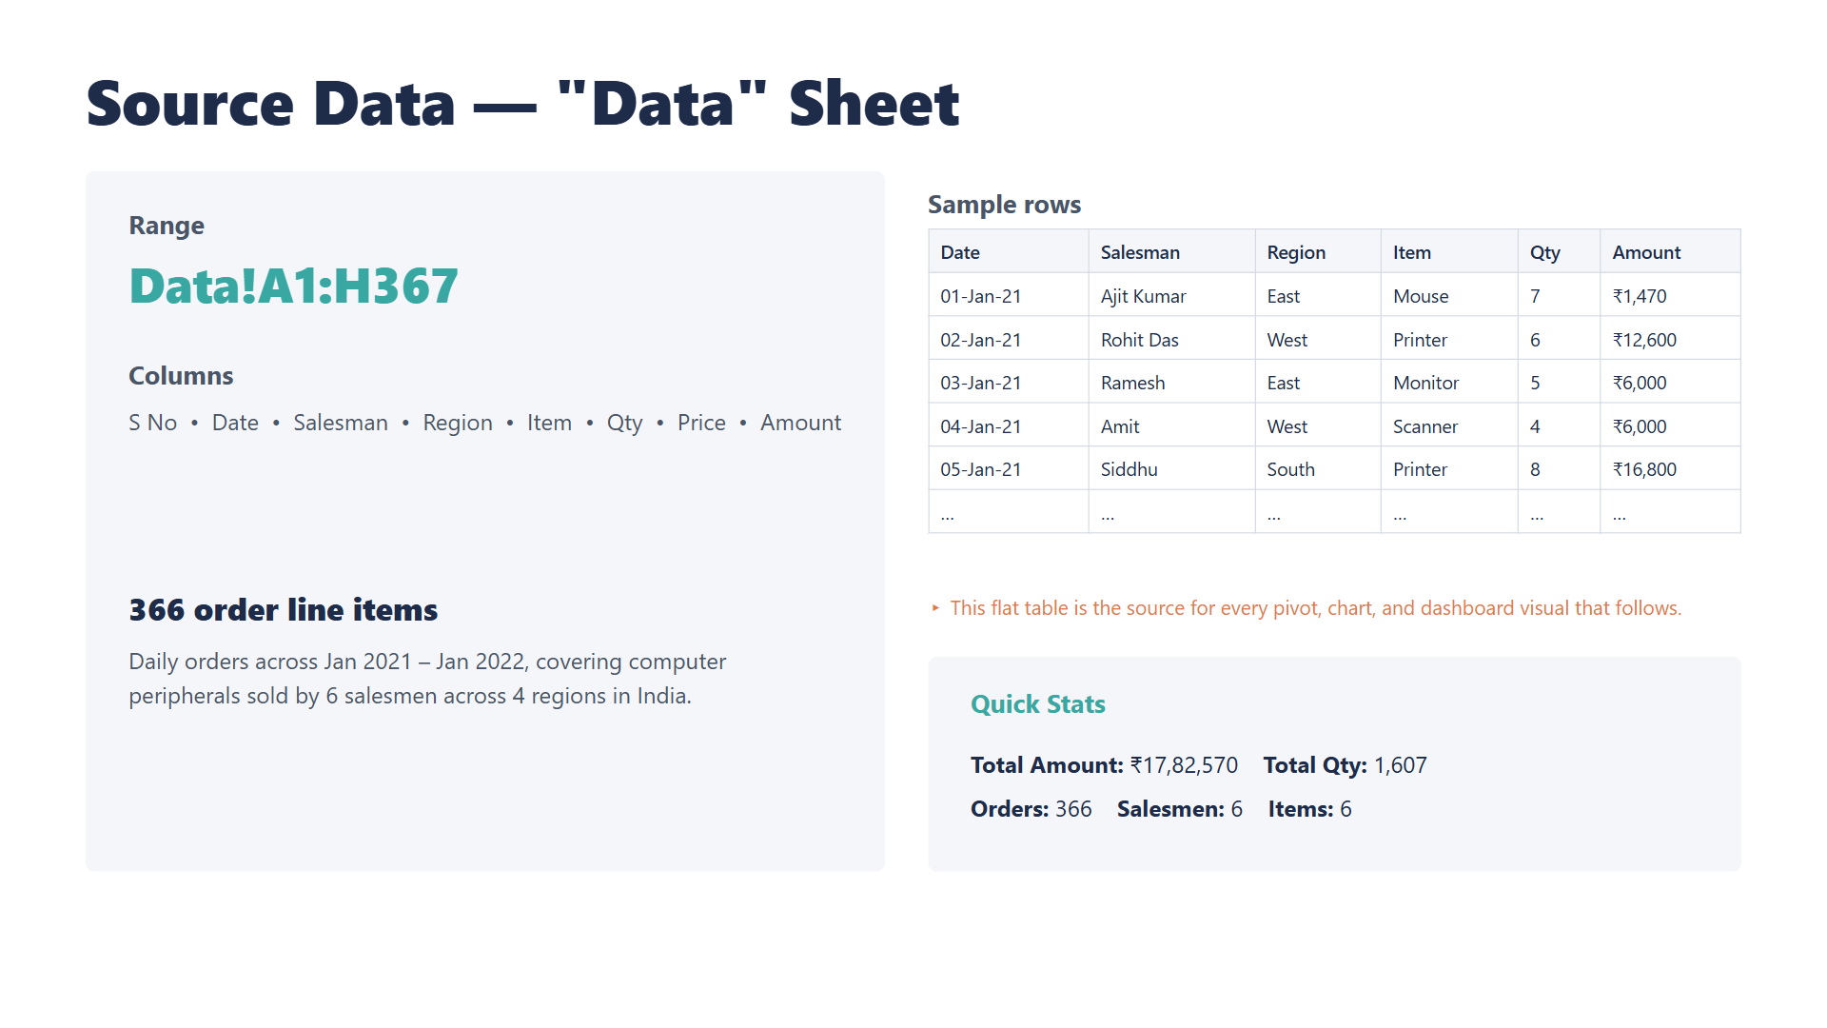

Slide 3
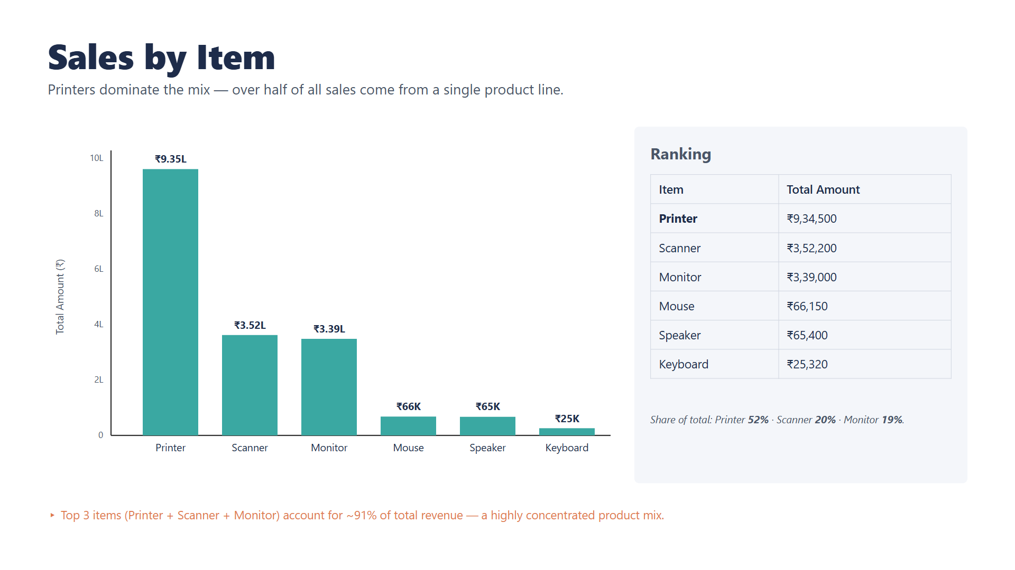

Slide 4
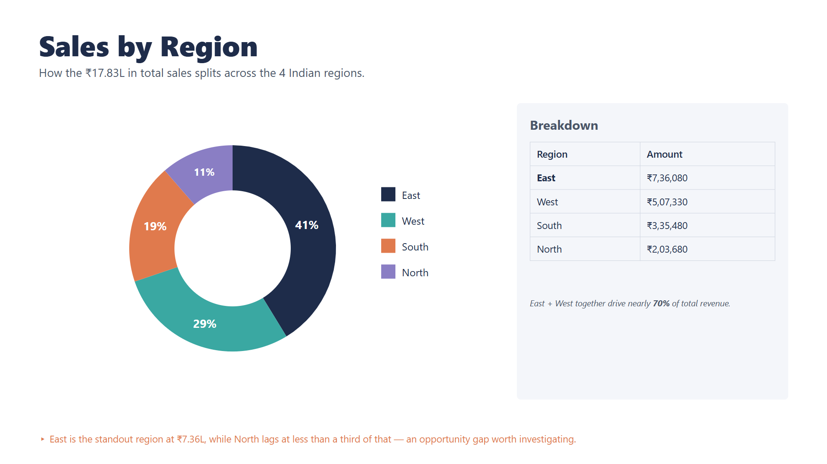

Slide 5
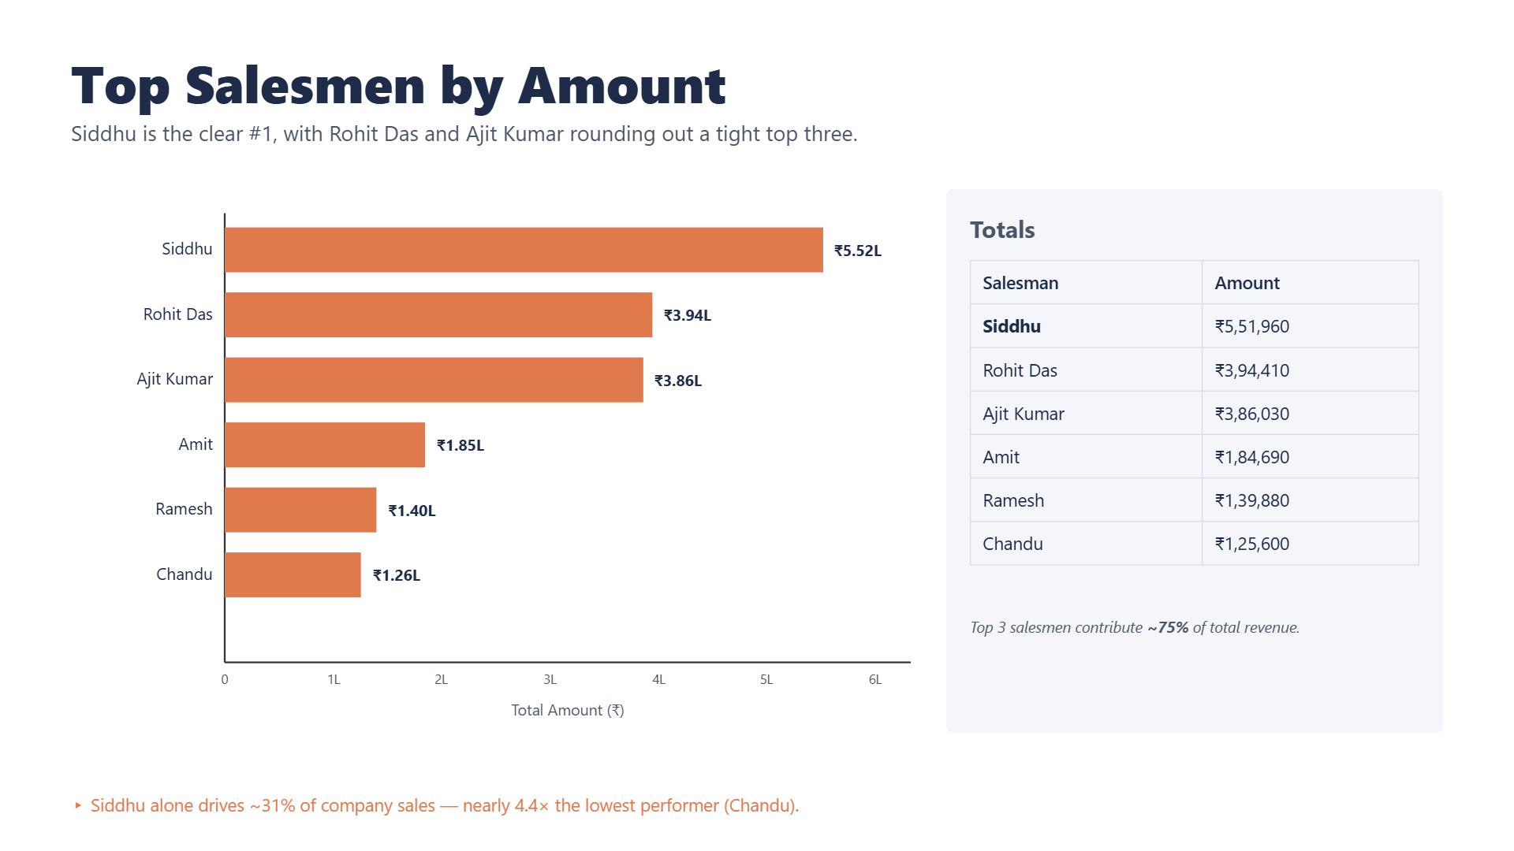

Slide 6
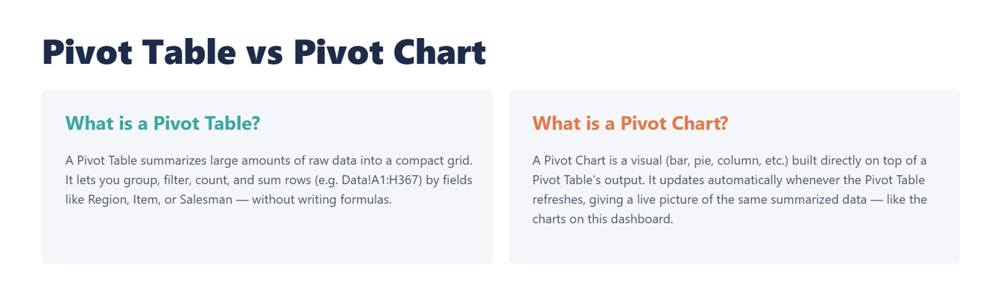
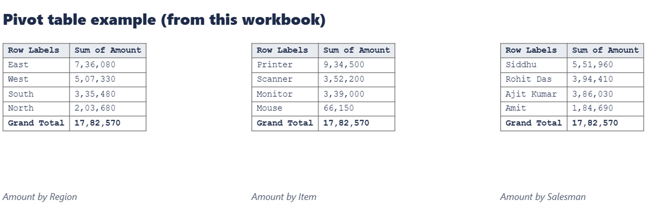
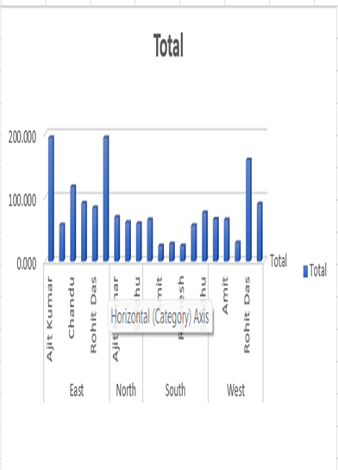

Slide 7
3 Pivot Tables — Combined Source
All three come from the same Data!A1:H367 cache, filtered/grouped differently.
PivotTable3 — by Item
PivotTable2 — by Item
PivotTable4 — by Region
Row Labels | Sum of Amount
Keyboard | 25,320
Monitor | 339,000
Mouse | 66,150
Printer | 934,500
Scanner | 352,200
Speaker | 65,400
Grand Total | 1,782,570
Row Labels | Sum of Amount
Keyboard | 25,320
Monitor | 339,000
Mouse | 66,150
Printer | 934,500
Scanner | 352,200
Speaker | 65,400
Grand Total | 1,782,570
Row Labels | Sum of Qty
East | 737
North | 189
South | 272
West | 409
Grand Total | 1,607
Each region also expands to show
per-salesman Qty (e.g. East: Ajit Kumar
194, Siddhu 194, Chandu 117…)
(Identical figures to PivotTable3 —
same grouping, different location)
▸ Combined: PivotTable2 and PivotTable3 both summarize Amount by Item (identical output, different sheet position); PivotTable4 breaks Qty down by Region and then Salesman. All three read from Data!A1:H367.

Slide 8
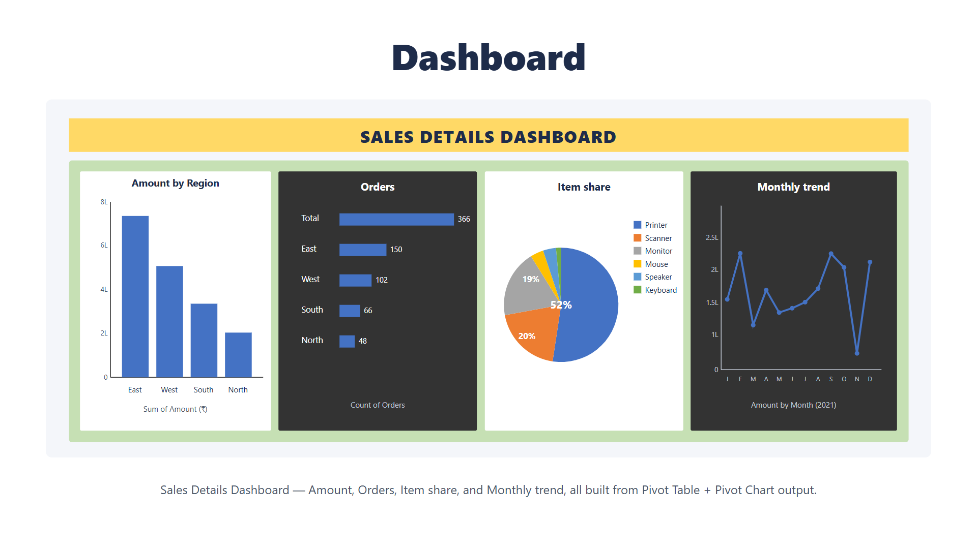

Slide 9
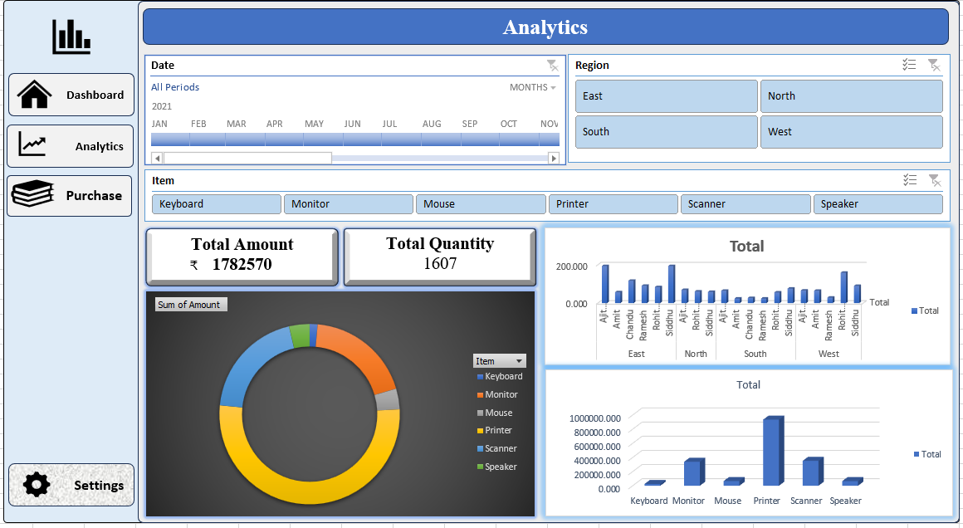
Main Dashboard

Slide 10



