Slide 1

Task Details
PRESENTED BY:
ABHAYA MANI PAUDEL

Slide 2
Overview
Introduction Of Host Company
My Task
What I Learned
Tools Used
Conclusion
Screenshots

Slide 3
Introduction Host Company
Kathmandu Living Labs is a leading civic-tech company. With over 9 years of experience and specialists on board, KLL offers a complete range of data and technology solutions to governments, development partners, businesses and civil society. Located at Chundevi, Kathmandu, KLL has received several national and international awards and have also been featured in world’s leading news outlets. KLL was founded primarily for advancing the Open Mapping Movement.

Slide 4
My Task
As per details, my task was to present schools of Kathmandu in an interactive map and display useful statistics about them.

Slide 5
Tools Used
React and Typescript for frontend
Bootstrap and Material UI for styling
GitHub
Overpass API
Visual Studio Code as Code Editor

Slide 6
Playing with queries on Overpass Turbo
The way leaflet works to display interactive map
Interesting findings

Slide 7
Conclusion
This task was very useful for me to get knowledge on how actually the data are displayed on map layers according to their latitude and longitude positions.

Slide 8
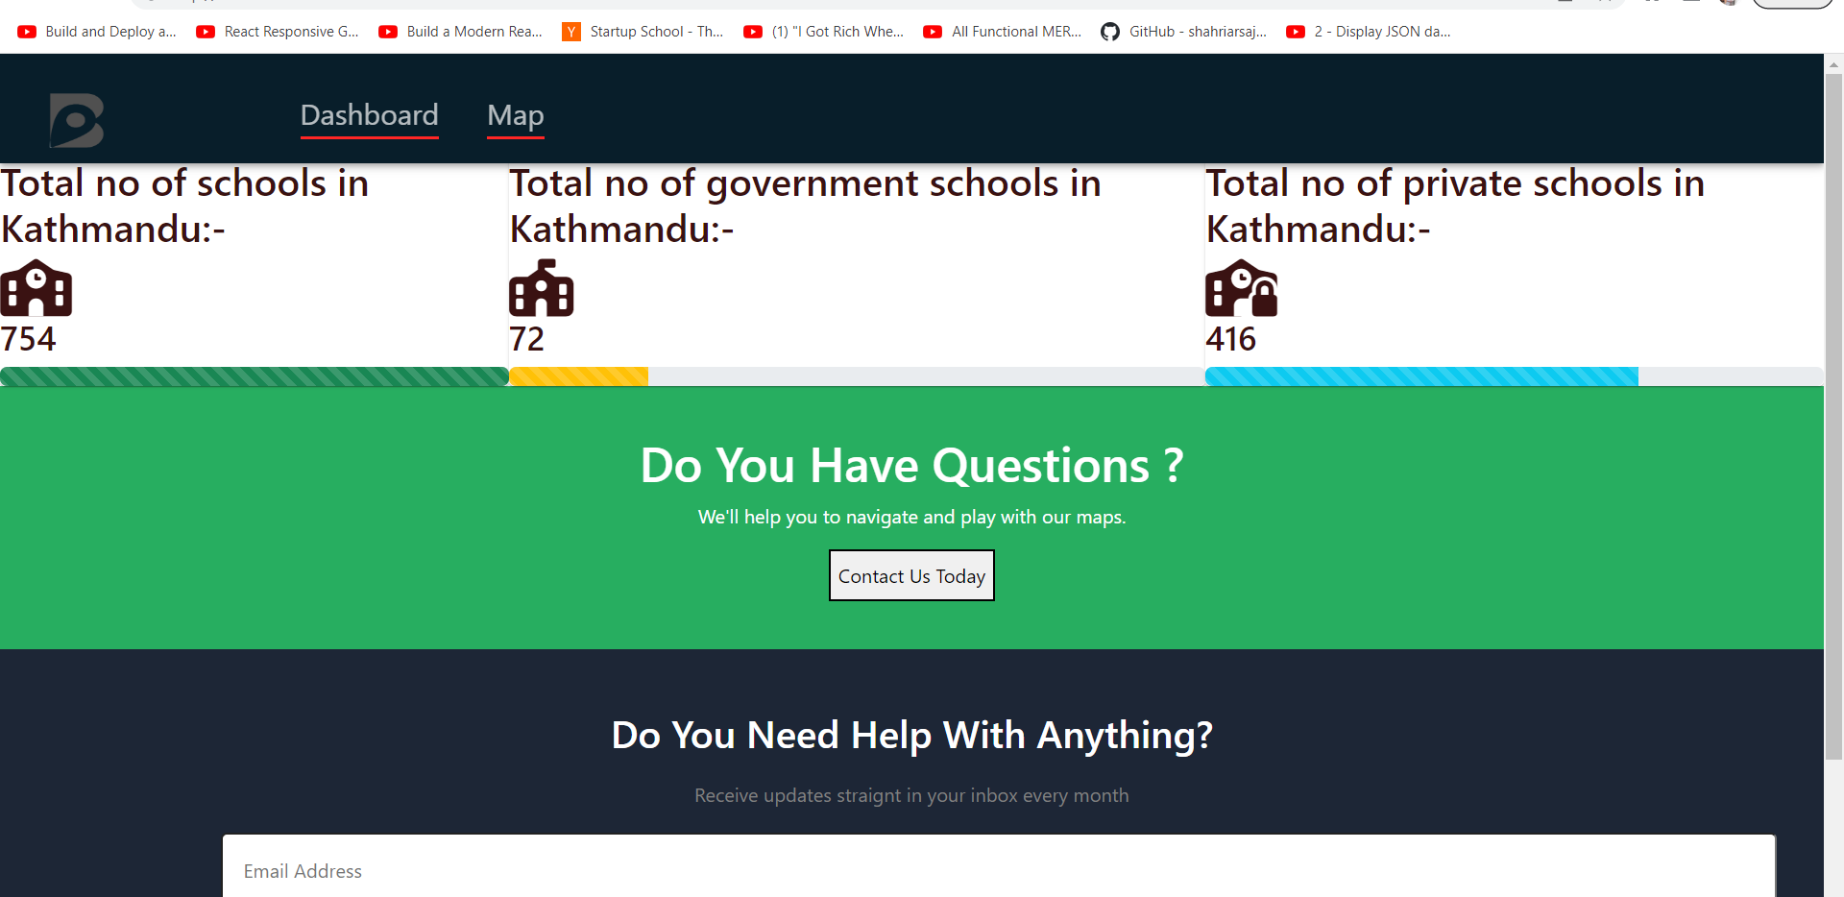
SCREENSHOTS
Figure: Dashboard

Slide 9
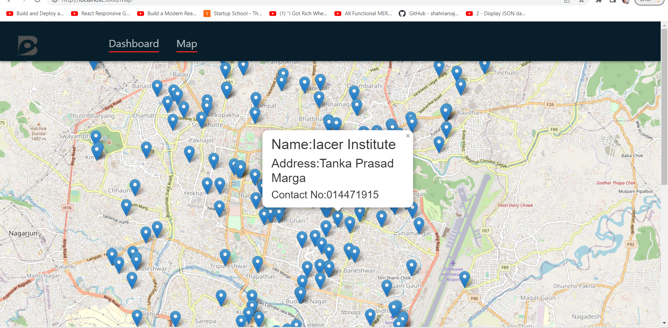
Figure : Interactive Map showing schools and description about them

Slide 10


