Slide 1


L.D. College of Engineering Ahmedabad
Internship
on
Project Management System
(Arth Infosoft Pvt. Ltd.)
Prepared By:-
Bhoye Ashishkumar Mahajambhai
(200280107106)
Guided By:-
Prof. Pinal Salot

Slide 2
Presentation Outline
Introduction
Problem Statement
Solution Overview
Why to Use
Flow of Work
Key features
Technology used
Conclusion

Slide 3
Introduction
A project management system is a software tool or platform designed to facilitate the planning, organization, execution, tracking, and reporting of projects and tasks within an organization.
It provides a centralized and structured environment for teams and stakeholders to collaborate, track progress, and manage all aspects of a project.
Imagine it as a central hub where you can:
Break down the project into smaller modules and assign them to team members.
Track progress and see how close you are to deadlines.
Generate reports on delayed tasks.

Slide 4
Problem Statement
Managing projects without using any tool can lead to several challenges and inefficiencies. Here are some common problems that arise:
Lack of Centralized Information
Difficulty in Task Assignment
Limited Visibility and Tracking
Inefficient Resource Management
Difficulty in Collaboration

Slide 5
Solution Overview
Our solution is an integrated project management system built using Django, designed to address common challenges faced in managing projects.
By providing a centralized platform for project planning, execution, and collaboration, our system streamlines project workflows, enhances communication, and improves overall project efficiency.
By implementing project management system, organizations can overcome common challenges in project management, improve project outcomes, and achieve greater success in their initiatives.

Slide 6
Why use pms?
Pms can make it easier for team members to work together and collaborate on tasks and projects.
Increased Collaboration
Enhanced Organization
Better Visibility
Increased efficiency
project management system can help teams work more efficiently and effectively.
Pms can help keep all project-related information organized and easily accessible.
Pms can provide better visibility into the progress and status of a project, allowing team members and stakeholders to see what has been completed and what still needs to be done.

Slide 7
Flow of work
01
step
User Registration and Authentication
02
step
Manager and Developer Dashboard
03
step
Project creation and assignment
04
step
05
step
Task Management
Reporting and analytics

Slide 8
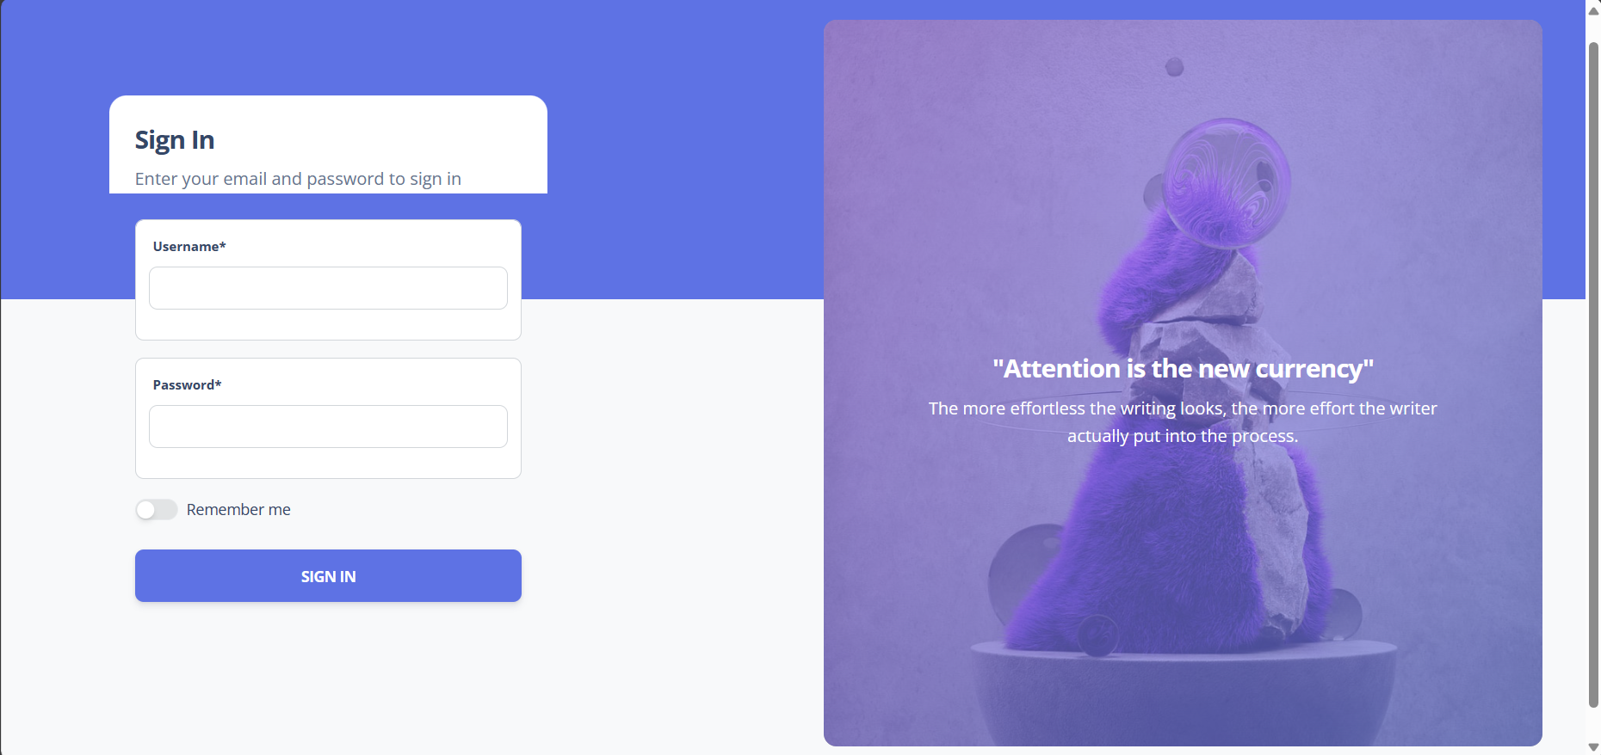
Snapshots

Slide 9
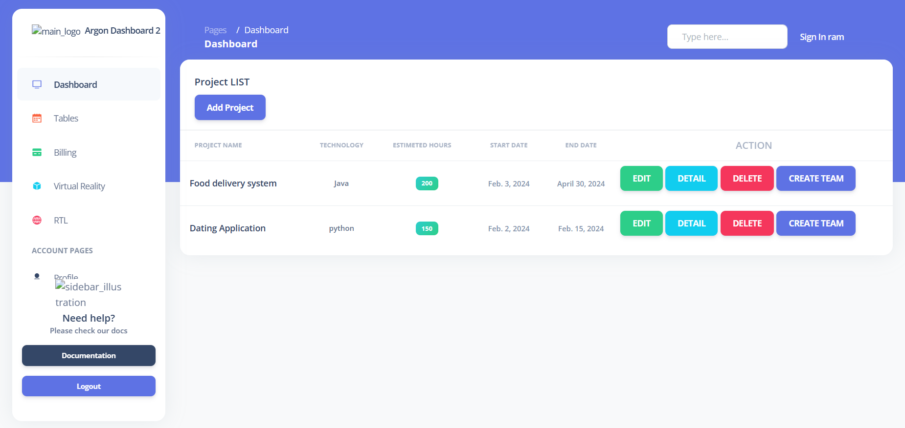
Snapshots

Slide 10
Key Features
The key features of the Project Management System:
Project Creation and Management
Task Management
Email Notification
Reporting and Analysis

Slide 11
Technology Stack
Front-end :- HTML, CSS
Back-end :- Python
Libraries :- Django
Database :- PostgreSQL

Slide 12
Conclusion
Implementing a project management system can be a useful and effective way to organize and track the progress of projects within an organization. In addition, it can help to increase efficiency, reduce errors, and improve communication among team members.
Overall, a well-implemented project management system can provide several benefits, including improved organization, increased transparency, and better collaboration among team members.

