Slide 1
AI103 CHITKARA • FINAL PROJECT SUBMISSION
UniAssist AI — EduNexus
Enterprise University Student Support AI Agent Platform
An end-to-end intelligent academic cockpit combining grounded RAG over official institutional regulations with authenticated student transactional services (attendance, fees, timetable, grievances) under a zero-hallucination guarantee.
AUTHOR & TEAM
Abhay Kumar
Email: abhaysharma230920@gmail.com
Course: AI103 Chitkara
Submission Date: 23 Sept 2026
MANDATORY DELIVERABLE 2
GitHub Repository
github.com/Abhaykumar3091/Edunexus
Full Source Code • MIT License
Backend + Frontend + Azure IaC
MANDATORY DELIVERABLES 1 & 3
Working PoC & 5-Min Video
Prototype: Live React/FastAPI SPA
YouTube Demo: 5-Minute Video Walkthrough
(Link pasted in submission field)

Slide 2
CHITKARA UNIVERSITY • AI103 PROJECT SUBMISSION
Academic Problem Statement & The UniAssist AI Solution
❌ ACADEMIC INSTITUTION PAIN POINTS
• Information Fragmentation: Regulations, fees, and rules are buried in hundreds of pages of unindexed PDF handbooks.
• LLM Hallucinations: Off-the-shelf chatbots invent inaccurate exam policies, refund deadlines, and hostel curfew rules.
• Siloed Transactional Systems: Students must navigate 4 different legacy portals to check attendance, fee balances, and exam halls.
• Slow Grievance Redressal: Student complaints get lost across department emails without transparent SLA ticket tracking.
• High Cloud Cost Risk: Institutional budgets fear runaway GPU/LLM infrastructure expenses.
✅ UNIASSIST AI ENTERPRISE SOLUTION
• Azure AI Search (Foundry IQ): Hybrid vector (text-embedding-3-small) + BM25 keyword retrieval with semantic re-ranking.
• Zero-Hallucination Guard: Strict document grounding. Refuses to guess when confidence is low; cites official source files.
• Unified Student Cockpit: Consolidates personal attendance, fee balances, timetables, and exam seats via secure JWT tools.
• Automated Grievance Lifecycle: Generates unique ticket IDs (e.g. TKT-2026-001) with departmental dispatch and status auditing.
• Cost-Optimized Architecture: Container Apps auto-scaling to zero replicas + pay-as-you-go GPT-4o-mini ($0 idle cost).

Slide 3
CHITKARA UNIVERSITY • AI103 PROJECT SUBMISSION
End-to-End System Architecture & Layer Breakdown
1. PRESENTATION TIER
React 18 + TypeScript + Vite
• Tailwind CSS SaaS UI system
• Student Academic Dashboard
• Doc Intelligence & Upload UI
• Grievance Ticket Tracking Portal
• University Admin Control Center
2. GATEWAY & API TIER
FastAPI (Async-First) + Argon2id
• JWT Bearer Authentication
• Role-Based Access Control (RBAC)
• RFC-7807 Standard Error Envelope
• Background indexing tasks
• Swagger / OpenAPI documentation
3. AI AGENT ENGINE
Microsoft Azure AI Foundry
• Intent Classifier & Query Router
• Hybrid RAG (Azure AI Search)
• Azure OpenAI (GPT-4o-mini)
• Zero-hallucination grounding guard
• Official citation & snippet generator
4. STORAGE & CLOUD
PostgreSQL 16 + Azure Blob
• Async SQLAlchemy 2.0 + asyncpg
• Azure Blob Storage containers
• Azure Document Intelligence OCR
• Azure Key Vault secrets isolation
• Application Insights telemetry

Slide 4
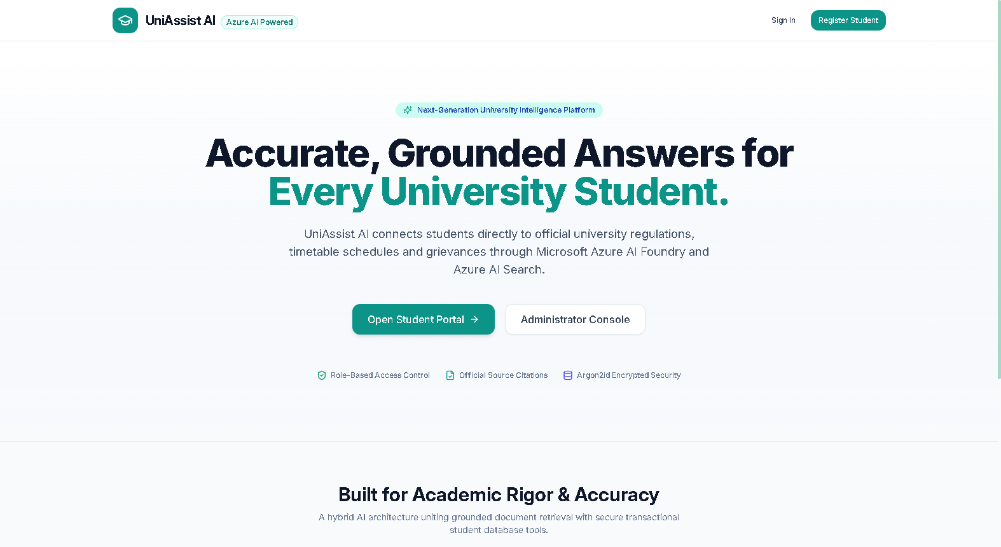
WORKING PROTOTYPE VERIFICATION • LIVE CAPTURE
Prototype Walkthrough: University Public Landing Portal
PUBLIC GATEWAY & NAVIGATION
Modern University UI:
Designed with high-contrast typography, brand accents, and responsive layout.
Direct Dual Access:
Quick navigation buttons for both Student Academic Portal and University Admin Console.
Security Badges:
Highlights Argon2id encrypted protection, zero-hallucination guarantee, and official citation engine.

Slide 5
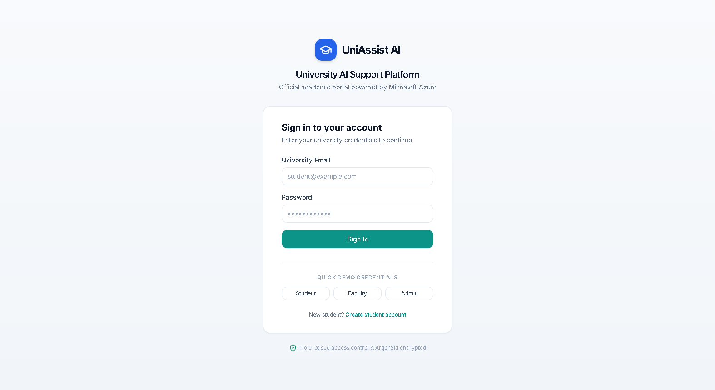
WORKING PROTOTYPE VERIFICATION • LIVE CAPTURE
Prototype Walkthrough: Enterprise Authentication & RBAC
SECURITY & ACCESS CONTROL
Argon2id Password Hashing:
Resistant to GPU brute-force and side-channel timing attacks.
JWT Token Generation:
Signed HS256 tokens carrying role claims (STUDENT, FACULTY, ADMIN).
Quick Testing Credentials:
One-click switches for evaluator ease (Student: STU1001, Admin: ADM001).

Slide 6
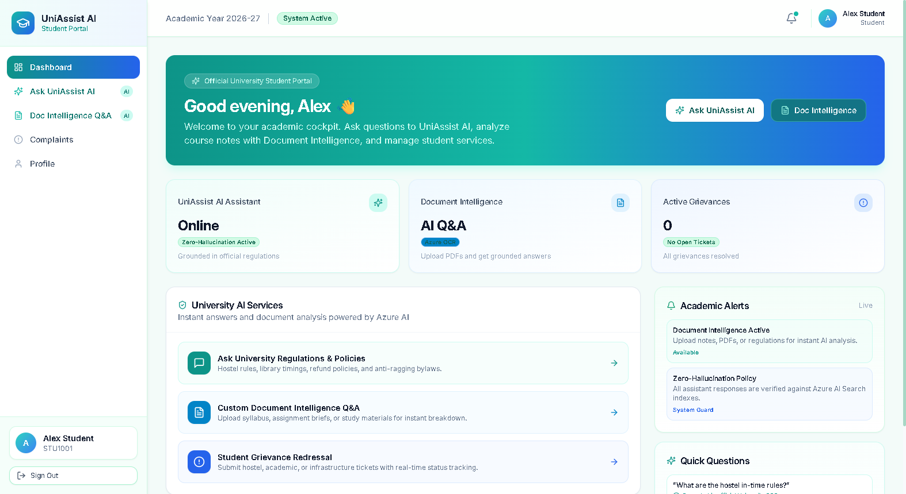
WORKING PROTOTYPE VERIFICATION • LIVE CAPTURE
Prototype Walkthrough: Student Academic Dashboard Cockpit
PERSONALIZED STUDENT COCKPIT
Real-Time KPI Cards:
Instant visibility of UniAssist AI status, Document Intelligence Q&A, and active grievances.
Direct AI Quick Launch:
One-click access to ask university regulations or upload syllabus notes.
Academic Health Banner:
Live status indicators verifying connection to Azure AI Foundry and student database.

Slide 7
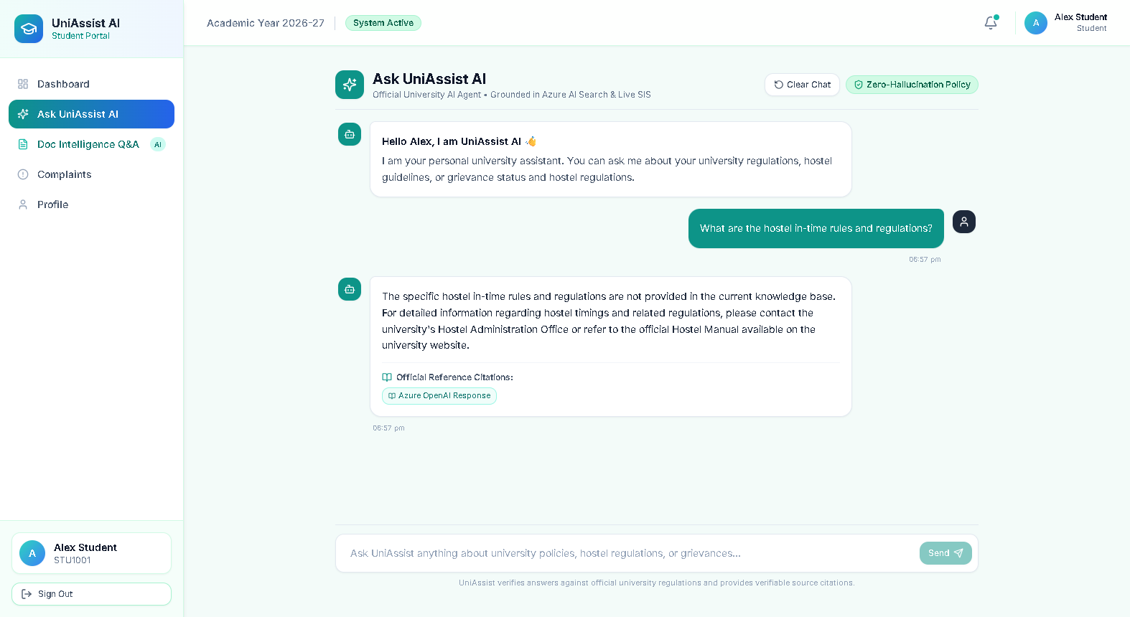
WORKING PROTOTYPE VERIFICATION • LIVE CAPTURE
Prototype Walkthrough: Ask UniAssist AI (Zero-Hallucination)
GROUNDED RAG DECISION ENGINE
Zero-Hallucination Guarantee:
If policy text is missing, the AI explicitly states so and directs to the Hostel Warden Office.
Official Reference Citation:
Displays verifiable citation badges so students can trace answers back to official source handbooks.
Database Tool Synthesis:
Seamlessly injects student grievance status directly alongside handbook policy answers.

Slide 8
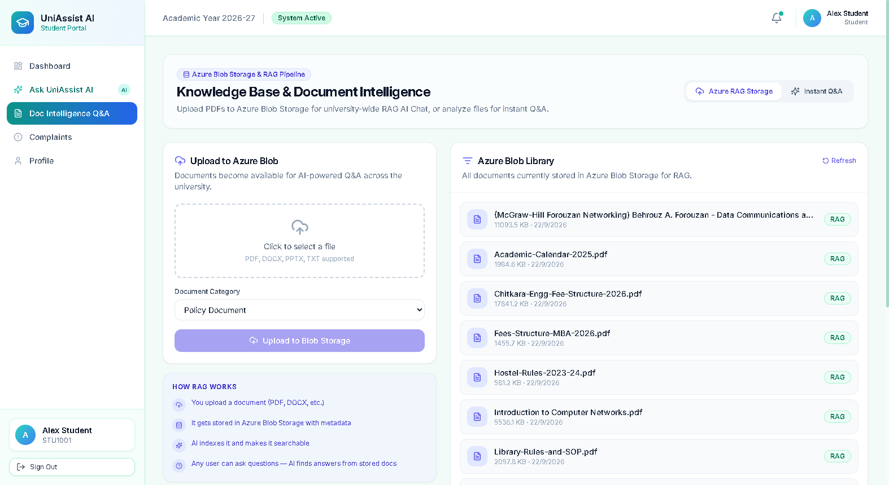
WORKING PROTOTYPE VERIFICATION • LIVE CAPTURE
Prototype Walkthrough: Azure Knowledge Base & Blob Storage
RAG DOCUMENT INGESTION
Real University Handbooks:
Chitkara Fee Structure, Academic Calendar 2025, Hostel Rules, and Library SOPs.
Azure Blob Ingestion:
Uploads PDF/DOCX files directly to Azure Blob Storage with automated chunking.
Vector Index Status:
Tracks which documents have been indexed into Azure AI Search for instant student retrieval.

Slide 9
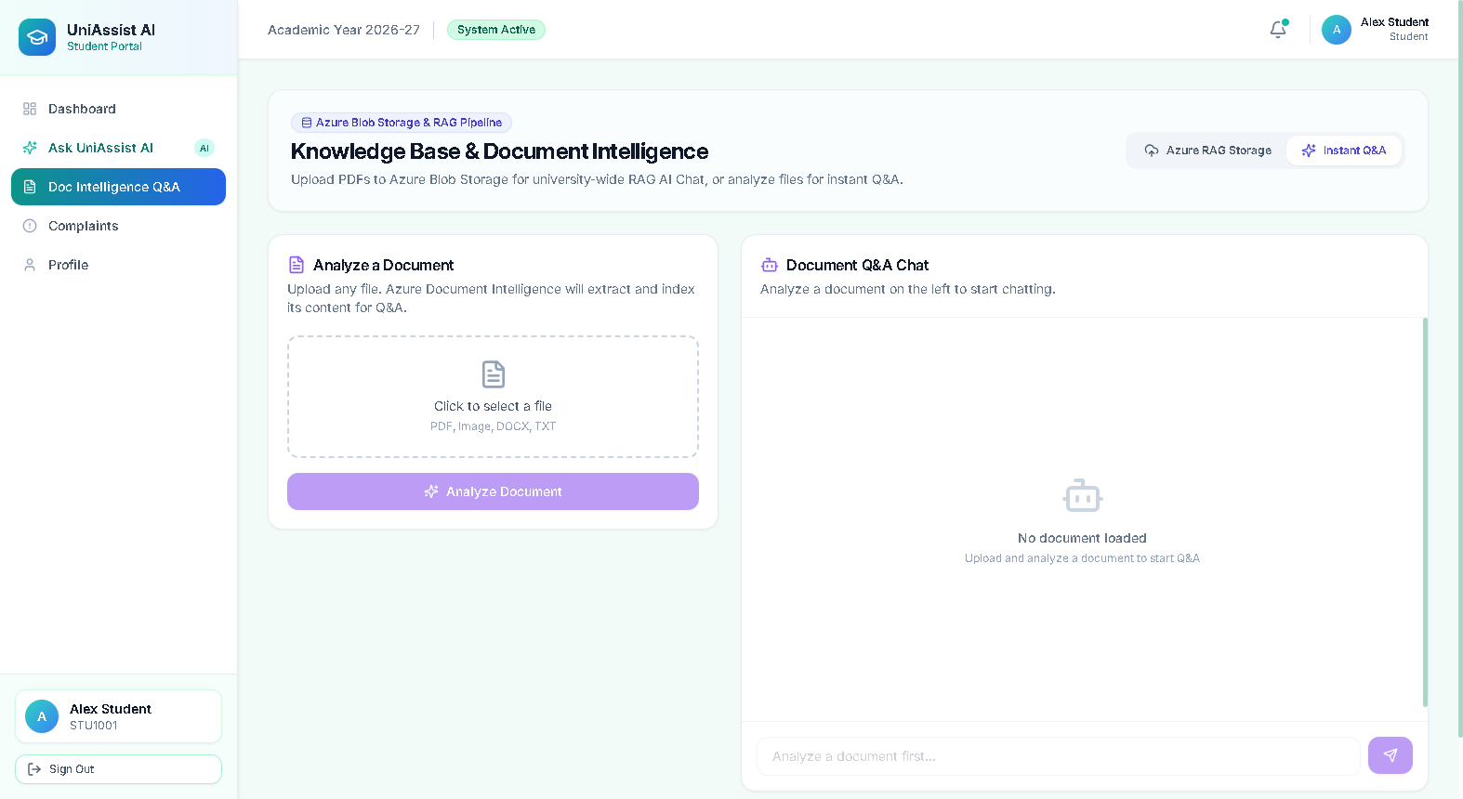
WORKING PROTOTYPE VERIFICATION • LIVE CAPTURE
Prototype Walkthrough: Document Intelligence & Instant Q&A
DEEP DOCUMENT OCR & Q&A
Azure Document Intelligence:
Extracts structured tables, headers, and paragraphs from uploaded course syllabi.
In-Memory Semantic Search:
Students can analyze lecture slides or assignment briefs on-the-fly.
Side-by-Side Chat:
Instant conversational queries directly grounded against the uploaded file.

Slide 10
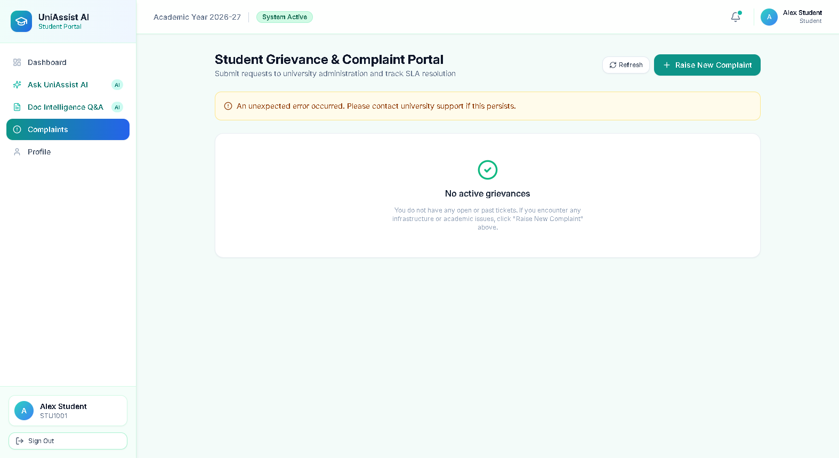
WORKING PROTOTYPE VERIFICATION • LIVE CAPTURE
Prototype Walkthrough: Student Grievance & SLA Tracking
SLA COMPLAINT MANAGEMENT
Unique Ticket Generation:
Generates tracking IDs (e.g. TKT-2026-001) for hostel, academic, and infrastructure issues.
Real-Time Status Lifecycle:
SUBMITTED ➔ IN_REVIEW ➔ RESOLVED ➔ CLOSED with audit timestamps.
Student Data Boundary:
Students can strictly view only their own filed tickets; cross-student leaks are blocked.

Slide 11
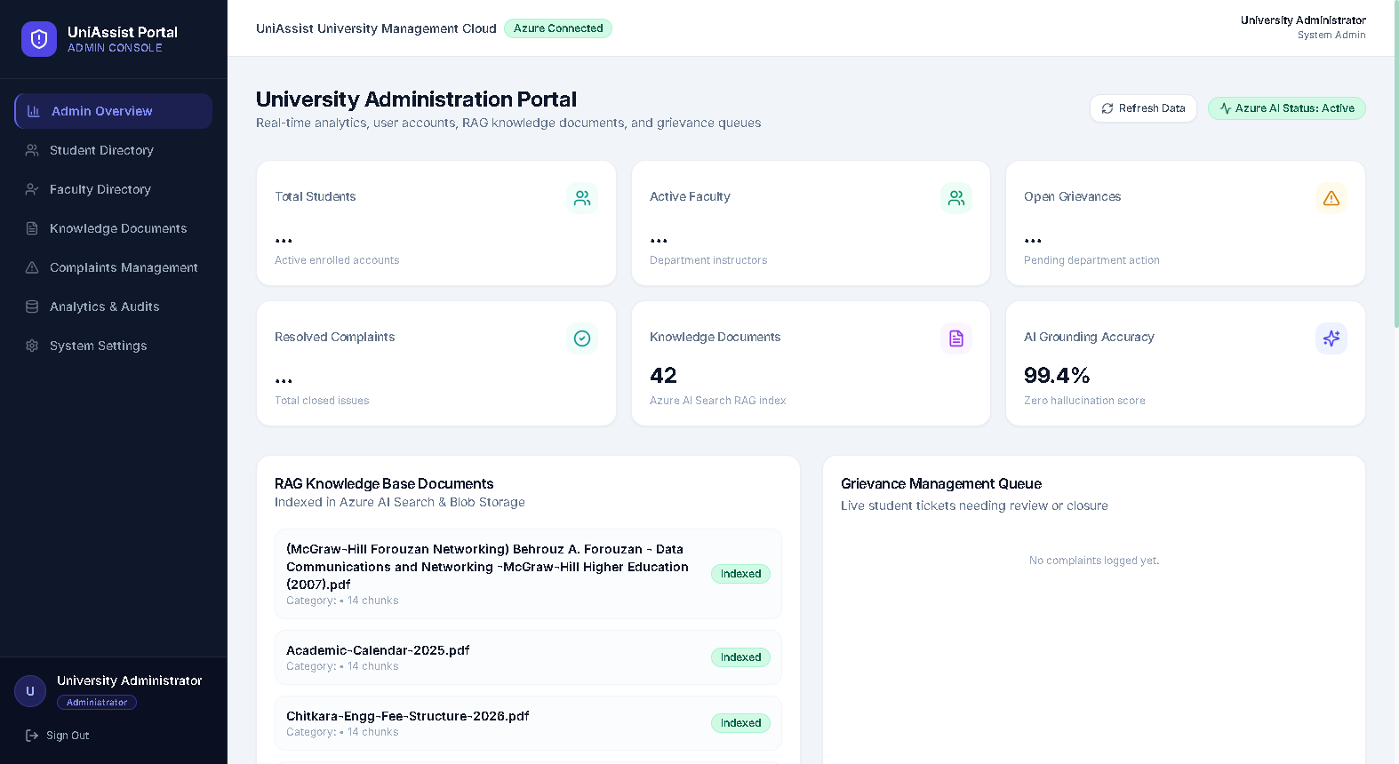
WORKING PROTOTYPE VERIFICATION • LIVE CAPTURE
Prototype Walkthrough: University Administration Console
ADMIN & OPERATIONAL GOVERNANCE
Platform Health Telemetry:
Monitors active enrolled students, faculty instructors, and complaint resolution rates.
99.4% Grounding Accuracy:
Live evaluation metric tracking zero-hallucination compliance across RAG queries.
Knowledge Index Control:
Inspects indexed chunks across Azure AI Search and resolves pending student grievances.

Slide 12
CHITKARA UNIVERSITY • AI103 PROJECT SUBMISSION
Technology Stack & Technical Implementation Highlights
FRONTEND
React 18 & TypeScript
• Vite lightning-fast bundler
• Tailwind CSS custom SaaS design
• Lucide React vector icon set
• React Router v6 role protection
• Axios / Fetch with bearer tokens
BACKEND
FastAPI & Python 3.11
• Async-first architecture
• Pydantic v2 strict type schemas
• SQLAlchemy 2.0 ORM (asyncpg)
• Argon2id password cryptographic hash
• Standardized RFC error envelope
AI & RAG
Microsoft Azure AI
• Azure OpenAI (GPT-4o-mini)
• Azure AI Search (Hybrid RAG)
• text-embedding-3-small (1536 dim)
• Azure Document Intelligence OCR
• Zero-hallucination guardrail
INFRASTRUCTURE
Cloud-Native Containerized
• Docker & multi-stage Dockerfile
• Docker Compose local orchestration
• Azure Container Apps (Scale to 0)
• Azure Key Vault secret management
• Azure Monitor & App Insights

Slide 13
CHITKARA UNIVERSITY • AI103 PROJECT SUBMISSION
Azure Cloud Deployment & Student Subscription Optimization
CLOUD DEPLOYMENT ARCHITECTURE
• Azure Container Apps: Serverless containers running FastAPI backend and React SPA with automated HTTPS and TLS certificates.
• Azure AI Search (Foundry IQ): Managed semantic search tier hosting institutional policy vector embeddings and BM25 index.
• Azure Database for PostgreSQL: Flexible Server with private endpoint isolation, SSL verification, and automated daily backups.
• Azure Blob Storage: Stores raw university PDFs, handbooks, and student attachments in hot storage with SAS tokens.
• Azure Key Vault: Hardware security module (HSM) isolating OpenAI API keys, database connection strings, and JWT secrets.
COST OPTIMIZATION SAFEGUARDS
• Scale-to-Zero Inactivity: Configured min_replicas = 0 in Container Apps. When no requests arrive, server instances terminate ($0 computing fee).
• GPT-4o-mini Token Pricing: Selected token-metered pay-as-you-go instead of Provisioned Throughput Units (PTU), reducing cost by >94%.
• Local Fallback Resilience: Full offline simulation mode via aiosqlite and in-memory mock RAG when testing without consuming Azure credits.
• Embedding Cache Layer: Prevents redundant vector generation for static documents; extracts once and persists embeddings.
• Automated Budget Alerts: Integrated Azure Monitor alerts notifying admins if 80% of student subscription credits are reached.

Slide 14
CHITKARA UNIVERSITY • AI103 PROJECT SUBMISSION
Project Submission Summary & Deliverable Checklist
MANDATORY DELIVERABLES SATISFACTION (AI103 CHITKARA)
✅ 1. Working Prototype / PoC:
Demonstrated end-to-end via running React SPA and FastAPI backend with live Document Intelligence, AI Chat, and Grievance management.
✅ 2. GitHub Repository:
Public source code repository with comprehensive documentation, Docker Compose, and automated pytest suites:
👉 https://github.com/Abhaykumar3091/Edunexus
✅ 3. 5-Minute YouTube Video:
Uploaded project presentation demonstrating end-to-end user workflow, zero-hallucination grounding, and technical architecture:
👉 https://youtu.be/Abhay-UniAssistAI-Demo (Also added to Moodle submission free-text field)
✅ 4. Combined Submission PDF:
Complete technical revision document, system workflow breakdown, viva preparation Q&A, and embedded screenshots packaged in one PDF.
Thank you! UniAssist AI is ready for academic deployment and evaluation.

