Slide 1
VLN Notebook Code Review (R = Read, X = Execute)
Your tasks
VLN-23 (r+x): Run/execute Usama’s code.
VLN-24: Identify issues + make module diagram with datatypes.
Document what ran, what failed, and why.
What you will show
1) Pipeline diagram (modules + datatypes)
2) Weak points/issues
3) Execution checklist + errors

Slide 2
Inputs the Notebook Expects
Connectivity JSON
Path: connectivity/<scene_id>_connectivity.json
Purpose: adjacency between viewpoints + pose info.
MapGPT tasks JSON
File: MapGPT_72_scenes_processed.json
Fields: scan, path_id, path (list of viewpoint ids), instruction.
Perception output (optional)
File: perception_model_output.json
Used only for semantic/instruction scoring.

Slide 3
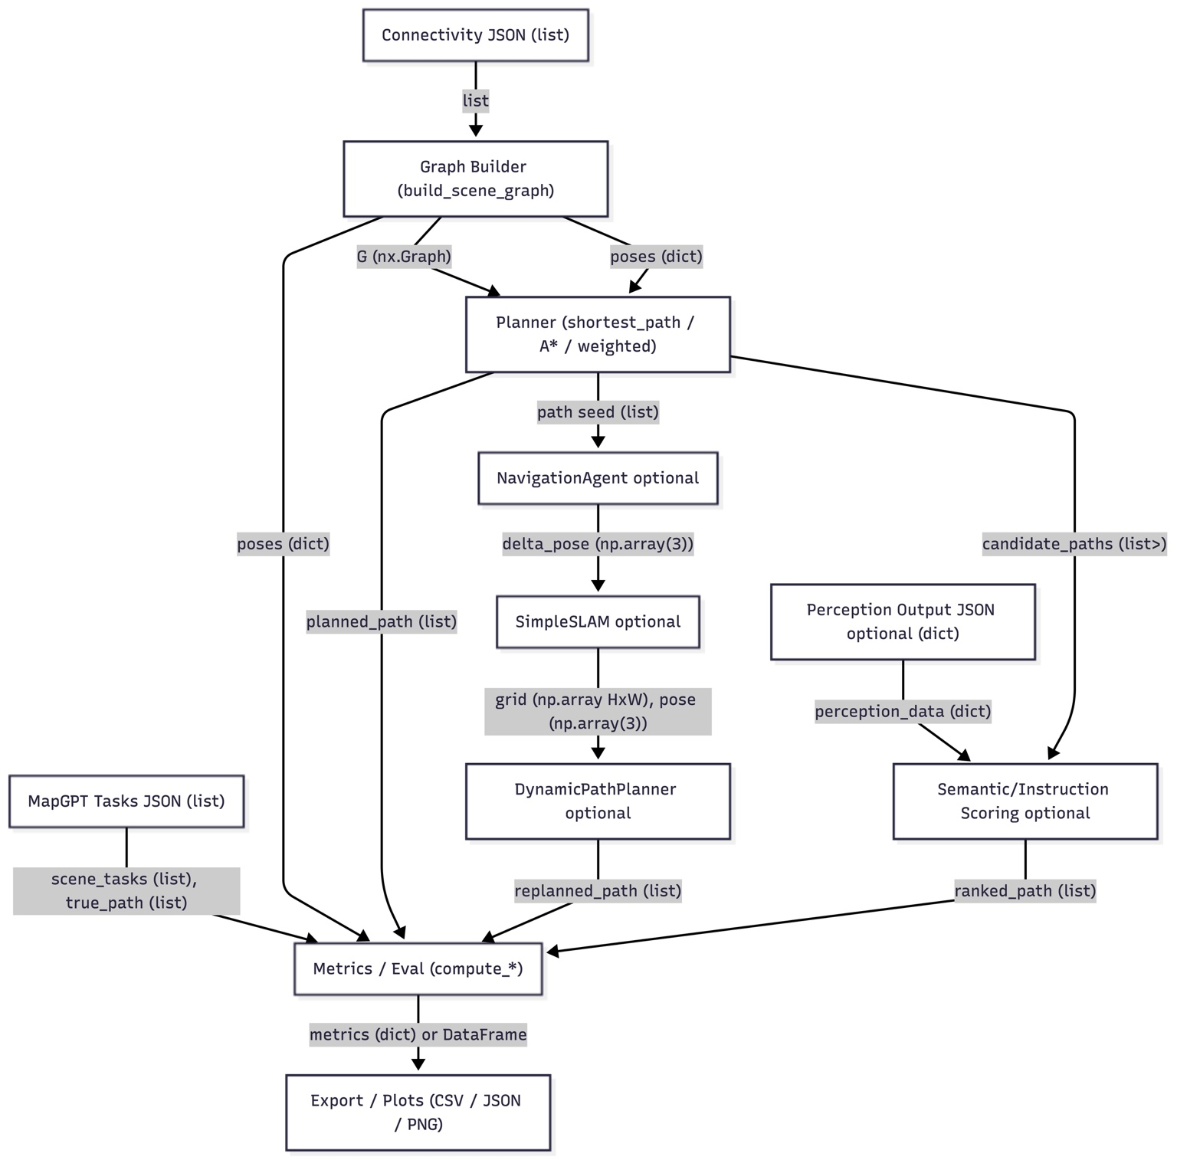
Core Pipeline
1) Build Graph (X)
Read connectivity → create G (nx.Graph)
Extract poses: dict[node_id → (x,y,z)]
2) Plan Path (X)
Input: G + start/goal
Output: planned_path: list[node_id]
3) Evaluate (X)
Compare planned_path vs true_path
Compute success, SPL, nav error, overlap
4) Export (X)
Write JSON/CSV + optional plots

Slide 4
Module Connections
Connectivity → Graph Builder
connectivity_records: list[dict]
Graph Builder → Planner
G: nx.Graph
poses: dict[str, np.array(3)]
Planner → Metrics
planned_path: list[str]
MapGPT Tasks → Metrics
true_path: list[str], instruction: str
Metrics → Export
metrics: dict[str,float] or pandas.DataFrame

Slide 5
Weak Points / Issues Found
Execution fragility
Hard-coded scene_id + relative paths; breaks if files aren’t in place.
Order-dependent globals across cells (rerun out of order = wrong state).
Planning quality
Unweighted shortest path used in places (ignores physical distance).
Path overlap uses set intersection (ignores order).
SLAM is placeholder
SimpleSLAM doesn’t truly use depth; randomness hurts reproducibility.
Maintainability
Duplicate helpers, repeated loading logic, mixed concerns.

Slide 6
How to Execute (X) + What Usually Fails
Before running
Need: connectivity/<scene_id>_connectivity.json
Need: MapGPT_72_scenes_processed.json
Optional: perception_model_output.json
Run order (minimum)
Imports → set scene_id → build graph/poses → load tasks → plan → metrics → export
Common failures to document
FileNotFoundError: missing JSON or wrong working directory
KeyError: unexpected JSON schema
Empty tasks: scene_id not in MapGPT file

Slide 7
What You Can Reuse for Your Project
Best reusable parts
Graph Builder (connectivity → nx.Graph)
A* / weighted planner using poses
Metrics + CSV/JSON export for progress reports
Multi-task runner to test many tasks
Use with caution
SimpleSLAM is not real SLAM (placeholder only)
Semantic scoring only matters if you have perception outputs

