Slide 1
Path Planning Notebook — After run
VLN-23 (R+X) & VLN-24 (Issues + Module Diagram)
What I will show
What the notebook does (modules + datatypes)
How I executed it successfully (inputs → outputs)
Key results files produced (CSV/JSON)
Weak points + next improvements
Notebook
path_planning.ipynb (Matterport connectivity + MapGPT tasks)

Slide 2
What was required to make it run (X)
Inputs present in the correct paths
connectivity/<scene_id>_connectivity.json
MapGPT_72_scenes_processed.json
Optional: perception_model_output.json
Correct run order (minimum)
Imports → scene_id → build graph/poses → load tasks → plan → metrics → export
Typical fixes (if it previously failed)
Place JSON files where the notebook expects them
Ensure scene_id exists in MapGPT tasks
Create output folders (planned_paths/) if needed

Slide 3
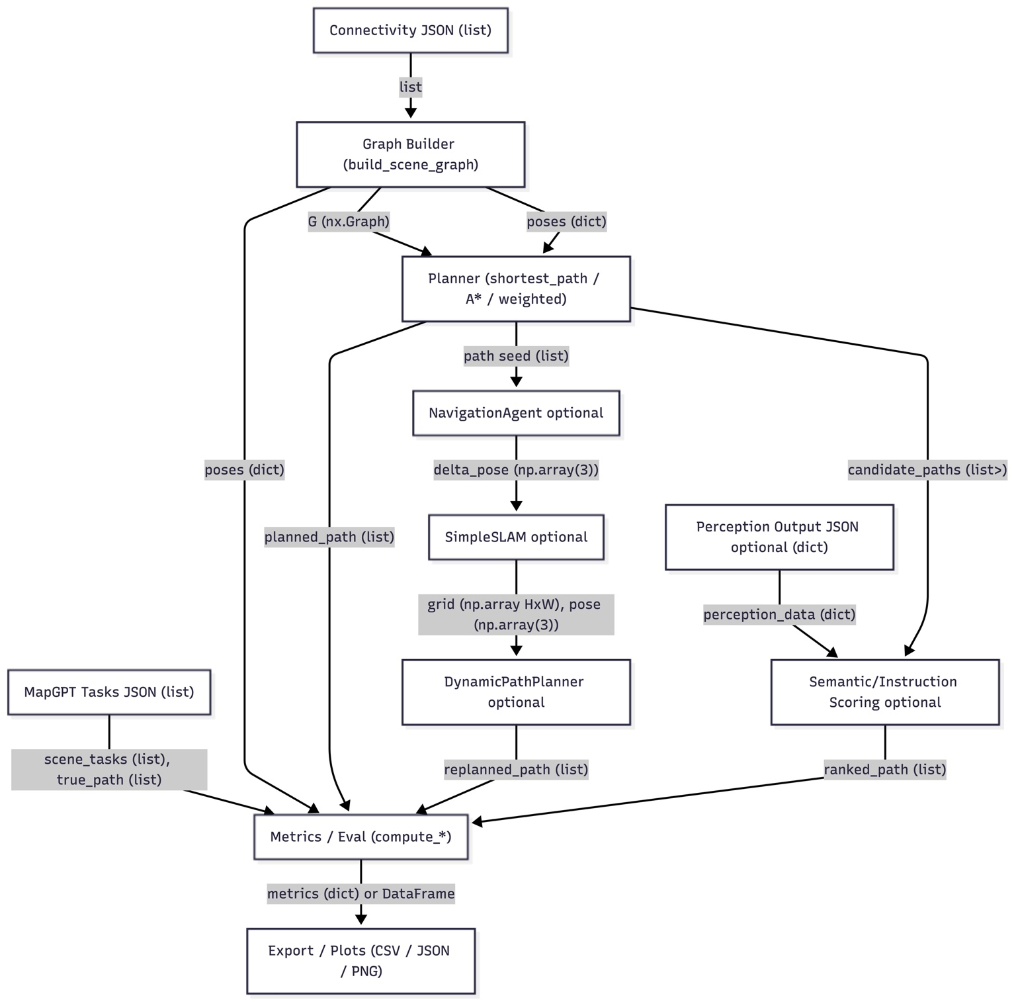
Core Pipeline (R → X → Outputs)
R: Connectivity JSON
Adjacency between viewpoints + pose metadata
X: Graph Builder
Builds G (nx.Graph) + poses (dict)
R: MapGPT Tasks
Provides true_path (ground truth)
X: Planner + Metrics
planned_path + evaluation metrics
X: Export
CSV/JSON reports

Slide 4
Modules + What They Share (Datatypes)
Connectivity → Graph Builder
connectivity_records: list[dict]
Graph Builder → Planner
G: nx.Graph
poses: dict[str, np.array(3)]
Planner → Metrics
planned_path: list[str]
Tasks → Metrics
true_path: list[str], instruction: str
Metrics → Export
metrics: dict[str, float] and/or pandas.DataFrame

Slide 5
Outputs Produced When It Runs (X)
Graph artifact
<scene_id>_graph.json
Per-task planned paths
planned_paths/<scene_id>_path_<path_id>_planned.json
Reports / exports
all_task_results.csv
scene_metrics.csv
successful_tasks.csv
summary_report.txt
paths_export.csv, path_visualization.json (if those cells are run)

Slide 6
Proof of Execution (what to show)
Console output
Number of tasks loaded for the scene
Planner output: planned path length / success count
Generated files
Show CSV/JSON files created after execution
Open scene_metrics.csv and point to key columns
One example episode
Show true_path vs planned_path
Show navigation error computed using poses

Slide 7
Issues That Still Remain (Even When Working)
Robustness
Hard-coded paths and scene_id; should be parameterized.
Limited validation for missing keys / missing poses.
Metrics quality
Overlap metric ignores order (set intersection).
Unweighted shortest path can ignore physical distance.
SLAM module
SimpleSLAM is a placeholder; not true SLAM.
Notebook design
Globals + repeated code → hard to maintain/test.

Slide 8
What’s Most Useful for Your Task Next
Reuse immediately
Graph builder (connectivity → nx.Graph)
A* / weighted planner using poses
Batch evaluation + CSV exports
Next upgrades
Replace placeholder SLAM with SLAM Toolbox outputs (map + pose)
Use weighted planning by default
Refactor into functions/CLI so it runs for any scene

