Slide 1

Basic Details of the Team and Problem Statement
Problem Statement Title:Govt.Billing and Invoicing system
Team Name:Code Warrior
Team Leader Name:Sakeeb
Institute Name:Netaji Subhas University of Techology

Slide 2
Idea/Approach Details
Describe your idea/Solution/Prototype here:
The Govt. Billing and Invoice app is determined to help sellers and customers ease the process of purchasing.
The app first authenticates the buyers with proper Login /Signup system.
Now that the seller is Logedin ,he can create bill and create invoice and get the pdf of it.
Describe your Technology stack here:
React
React-native
Expo-rout
Firebase

Slide 3
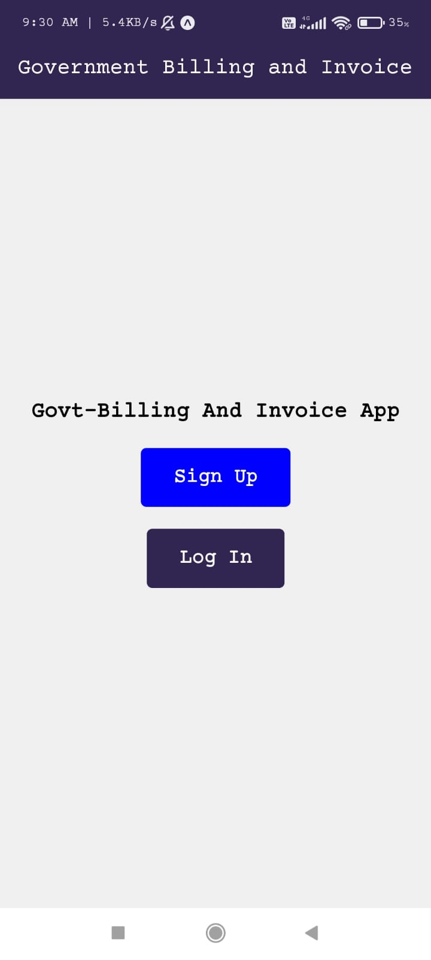
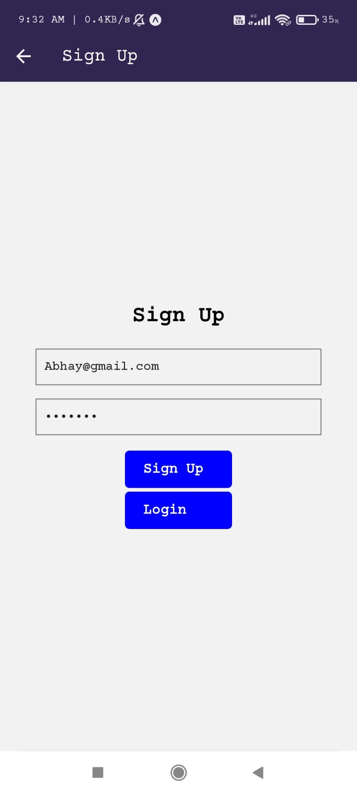
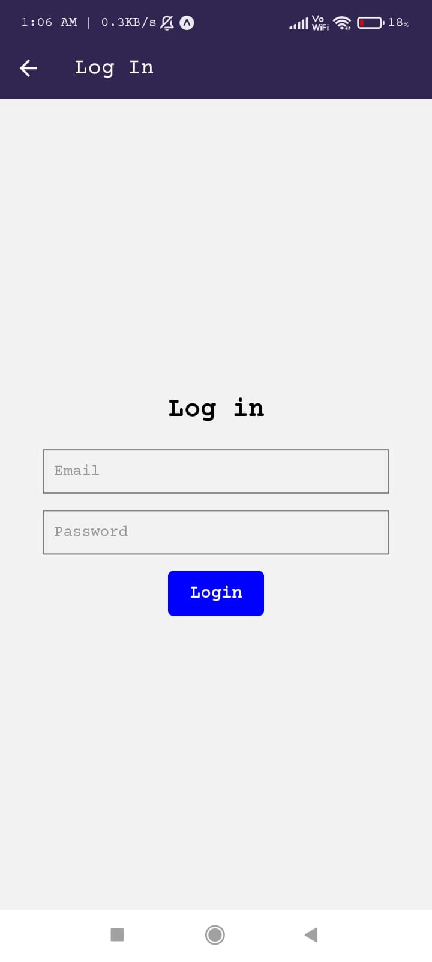
The App

Slide 4
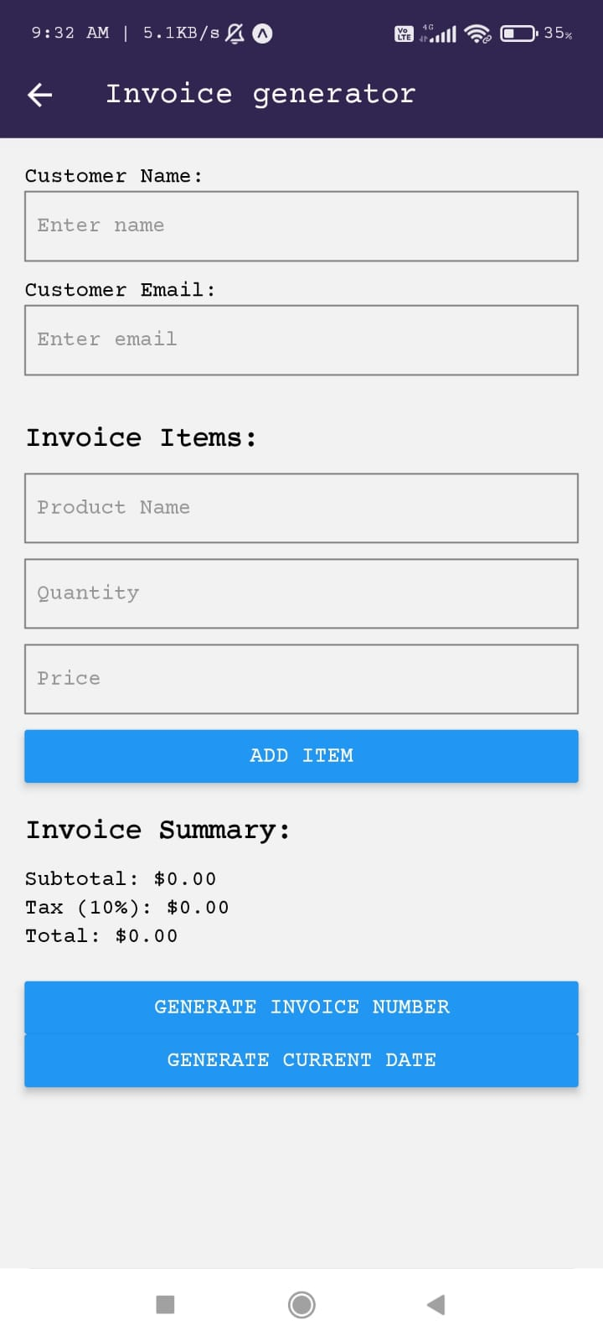
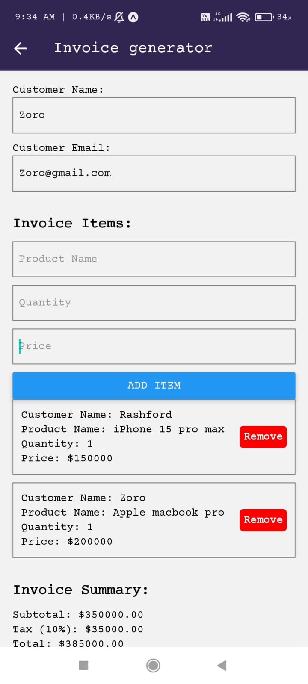

Pdf Generate

Slide 5
Idea/Approach Details
Describe your Use Cases here
Describe your Dependencies / Show stopper here
Ecommerce Platform
Business
Retail Stores
Rent and Lease
Non Profit Organization
React
React-Native
Expo
React Native styled Components
React Native components: Such as View, Text, TextInput, Button, Alert, FlatList, and more

Slide 6
Team Member Details
Team Leader Name: Sakeeb Hasan
Branch(Btech) stream-Information Technology Year-III
Team Member 1: Abhay Prajapati
Branch(Btech) stream-Information Technology Year-III
Team Member 2 Name: Vaibhav Aggarwal
Branch(Btech) stream-Information Technology Year-III
Team Member 3 Name: Md. Ashraf
Branch(Btech) stream-Information Technology Year-III
Team Member 4 Name: Khushi
Branch(Btech) stream-Information Technology Year-III
Team Member 5 Name:Utkarsh Kumar
Branch(Btech) stream-Information Technology Year-III

