Slide 1
Ride-Hailing Surge Pricing & Dispatch Simulator
A marketplace experimentation platform for pricing and dispatch trade-offs
All results are from synthetic simulation — see docs/ASSUMPTIONS.md

Slide 2
The Problem
A two-sided marketplace balancing rider experience, driver earnings, and revenue
• Riders want low price + short wait. Drivers want steady, well-paid work.
• When demand > supply, riders wait longer and some cancel; when supply > demand, driver-hours go to waste.
• Platforms have three levers to close the gap: surge pricing, driver incentives, dispatch quality.
• The first two show up immediately in a P&L. Dispatch is a software investment that's hard to justify without a controlled experiment.
“Can dispatch reduce wait time without raising cost?”

Slide 3
Marketplace Dynamics
10-zone synthetic city, Poisson demand, time-of-day patterns
• 10 zones (Downtown, Airport, University, Residential x2, Suburban x2, Transit Hub, Nightlife, Business Park), each with a distinct demand curve and directional flow pattern.
• Ride requests: Poisson arrivals per zone per minute, rate driven by time-of-day and scenario.
• Riders: 3 segments (price-sensitive / normal / time-sensitive), logistic accept/cancel functions.
• Drivers: shift-based online/offline, logistic accept function driven by pay, pickup distance, and current utilization.

Slide 4
Simulation Architecture
Time-stepped, 1-minute ticks, 24 simulated hours
• 12-step fixed sequence per tick: demand -> driver states -> marketplace state -> surge -> pricing -> rider accept/reject -> dispatch -> driver accept/reject -> trip advance -> cancellations -> metrics.
• Common Random Numbers: the same simulated riders/drivers/timing replay identically across every policy at a given seed -- turns policy comparison into a precise paired experiment.
• Reproducible: numpy.random.SeedSequence-derived streams (never Python's hash()), verified via bit-identical repeat-run tests.
• ~0.3s per 24-hour simulation -- the full 1,080-run experiment matrix completes in under 6 minutes.

Slide 5
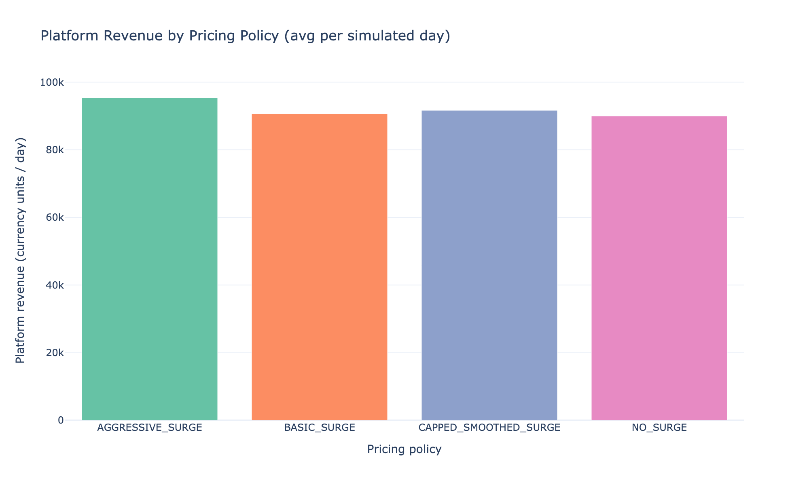
Pricing Strategies
4 policies, capped, tested against a no-surge control
• NO_SURGE — control
• BASIC_SURGE — proportional to imbalance, capped 1.0-2.0x
• AGGRESSIVE_SURGE — higher gain, capped 1.0-3.0x, updates every minute
• CAPPED_SMOOTHED_SURGE — same signal, exponentially smoothed, capped 1.0-2.5x

Slide 6
Dispatch Strategies
5 heuristics — explicitly not a global optimum
• NEAREST_DRIVER — minimize pickup distance among idle drivers
• ETA_OPTIMIZED — minimize predicted pickup time, incl. drivers about to free up nearby
• DRIVER_EARNINGS_AWARE — among nearest candidates, maximize predicted driver-acceptance probability
• MARKETPLACE_AWARE — penalize pulling a driver out of an undersupplied zone
• ADVANCED_HEURISTIC — weighted combination of all of the above + cancellation-risk urgency
Why not the exact optimal assignment? O((R+D)^3) per tick via the Hungarian algorithm doesn't scale, and the state is stale again a minute later anyway — a deliberate optimality-vs-speed trade-off.

Slide 7
Experiment Design
1,080 runs, statistically powered, not just 'ran it a lot'
• Core: 4 pricing x 5 dispatch x 24 common-random-number seeds = 480 runs (NORMAL scenario) — prioritizes statistical power on the primary comparison.
• Robustness: same 20 combos x 6 seeds x 5 stress scenarios (peak, shortage, shock, low-demand, congested-peak) = 600 runs.
• Sensitivity: 6 parameters x +/-30% x 8 seeds = 224 further runs.
• Primary metric: P90 rider wait. Guardrails: cancellation rate, driver earnings/hour, driver acceptance rate, price index.
• Statistics: bootstrap 95% CI, paired Wilcoxon test, matched-pairs Cohen's d, pre-registered >=5% practical-significance bar.

Slide 8
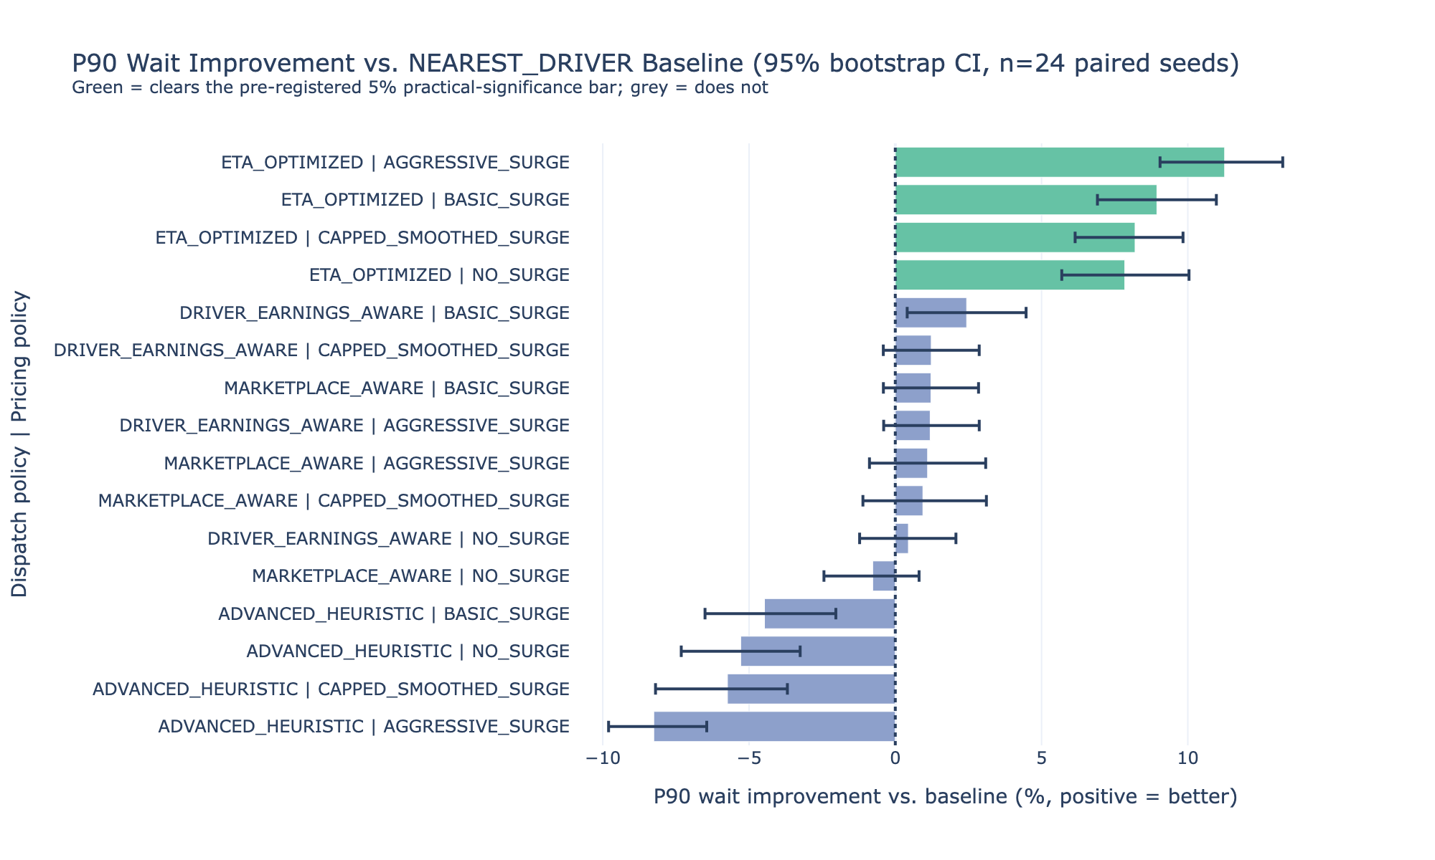
Results
ETA_OPTIMIZED wins on every metric, every pricing policy
• P90 wait: -8.9% (BASIC_SURGE), -7.8% to -11.3% across all 4 pricing policies
• Driver earnings/online-hour: +1.9%
• Cancellation rate: -4.7% (relative)
• Platform revenue: +2.7%
• All p < 0.001, n=24 paired seeds
• Sign survives all 12 sensitivity perturbations

Slide 9
Key Insight
Dispatch is the only lever tested that improved rider experience,
driver earnings, AND platform revenue simultaneously —
at zero incremental marginal cost per ride.
A more “sophisticated” hand-tuned heuristic combining more objectives actually performed
WORSE than the naive baseline — a real, reported negative finding, not hidden.

Slide 10
Product Recommendation
Decision matrix: surge vs. incentives vs. dispatch
• LAUNCH: ETA_OPTIMIZED-style dispatch, in shadow mode first, then phased 1% -> 5% -> 25% -> 100%.
• DO NOT LAUNCH: ADVANCED_HEURISTIC — underperformed baseline in every configuration tested.
• TEST NEXT: sensitivity analysis (done) + a real production shadow-mode test of the core mechanism.
Real-world data that would sharpen this: actual rider price-sensitivity/cancellation curves, driver pickup-acceptance logs, and driver-supply-vs-incentive elasticity estimates.

Slide 11
Technical Architecture & AI
Engine -> results warehouse -> dashboard / API / AI copilot
• Engine (Python) -> file-based results warehouse (Parquet/CSV) -> statistical analysis layer
• Streamlit + Plotly dashboard for live simulation and experiment browsing
• FastAPI service exposing simulation + results (with full Postgres schema specified for production scale)
• AI Marketplace Analyst: Claude tool-calling over 5 deterministic functions — the LLM never computes a metric itself, only explains numbers a real function call returned

Slide 12
Future Roadmap
What's next, prioritized
• 1. Driver supply-response-to-incentive model (biggest remaining gap)
• 2. 24-seed robustness scenarios (currently 6)
• 3. Combined (not one-at-a-time) worst-case sensitivity perturbations
• 4. Live end-to-end test of the AI copilot against a real API key
• 5. Per-zone fairness/equity guardrails (e.g. driver-earnings Gini coefficient)
• 6. A real production shadow-mode A/B test of the dispatch mechanism

