Slide 1

Improved RRT-Connect Based Path Planning Algorithm for Mobile Robots
ENPM - 661 FINAL PROJECT 2024
Group: 16
By: Abhey Sharma Ishan Kharat

Slide 2
Problem Statement
Traditional path planning algorithms have an exponential increase in computational complexity in complex environments
Algorithms tend to fall into local minimal.
Obtaining minimal computation time at detecting optimal path is still a challenge
The traditional RRT and RRT-Connect algorithms have limitations in terms of search efficiency

Slide 3
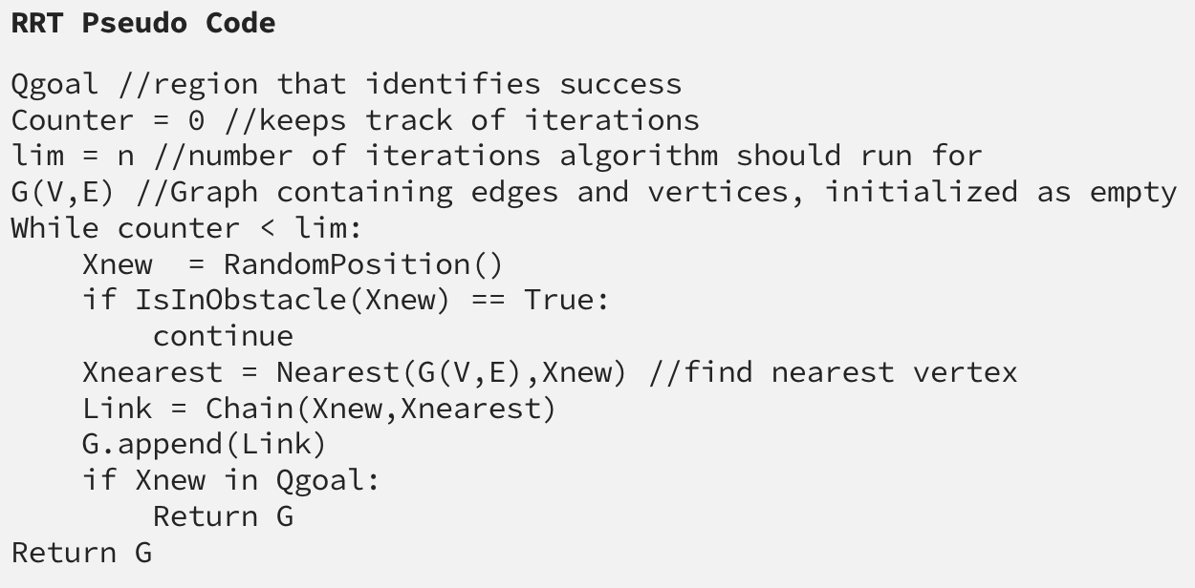
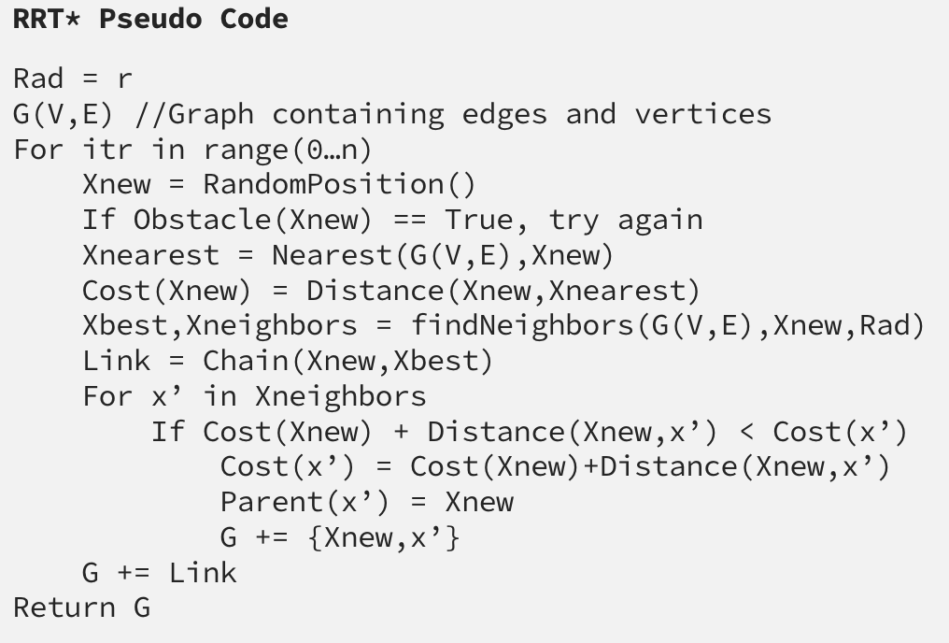
Reference:
medium.com/robotic-path-planning-rrt-and-rrt

Slide 6
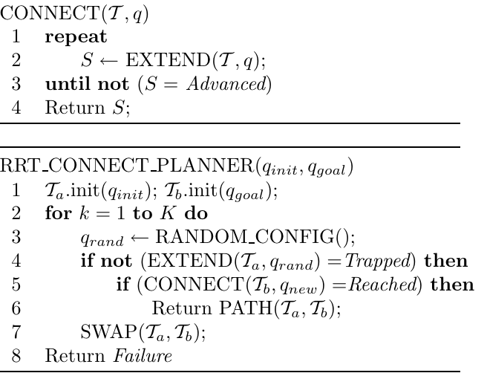
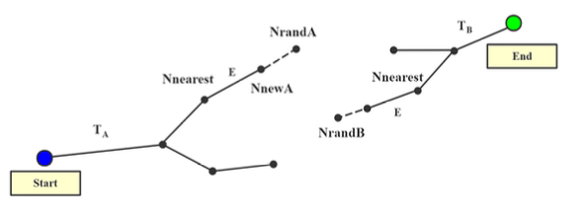
RRT Connect

Slide 8
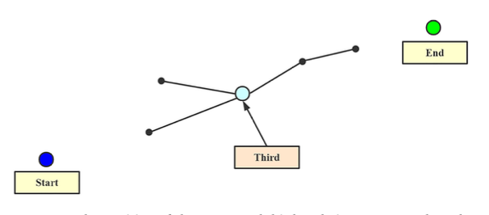
Proposed Implementation
Generation of a Third Node:
Generates a third node in the configuration space, in addition to the start and end points
Demonstrated as the midpoint of the line connecting the start and end points
Dichotomy-based approach if midpoint is on an obstacle

Slide 9
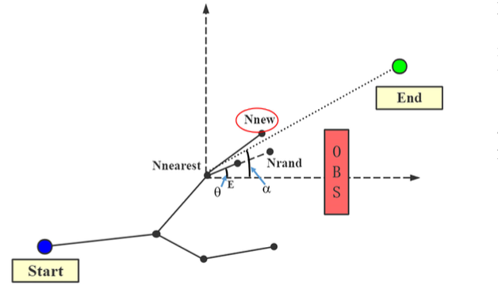
2. Increasing the Power of Guidance
Algorithm modifies the generation of new nodes to be more biased towards the target point
Coordinates of the new node are calculated based on the nearest node, sampling point, and the angle between the nearest node and the target point

Slide 10
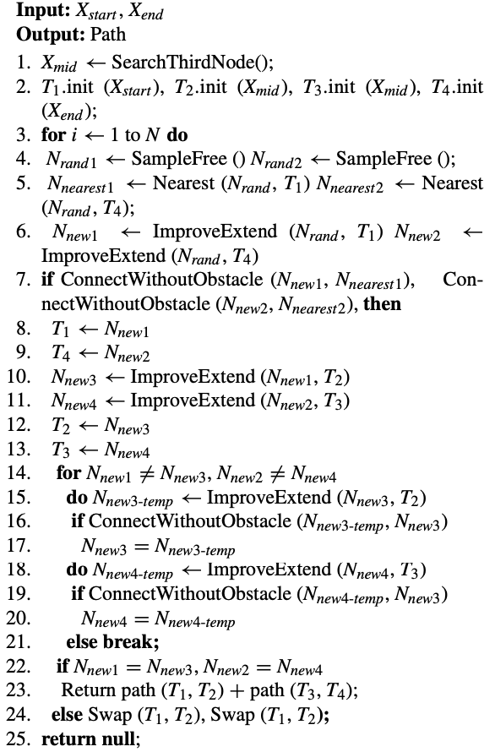
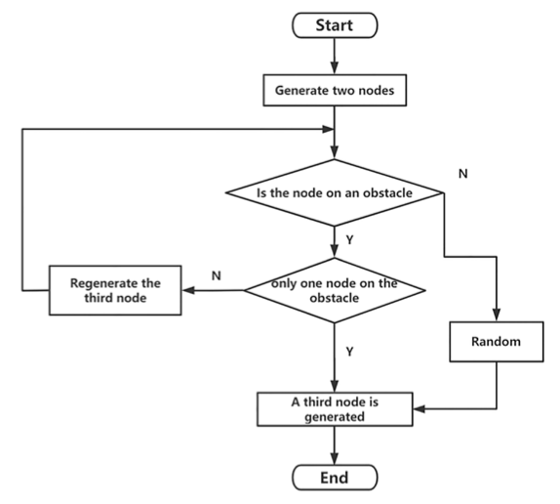
Improved - RRT Connect

Slide 12
Simulation

Slide 13
Results Metrics
Algorithm | Avg Time (sec) | Avg No of Iterations | Avg Length (units)
RRT | 0.3362494349 | 1365 | 68.6245
RRT * | 0.4589979768 | 1585.4 | 66.61785
RRT - Connect | 0.18016922 | 742.85 | 62.6725
Improved RRT - Connect | 0.1001125446 | 585.35 | 55.24189324
Average Results of 30 Experiments of 4 Different Algorithms

Slide 14
Future Work
Implementation of real - time path planning in 3D environments
Use of non – holonomic constraints to the proposed method
Add multiple obstacles in the Map for testing

Slide 15
Conclusion
The performance of four algorithms executed in an environment was compared
Evaluation is based on Average Time, No of iterations, and length
IRRT-Connect reduced the number of iterations by 24%, planning time by 42%, and path length by 11% compared to RRT-Connect

Slide 16
Reference
Meta Paper: https://ieeexplore.ieee.org/abstract/document/9591654
https://ieeexplore.ieee.org/document/844730
https://msl.cs.illinois.edu/~lavalle/papers/Lav98c.pdf

Slide 17
Thank You!
Q&A ??

