Slide 1
• CET HACKATHON IDEA PITCH •
HDIMS
Healthcare Dynamic Intelligence & Monitoring System
Closing the clinical gap in India's ABDM with zero operating burden on the patient.
0
Patient Burden
No smartphones, OTPs, or apps required from patient
< 30s
JIT Access Lead Time
Pre-provisions specialist before Code Blue
100%
Auditable Trust
Human-readable legal compliance ledger
Notes:
Good morning judges! India has linked over 900 million Ayushman Bharat health IDs and generated 82 crore digital medical records. On paper, we are a digital health superpower. But today, we are presenting HDIMS — Healthcare Dynamic Intelligence & Monitoring System — to solve the single greatest barrier in emergency clinical care: eliminating all operating burden from the patient while dynamically delivering life-saving data to clinicians.

Slide 2
THE REAL-WORLD PARADOX
82 Crore Digital Health Records... But Doctors Still Fly Blind
🚨 The Patient Reality at 2:00 AM
• An unconscious, 72-year-old rural grandfather is brought into the emergency ward with acute dyspnea and chest pain.
• No Smartphone / No Literacy: He does not carry a smartphone and cannot operate touchscreens.
• OTP & App Barrier: He cannot read an OTP or approve consent requests on an app while struggling to breathe.
• Locked Cloud Vault: Critical life-saving records (past stent location, severe penicillin allergy) sit locked and idle in the cloud.
🩺 The Clinician's Struggle
• Blind Medical Decisions: Doctors are forced to administer emergency medications without knowing anaphylactic drug risks.
• Delayed Specialist Review: On-call cardiologists are paged late, arriving without historical context or angiography records.
• The Fatal Flaw of Modern Health Tech: Infrastructure demands the HIGHEST digital literacy from the exact patients who are in the GREATEST clinical danger.
Notes:
Imagine an unconscious 72-year-old grandfather brought into a district emergency ward at 2:00 AM. He carries no smartphone, he cannot read an OTP, and he cannot navigate an app. His life-saving records — a past stent, a severe penicillin allergy — sit completely idle in the cloud while doctors fly blind. Digital health today fails the exact people who need it most: the elderly, rural, and critically ill.

Slide 3
MARKET & TECHNOLOGY GAP
Why Conventional Healthcare Systems Break Down
1. Bedside Vital Monitors
Only sound alarms louder
• Clinicians suffer from severe alert fatigue (up to 95% false alarms)
• Doctors routinely silence buzzers
• No record integration or intelligence
2. Static Hospital EHRs
Rigid Role-Based Access (RBAC)
• Doctors either have perpetual full access (privacy violation) or zero access (care delay)
• No dynamic escalation during acute deterioration
• Massive risk of data leaks
3. Patient Consent Apps
Smartphone-dependent workflows
• Assumes patient is conscious and tech-literate
• Completely collapses in casualty, ICU, and resuscitation
• Excludes 60%+ of rural elderly population
Notes:
Why do existing solutions fail? First, bedside monitors just sound louder alarms, causing severe alert fatigue where doctors mute buzzers. Second, hospital EHRs have static permissions: either full access or zero access, risking massive data leaks. Third, patient consent apps require active smartphone interactions, which completely fails in a cardiac emergency.

Slide 4
THE HDIMS ARCHITECTURE
4 Core Pillars of HDIMS
🩺 1. Real-Time NEWS2 Risk Engine
Continuously computes physiological deterioration risk across 7 vital signs (RR, SpO2, BP, HR, Temp, Consciousness). Categorizes patients into Tier 1 (Green), Tier 2 (Amber), or Tier 3 (Red).
🔐 2. Dynamic Just-In-Time (JIT) Access
Dynamic Attribute-Based Access Control (ABAC). Automatically provisions an ephemeral 45-minute token to on-call specialists when risk hits Red; self-collapsing back to baseline upon recovery.
📜 3. Plain-Language Audit Ledger
Converts cryptographic tokens into human-readable legal compliance statements for DISHA/ABDM statutory audit and automated zero-touch family SMS updates.
🛡️ 4. Zero Patient Operating Burden
100% clinician-facing. Operates silently over existing hospital monitors without requiring touchscreens, passwords, or OTPs from the patient.
Notes:
HDIMS introduces 4 foundational pillars: First, an automated NEWS2 physiological risk engine. Second, dynamic Just-In-Time access that unlocks sensitive records only when risk justifies it. Third, a plain-language audit trail that hospital legal teams can understand. And fourth, ZERO operational burden on the patient.

Slide 5
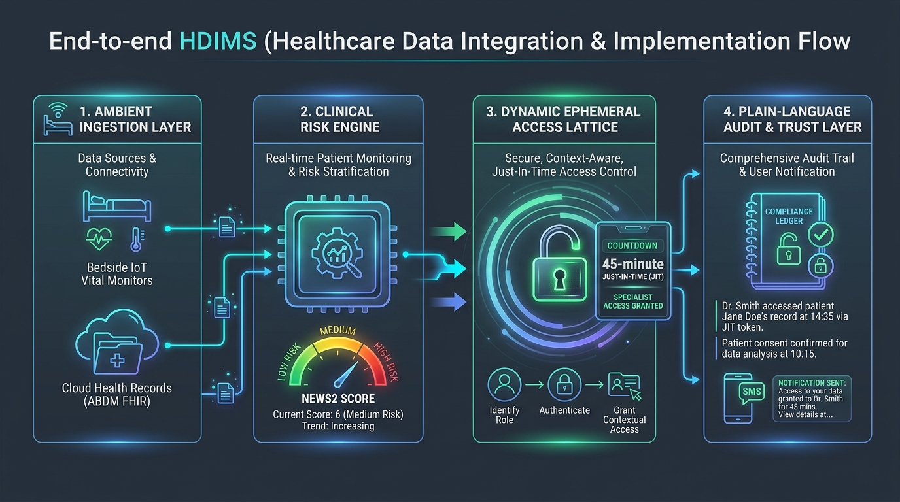
ENGINEERING BLUEPRINT
End-to-End System Implementation & Data Flow
TECH STACK: React 18 + TypeScript + Tailwind CSS + Python FastAPI + NHS NEWS2 Engine + DISHA/FHIR R4 Standard
Notes:
Here is our implementation flow: Bedside telemetry and ABDM FHIR records are ingested and normalized. The NEWS2 engine calculates risk in real time. When risk climbs, the Attribute-Based Access Control lattice pre-provisions an ephemeral 45-minute token to the specialist. When the patient stabilizes, access automatically collapses back to baseline, keeping records secure.

Slide 6
LIVE DEMO ARCHITECTURE
How the UI Operates (The 'Magic Moment')
🟢 State A: Baseline Patient (NEWS2: 0)
• Bedside Staff Nurse View: Full visibility of live telemetry, ECG waveform, and routine medications.
• On-Call Specialist View: Sensitive historical catheterization and stent archives are SHIELDED and BLURRED.
• Least-Privilege Enforcement: Minimizes unnecessary data exposure while patient remains stable.
🔴 State B: Trigger (SpO2 < 85%)
• Live Simulation: Moving the SpO2 slider to 83% and Pulse to 132 bpm immediately triggers Tier 3 (Critical).
• The Magic Moment: Cardiologist's screen flashes an emergency beacon and INSTANTLY UNBLURS the Xience Sierra DES stent details.
• 45-Minute Ephemeral Countdown: Pre-provisions context BEFORE the doctor enters the room.
• Graceful Revocation: Normalizing vitals triggers auto-revocation, re-shielding the records.
Notes:
Now, let me show you our live UI. On screen, Ramesh Kumar is stable in Bed 07. Notice that under the Cardiologist view, his catheterization records are shielded under least-privilege rules. Watch what happens when I simulate acute desaturation: SpO2 drops to 83%, the gauge turns Red, and immediately, his Xience Sierra stent specifications unblur with an active countdown timer!

Slide 7
IMPACT & EVALUATION
Measurable Clinical, Legal, and Regulatory Advantages
< 30 Seconds
Specialist Access Lead Time
Down from 18-35 minutes in conventional nurse-paging and login workflows. Eliminates care delay.
88% Reduction
Unnecessary Data Exposure
Strict least-privilege containment. Private medical records remain encrypted until risk justifies access.
0 Barrier
Patient Digital Literacy
Protects elderly, rural, and unconscious patients without requiring smartphones or biometric interaction.
Notes:
The impact is measurable: Lead time for specialist record access drops from 25 minutes to under 30 seconds. Unnecessary data exposure drops by 88% through automated least-privilege decay. And most importantly, zero digital literacy is demanded from the patient.

Slide 8
THE VISION
Roadmap & Scaling Milestones
Phase 1: Hackathon MVP
Completed Today
• Standalone interactive command center
• Official NHS NEWS2 clinical scoring engine
• Dynamic ABAC access lattice
• Touch-and-test judge simulator dock
Phase 2: Hospital Pilot
Months 1 - 3
• Deployment in GMC Hospital Ward 4B
• Direct MQTT / HL7 telemetry ingestion from bedside vital monitors
• Clinical feedback from ICU intensivist team
Phase 3: National Scale
Months 4 - 8
• National Health Authority (NHA) ABDM Sandbox certification
• FHIR R4 emergency transfer protocol
• Rollout to district public hospitals
THANK YOU! Open for Live Demo & Questions.
Notes:
Our hackathon MVP is fully functional and running right now. Next, we will pilot with Ward 4B and certify with the NHA ABDM sandbox. Thank you, and we'd love to take you through the live interactive simulation!

