Slide 1

8086 Assembly Stopwatch
A simple explanation of how the stopwatch program works

Slide 2




Purpose of the Program
This program is a stopwatch built in 8086 Assembly.
It shows time in MM:SS:HH format.
It uses BIOS interrupts to read keyboard, timer, and update screen.
User controls: SPACE = Start/Stop, R = Reset, Q = Quit.

Slide 3
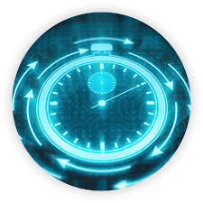
DATA Section Explained
  Contains all the strings displayed on screen: header, title, controls.
  Variables used:
  - start_tick: stores tick count when stopwatch starts.
  - accumulated: stores previous run time ticks.
  - current_tick: final tick value to display.
  - is_running: 0 = stopped, 1 = running.
  - time_str: buffer storing formatted time output.

Slide 4
Program Initialization
01
MOV AX, @DATA → Load data segment.
02
INT 10h → Set text mode (80x25).
03
Cursor hidden using INT 10h AH=01h.
04
DRAW_INTERFACE is called to print UI and timer display.

Slide 5


Main Loop Flow
Program keeps checking for keypress using INT 16h AH=01h.
If a key is pressed → HANDLE_INPUT.
If no key → TIMER_SECTION updates timer.
A small delay loop controls update speed.

Slide 6
Input Handling (HANDLE_INPUT)
INT 16h AH=00h reads the key pressed.
Keys:
Q/q → Quit program.
SPACE → Toggle start/stop state.
R/r → Reset timer.
If no matching key, it returns to timer update.

Slide 7
Start/Stop (TOGGLE_ROUTINE)
  is_running is flipped (0→1 or 1→0).
  If starting: store current BIOS tick (DX) into start_tick.
  If stopping: get current tick, subtract start_tick, add to accumulated.
  Status text on screen is updated accordingly.

Slide 8
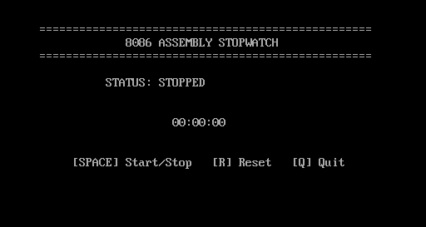
Reset Routine
  is_running set to 0 (stopped).
  accumulated set to 0.
  start_tick set to 0.
  DRAW_ZEROS prints 00:00:00 on the screen.

Slide 9
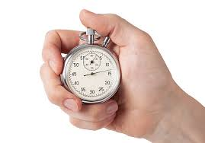
TIMER_SECTION
  If stopwatch is running:
  - Get current tick using INT 1Ah.
  - Subtract start_tick and add accumulated.
  - Store result in current_tick.
  - Call TICKS_TO_TIME to convert ticks to MM:SS:HH.
  - Call DRAW_TIME to print time.
  If not running: skip time update.

Slide 10

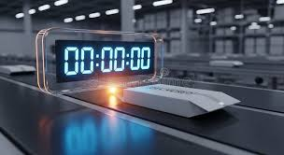
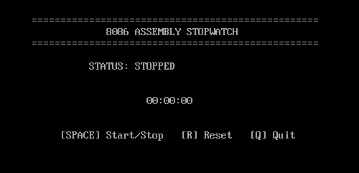
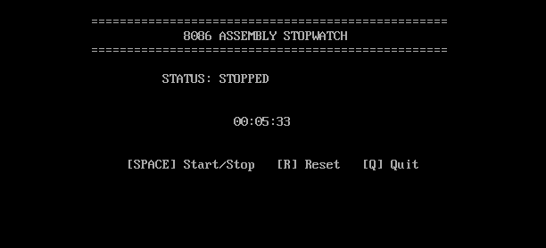
Drawing Output
DRAW_INTERFACE prints header, title, controls, initial time.
DRAW_ZEROS prints 00:00:00 when resetting.
DRAW_TIME prints time_str at the correct screen position.

Slide 11
TICKS_TO_TIME (Simple Explanation)
Takes current_tick value and converts it to:
- Minutes
- Seconds
Uses division by constants to convert from BIOS ticks to time.
- Hundredths
Updates the time_str buffer.

Slide 12

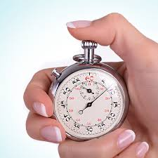

Summary
The program uses BIOS interrupts to build a working stopwatch.
Handles input, timing, and display manually.
Shows how low-level hardware timing works in 8086 Assembly.
Simple logic, modular design, easy to understand flow.

Slide 13





