Slide 1

HACKATHON
ON
“THE FUTURE OF FOOD TECH”
TEAM
BALASAKTHI A (3RD YR IT)
SHARRAN N (3RD YR MECH)

Slide 2
HACKATHON
ON
“THE FUTURE OF FOOD TECH”
PROBLEM STATEMENTS
WE CHOSE
KITCHEN DESCRIPTION BUILDER
KITCHEN REVIEW SUMMARY

Slide 3
KITCHEN DESCRIPTION BUILDER
Description:
Build algorithms to automate text generation for the kitchen type based on the menus that kitchen offers. The summary should be 2-3 lines in the mobile screen width.

Slide 4
STRENGTH
THREAT
T
OPPUTUNITIES
WEAKNESS
Data Quality issues
Competitions
Ethical concerns
Bias in training data
Changes in menu format
S
O
Automation
Scalability
Objectivity
Personalisation
Data Dependency
Limited Understanding
Template Limitation
Neural network challenge
Integration with other platforms
Targeted Marketing
New cuisine Discovery
Personalization advancement
W
What are we going to do?
Collection of Data
Keyword Extraction
Text Generation
Keyword Extraction
Frequent dishes

Slide 5
STRENGTH
THREAT
T
OPPUTUNITIES
WEAKNESS
Data Quality issues
Competitions
Ethical concerns
Bias in training data
Changes in menu format
S
O
Automation
Scalability
Objectivity
Personalisation
Data Dependency
Limited Understanding
Template Limitation
Neural network challenge
Integration with other platforms
Targeted Marketing
New cuisine Discovery
Personalization advancement
W
What are we going to do?
Collection of Data
Either from the Kitchen itself as a file/ as a pdf
Or we can scrap the menu from their respective profiles or other open source websites
Keyword Extraction
Frequent dishes

Slide 6
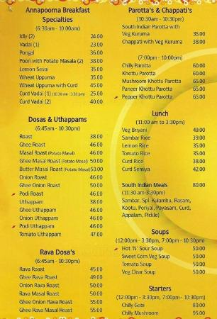
STRENGTH
THREAT
T
OPPUTUNITIES
WEAKNESS
Data Quality issues
Competitions
Ethical concerns
Bias in training data
Changes in menu format
S
O
Automation
Scalability
Objectivity
Personalisation
Data Dependency
Limited Understanding
Template Limitation
Neural network challenge
Integration with other platforms
Targeted Marketing
New cuisine Discovery
Personalization advancement
W
What are we going to do?
Collection of Data
Either from the Kitchen itself as a file/ as a pdf
Or we can scrap the menu from their respective websites
Keyword Extraction
Frequent dishes
Text Generation
Pre Trained models
Template based approach
Neural Network approach?!
Named entity recognition
Personalized Data
(Chef’s note)

Slide 7
STRENGTH
THREAT
T
OPPUTUNITIES
WEAKNESS
Data Quality issues
Competitions
Ethical concerns
Bias in training data
Changes in menu format
S
O
Automation
Scalability
Objectivity
Personalisation
Data Dependency
Limited Understanding
Template Limitation
Neural network challenge
Integration with other platforms
Targeted Marketing
New cuisine Discovery
Personalization advancement
W
What are we going to do?
Text Generation
Pre Trained models
Template based approach
Neural Network approach?!
Keyword Extraction
Frequent dishes
Keyword Extraction
Frequent dishes

Slide 8
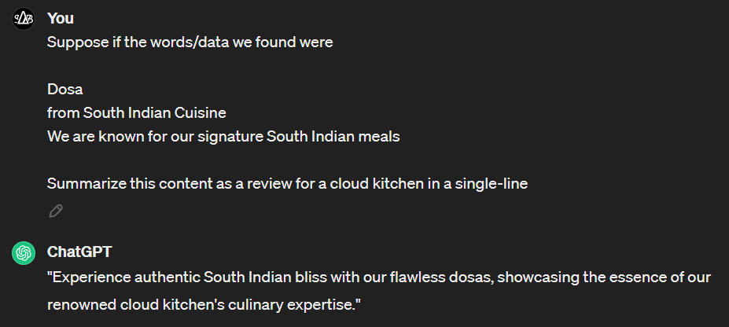
KITCHEN DESCRIPTION BUILDER

Slide 9
KITCHEN DESCRIPTION BUILDER

Slide 10
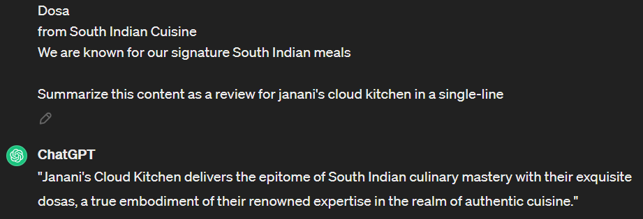
KITCHEN DESCRIPTION BUILDER

Slide 11
KITCHEN DESCRIPTION BUILDER

Slide 12
Swot analysis
S
W
T
A final check
O

Slide 13
STRENGTH
S
Automation
Scalability
Objectivity
Personalisation
W
T
WEAKNESS
O
Data Dependency
Limited Understanding
Template Limitation
Neural network challenge

Slide 14
STRENGTH
Automation
Scalability
Objectivity
Personalisation
WEAKNESS
W
Data Dependency
Limited Understanding
Template Limitation
Neural network challenge
S
O
OPPUTUNITIES
T
Integration with other platforms
Targeted Marketing
New cuisine Discovery
Personalization advancement

Slide 15
STRENGTH
WEAKNESS
Automation
Scalability
Objectivity
Personalisation
Data Dependency
Limited Understanding
Template Limitation
Neural network challenge
OPPUTUNITIES
O
Integration with other platforms
Targeted Marketing
New cuisine Discovery
Personalization advancement
T
W
S
THREAT
Data Quality issues
Competitions
Ethical concerns
Bias in training data
Changes in menu format

Slide 16
STRENGTH
OPPUTUNITIES
WEAKNESS
Automation
Scalability
Objectivity
Personalisation
Data Dependency
Limited Understanding
Template Limitation
Neural network challenge
Integration with other platforms
Targeted Marketing
New cuisine Discovery
Personalization advancement
THREAT
T
Data Quality issues
Competitions
Ethical concerns
Bias in training data
Changes in menu format
S
O
W

Slide 17
HACKATHON
ON
“THE FUTURE OF FOOD TECH”
PROBLEM STATEMENTS
WE CHOSE
KITCHEN DESCRIPTION BUILDER
KITCHEN REVIEW SUMMARY

Slide 18
KITCHEN REVIEW SUMMARY
Description:
Build algorithms to automate the generation of summaries for customer reviews. We receive numerous reviews from different customers for various orders, and we need to generate summaries from the hundreds of reviews collected.

Slide 19
Problem?
Do we have time to give reviews and feedbacks?
And even if we have time, When to give feedback?
NO!

Slide 20
Could be a solution
A notification could be a nice idea.
Psst…
Had your food? So, how was it?

Slide 21
Review
So how was the food?
Type your review…
SUBMIT

Slide 22

Review
RATINGS
Again
So how was the food?

Slide 23
Again
So how was the food?
RATINGS
Delicious Flavourful Fresh Satisfying Delectable
Tasty Well-Prepared Appetizing Mouthwatering Enjoyable

Slide 24
Again
So how was the food?
Delicious Flavourful Fresh Satisfying Delectable
Tasty Well-Prepared Appetizing Mouthwatering Enjoyable
Thank you for your response
Still wanna give review?
Quality (Food)
Quality (Packaging)
YES
NO
Quantity
Timeliness
SUBMIT

Slide 25
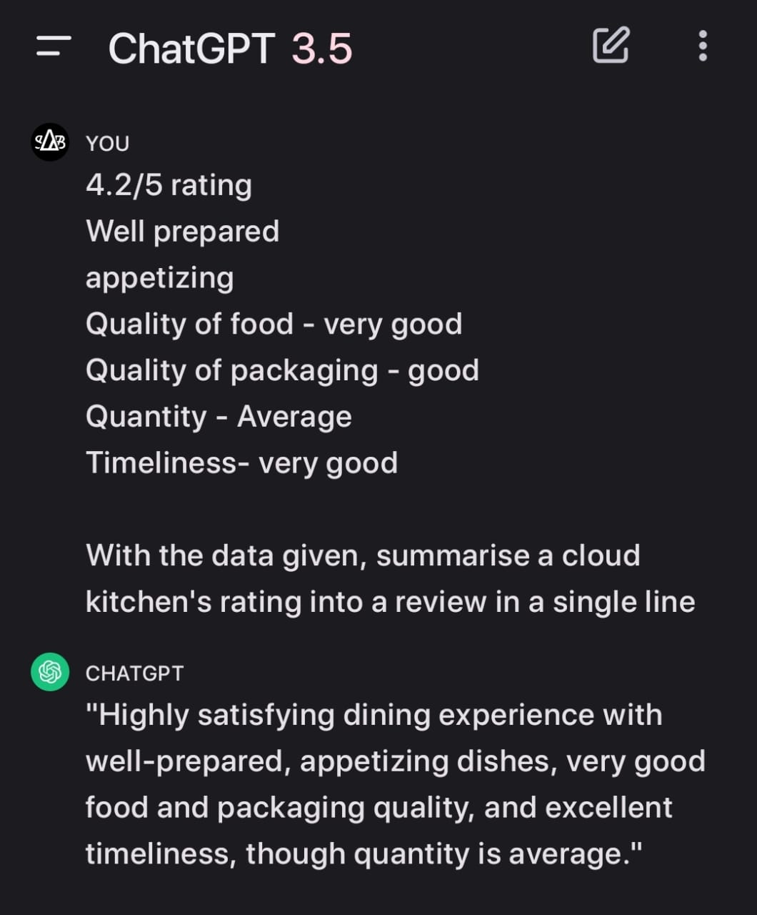
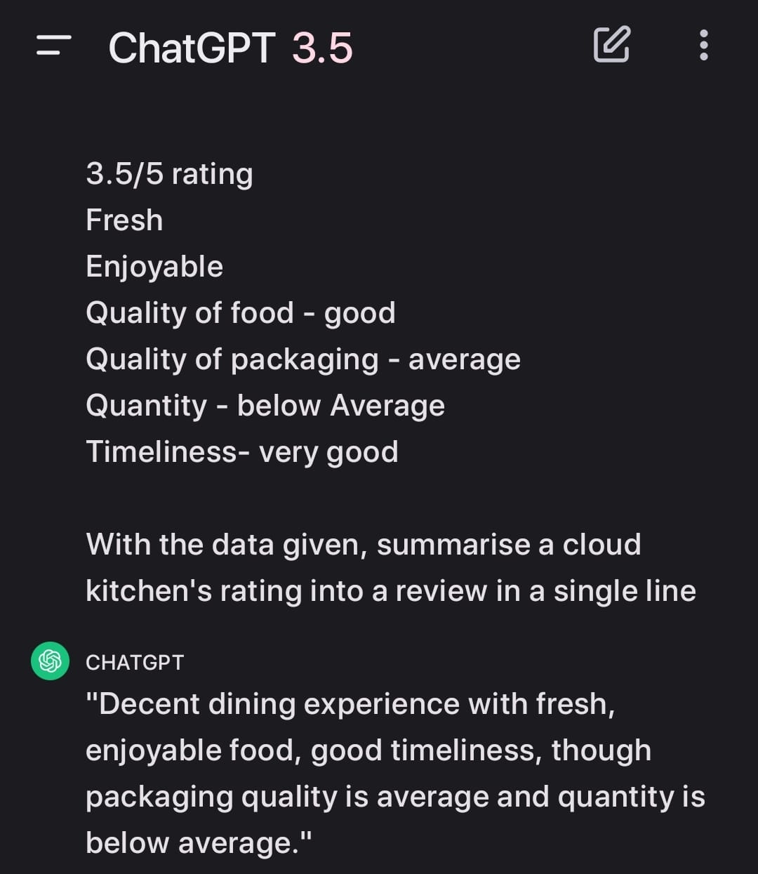

Slide 26
Swot analysis
S
W
T
A final check
O

Slide 27
STRENGTH
S
Efficiency
Scalability
Clear Overview
Easy to Analyse
W
T
WEAKNESS
O
Limited Understanding
Missing Information
Specificity

Slide 28
STRENGTH
Automation
Scalability
Objectivity
Personalisation
WEAKNESS
W
Limited Understanding
Missing Information
Specificity
S
O
OPPUTUNITIES
T
Personalization advancement
Enhanced UX
Simplified Feedback

Slide 29
STRENGTH
WEAKNESS
Automation
Scalability
Objectivity
Personalisation
Data Dependency
Limited Understanding
Template Limitation
Neural network challenge
OPPUTUNITIES
O
Personalization advancement
Enhanced UX
Simplified Feedback
T
W
S
THREAT
Customers
Decreased Trust
Difficulty in addressing concerns

Slide 30
STRENGTH
OPPUTUNITIES
WEAKNESS
Automation
Scalability
Objectivity
Personalisation
Data Dependency
Limited Understanding
Template Limitation
Neural network challenge
Integration with other platforms
Targeted Marketing
New cuisine Discovery
Personalization advancement
THREAT
T
Customers
Decreased Trust
Difficulty in addressing concerns
S
O
W

Slide 31

Thank you
Balasakthi a
Sharran n

