Slide 1


Introduction to Student Result Managemnt System
Managing student results is a critical task for educational institutions. It involves recording, tracking, and disseminating student performance data.

Slide 2
Overview of the Dashboard and its Components
Dashboard:
Navigation: Users can easily navigate between different sections of the Student Result Management System using the navigation links provided in the header.
Search Functionality: The search form allows users to search for specific student records based on registration numbers, enhancing the accessibility and usability of the system.
Background Image: The background image enhances the visual appeal of the dashboard, creating a more engaging user experience.
Form Interaction: The form allows users to interact with the system, providing input and triggering actions such as searching for student records.
Footer Information: The footer provides additional information and context to the dashboard, improving user understanding and trust in the system.

Slide 3
Add result
This dashboard serves as an interface for administrators or authorized personnel to add student results into the system. It provides a user-friendly form where they can input details such as registration number, student name, year, and marks obtained in each academic year. The system is designed to handle up to four years of academic data.
Features:
Navigation links allow easy access to different sections of the system, such as Dashboard, View Result, and Edit Result.
Form validation (specified by required attribute in input fields) ensures that essential fields are filled before submitting.
The system can handle multiple academic years, accommodating a variety of educational programs.
The Save button submits the form data, presumably to a backend system for processing and storage.

Slide 4
Edit result:
Edit Result Functionality: This page allows administrators or authorized users to edit student result details, such as their marks for different academic years, which is crucial for maintaining accurate academic records.
Navigation: Users can easily navigate between different sections of the system, including the dashboard, view result, add result, and logout, enhancing user experience and system usability.
Form Interaction: Users can input the registration number of the student and then edit their details, with the option to save the changes made. This form facilitates user interaction and data modification within the system.
Data Validation: HTML attributes like required ensure that essential fields are filled before submitting the form, improving data integrity.
Script Integration: The inclusion of JavaScript files indicates the presence of client-side scripting to handle dynamic behavior, such as displaying the edit form upon searching for a student's registration number.

Slide 5
Search:
This code is likely part of a web application designed for educational institutions or any organization where student records are managed.
It allows users to search for student details by entering their registration number.
Upon entering a registration number, the application dynamically fetches and displays the corresponding student's details including their name, year, marks, and mobile number.
The "Back" button enables users to navigate back to the previous page, presumably a dashboard or search form.

Slide 6
View result:
Student Result Management: Provides a platform for students, teachers, and administrators to access and view academic results conveniently.
User Navigation: Offers easy navigation through the dashboard with links to various sections such as viewing results, adding results, and editing results.
Dynamic Result Display: Utilizes JavaScript to dynamically display search results, enhancing user experience by updating content without page reloads.
Data Presentation: Presents student results in a structured format, making it easy for users to interpret and analyze academic performance.
Responsive Design: Ensures responsiveness across different devices and screen sizes, facilitating access to student results from desktops, tablets, and smartphones.
Efficient Information Retrieval: Allows users to quickly search for and access specific student records using registration numbers or other identifiers.

Slide 7
Features of the Student Result Management System
1
Performance Analysis
2
Result Database:
3
Customization
stores data of students with registration number and creates a database.
Allows customization of grading systems, exam types, and academic terms.
It allows in-depth analysis of student performance to identify areas of improvement.

Slide 8




Objectives of Implementing the System
Efficiency
To streamline result management processes for faster outcomes.
Transparency
To ensure transparency in grading and result distribution.
Customization
Offering flexibility to adapt to the specific needs and requirements of different educational institutions, including support for various grading systems, exam formats, and reporting formats.

Slide 9
Future Scope and Enhancements
1
AI Integration
Future integration of AI for predictive analysis and personalized feedback.
2
Enhanced Data Security
Improving security measures to protect student data and privacy.
3
Mobile Accessibility
Development of mobile apps for easier access to academic results.

Slide 10
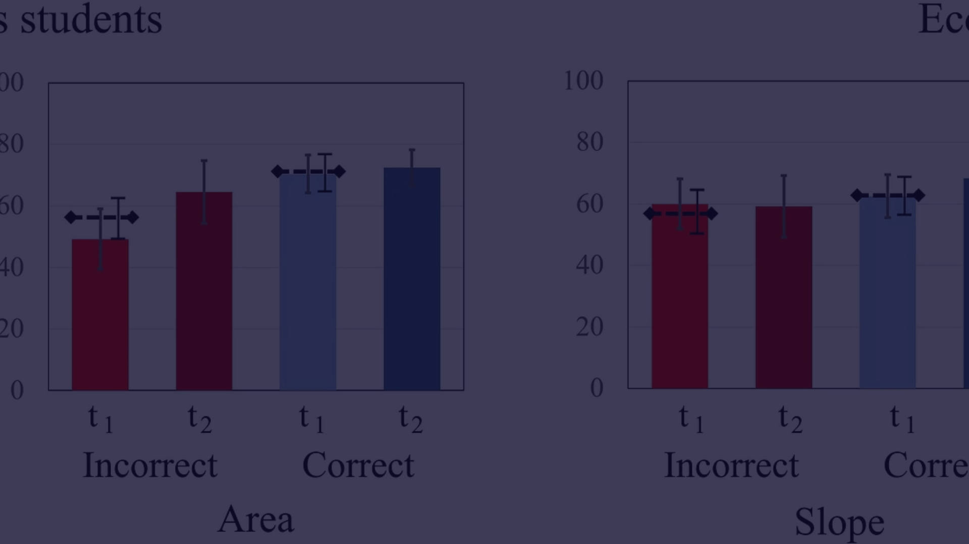
Benefits of Using the Student Result Management System
Efficiency
Data Accuracy
Improved Communication
Streamlines the result tracking and announcement process for educational institutions.
Ensures accurate and timely recording of student academic performance data.
Facilitates better communication between teachers, students, and parents regarding academic progress.

Slide 11
Implementation Challenges and Solutions
Challenges
Solutions
Resistance to change, data migration issues, and training requirements.
Comprehensive change management, data migration strategies, and training programs.

Slide 12
Conclusion and Key Takeaways
3
95%
Data Management
Time Savings
Improved data management leads to better decision-making.
Significant time savings in result generation and analysis.

Slide 13
Thank You

