Slide 1









Idea submission

Slide 2


Team details
Team Lead:
Name : Aditya C
Contact : 9535931646
Email : adityachitgopker.cs24@bmsce.ac.in
Team Member 2:
Name : Abhishek KS
Contact : 8431257083
Email : abhishekks.cs24@bmsce.ac.in
Team Member 3:
Name : Abhinav Chandrasekhar
Contact : 9880900422
Email : abhinavchandrasekar.cs24@bmsce.ac.in

Slide 3


Our solution
Our project focuses on building an AI-powered supply chain resilience platform designed for logistics departments.
Using Python for the backend, we've integrated real-time data from OpenWeatherMap for weather predictions and Mapbox for traffic conditions.
On the front end, we’ve used TypeScript and React.js to create an intuitive interface that displays the data clearly.

Slide 4
Our solution
The platform helps logistics teams make informed decisions such as:
Prevents disruptions and reduces losses and identifies supply chain risks
Optimized route planning by analyzing weather and traffic patterns, ensuring safe and efficient travel routes.
Saves Costs & Boosts Efficiency
By leveraging these technologies, the system minimizes risks, optimizes delivery times, and enhances the resilience of the supply chain.

Slide 5

TECHNICAL APPROACH
AIML
IoT
Real-Time Sensors
Cloud Computing and Edge Computing
Big data and advanced analytics
Geographic Information Systems

Slide 6
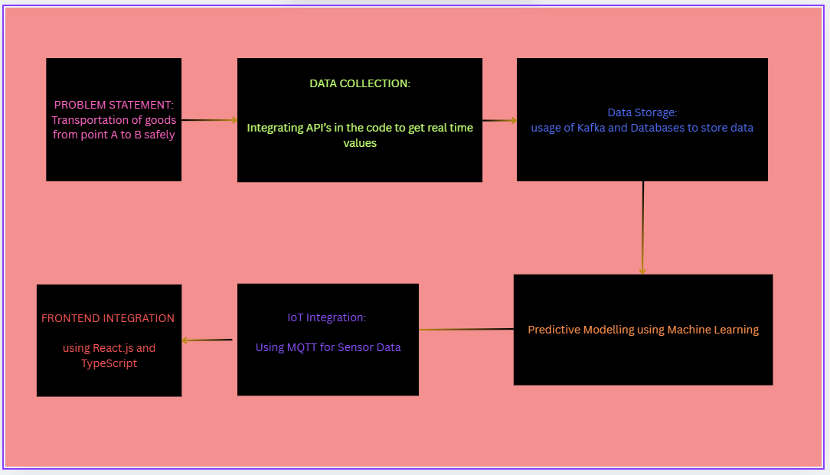
Workflow/pipeline

Slide 7
.
Feasibility & FUTURE SCOPE
The pros and cons of the key technologies used in our AI-powered supply chain resilience platform:
OpenWeatherMap API:
Pros:
Comprehensive Weather Data: Provides a wide range of weather data (current conditions, forecasts, historical data) globally.
Easy Integration: Well-documented REST API that is easy to integrate with any platform.
Cons:
Accuracy: Weather data is not always 100% accurate and may vary depending on location, especially in real-time conditions.
Rate Limits: High usage may lead to rate limiting or require paid plans to handle the volume of requests.

Slide 8
.
Feasibility & FUTURE SCOPE
MapBox API:
Pros:
Advanced Geospatial Features: Provides detailed and customizable maps, including geocoding, routing, and real-time traffic data.
Scalable: Can handle large-scale data and complex geographical tasks.
Cons:
Pricing: Although Mapbox has a free tier, heavy usage can become expensive, especially with high-volume requests.
Complexity: Advanced geospatial features may require a deeper understanding of mapping and spatial data.

Slide 9
.
Feasibility & FUTURE SCOPE
MQTT:
Pros:
Lightweight: MQTT is designed for low-bandwidth, high-latency, and low-power environments, making it ideal for IoT applications.
Real-Time Communication: It supports real-time messaging, which is crucial for IoT sensor data.
Cons:
Security Concerns: MQTT typically lacks built-in encryption and authentication (though it can be configured), making it vulnerable if not properly secured.
Scalability Challenges: As the number of devices grows, managing MQTT brokers can become more complex and resource-intensive.

