Slide 1
Climate Change Analysis
By Skanda.V.C
Abhishek M
Venkatesh

Slide 2
Motivation
Climate Change has become a hotly contested debate nowadays. Many people believe that Climate Change is real and is severely affecting the world. But at the same time , there are few people who believe that it is a hoax. The project aims to an analysis on temperature change which has been happening throughout the world and how various geographic regions of the world are being affected. Also, the project aims to predict future temperatures region wise so that timely remedies are taken to prevent Kerala and Kodagu flood like events.

Slide 3
Purpose of the Website
The website has been designed to know more about the changes in temperature that are going to take place in our environment.
The website will provide rich information about the past, present and future temperatures and the necessary changes required to prevent them.
A Linear Regression model has been developed to predict future temperatures of each city in the world.
A host of graphs, maps would be there for easy visualization of data so that it helps data scientists and environmentalists alike.

Slide 4
Layout of The Website
The Website would consist of 3 main web pages.
The Home page would consist of a world map from which the required city can be selected.
The coordinates are captured along with input temperature and sent for processing.
The future temperature would be output in a new webpage along with all the necessary graphs and visualizations to analyse the data correctly.
There would be sign-up page for users to register so that data can be downloaded.

Slide 5
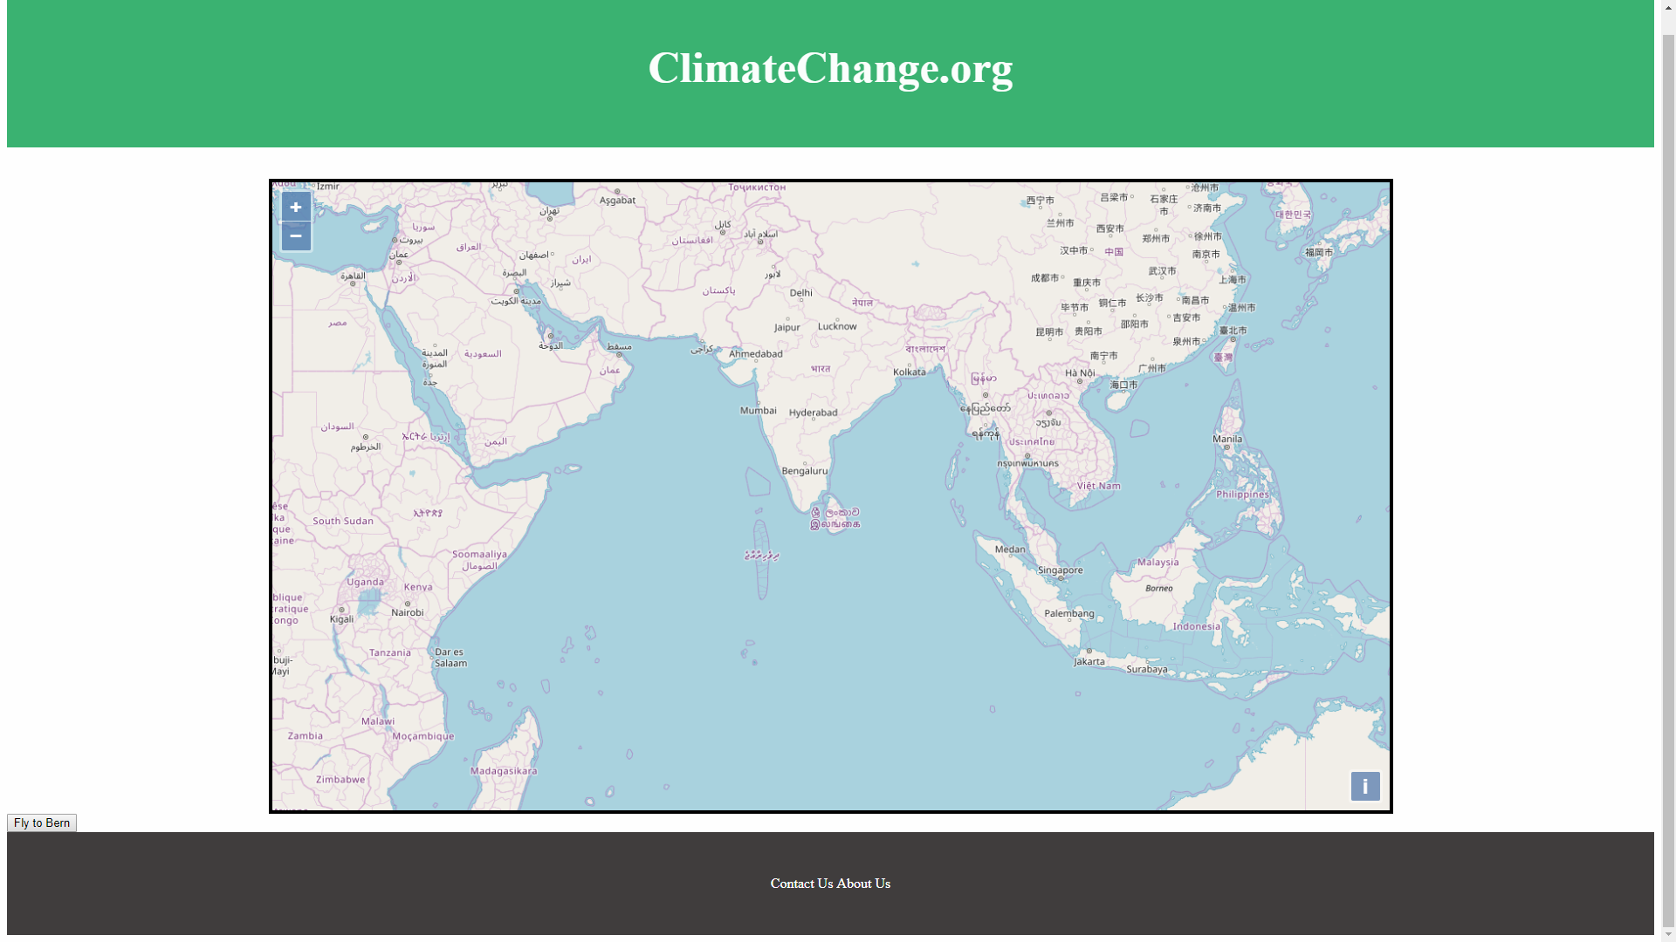
Screenshot of Prelimilary Screenshot

Slide 6
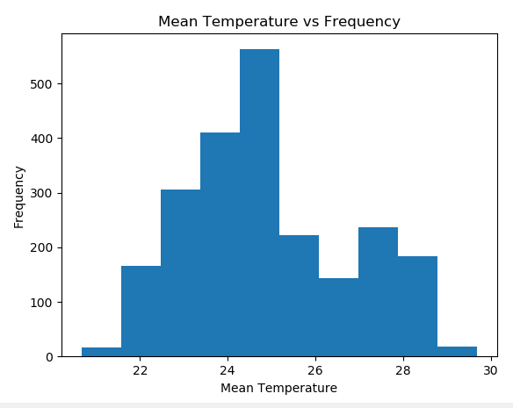
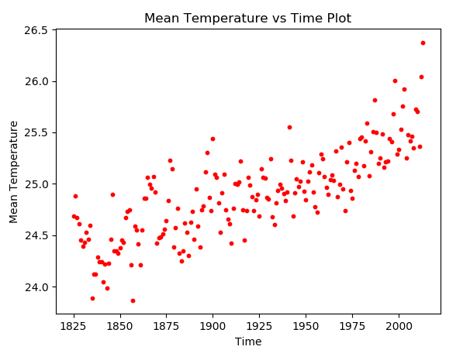
Graphs that would be displayed.
Histogram
Scatter Plot

Slide 7
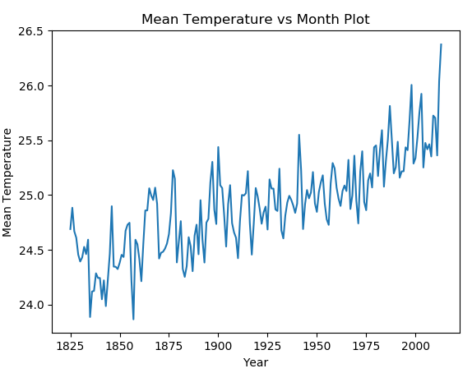
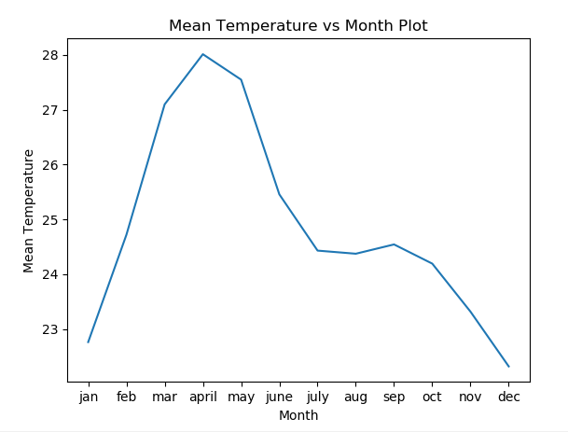
Graphs that would be displayed.
Line Charts

Slide 8

Features
Geolocation. The site with user permission will get the current location and give the data for the location.
Animations to make webpage look more interactive
Facility to download the graphs and other data on sign-in

