Slide 1
WEEK 1
STATINOMICS
C R DEEPAK KUMAR
HARIRAMKRISHNAN.S

Slide 2
IMPUTATION
MEDIAN
TRANSPOSED THE DATA, THEN APPLIED MEDIAN TO EACH OBSERVATION
ITS NOT AFFECTED BY OUTLIERS
df.fillna(df.median())

Slide 3
PREDICTION
SLOPE(Y,X)
WEEK_DAYS CONVERTED TO 1,2,3,4,5 RESPECTIVELY. (X)
INTERCEPT(Y,X)
WEEK_DAYS CONVERTED TO 1,2,3,4,5 RESPECTIVELY. (X)
Accuracy is 93%. Using r2.
FOR WEEK 2 VALUES, KEPT X AS 6,7,8,9,10 RESPECTIVELY
USED FORMULA SLOPE*X+INTERCEPT

Slide 4
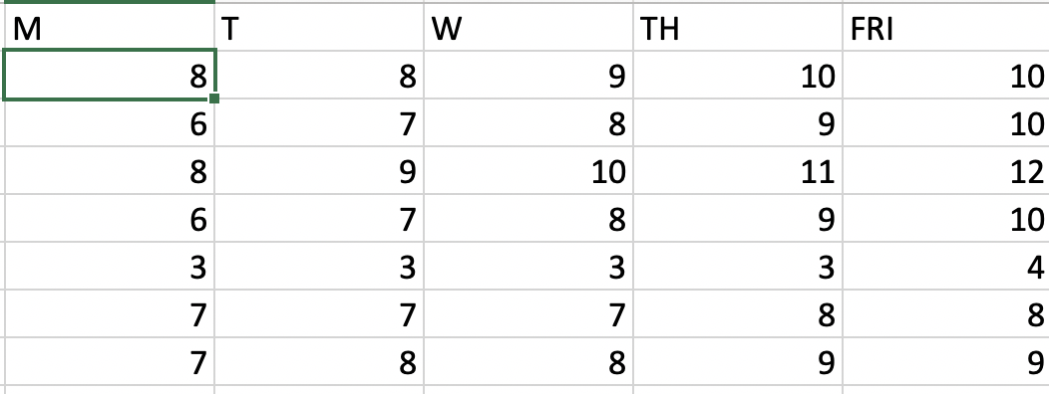
FIRST 7 VALUES OF WEEK 2

Slide 5
THANK YOU

