Slide 1
WEEK – 3 STATINOMICS
C R DEEPAK KUMAR
DEEPAK RAMESH

Slide 2
SEQUENCE
TREND OF THE DATA
COMPARISION OF MISSINGNESS PRESENT IN DATA
IMPUTATION METHODS
MEASURE OF SKEWNESS AND KURTOSIS
VISUALISING THE DISTRIBUTION
FEATURE IMPORTANCE
PREDICTION

Slide 3
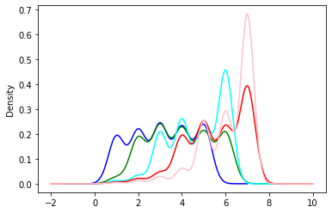
TREND OF DATA
DARK BLUE – MONDAY
GREEN – TUESDAY
CYAN – WEDNESDAY
RED – THURSDAY
PINK - FRIDAY

Slide 4
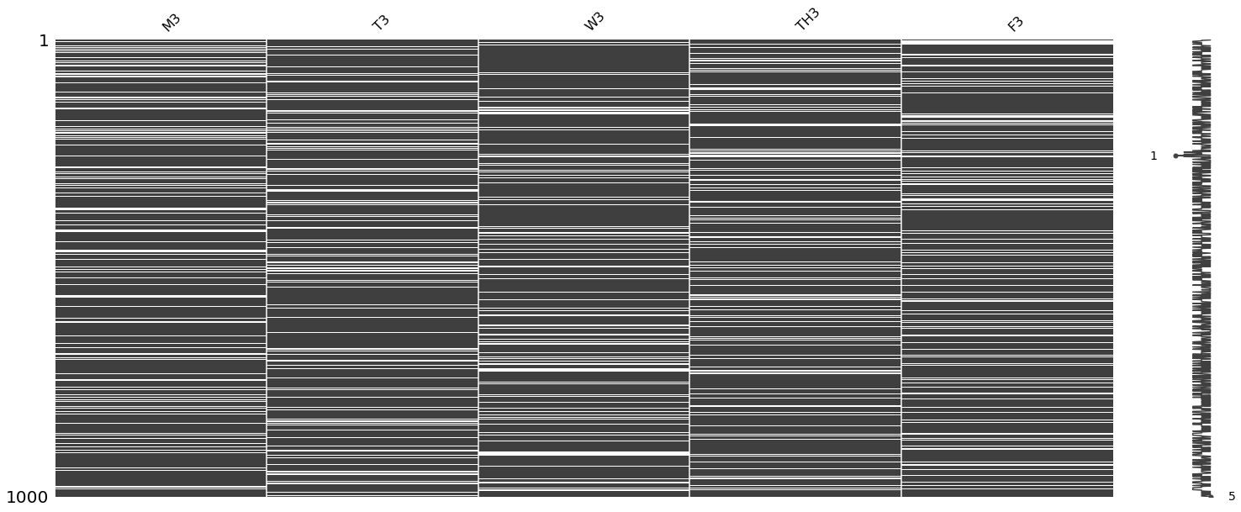

Slide 5
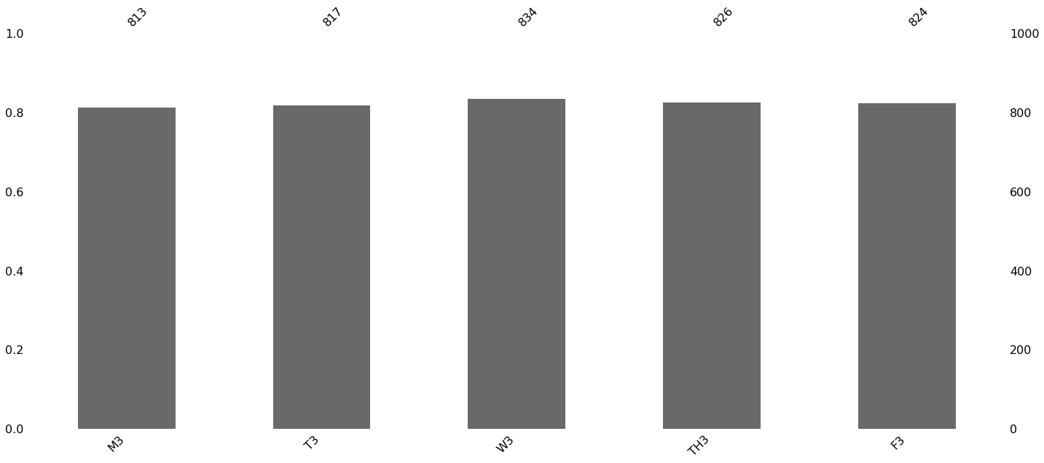

Slide 6
COMPARISION OF MISSINGNESS PRESENT IN DATA
MISSING COMPLETELY AT RANDOM (MCAR):
NO PATTERN BETWEEN OF FILLED VALUES PRESENT IN DATA
MISSING AT RANDOM (MAR):
PATTERN PRESENT IN FILLED VALUES PRESENT IN DATA
MISSING NOT AT RANDOM:
PATTERN PRESENT IN MISSING VALUES AS WELL AS FILLED VALUES IN DATA
CONCLUSION:
MISSING VALUES ARE RANDOM BUT ACTUAL VALUES FOLLOW POSITIVE TREND THEREFORE IT IS MAR

Slide 7
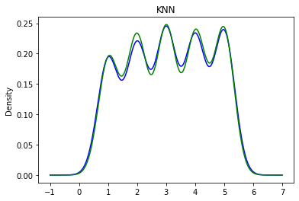
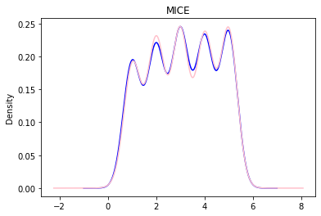
IMPUTATION

Slide 8
SKEWNESS
Z_{g1} < −2, the population is very likely skewed negatively
Z_{g1} is between −2 and +2, you can’t reach any conclusion about the skewness of the population: it might be symmetric, or it might be skewed in either direction.
If Z_{g1} > 2, the population is very likely skewed positively

Slide 9
SKEWNESS
SKEWNESS: g₁ = m₃ / m₂^{3/2} (POPULATION)
SAMPLE SKEWNESS:
STANDARD ERROR IN SKEWNESS:
95% PERCENT CONFIDENCE INTERVAL OF POPULATION SKEWNESS:
G1 +-2SES

Slide 10
KURTOSIS
Z_{g2} < −2, the population very likely has negative excess kurtosis (kurtosis <3, platykurtic)
Z_{g2} is between −2 and +2, you can’t reach any conclusion about the kurtosis: excess kurtosis might be positive, negative, or zero.
Z_{g2} > +2, the population very likely has positive excess kurtosis (kurtosis >3, leptokurtic)

Slide 11
KURTOSIS
KURTOSIS: m₄ / m₂²
EXCESS KURTOSIS OF POPULATION (G2) : KURTOSIS -3
SAMPLE EXCESS KURTOSIS:
STANDARD ERROR IN KURTOSIS :
TEST STATISTIC: G2/SEK

Slide 12
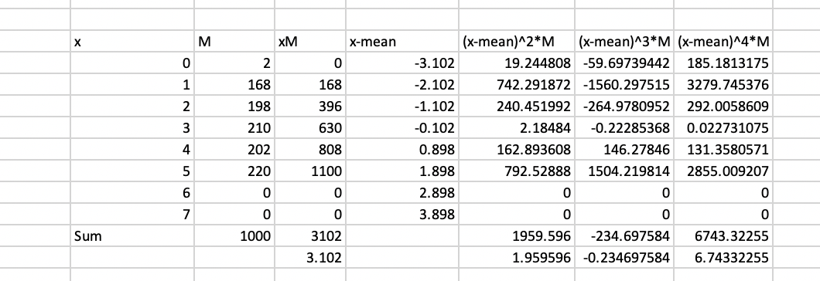
MOMENTS OF THE DATA

Slide 13
MONDAY
TUESDAY
 |  | m3 | -0.234697584
Kurtosis | 1.756066043 | m2 | 1.959596
sample Excess Kurtosis | -1.24415201
 |  | Sample Skewnwss | -0.085686224
Standard error of Kurtosis | 0.154534255 | Standard error of Skewness | 0.077343816
Test Statistic | -8.0509788
 |  | 95% confidence Interval | -0.240373855
 |  |  | 0.069001407
 |  | m3 | 5.94776752
Kurtosis | 2.131822675 | m2 | 2.873628
sample Excess Kurtosis | -0.86650981
 |  | Sample Skewnwss | 1.222813903
Standard error of Kurtosis | 0.154534255 | Standard error of Skewness | 0.077343816
Test Statistic | -5.60723451
 |  | 95% confidence Interval | 1.068126271
 |  |  | 1.377501534
WEDNESDAY
THURSDAY
 |  | m3 | 10.31551289
Kurtosis | 1.740525552 | m2 | 4.069704
sample Excess Kurtosis | -1.25977048
 |  | Sample Skewnwss | 1.258342296
Standard error of Kurtosis | 0.154534255 | Standard error of Skewness | 0.077343816
Test Statistic | -8.15204684
 |  | 95% confidence Interval | 1.103654664
 |  |  | 1.413029927
 |  | m3 | 26.95011157
Kurtosis | 1.552841478 | m2 | 7.918144
sample Excess Kurtosis | -1.44839637
 |  | Sample Skewnwss | 1.211372407
Standard error of Kurtosis | 0.154534255 | Standard error of Skewness | 0.077343816
Test Statistic | -9.37265572
 |  | 95% confidence Interval | 1.056684776
 |  |  | 1.366060038

Slide 14
FRIDAY
 |  | m3 | 36.85827078
Kurtosis | 1.275647137 | m2 | 10.327208
sample Excess Kurtosis | -1.72698169
 |  | Sample Skewnwss | 1.112276529
Standard error of Kurtosis | 0.154534255 | Standard error of Skewness | 0.077343816
Test Statistic | -11.1753973
 |  | 95% confidence Interval | 0.957588897
 |  |  | 1.26696416

Slide 15
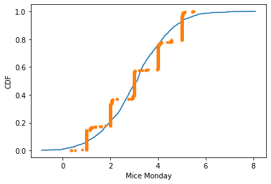
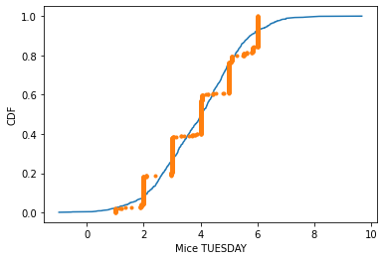
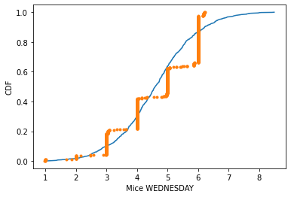
VISUALISING DISTRIBUTION

Slide 16
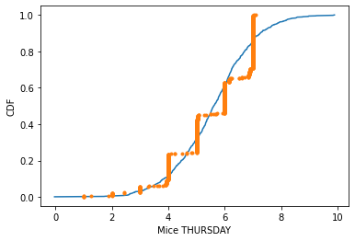
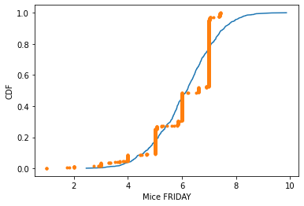

Slide 17
IMPORATANT FEATURES FOR PREDICTION
USING RANDOM FOREST REGRESSOR:
For Monday : Tuesday
For Tuesday : Monday and Wednesday
For Wednesday : Tuesday and Thursday
For Thursday : Wednesday and Friday
For Friday : Thursday

Slide 18
SCORES OF PREDICTION
Scores of Each Prediction:
Monday: 96%
Tuesday: 98%
Wednesday: 98%
Thursday: 98%
Friday: 95%

Slide 19
THANK YOU

