Slide 1
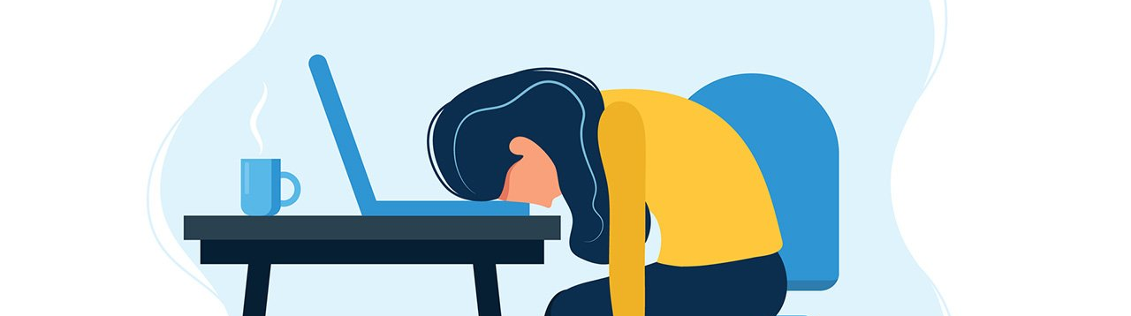
HANDLING PRESSURE
INSTRUCTOR : DR. JOUMANA DARGHAM
PRESENTED BY:
ABHI PATEL (40289176)
KHUSHI PARIKH (40292715)

Slide 2
INDEX
TABLE OF CONTENTS
NAVIGATING THE CODE STROM
MANAGING PRESSURE IN OUR DAILY LIFE
INTRODUCTION
THE PRESSURE COOKER OF SOFTWARE DEVELOPEMNT
BUGS, GLITCHES AND FEATURE SURPRISES
PROJECT MANAGEMENT ROLLERCOASTER
CASE STUDY
VERSION CONTROL YOGA
TOOLBOX: OUR SAVIOR
FOSTERING TEAM SUPPORT
STEALTH-MODE
REFERENCES

Slide 3

TURNING BUGS INTO FEATURES WITH A SMILE
NAVIGATING
THE CODE STROM:
HANDLING PRESSURE IN SOFTWARE ENGINEERING AND PROJECT MANAGEMENT
Handling pressure in software engineering refers to the ability of software developers, engineers, and related professionals to effectively manage and cope with demanding situations, tight deadlines, high expectations, and challenging problems that arise during the development and maintenance of software systems.

Slide 4
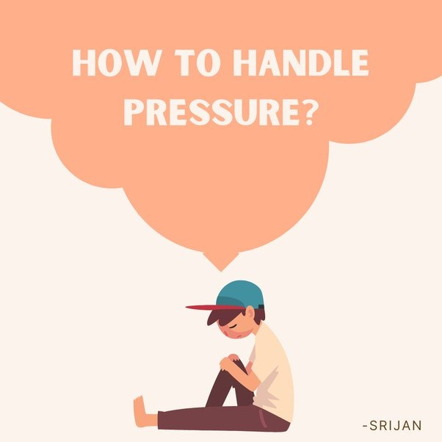
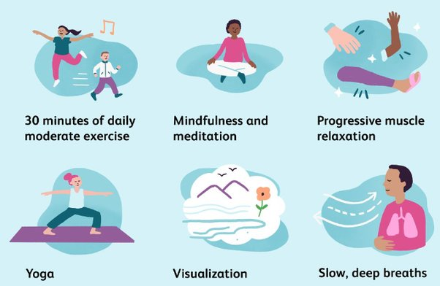
MANAGING PRESSURE IN OUR DAILY LIFE
01.
DAILY LIFE
PRESSURE.
MANAGING STRATEGY.
High Workloads
Job Insecurity
Work-Life Balance
Office Politics
Performance Expectations
Technology and Connectivity
Time Management
Setting Boundaries
Seeking Support
Self-Care
Communication
Skill Development
02.

Slide 5

About the pressure handling
INTRODUCTION
Pressure handling in software engineering refers to the ability of software developers and teams to effectively manage and respond to various types of pressure that can arise during the development process.
Importance of Pressure Handling
Meeting Deadlines
Maintaining Quality
Managing Stakeholder Expectations
Problem Solving
Team Morale
Adaptability
Risk Management
Resource Optimization
Algorithm: Word used by programmers when they don’t want to explain what they did.

Slide 6
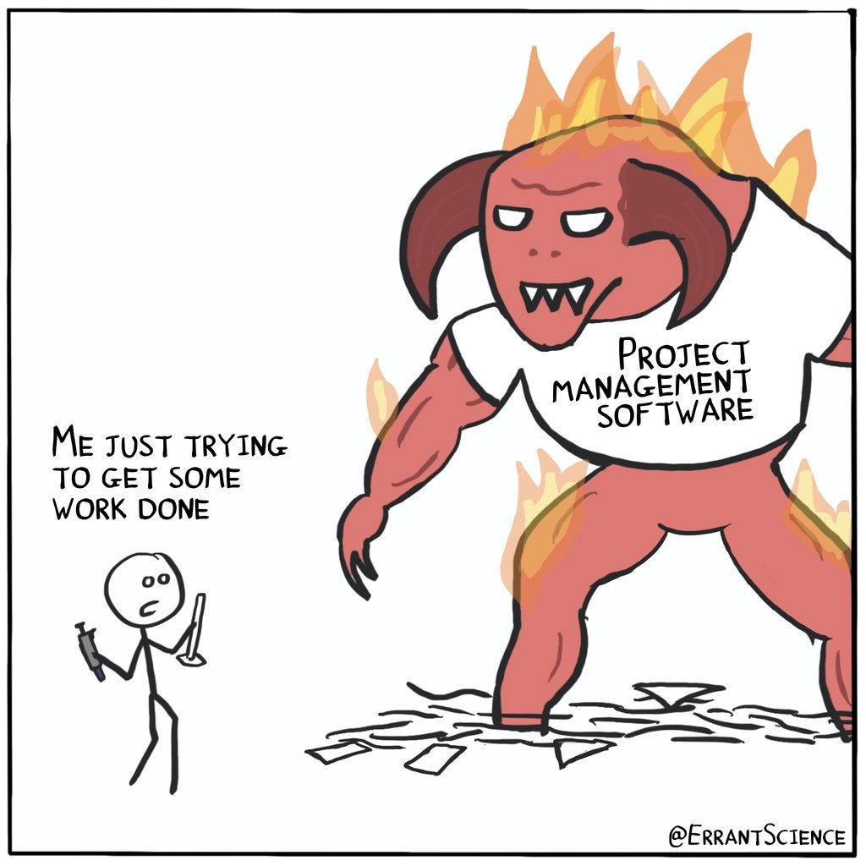
THE PRESSURE COOKER OF SOFTWARE DEVELOPEMNT
Imagine you're a software developer sitting at your desk, sipping your morning coffee as you start your workday. You're just about to dive into coding when suddenly your team lead rushes over with a panicked expression.
"Hey, we've got an urgent client request!" they exclaim. "They need a new feature added to the app by the end of the day."
We rallied, brainstormed, and dove into coding. But the API we relied on had changed overnight. With no time to spare, we scrambled for a workaround while our project manager kept the client reassured. We divided and conquered, fixing issues simultaneously. Despite the chaos, by the end of the day, the new feature is implemented, the bug is fixed, and the client is thrilled with the rapid response.
As you finally exhale and reflect on the day's events, you realize that this is another day, another whirlwind in the dynamic world of software development.

Slide 7
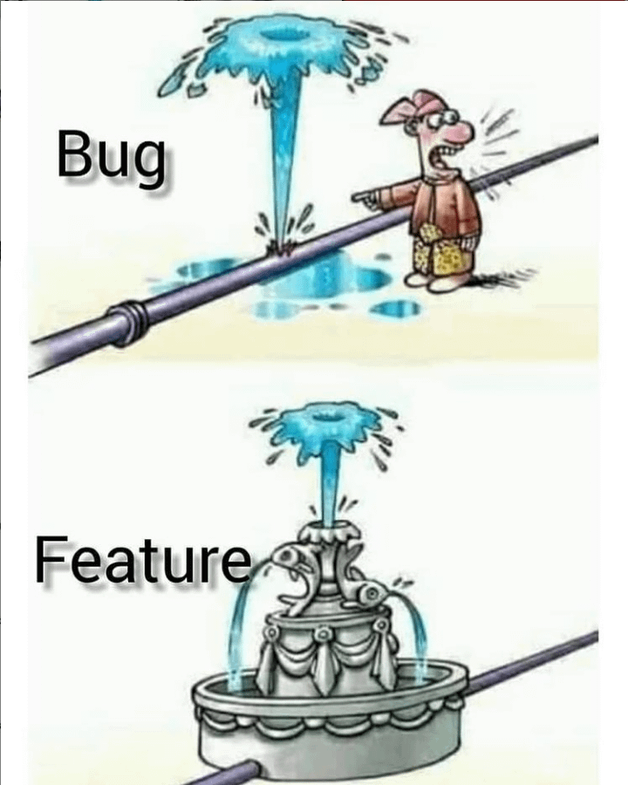
BUGS, GLITCHES AND FEATURE SURPRISES
Communicate: Clearly communicate the steps being taken to address the issue, including estimated timelines for resolution.
Collaborate: Work closely with team members, including developers, testers, and product managers, to diagnose and resolve the bug efficiently.
Bugs
Software bugs are errors, flaws, deficiencies, or defects in a computer program or system that cause it to produce an incorrect or unexpected result or to behave in unintended ways.
Assess the Situation: Determine how widespread the issue is and its severity in terms of functionality and potential consequences.
Gather Information: Gathering information may include error messages, user reports, logs, and any recent changes made to the system or software.
Glitches
A glitch is a short-lived fault in a system, such as a transient fault that corrects itself, making it difficult to troubleshoot.
It’s not a bug, It’s a feature

Slide 8

Project Management Rollercoaster
Ups:
Clear Goals and Direction
Resource Optimization
Risk Mitigation
Stakeholder Communication
5. Team Collaboration
Downs:
Tight Deadlines
Scope Creep
Conflict Resolution
Uncertain Environments
Client Expectations

Slide 9
CASE STUDY.
Scenario:
A multinational company is preparing to launch a new product line in a highly competitive market. The project faces tight deadlines, aggressive targets, and limited resources, placing immense pressure on the project team to deliver results.
Pressure Handling Strategies:
1. Prioritization: Sarah analyzes tasks, prioritizing based on launch impact while maintaining essential project management practices.
2. Adaptability: Flexibly adjusts plans and resources in response to market shifts and stakeholder needs.
3. Delegation: Empowers team members, distributes workload, and fosters collaboration for collective accountability.
4. Organizational Support: Advocates for additional resources, demonstrating strategic importance and potential ROI to senior management.
5. Leading by Example: Sarah communicates openly, solicits feedback, and fosters a culture of continuous improvement, setting high standards for excellence.
Outcome: 😁
Despite immense pressure, Sarah's strategic approach and effective project management ensure the successful launch of the new product line, meeting objectives within allocated time and budget, exceeding stakeholder expectations, and positioning the company for future growth.
Conclusion:
Balancing project management with pressure demands strategic communication, adaptability, and stakeholder engagement. Organizational support and pressure-handling strategies drive project success, fostering growth and competitiveness.

Slide 10

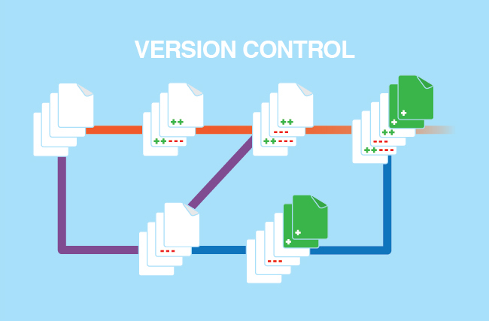
Version Control Yoga
Version control is like keeping your balance when things get tough. Just as yoga helps ease physical tension, version control commands such as commit and merge help ease the stress of handling different project versions. They make sure everyone works together smoothly, solve problems before they get big, and make it easier for teams to handle complex projects. It's like finding your footing when life gets hectic.
Mostly GIT

Slide 11


Toolbox: Our Savior
Toolbox for Effective Pressure Handling:
1. Collaboration Platforms: Utilize tools like Slack or Microsoft Teams for seamless communication and task management, fostering collaboration among team members.
2. Communication Apps: Employ Zoom or Google Meet for efficient virtual meetings and quick decision-making, facilitating clear communication and swift problem-solving.
These tools aid in managing pressure effectively, ensuring productivity and well-being.
Communication is 🔑

Slide 12

Team Work
In the fast-paced world of project management, having team support for effective practices is crucial for success under pressure. This report looks at strategies for balancing good practices with high pressure, especially by building team support. We'll discuss identifying resistance, emphasizing thorough planning, and fostering collaboration to handle pressure effectively.
Fostering Team Support
1. Identify Sources of Resistance:
- Conduct team workshops to encourage open discussions.
- Administer surveys or interviews to gather insights.
2. Emphasize Value of Thorough Planning:
- Provide concrete examples of planning's impact.
- Engage in collaborative planning exercises.
3. Lead by Example:
- Foster continuous learning and professional development.
- Celebrate successes resulting from effective practices.
4. Provide Support and Resources:
- Address skill gaps through training or coaching.
- Allocate adequate resources for effective planning and execution.

Slide 13
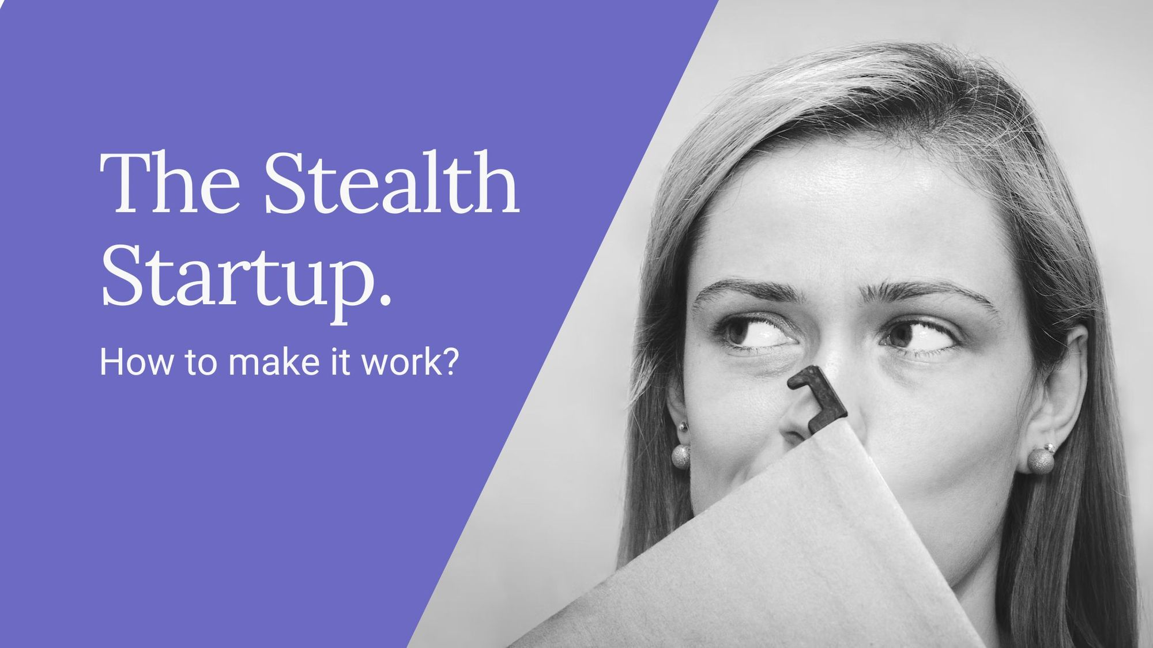
Stealth-Mode
"Stealth mode" refers to a strategy adopted by companies or individuals to operate in a low-profile or secretive manner, typically to maintain a competitive advantage or protect intellectual property.
Challenges of implementing stealth mode:
Isolation and loneliness from off-hours work and lack of support hinder effective management
Risk of burnout rises due to balancing regular tasks with stealth-mode management, decreasing satisfaction and well-being.
Strategies for Handling Pressure in Stealth-Mode Project Management:
Collaborate with like-minded individuals for emotional support and workload sharing.
Use project achievements to advocate for formal management processes.
Initiate discussions with stakeholders about embracing structured project management, advocating for incremental improvements.
Conclusion:
Stealth-mode project management provides a temporary solution for pressure handling in resistant environments. Despite challenges like isolation and burnout, strategic approaches such as building support networks, leveraging successes, and advocating for change can mitigate risks.

Slide 14
REFERENCES
https://www.researchgate.net/publication/338672723_Time_Pressure_in_Software_Engineering_A_Systematic_Review
https://www.academia.edu/20367219/Impact_of_Stress_on_Software_Engineers_Knowledge_Sharing_and_Creativity_
https://www.canva.com/design/DAGAQ00kpuw/RAnTsYL5RnPXKaWSkI8YJw/edit?utm_content=DAGAQ00kpuw&utm_campaign=designshare&utm_medium=link2&utm_source=sharebutton
https://www.scalablepath.com/for-freelancers/mindfulness-for-software-developers
https://www.cio.com/article/286118/agile-development-how-to-deal-with-software-development-schedule-pressure.html
https://thevaluable.dev/programmer-stress-causes/

Slide 15
THANK YOU
PRESSURE
HANDLING
😇

