Slide 1

AGENTIC ARTIFICIAL INTELLIGENCE
INTRODUCTION:
WHAT IS AGENTIC ARTIFICIAL INTELLIGENCE ?
AI systems that can act autonomously, make decisions, and take actions toward achieving specific goals — similar to how a software “agent” works independently without requiring constant user instructions.
These systems don’t just answer questions like normal AI models—they plan, reason, take initiative, and execute tasks on your behalf.

Slide 2
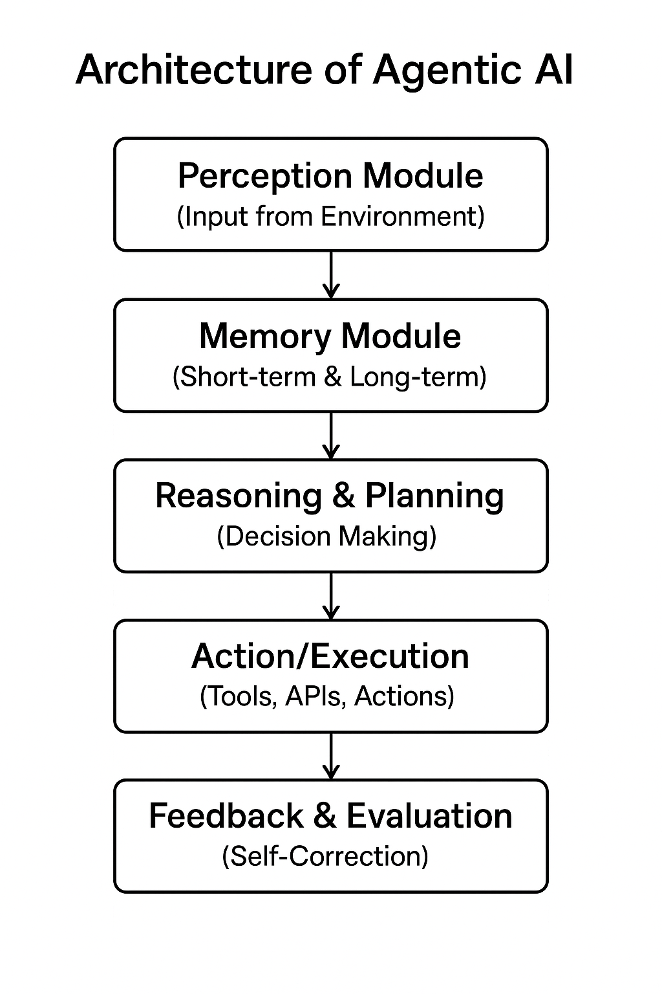
ARCHITECTURE OF AGENTIC ARTIFICIAL INTELLIGENCE
Perception Module: Collects and interprets input from the environment (text, images, data).
Memory Module: Stores short-term task data and long-term knowledge or preferences.
Reasoning & Planning: Breaks goals into steps, performs logical reasoning, and creates action plans.
Action/Execution Module: Executes tasks using tools, APIs, software, or devices.
Feedback & Evaluation: Monitors results, corrects errors, and updates plans for improvement.

Slide 3
AGENTS OF AGENTIC ARTIFICIAL INTELLIGENCE
*An “agent” is anything that can be viewed as perceiving its environment through sensors and acting upon that environment through actuators.
*Percept refers to the agent’s perceptual inputs at a given time instant; an agent’s perceptual sequence is the complete history of everything the agent has ever perceived.
*In general, an agent’s choice of action at any given instant can depend on the entire precept sequence observed to date, but not on anything it hasn’t perceived.

Slide 4
TYPES OF AGENTS
Simple Reflex Agents
Model Based Agents
Utility Based Agents
Goal Based Agents
Learning Agents

Slide 5
1. SIMPLE REFLEX AGENTS
Acts only on the current percept without considering any history
Uses fixed condition–action rules to decide actions.
Works best in fully observable and simple environments.
Cannot handle complex or uncertain situations.
Fast but very limited in intelligence and adaptability.

Slide 6
#Simple reflex Agent
class SimpleReflexVacuumAgent:
def __init__(self):
self.actions = ["Left", "Right", "Suck", "NoOp"]
def decide(self, location, status):
if status == "Dirty":
return "Suck"
elif location == "A":
return "Right"
else:
return "Left"
# Test the agent
agent = SimpleReflexVacuumAgent()
print(agent.decide("A", "Dirty")) # Output: Suck
print(agent.decide("A", "Clean")) # Output: Right

Slide 7
Acts only on current percept (location & status)
If dirty → Suck
If clean at A → Move Right
If clean at B → Move Left
No memory of past actions
Useful for simple environments

Slide 8
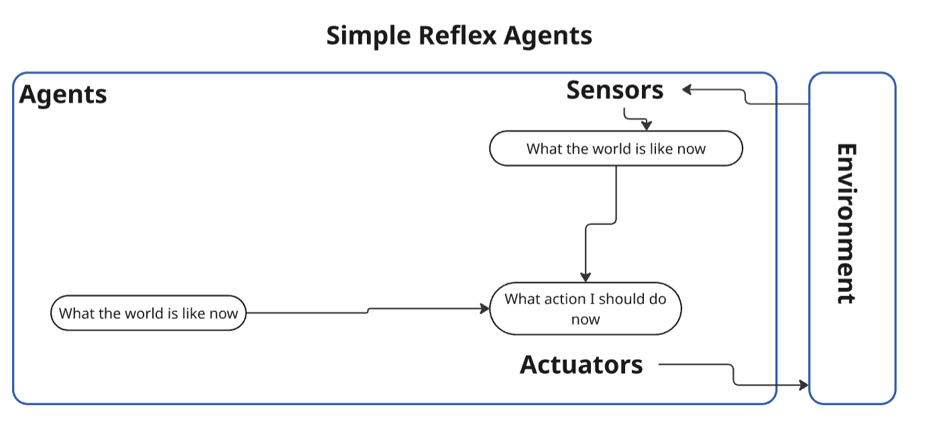

Slide 9
2. MODEL BASED REFLEX AGENTS
Maintains an internal state representing unobserved parts of the
environment.
Updates its internal model using percept history.
More capable than simple reflex agents in dynamic environments.
Uses internal information to choose appropriate actions.
Handles partial observability more effectively.

Slide 10
#Model-Based Reflex Agent
class ModelBasedVacuumAgent:
def __init__(self):
self.model = {"A": None, "B": None}
def decide(self, location, status):
self.model[location] = status
if self.model["A"] == "Clean" and self.model["B"] == "Clean":
return "NoOp" # Done
elif status == "Dirty":
return "Suck"
elif location == "A":
return "Right"
else:
return "Left"
# Test
agent = ModelBasedVacuumAgent()
print(agent.decide("A", "Dirty"))
print(agent.decide("A", "Clean"))

Slide 11
Maintains an internal model of environment
Stores cleanliness of rooms A & B
If both clean → NoOp
If current room dirty → Suck
Otherwise moves based on location
More intelligent than simple reflex agent

Slide 12
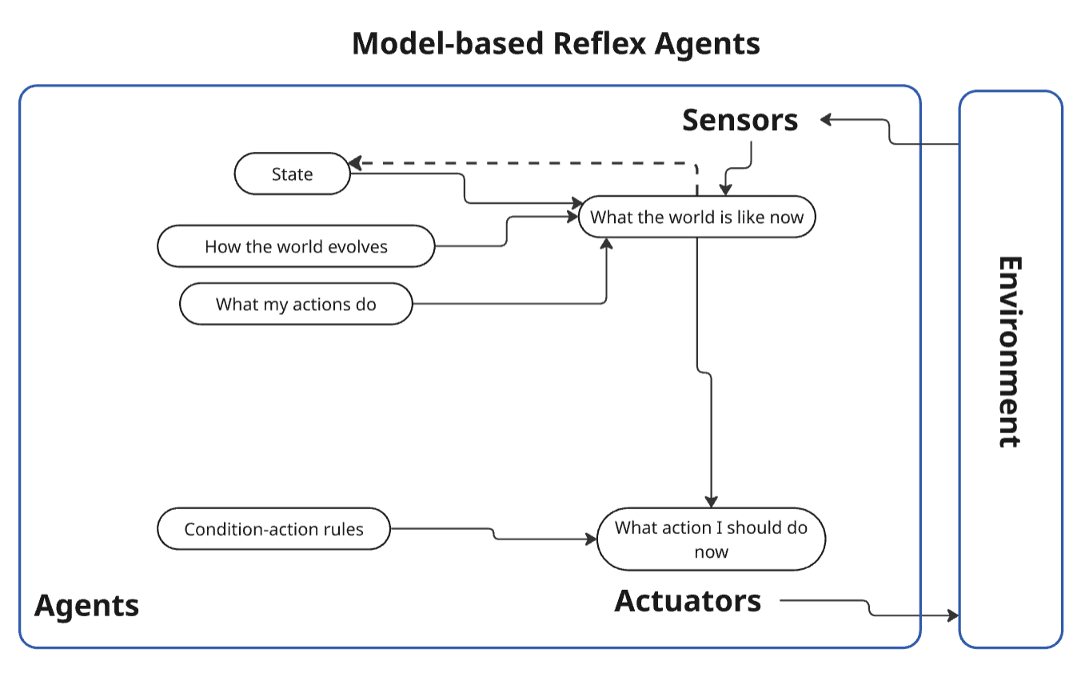

Slide 13
3. GOAL BASED AGENTS
Uses goals to guide its decisions and actions.
Evaluates which actions will help it achieve the goal.
Supports planning, reasoning, and decision-making.
Considers the future consequences of actions.
More flexible and intelligent than reflex agents.

Slide 14
#Goal-based Agent
class GoalBasedAgent:
def __init__(self, goal):
self.goal = goal
def decide(self, current_position):
if current_position == self.goal:
return "Goal Reached"
elif current_position < self.goal:
return "Move Forward"
else:
return "Move Backward"
# Test
agent = GoalBasedAgent(goal=5)
print(agent.decide(2)) # Move Forward
print(agent.decide(5)) # Goal Reached

Slide 15
Works towards a specific goal
Compares current position with the goal
If reached → 'Goal Reached’
If lower → Move Forward
If higher → Move Backward
Used in path planning & navigation tasks

Slide 16
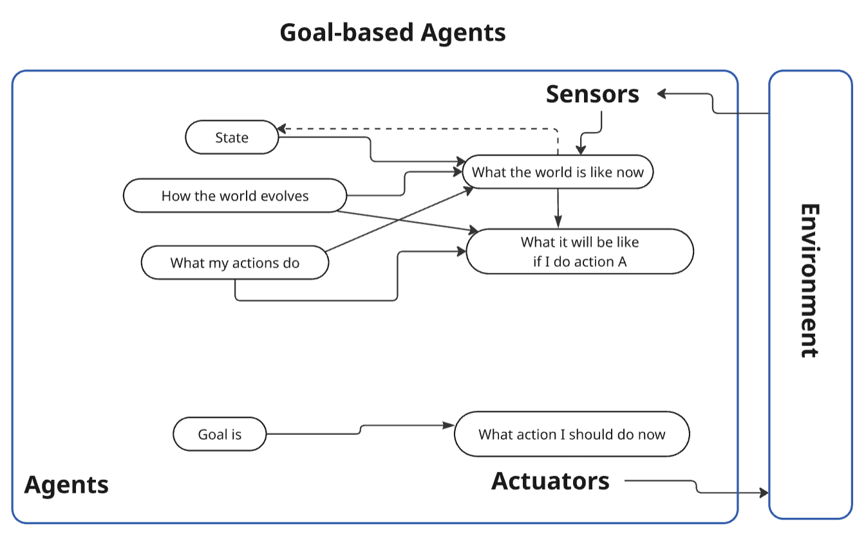

Slide 17
4. UTILITY BASED AGENTS
Chooses actions based on a utility function that measures preference.
Compares possible outcomes and selects the most optimal one.
Handles situations where multiple goal-achieving actions exist.
Helps in making decisions under uncertainty.
Aims for the highest satisfaction or performance.

Slide 18
#Utility-Based Agent
class UtilityAgent:
def __init__(self):
pass
def utility(self, state):
utilities = {"Sleep": 2, "Study": 8, "Play": 5}
return utilities[state]
def decide(self):
states = ["Sleep", "Study", "Play"]
best = max(states, key=self.utility)
return best
# Test
agent = UtilityAgent()
print(agent.decide()) # Output: Study

Slide 19
Chooses actions based on highest utility (usefulness)
Utility values: Sleep=2, Study=8, Play=5
Selects option with maximum utility
Ensures best possible outcome
Used in decision-making systems

Slide 20
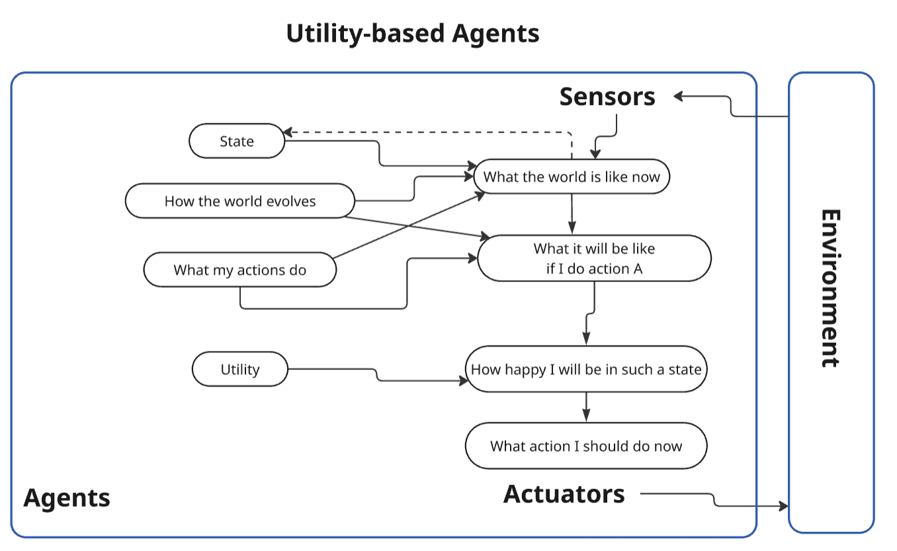

Slide 21
5. LEARNING AGENTS
Improves its performance through experience and feedback.
Contains components like learning element, critic, performance element,
and problem generator.
Adapts to changing or unknown environments over time.
Continuously updates its behavior for better efficiency.
Most advanced agent type due to its self-improving nature.

Slide 22
#Learning Agent
import random
class LearningAgent:
def __init__(self):
self.q_values = {"A": 0, "B": 0}
def decide(self):
return max(self.q_values, key=self.q_values.get)
def learn(self, action, reward):
self.q_values[action] += reward
# Test
agent = LearningAgent()
action = agent.decide()
agent.learn(action, 5)
print(agent.q_values)

Slide 23
Learns from experience using rewards
Uses Q-values to store action quality
Initially all values = 0
After learning: Q[action] += reward
Over time selects best action
Basis of reinforcement learning

Slide 24
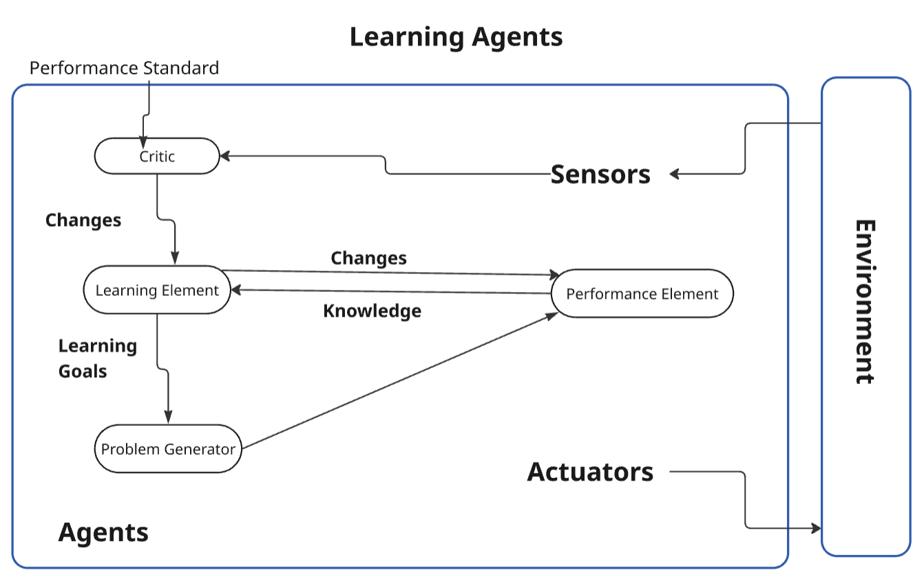

Slide 25
By:
Niveditha P L | USN: 4SU24CS058
Apeksha Jain | USN: 4SU24CS022
Abhishek M K | USN: 4SU24CS004
Abhi T A | USN: 4SU24CS001
THANK YOU…

