Slide 1
The Geography of Privatization: Analyzing Institutional Concentration in Indian Higher Education
Sector : Education
Team Details : Team G-1 (Section-D)
Gauri Mehrotra (2401010170)
Milind Bansal (2401010277)
Sambhav Kumar (2401010409)
Abhishek Verma (2401010023)
Abhishek Kumar Patel (2401010020)
Himank Kaushik (2401010187)
Institute : Newton School of Technology
Faculty : Mr. Archit Raj

Slide 2
Executive Summary
Problem Statement : Investigating whether the growth of private colleges in India is regionally concentrated in specific states or evenly distributed across the country.
Approach : A comparative analysis of higher education institutions in India,
mapping institutional management types against state-level and regional demographics.
Key Insights :
Private institutions account for 62.74% of total colleges, indicating private sector dominance.
Growth of private universities is uneven and concentrated in specific states such as Telangana, Karnataka, and Maharashtra.
Private institutions have driven the majority of expansion since 2000.
Forecasting suggests continued growth, primarily led by private institutions.
Sector & Business Context
Sector Overview : India has one of the largest higher education systems globally, seeing a massive shift toward private ownership in the last decade.
Current Challenges : State-wise and region-wise disparities in the
expansion of private universities remain a significant challenge, with growth concentrated in select states and urban centers rather than being evenly distributed across the country.
Why this problem was chosen : To determine if private market forces are naturally excluding specific geographic populations.

Slide 3
Problem Statement & Objectives
Problem Statement : Does the increase in private institutional participation correlate with higher geographic concentration in specific Indian states or locations?
Project Scope : Analysis of higher education institutions in India, with a focus on private vs. state and central universities.
Success Criteria : Identification of the correlation between private ownership and state-wise as well as rural–urban distribution of institutions.
Data Description
Dataset Source : Dataset Link
Data Structure : Relational tables including Institution names, State, District, and Management.
Columns : (14 columns)
State
District
University Type
University Name
College Name
College Type
Address
Website
Management
Year of Establishment

Slide 4
Specialised in
Location
Upload Year
The Institute Added In Survey Year
Data Size :
Original dataset - 47590 rows
Working dataset - 9000 rows
Limitations : Missing data for certain newly formed districts or private colleges not yet registered.
Data Cleaning & Preparation
Dataset Sampling: Randomized the raw dataset and selected 9,000 rows as the working dataset using a Python script.(script reference in Appendix)
Handling Missing Values: Replaced empty cells with “Not Specified” or “Not Defined” to ensure data completeness.
Data Type Formatting: Converted columns to their appropriate data types for consistency and accurate analysis.
Data Splitting: Separated University ID from University Name and College ID from College Name using a delimiter-based split.

Slide 5
KPI and Metric Framework
KPI 1: Private College Share (%)
Formula:
Private College Share (%) = (Number of Private Colleges / Total Number of Colleges) × 100
Purpose:
This KPI indicates the level of privatisation and the dominance of private institutions.
Insight:
Private institutions form the majority of colleges, indicating strong private sector participation.
KPI 2: Private-to-Government College Ratio
Formula:
Private-to-Government Ratio = Number of Private Colleges / Number of Government Colleges
Purpose:
Shows ownership balance and privatisation intensity.
Insight:
There are nearly 2 private colleges for every 1 government college.

Slide 6
KPI 3: Private College Share by Location (Urban vs Rural)
Formula:
Urban Private Share (%)
= (Private Colleges in Urban / Total Urban Colleges) × 100
Rural Private Share (%)
= (Private Colleges in Rural / Total Rural Colleges) × 100
Purpose:
Shows geographic distribution of privatisation.
Insight:
Private colleges dominate both rural and urban areas, with stronger presence in rural areas.
KPI 4: Education Privatization Growth Trend
Formula:
Privatisation Trend = Private Colleges per Year / Total Colleges per Year
Purpose:
Identifies growth patterns and structural shifts.
Insight:
Private colleges have increased significantly over time.
KPI 5: College Growth Forecast (2030)
Method:
Linear trend forecasting using establishment year data.

Slide 7
Purpose:
Shows expected future expansion.
Insight:
Higher education institutions are expected to continue growing.
KPI 6: College Distribution Across States
Formula:
College Density = Count of Colleges per State
Purpose:
Identifies regional concentration.
Insight:
Some states have significantly higher college concentration.
KPI 7: Ownership Shift Correlation (Private vs Government Growth)
Formula:
Correlation (Private, Government)
Purpose:
Shows structural expansion pattern.
Insight:
Both sectors are growing, but private growth is stronger.

Slide 8
KPI 8: Privatisation vs Urbanisation Correlation
Formula:
Correlation (Private Colleges, Urban Colleges)
Purpose:
Shows geographic spread.
Insight:
Private colleges are not limited to urban areas.
Exploratory Data Analysis (EDA)
Trend Analysis: A line chart showing the privatisation trend over the years.
Comparative Analysis: A bar chart comparing the all states on the basis of their Private-to-Government ratio.
Distribution Analysis: A bar chart illustrating the distribution of different types of colleges across rural and urban locations.
Correlation Analysis:
  The KPI cards indicate that privatisation has a moderate association with geographic concentration and a strong positive growth trend over time, while its relationship with urban locality is very weak and slightly negative, and the variation across states and management types remains weak, suggesting that privatisation growth is widespread rather than limited to specific regions or management structures.

Slide 9
Advanced Analysis
Forecasting Analysis:
  Forecasting was performed using historical college establishment data to estimate future growth.
    The forecast indicates that the number of colleges is expected to increase steadily by 2030, reaching approximately 173 colleges per year.
    This suggests continued expansion of higher education, driven primarily by private sector participation.
    The decade-wise growth chart shows cyclical spikes, indicating that college establishment increases in phases rather than uniformly.
    If the current trend continues, private institutions will remain the dominant contributors to expansion.
Segmentation Analysis:
-> Segmentation was performed using -
  Management Type
  Location (Urban vs Rural)
  State-wise distribution
  College type
-> Key Insights -
  Management Segmentation -
    Private colleges account for 62.74% of total colleges
    Government colleges account for only 37.26%
    Private-to-Government ratio is 1.9954, meaning almost 2 private colleges exist for every government college
Location Segmentation -
  Private colleges are more concentrated in urban areas

Slide 10
Rural areas have relatively fewer institutions, indicating access inequality
State Segmentation -
  Some states show very high private-to-government ratios, indicating strong privatization
  Other states rely more on government institutions
College Type Segmentation -
  Affiliated colleges dominate the system
  Autonomous and constituent colleges are fewer
Root Cause Analysis:
Root cause analysis was conducted to understand why privatization is increasing.
-> Root Causes Identified:
  Government capacity limitations -
    Government cannot expand fast enough to meet rising demand
  Increasing demand for higher education -
    More students seeking degrees
    Private sector filling the gap
  Policy support -
    Liberal policies encouraging private investment in education
Risk and Anomaly Analysis:
Risk analysis helps identify potential concerns.
-> Key Risks Identified:
  Over-privatization -
    Private share already at 62.74%
    May reduce affordability and accessibility
  Regional imbalance -
    Some states have significantly higher private ratios
    Leads to unequal access
-> Anomalies observed:
Sudden spikes in certain decades in growth chart

Slide 11
Certain states showing extremely high private ratios compared to others
Scenario Analysis:
  Scenario 1: If current trend continues-
    Private colleges will dominate even more
    Private share may exceed 70% by 2030
  Scenario 2: If government increases investment-
    Government college share will improve
    Education accessibility will become more balanced
  Scenario 3: If private growth slows-
    Overall college growth rate will reduce
Final Conclusion:
Advanced analysis reveals that India's higher education expansion is strongly privatization-driven, uneven across regions, and expected to grow further, highlighting the need for balanced policy intervention.
Dashboard Design
Dashboard Implementation:
The dashboard was implemented using Google Sheets, leveraging pivot tables, calculated formulas, charts, and interactive slicers to analyse institutional concentration and privatisation trends in Indian higher education.
Key Google Sheets features used:
  Pivot Tables → for aggregation by state, management, location, and year
  Calculated Fields → for KPIs such as private share, ratios, and correlations

Slide 12
Charts → line charts, bar charts, and pie charts
Slicers / Filters → for interactive analysis
This enabled dynamic and user-driven exploration of the dataset.
Dashboard Objective:
The primary objective of the dashboard is to:
  Analyse the extent of privatisation in Indian higher education
  Identify geographic concentration of institutions
  Compare private and government institutional presence
  Understand ownership trends over time
  Forecast future institutional growth
This dashboard helps decision-makers understand structural patterns and supports education planning.
Dashboard View Structure:
The dashboard is organised into four major analytical sections:
  Overview & Privatisation KPIs : This section provides high-level summary indicators such as:
    Private College Share: 62.74%
    Private-to-Government Ratio: 1.99
    % Private Colleges in Rural Areas: 68.44%
    % Private Colleges in Urban Areas: 63.77%
    Forecasted College Count: 249.23
These KPIs highlight the strong dominance of private institutions.

Slide 13
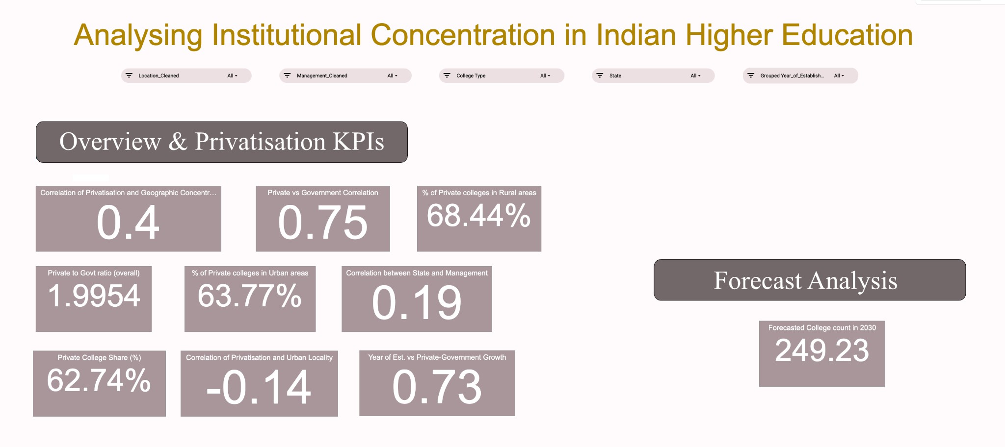
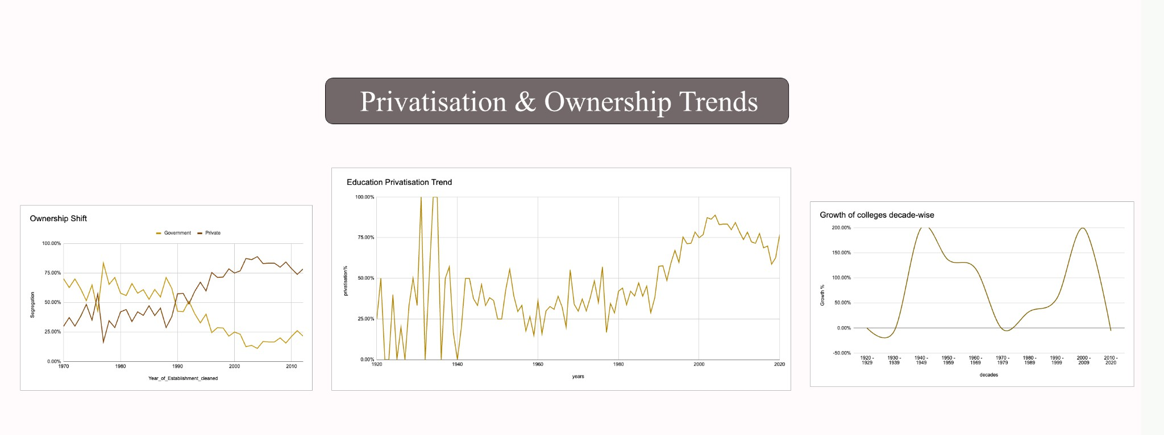
Privatisation & Ownership Trends : This section uses line charts to show:
  Growth of private vs government institutions over time
  Ownership shift trends
  Decade-wise institutional growth
Insight: Private institutions have increased significantly, especially after 2000.
Geographic Distribution Analysis: This section includes:
  State-wise college distribution
  Private-to-government ratio by state
  Rural vs urban distribution
Insight: Certain states show high institutional concentration and private dominance.

Slide 14
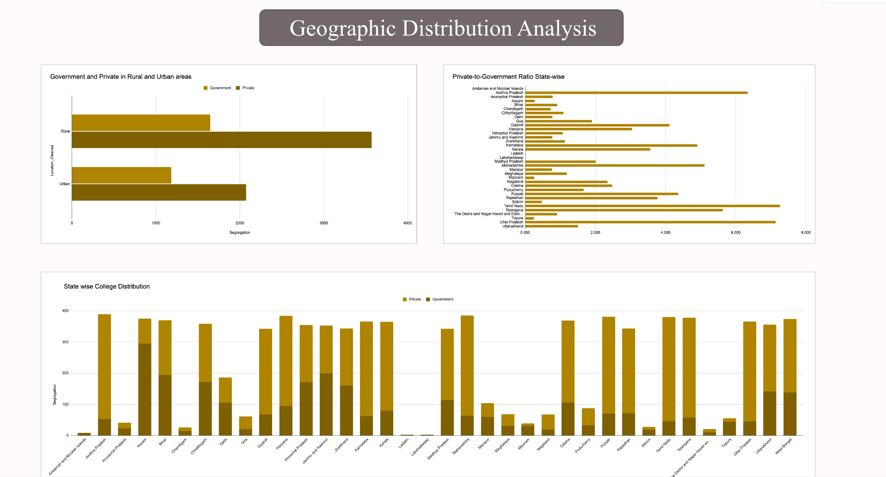
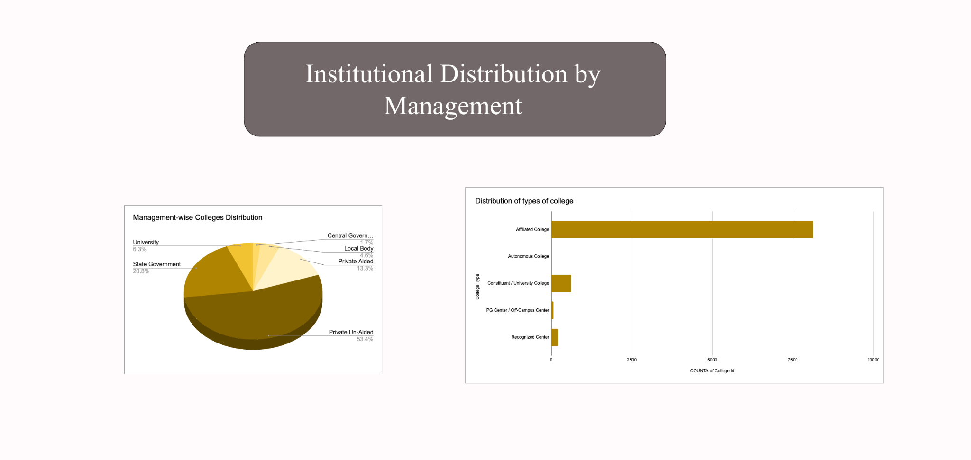
Institutional Distribution by Management: This section shows:
  Management-wise distribution (Private, Government, Aided)
  College type distribution
Insight: Private unaided institutions form the majority.
Filters and Drilldowns:
Interactive filters allow users to dynamically analyse data by:
  State
  College Type
  Management Type
  Location (Rural / Urban)
  Year of Establishment

Slide 15
These filters enable detailed drill-down analysis.
Dashboard Explanation:
The dashboard provides a comprehensive view of institutional concentration. Key findings include:
  Private institutions dominate Indian higher education
  Institutional growth has accelerated in recent decades
  Rural areas also show strong private presence
  Institutional distribution varies significantly across states
  Private sector growth is expected to continue
The dashboard enables easy interpretation through visualisations and interactive exploration.
Insights Summary
Private institutions are the primary drivers of higher education expansion
With 62.74% of colleges under private management, policymakers must recognize that higher education growth in India is largely dependent on private sector participation rather than government expansion.
India’s higher education system is structurally shifting toward privatization
The Private-to-Government ratio of 1.99 indicates a significant structural shift, requiring regulatory frameworks to ensure quality and affordability in private institutions.
Private college growth is uneven and concentrated in specific states

Slide 16
State-wise analysis shows higher private concentration in select states, indicating the need for region-specific education planning rather than uniform national policies.
Certain time periods show rapid expansion, indicating policy influence
Growth spikes suggest that government policies directly influence higher education expansion, highlighting the importance of strategic planning.
Recommendations
Recommendation 1: Increase government colleges in states with high private dominance
  Mapped Insight:Private institutions dominate higher education, with a Private-to-Government ratio of 1.99.
  Recommendation:The government should establish more public colleges in states where private institutions significantly outnumber government institutions.
  Business Impact:
    Improves affordability of higher education
    Reduces over-dependence on private institutions
    Ensures equal access to education
  Feasibility:
    High feasibility through phased expansion
    Can be implemented via central and state government education programs
Recommendation 2: Focus on expanding higher education infrastructure in rural areas

Slide 17
Mapped Insight: Private colleges are concentrated in urban areas, creating rural access gaps.
Recommendation:Government should prioritize establishing colleges in rural and semi-urban regions.
Business Impact:
  Improves rural education access
  Increases student enrollment
  Supports regional economic development
Feasibility:
  Moderate feasibility
  Can be implemented through targeted rural education schemes
Recommendation 3: Implement stronger regulation and monitoring of private institutions
  Mapped Insight:Rapid privatization increases the need for regulatory oversight.
  Recommendation:Introduce stricter quality standards, fee regulations, and accreditation policies for private institutions.
  Business Impact:
    Ensures education quality
    Prevents excessive fee structures
    Protects student interests
  Feasibility:
    High feasibility
    Can be implemented through existing regulatory bodies such as UGC and AICTE
Recommendation 4: Promote Public-Private Partnerships (PPP) in education

Slide 18
Mapped Insight:Private sector is driving most higher education expansion.
Recommendation:Encourage collaboration between government and private institutions.
Business Impact:
  Faster infrastructure development
  Reduced government investment burden Improved quality and innovation
Feasibility:
  High feasibility
  Already successfully used in multiple sectors
Conclusion :These recommendations aim to ensure balanced, accessible, and sustainable growth of higher education in India while addressing regional and privatization challenges.
Impact Estimation
Save Cost: Optimizes government spending by identifying priority states for public college expansion.
Improve Efficiency: Enables faster and more accurate education infrastructure planning using real-time insights.
Improve Service: Improves access to higher education by highlighting underserved rural and state regions.
Reduce Risk: Helps prevent excessive privatization and ensures balanced and affordable education growth.

Slide 19
Limitations
Data Issues:
  No data on students, faculty, or quality
  Possible missing or incomplete records
  No status (active/closed) of institutions
Assumption Risks:
  More colleges ≠ better access or quality
  Rural/Urban classification assumed correct
  All colleges assumed equal in size/capacity
Cannot Be Concluded:
  Education quality differences
  Student outcomes or placements
  Reasons behind private sector dominance
Future Scope
More Analysis:
  State-wise expansion analysis
  Trend analysis over years
  Specialisation growth analysis
New Data Needed:
  Student enrollment
  Placement data
  Faculty and infrastructure data
Conclusion
Private colleges dominate overall
Private sector drives higher education expansion
Higher education has expanded geographically

Slide 20

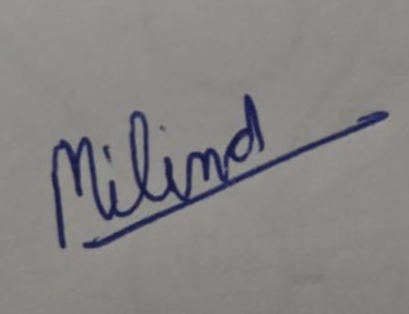
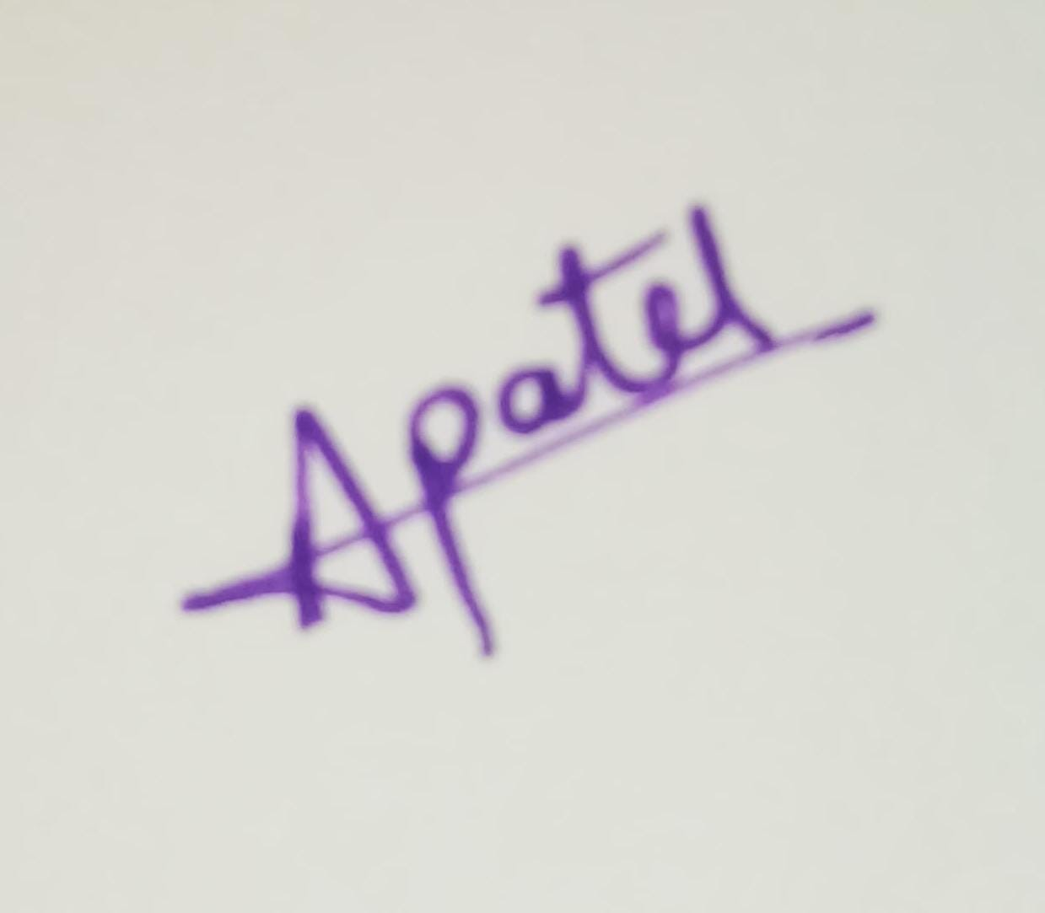
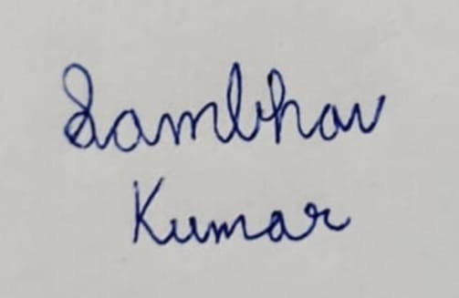


Contribution Matrix
Team Member | Dataset & Sourcing | Cleaning | KPI & Analysis | Dashboard | Report Writing | PPT | Overall Role
Gauri Mehrotra | Primary | Review | Secondary | Final Review | Review | Final Polish | Team Lead
Milind Bansal | Secondary | Primary | Primary | Analysis Support | Insights Section | Support | Data Insights Lead
Sambhav Kumar | Support | Secondary | Support | Primary | Descriptions | Support | Dashboard Architect
Abhishek Verma | Support | Support | Support | Secondary | Support | Primary | Presentation Designer
Abhishek Kumar Patel | Support | Support | Support | Support | Primary | Support | Report Manager
Himank Kaushik | Support | Support | Support | Support | Support | Primary | Presentation Designer
Declaration: We confirm that the above contribution details are accurate and verifiable through version history and submitted artifacts.
Team Sign Block :

Slide 21
Appendix
Python Script for randomisation :
import pandas as pd
df = pd.read_csv("Cleaned College.csv") TARGET = 9000
MIN_PER_STATE = 30
state_counts = df['State'].value_counts() states = state_counts.index
# Step 1 — initial allocation
allocation = {state: min(MIN_PER_STATE, state_counts[state]) for state in states} current_total = sum(allocation.values())
remaining = TARGET - current_total
# Step 2 — distribute remaining proportionally to states that still have data capacity = {state: state_counts[state] - allocation[state] for state in states} while remaining > 0:
for state in states:
if capacity[state] > 0: allocation[state] += 1
capacity[state] -= 1
remaining -= 1
if remaining == 0: break
# Step 3 — sample sampled_df = pd.concat([
df[df['State'] == state].sample(n=allocation[state], random_state=42) for state in states
])
print("Final rows:", len(sampled_df)) print(sampled_df['State'].value_counts())

Slide 22
Data Dictionary :
Column Name | Data Type | Variable Type | Description | Example | Missing Values
State | String | Categorical (Nominal) | Name of the State or Union Territory where the institute is located | Uttar Pradesh | Possible
District | String | Categorical (Nominal) | District where the institute is located | Jaipur | Possible
University Type | String | Categorical (Nominal) | Type of university affiliating the college | State Public University | Few
University Name | String | Categorical (Nominal) | Name of the affiliating university | Pondicherry University | Few
College Name | String | Categorical (Nominal) | Official name of the college/institute | Tagore Government College of Education | No
College Type | String | Categorical (Nominal) | Institutional affiliation type | Affiliated College | Few
Address | String | Text | Full postal address of the institute | Port Blair, Andaman & Nicobar | Yes
Website | String (URL) | Text | Official website of the institute | www.jnrm.and. nic.in | Yes

Slide 23
Management | String | Categorical (Nominal) | Type of management controlling the institute | Private Un-Aided | No
Year of Establishment | Integer | Numerical (Discrete) | Year the institute was established | 1983 | Few
Specialised in | String | Categorical (Nominal) | Area of specialization of the institute | Engineering, Medical | Yes
Location | String | Categorical (Nominal) | Type of geographical location | Urban / Rural | Few
Upload Year | Integer | Numerical (Discrete) | Year when institute record was uploaded | 2020 | Few
The Institute Added In Survey Year | Integer | Numerical (Discrete) | Year when institute was added to the survey database | 2019 | Few

