Slide 1


Newton School of Technology | Team G-1 (Section-D)
The Geography of Privatisation:
Analysing Institutional Concentration in Indian Higher Education
Presented by:: Gauri Mehrotra, Milind Bansal, Sambhav Kumar, Abhishek Verma, Abhishek Kumar Patel, Himank Kaushik

Slide 2
Problem Statement:
Does the increase in private institutional participation correlate with higher geographic concentration in specific Indian states or locations?
The Shifting Landscape of Indian Higher Education
India boasts one of the globe''s largest higher education systems,, experiencing rapid expansion over recent decades.. Private institutions are increasingly pivotal,, yet their growth may not be uniformly distributed across all states and regions..
Policymakers require a clear understanding of whether this privatisation trend exacerbates regional imbalances in educational access..

Slide 3

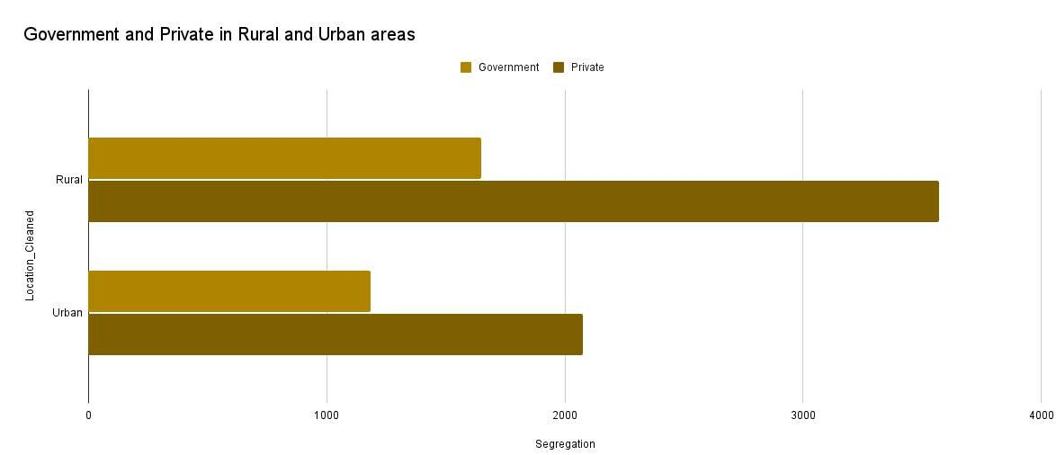

Informing Balanced Education Infrastructure Planning
Our primary objective is to meticulously analyse whether private sector growth in higher education is evenly distributed across India.. This analysis will furnish critical insights to support governmental and institutional decisions..
Ultimately,, this aims to foster more equitable and balanced education infrastructure planning nationwide,, ensuring access and quality are maintained..

Slide 4

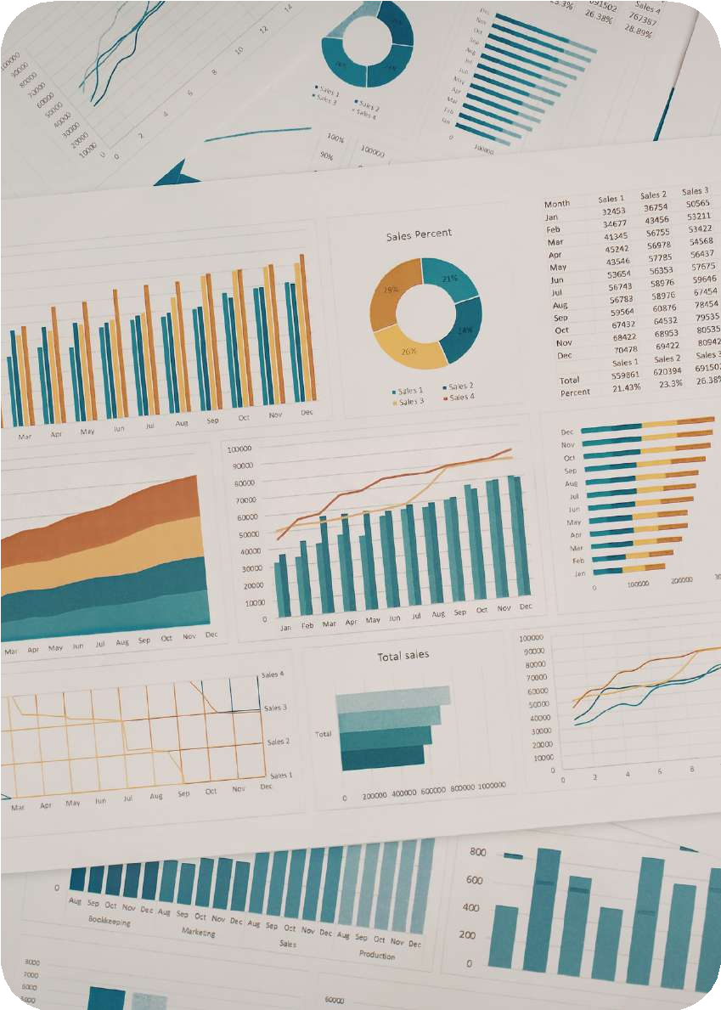

Data Engineering: From Source to Actionable Insight
Data Source: List of all Colleges Dataset
Dataset from Kaggle
Dataset Scope
Original Dataset: 47,590 rows. Working Dataset: 9,000 rows, 14 key columns, spanning 1990–2020.
Data Cleaning Protocol
Missing values were addressed by replacing them with "Not Specified" or "Not Defined". Data types were rigorously converted for accuracy. University and College IDs were separated from names, and a random sampling ensured state representation.
Key Data Points
Focus was placed on: State, District, Management Type, Year of Establishment, Location, and College Type.

Slide 5

Key Performance Indicators for Education Analysis
Private College Share (%)
Formula: (Private Colleges
/ Total Colleges) × 100
Measures the extent of private sector dominance in higher education.
Private-to-Government Ratio
Formula: Private Colleges / Government Colleges
Indicates the structural shift towards privatisation within the system.
College Growth Rate
Forecasted College Count
Predicts future growth trajectories of educational institutions until 2030.
Formula: (Current Year Colleges - Previous Year Colleges) / Previous Year Colleges × 100
Tracks the expansion trend of colleges over specific periods.

Slide 6

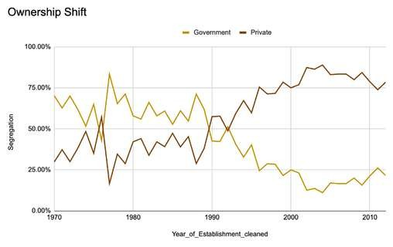
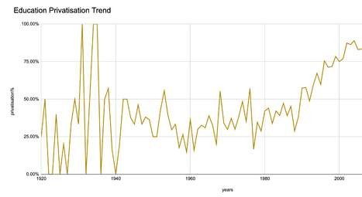
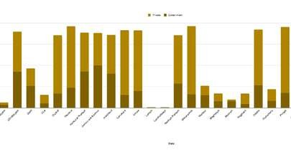
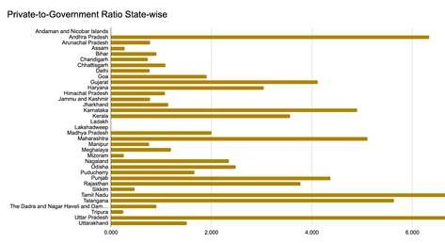
Key Insights from Exploratory Data Analysis (EDA)
Private Dominance
Increasing Trend
Regional Concentration
Regional Disparity
Private institutions now hold a significant 62.74% share of higher education, with nearly 2 private colleges for every government college.
The privatisation trend has consistently accelerated over time, indicating a steady shift in the educational landscape.
Private colleges dominate most states, especially Tamil Nadu, Maharashtra, Karnataka, and Uttar Pradesh, far exceeding government institutions.
Certain states exhibit significantly higher private-to- government ratios, highlighting regional imbalances.

Slide 7

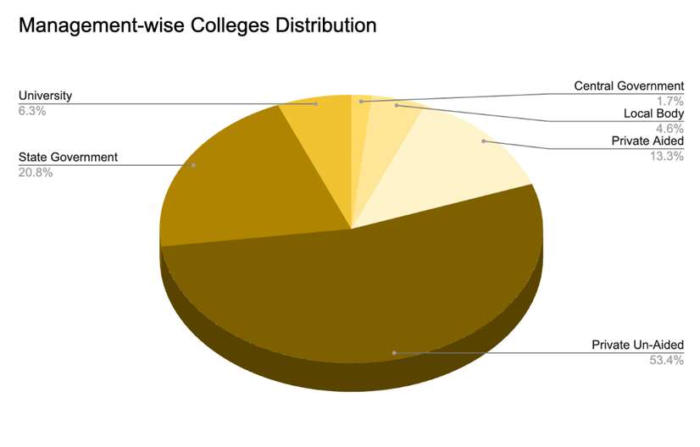
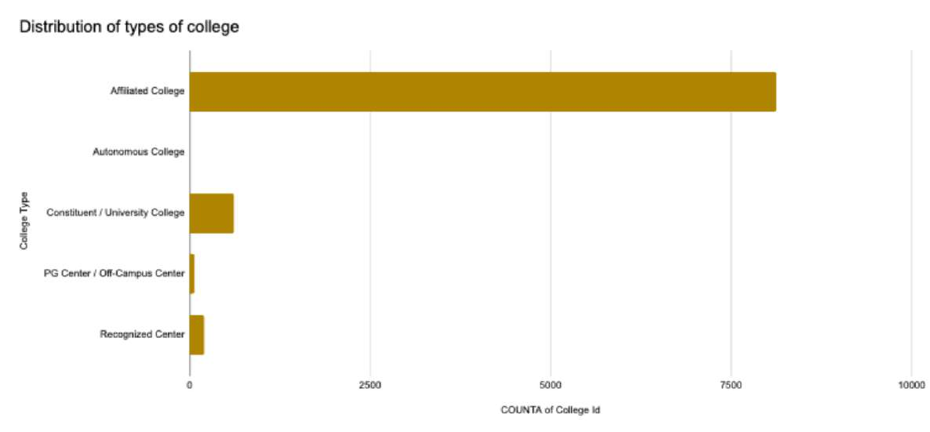
Forecasting Growth and Understanding Regional Imbalances
Forecasting Insights:
The number of colleges is projected for steady growth until 2030.
An estimated growth of approximately 173 colleges per year is anticipated.
Private institutions are expected to remain the dominant drivers of this expansion.
Segmentation Insights:
Private colleges: 62.74% | Government colleges: 37.26%.
Root Causes Identified:
Government expansion struggles to keep pace with demand. Private sector effectively fills the demand gap.
Urban areas offer greater profitability for private institutions. Policy support often encourages further privatisation.

Slide 8

Strategic Recommendations for a Balanced Education Landscape
Increase Government Colleges
Focus on expanding public institutions in states with high private dominance to improve affordability and balance the educational ecosystem.
Expand Rural Education Infrastructure
Invest in developing educational facilities in rural areas to enhance access and reduce existing inequalities.
Strengthen Private Sector Regulation
Implement robust regulatory frameworks for private institutions to ensure quality standards and control tuition fees, promoting fairness and accessibility.
Promote Public-Private Partnerships (PPPs)
Foster collaborations between public and private entities to accelerate expansion and improve infrastructure without compromising accessibility or quality.

Slide 9
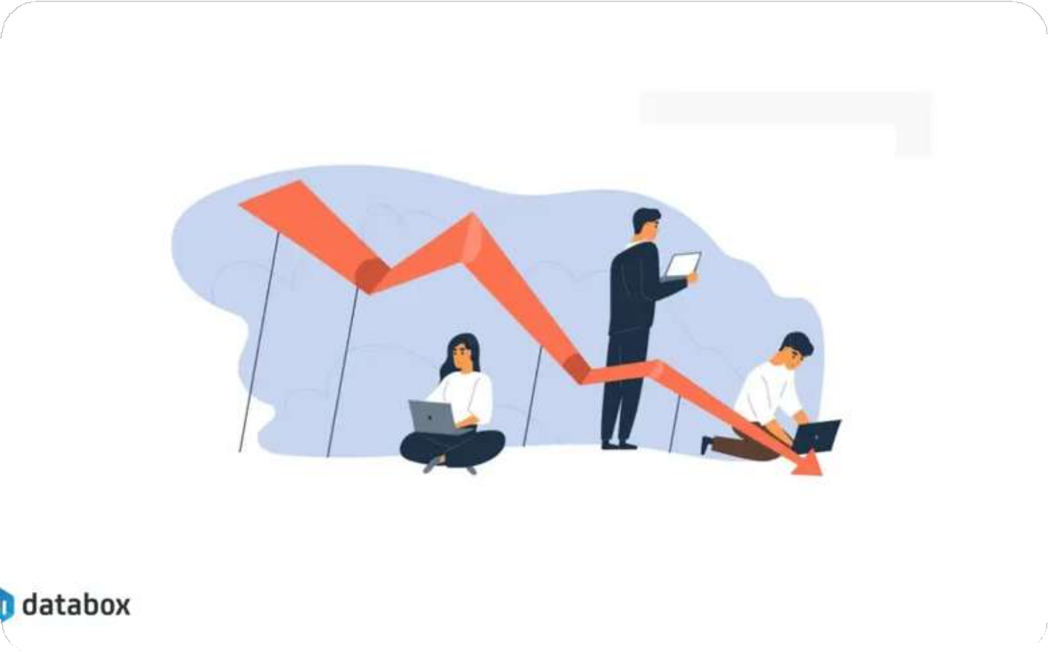
Anticipated Impact & Value Creation
Business Impact:
Helps government identify priority regions for new colleges.
Supports data-driven and effective education policy decisions.
Ensures balanced development of higher education infrastructure.
Improves access to education in underserved rural areas.
Optimizes resource allocation and planning efficiency.
EEssttiimmaatteedd IImmppaacctt::
Improves access to higher education, especially in rural regions.
Reduces regional imbalance in college distribution. Enhances overall education coverage and accessibility. Enables efficient and strategic infrastructure planning.

Slide 10


Limitations and Next Steps for Enhanced Analysis
Limitations Encountered:
Analysis was based on a sampled dataset, not the complete data.
Lack of student, faculty, placement, and quality-related information.
Some district-level and institutional data were missing or incomplete.
Forecasting was based on historical trends and may not reflect future uncertainties.
Number of colleges does not necessarily indicate education quality or access.
Future Enhancements:
Expand analysis using the complete AISHE dataset for more comprehensive insights.
Perform state-wise and district-level analysis to identify regional trends and gaps.
Analyse trends over multiple years to understand growth patterns in higher education.
Study specialisation-wise growth to identify emerging academic fields.
Incorporate student enrolment, placement, faculty, and infrastructure data for deeper analysis.
Apply advanced Machine Learning models to improve forecasting accuracy.

