Slide 1
HTML
Hyper text markup language

Slide 2
Use of HTML
To define the browser what to display in the user interphase.
To develop web sites
To develop web applications
HTML describes the structure of a web page semantically

Slide 3
Markup
Html files can be created by saving a note file by editing its file extension to .html or .htm
HTML markup consists of several key components, including those called tags (and their attributes), character-based data types, character references and entity references.
Two types of tag container tag & empty tag

Slide 4
Example
<html>
<head>
<title>This is a title</title>
</head>
<body>
<p>Hello world!</p>
</body>
</html>

Slide 5
Head
The HTML <head> element provides general information (metadata) about the document, including its title and links to its scripts and style sheets.
The <head> element is a container for all the head elements.
The <head> element can include a title for the document, scripts, styles, meta information, and more.
The following elements can go inside the <head> element:
<title> (this element is required in an HTML document)
<style>
<base>
<link>
<meta>
<script>
<noscript>

Slide 6
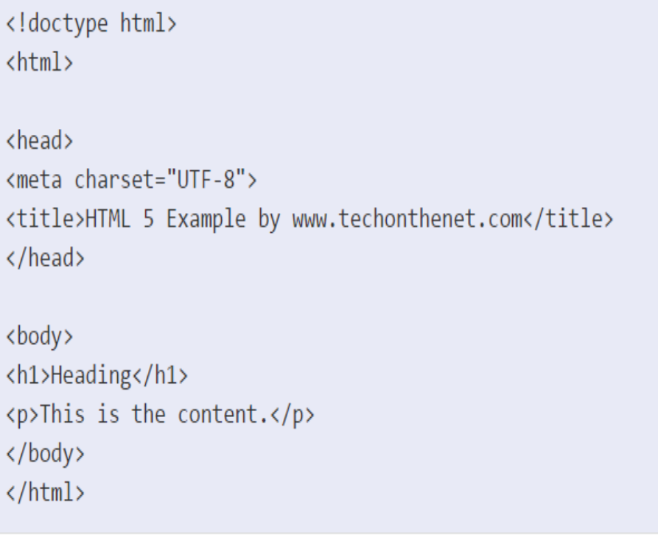
Body
The HTML <body> tag defines the main content of the HTML document or the section of the HTML document that will be directly visible on your web page. This tag is also commonly referred to as the <body> element.

Slide 7
Tags and Attributes
Element is indicated by a pair of tags: a "start tag" <p> and "end tag" </p>
The general form of an HTML element is therefore: <tag attribute1="value1" attribute2="value2">''content''</tag>
Empty elements and take the form <tag attribute1="value1" attribute2="value2">

Slide 8
Tags and Attributes
Most of the attributes of an element are name-value pairs, separated by "=" and written within the start tag of an element after the element's name.
Ex:
  The id attribute provides a document-wide unique identifier for an element.
  The class attribute provides a way of classifying similar elements. This can be used for semantic or presentation purposes.

Slide 9
Tags and Attributes
  Style attribute to assign presentational properties to a particular element.
  The lang attribute identifies the natural language of the element's contents
  <abbr id="anId" class="jargon" style="color:purple;">HTML</abbr>
  For more tags visit-https://www.w3schools.com/tags/
  For more attributes visit-
  https://www.w3schools.com/tags/ref_attributes.asp

Slide 10
Interview Questions
What is the use of span tag? Give one example.
  The span tag is used for following things:
  For adding color on text
  For adding background on text
  Highlight any color text etc.
How to insert a copyright symbol on a browser page?
  can insert a copyright symbol by using &copy; or &#169; in an HTML file.

Slide 11
Interview Questions
How do you insert a comment in html?
  Comments in html begins with “<!–“nd ends with “–>”
How many tags can be used to separate section of texts?
  There are three tags used to separate the texts. i.e. usually <br> tag is used to separate line of texts. Other tags are<p> tag and <blockquote> tag.

Slide 12
Interview Questions
What is a better way to design the layout of a web page – a table tag or div?
  - The better way to design the layout of the webpage is by using the <div> tag.
  - The <table> tag is used to present the data in tabular format.

