Slide 1








Bluestock Fintech
Capstone Project I - Mutual Fund Analytics
An End-to-End Financial Data Engineering, Exploratory Analytics & Interactive Power BI Analytics Solution
CORE TECHNOLOGY STACK & FRAMEWORKS
Abhishek Mondal
40 Schemes | 64,320 NAV Records | 32,778 Transactions

Slide 2








Problem Statement & Strategic Objective
Bluestock Fintech
The Financial Data Challenge
Platform Objective
Mutual fund data is fragmented across multiple disparate sources including AMFI, MFAPI, and market exchanges. It contains complex, raw details on daily NAVs, fund AUMs, investor transactions, SIP flows, and market benchmarks.
Build a production-grade, end-to-end Mutual Fund Analytics Platform to collect, clean, transform, store, and analyze data for evaluating fund performance, investor risk, SIP trends, and portfolio behavior.
•
Data Fragmentation: Unstructured raw feeds hinder consolidated reporting.
•
ETL Pipeline: Clean and structure raw inputs into SQLite relational storage.
•
Risk Identification: Lack of automated risk metrics (Sharpe, Sortino, Drawdown).
•
Advanced Analytics: Compute CAGR, Alpha, Beta, VaR, and fund scorecards.
•
Actionable Insights: Retail investors struggle to compare fund efficiency effectively.
•
Interactive BI: Deliver executive dashboard insights via Power BI.
End-to-End System Data Flow
Raw Data
Python ETL
SQLite DB
SQL & Python Analytics
Power BI Dashboard
Investment Insights

Slide 3






Data Sources & Scope Coverage
Bluestock Fintech
MUTUAL FUND SCHEMES
FUND HOUSES (AMCS)
NAV HISTORY RECORDS
INVESTOR TRANSACTIONS
40
10
64,320
32,778
Primary Data Sources
Integrated Datasets (11 Tables)
AMFI India & MFAPI REST API
Fund Master
Scheme Performance
Automated extraction of historical daily NAVs (2022–2026), scheme classifications, and live NAV feeds.
NAV History
Investor Transactions
Industry AUM
Portfolio Holdings
NSE / BSE Benchmark Indices
SIP Inflow Trends
Benchmark Indices
NIFTY50 & NIFTY100 daily price histories used for relative risk, Beta, and Alpha calculation.
Category Inflows
Live NAV Data
Folio Count Statistics

Slide 4








System Architecture & Pipeline Engineering
Bluestock Fintech
The robust multi-tiered data pipeline processes unstructured financial feeds into an optimized relational SQLite database with 11 dimension and fact tables.
1. Ingestion
2. Cleaning
3. Loading
4. Storage
5. Analytics
6. Power BI
Python REST scripts fetching raw JSON/CSV feeds
Pandas missing value handling & date normalization
SQLAlchemy ORM into SQLite Relational DB
11 Fact & Dimension structured schemas
SQL queries & Python quantitative scripts
Interactive dashboard visualizations & KPIs
Pipeline Processing Logic
Relational Database Design
•
Type Coercion: Standardized numerical NAV precision & date formats.
•
Fact Tables: `nav_history` (64,320 rows), `investor_transactions` (32,778 rows).
•
Data Validation: Automated checks for duplicate transactions and missing trade records.
•
Dimension Tables: `fund_master`, `scheme_metadata`, `benchmark_index`.
•
Calculated Fields: Pre-computing daily log returns and cumulative returns.
•
Optimization: Indexed primary/foreign key joins for instant Power BI queries.

Slide 5


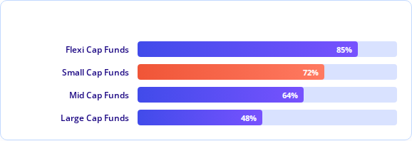
EDA — Industry & Market Dynamics
Bluestock Fintech
Long-Term NAV Trajectory
Structural Industry Growth Metrics
NAV values demonstrate an overall upward trajectory across analyzed schemes from 2022 to 2026, effectively navigating market volatility phases.
•
SIP Contribution Velocity: Monthly SIP inflows sustained record high growth, reflecting expanding retail participation across tier-2/3 cities.
•
Fund House AUM Concentration: Top AMC players command a major share of AUM, driven by flagship Flexi-Cap and Large-Cap offerings.
Category Inflow Share
•
Industry Folio Expansion: Total mutual fund folios reached 26.12 Cr, backed by aggressive digital onboarding.
•
Equity Dominance: High net inflows shifted towards growth-oriented equity and hybrid schemes.

Slide 6




EDA — Investor Demographics & Fund Risk
Bluestock Fintech
ANALYZED TRANSACTIONS
SIP TRANSACTIONS
TOP AGE GROUP SIP
KEY INFLOW CATEGORY
32,778
19,716
30-45 Yrs
Flexi Cap
Investor Behavioral Insights
Sector & Risk Distribution
•
Age Cohort SIP Activity: Investors aged 30-45 exhibit highest average monthly SIP commitments and longest holding tenure.
•
Sector Concentration: Financial Services, IT, and Capital Goods dominate top scheme holdings.
•
Geographic Spread: Maharashtra, Gujarat, and Karnataka lead total investment transaction volumes.
•
Return vs Risk Divergence: Small-Cap funds offer elevated CAGR but display higher standard deviation and downside risk.
•
Transaction Split: Systematic Investments (SIPs) constitute ~60.1% of all recorded transaction counts.
•
Net Inflow Winners: Mid-Cap and Multi-Cap categories show strongest quarterly inflow retention.

Slide 7


Fund Performance & Risk Analysis
Bluestock Fintech
Calculation Methodology : Daily Returns CAGR Sharpe Ratio Sortino Ratio Max Drawdown
Top 3-Year Annualized CAGR
Risk-Adjusted Ratios
Scheme Code | 3-Year CAGR | Performance Grade
119094 | 35.11% | Exceptional
148567 | 34.00% | Outperformer
120504 | 32.49% | Outperformer
Scheme Code | Sharpe Ratio | Sortino Ratio
148567 | 1.4483 | 2.3856
120843 | 1.3067 | 2.3643
148569 | 1.2349 | 2.1469
119551 | 1.2083 | 1.9840
120505 | 1.1801 | 1.9120

Slide 8



Alpha, Beta & Composite Fund Scorecard
Bluestock Fintech
Alpha (vs NIFTY100) & Max Drawdowns
Composite Scorecard Weighting
Top Alpha Leaders:
Worst Drawdowns:
•
119598: 0.30337
•
119599: -52.57%
•
149324: 0.30058
•
119095: -51.68%
•
120505: 0.29264
•
101207: -35.45%
•
148569: 0.28270
Top Ranked Composite Funds
Rank | Fund Name | Category | Composite Score
#1 | Mirae Asset Large Cap Fund | Large Cap | 85.90
#2 | ICICI Prudential Midcap Fund | Mid Cap | 81.79
#3 | Kotak Flexicap Fund | Flexi Cap | 81.54
#4 | HDFC Mid-Cap Opportunities Fund | Mid Cap | 80.64
#5 | ICICI Prudential Bluechip Direct | Large Cap | 79.49

Slide 9
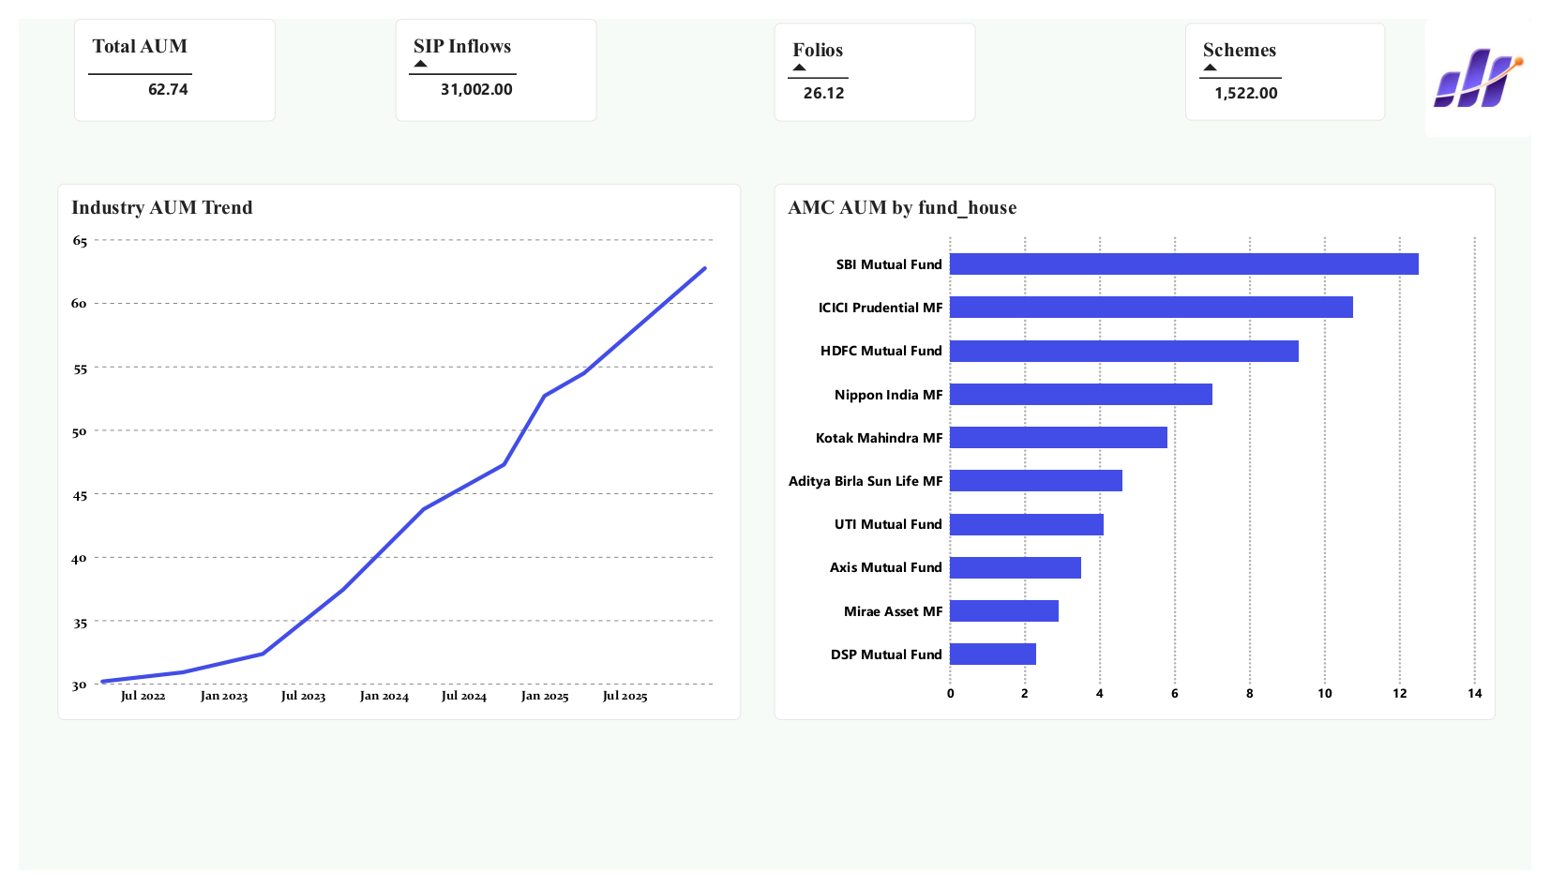


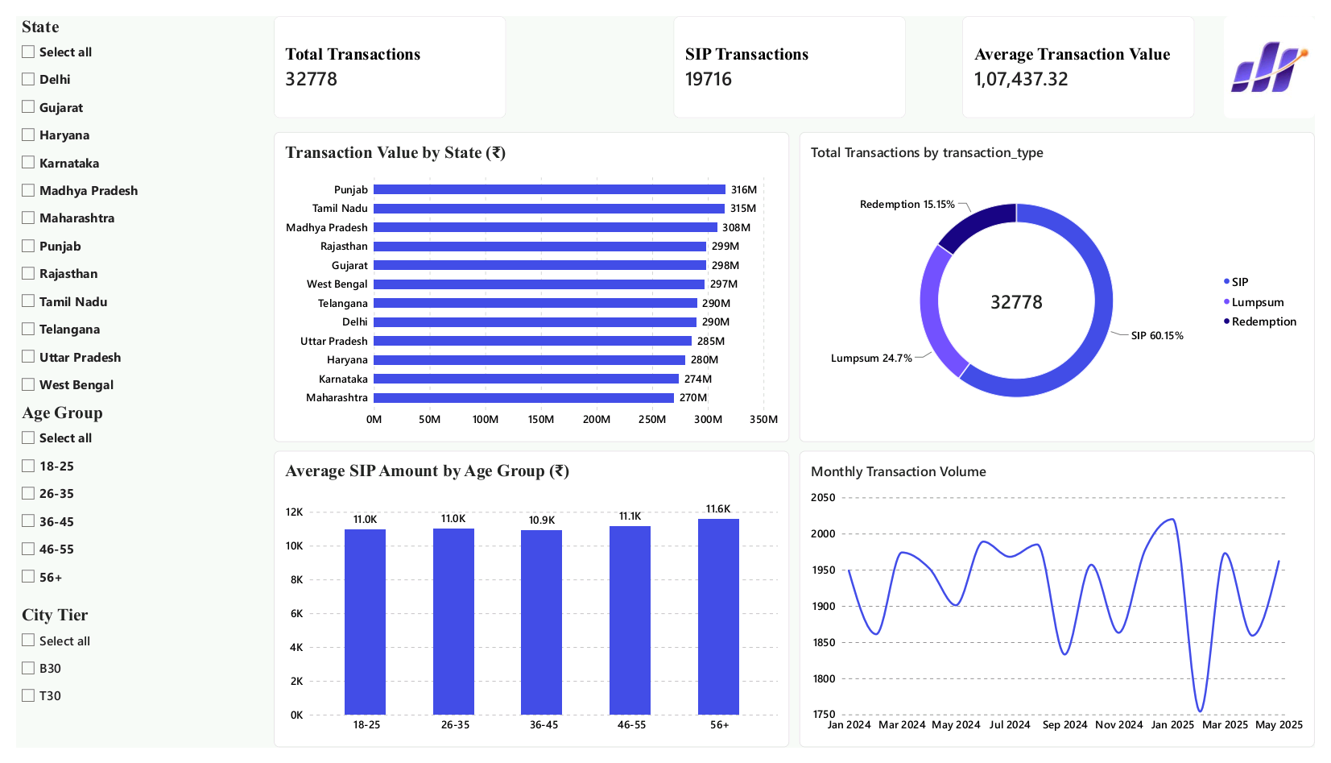
Interactive Power BI Dashboard
Bluestock Fintech
Executive report pages designed for macro industry tracking and granular fund comparative analytics.
Page 1: Industry Overview KPIs
TOTAL INDUSTRY AUM
62.74 Lakh Cr
MONTHLY SIP INFLOWS
31,002 Cr
TOTAL FOLIOS
26.12 Cr
TRACKED SCHEMES
1,522
Page 2: Fund Performance Analytics
•
Scatter Plot: 3-Year Return vs Risk matrix for instant tiering.
•
Fund Scorecard: Dynamic rank filtering based on composite scores.
•
Interactive Slicers: Fund House, Category, and Plan filters.

Slide 10






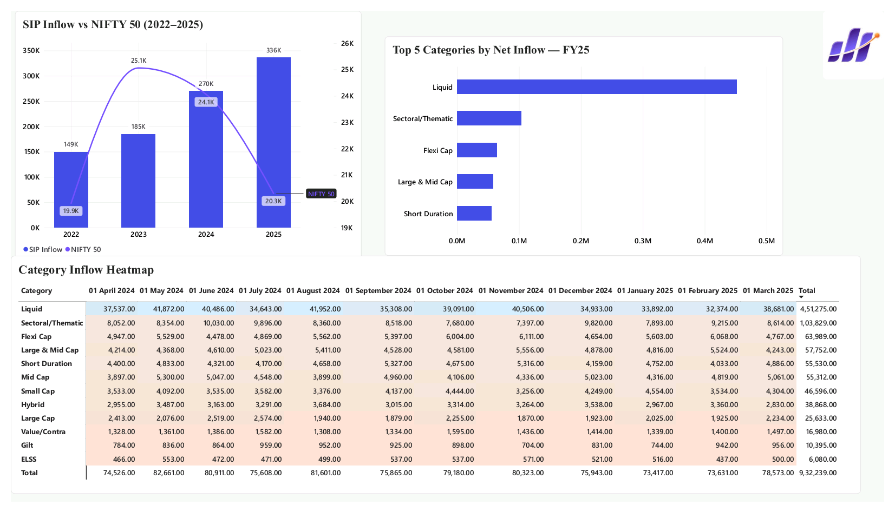


Power BI — Investor & Market Analytics
Bluestock Fintech
Page 3: Investor Analytics
Demographic Dashboard Active Filters
32,778
19,716
30-45
Total Txns
SIP Txns
Peak Age
•
Transaction split visualization across SIP vs Lumpsum.
•
State-wise inflow heat maps identifying high-volume regions.
Page 4: SIP & Market Trends
Inflow Trends & NAV Drill-through NIFTY50 Overlay
Monthly
Heatmap
Drill-down
SIP Inflows
Category Flow
NAV History
•
SIP flow trajectory overlay against NIFTY50 index trend.
•
Interactive drill-through to individual scheme NAV historical details.

Slide 11






Key Findings & Advanced Analytics
Bluestock FintechC
1. Long-Term NAV Growth
2. Risk Separation
3. VaR / CVaR Risk
Overall upward movement across 2022–2026 confirms strong compounding resilience of equity funds despite short-term pullbacks.
Outperformers generated superior Sharpe (>1.3) and Sortino (>2.1) ratios, proving downside protection is key to long-term returns.
Historical VaR (95%) and CVaR analysis highlight elevated tail-risk in Small-Cap schemes, requiring strict exposure capping.
4. SIP Continuity & Churn
5. Sector Concentration
6. Scorecard Model
Cohort tracking identified key drop-off intervals in SIP contributions, enabling proactive investor retention strategies.
Sector HHI index revealed high concentration risks in Banking and IT, emphasizing need for multi-asset diversification.
The 5-factor weighted scorecard provides an objective framework to benchmark schemes beyond pure unadjusted returns.

Slide 12
Bluestock Fintech
Thank You!
Bluestock Fintech — Capstone Project I - Mutual Fund Analytics
Data
ETL Pipeline
SQLite DB
Analytics
Power BI Dashboard
Insights

