Slide 1
Vaccination Portal
Online Slot Booking Room

Slide 2
The Team
Kelly Choi
Kathi Vamshi Krishna Reddy
Sai Abhishek Palati
Dipasha Sodhia

Slide 3
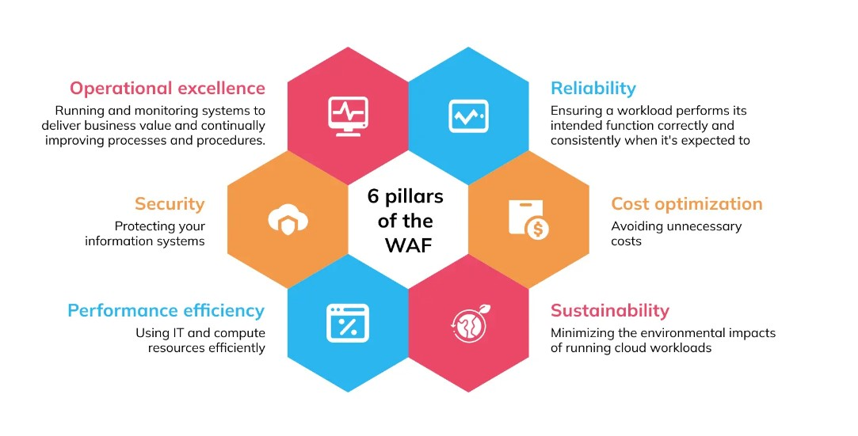
The Well Architected Framework

Slide 4




Operational Excellence
Operation excellence allows for continuous improvements and a monitoring system to make sure workloads are running effectively. This pillar is a concept of microservices that also takes into account delivery business value. When you change code, they should be making frequent and minor changes so you can always undo and go back to previous changes. You should always consider that applications will always fail so you should keep this in mind when making an application.
The AWS services that are related to Operational Excellence include:
AWS Trusted
Advisor
AWS Cloud Watch
Aurora Amazon
RDS Instance
Amazon CloudFront

Slide 5


Security
The Security Pillar focuses specifically on identifying and mitigating potential security risks in AWS environments. By following the AWS Security Pillar, organizations can implement a comprehensive security strategy for their AWS environments that helps ensure the confidentiality, integrity, and availability of their data and resources.
The AWS services that we have used related to the Security Pillar are:
AWS KMS
AWS Shield
AWS Trusted
Advisor
AWS Cloud Watch

Slide 6





Reliability
The ability of a system to recover from infrastructure or service disruptions, dynamically acquire computing resources to meet demand, and mitigate disruptions such as misconfigurations or transient network issues.
There tools that we used for reliability in the cloud are :
AWS Trusted Advisor AWS Shield Auto Scaling CloudWatch CloudFormation
VPC S3 KMS Lambda

Slide 7

Cost Optimization
Cost optimization focuses on adequately running systems at the lowest possible price point without compromising the best practices.
Based on our particular model, Lambda is cost optimized as it only runs when we use it. In contrast, EKS is not an example of cost optimization as it is always running
Cost optimization has five design principles in the cloud. Cloud financial management should be implemented and we should measure overall efficiency. A consumption model should be adopted so we can analyze and attribute expenditure. This allows us to stop spending money on undifferentiated heavy lifting.
The AWS services that are related to Cost Optimization include:
AWS Cognito
AWS Cloudwatch
AWS Trusted Advisor

Slide 8


Performance
The Performance Pillar focuses specifically on ensuring that systems deployed on AWS are designed for optimal performance and efficiency. Organizations can ensure that their AWS workloads are designed for optimal performance and efficiency, with appropriate resource allocation, capacity planning, and performance monitoring in place. This can help to minimize latency, reduce operational costs, and improve user experience.
The AWS services that we have used related to the Security Pillar are:
AWS CloudWatch AWS CloudFormation AWS CloudFront
AWS Lambda
AWS DynamoDB RDS Instance S3 ELB

Slide 9
Sustainability
The ability to increase efficiency across all components of a workload by maximizing the benefits from the provisioned resources.
The best practice areas for sustainability in the cloud:
Region Selection – AWS Global Infrastructure
User Behavior Patterns – Auto Scaling, Elastic Load Balancing
Software and Architecture Patterns – AWS Design Principles
Data Patterns –Amazon S3
Development and Deployment Process – AWS CloudFormation
AWS AutoScaling AWS ELB S3 AWS CloudFormation

Slide 10
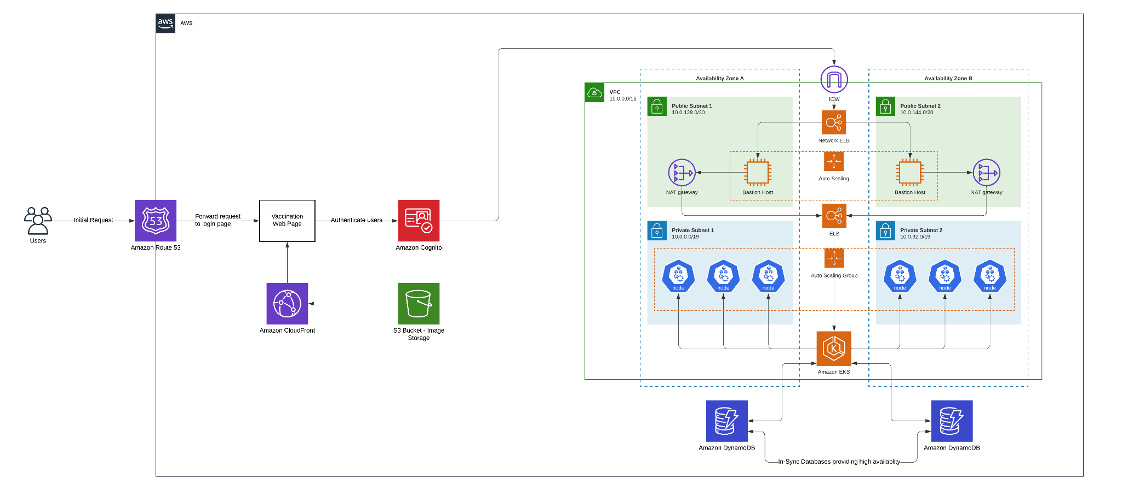
Vaccination Portal Architecture

Slide 11
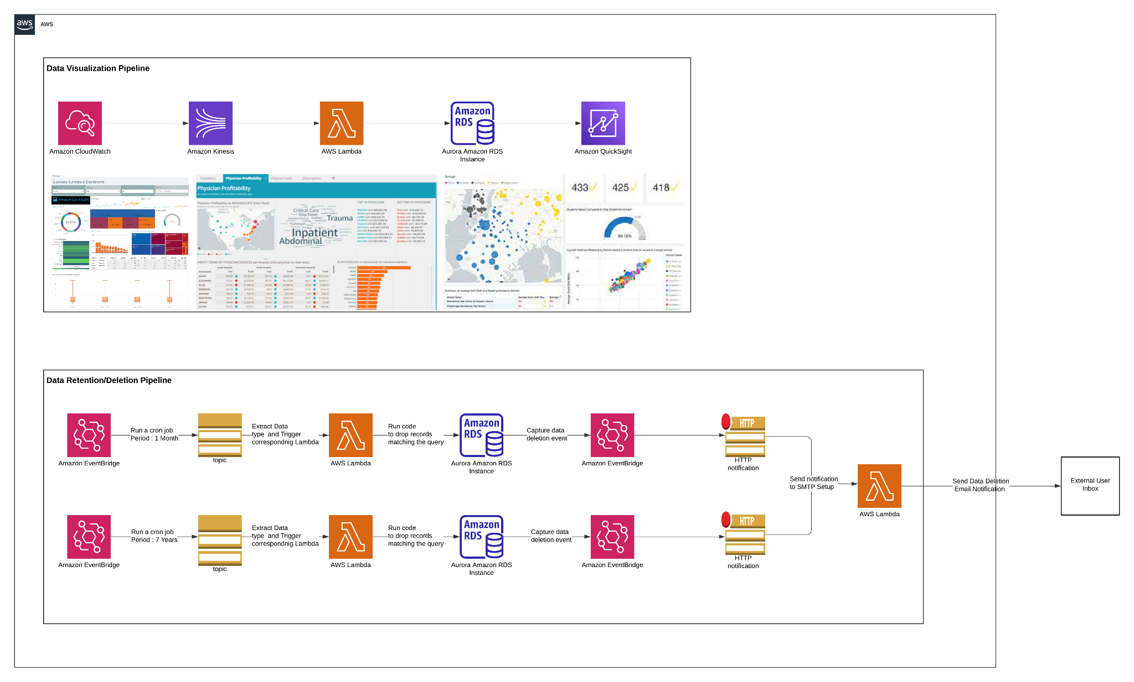
Data Visualization and Data Deletion/Retention Pipelines

Slide 12
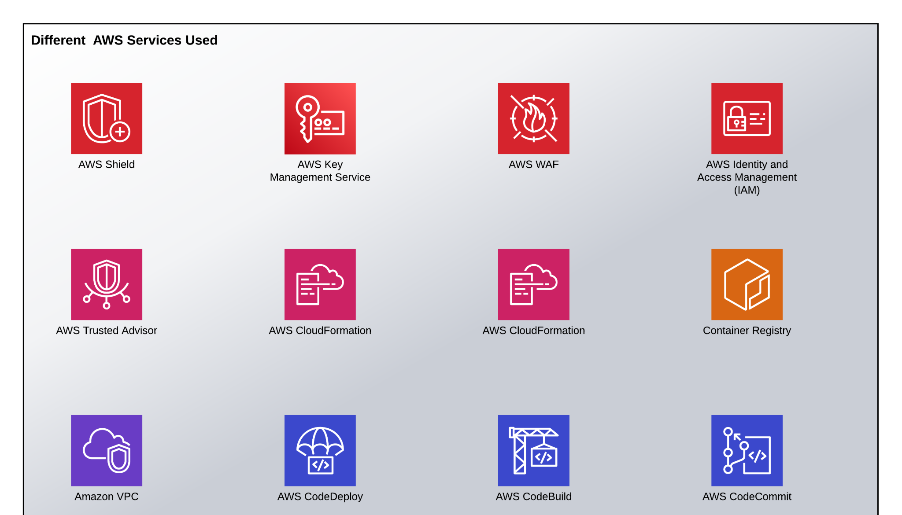
Other Services

Slide 13
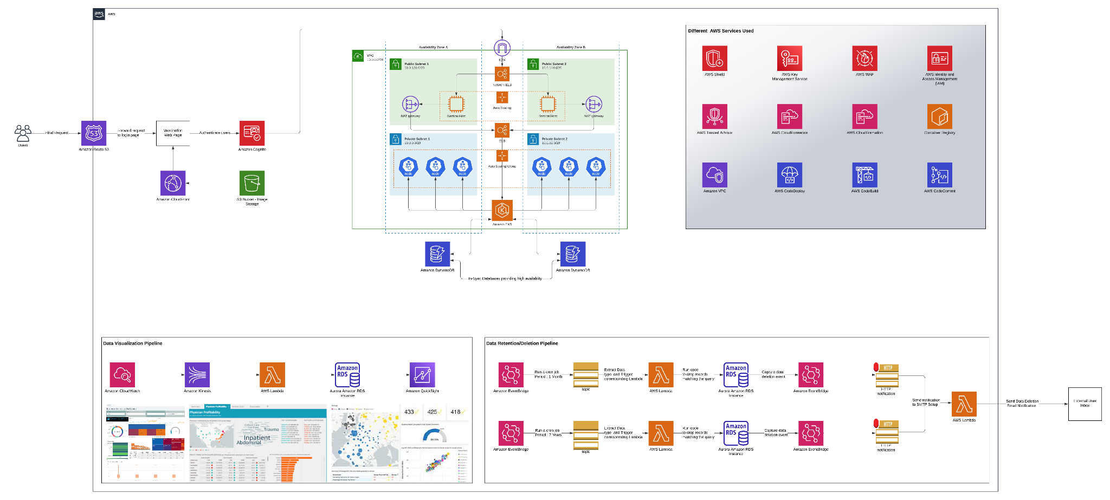
Final Architecture Diagram

