Slide 1


SMART INDIA HACKATHON 2024
Problem Statement ID: SIH 1607
Problem Statement Title: Smart AI based solution for traffic management on the routes with heavy traffic from different directions, with real-time monitoring and adaptation of traffic light timings
Theme: Smart Automation
PS Category: Software
Team ID:
Team Name: NexSpy

Slide 2
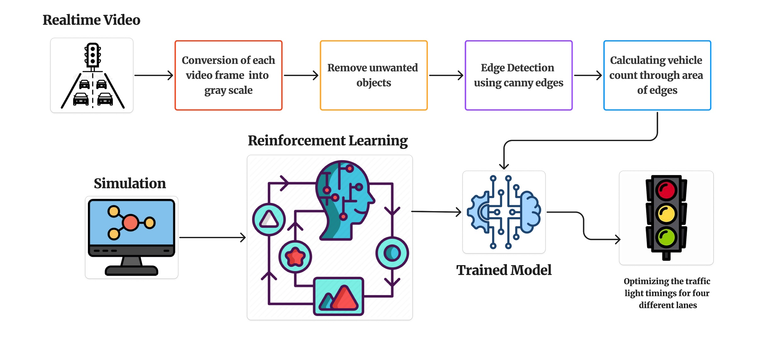
IDEA OVERVIEW
NexSpy

Slide 3




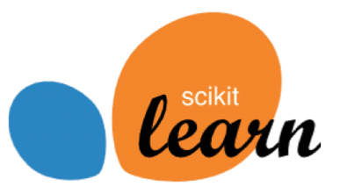

TECHNICAL APPROACH
NexSpy
Lane Separation
Reinforcement learning
Edge Detection
Define the reward function to encourage efficient traffic flow, train the model using simulation data
Isolate and crop the incoming vehicles lane using semantic segmentation
Tech Stack
Highlight boundaries of the vehicles and other key elements using canny edges
2
2
Frame Acquisition
3
Simulation
Begin by capturing the frames of the roads at intersection from video using OpenCV
Create a realistic traffic simulation which mimics real-world traffic patterns using SUMO
Area Comparison
Trained model
1
Road with largest area corresponds to the highest traffic density
Predicts green light timings for each lane based on real time traffic counts
1
4
3

Slide 4
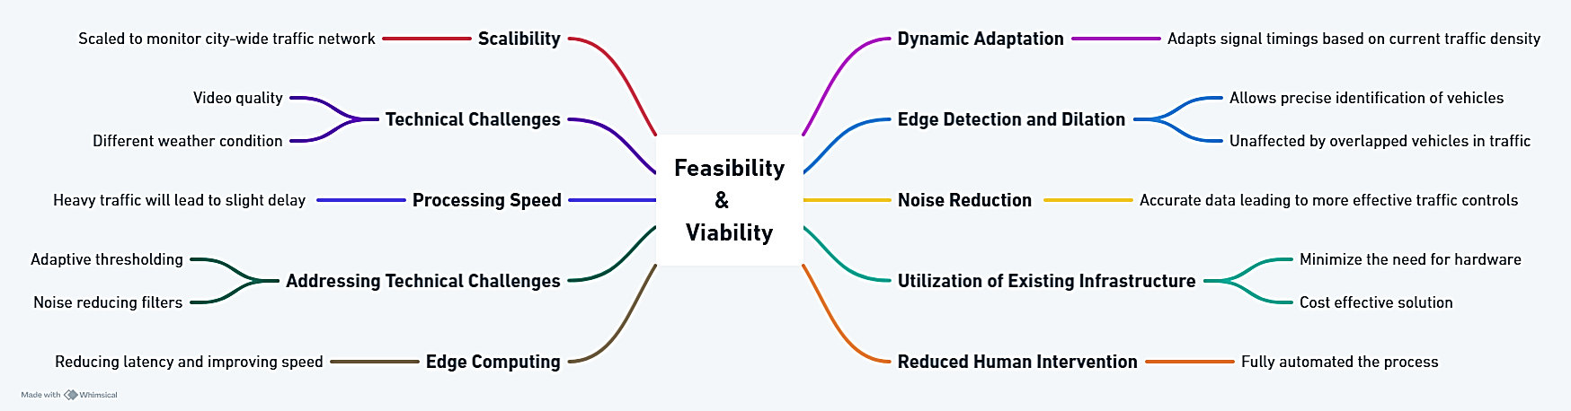
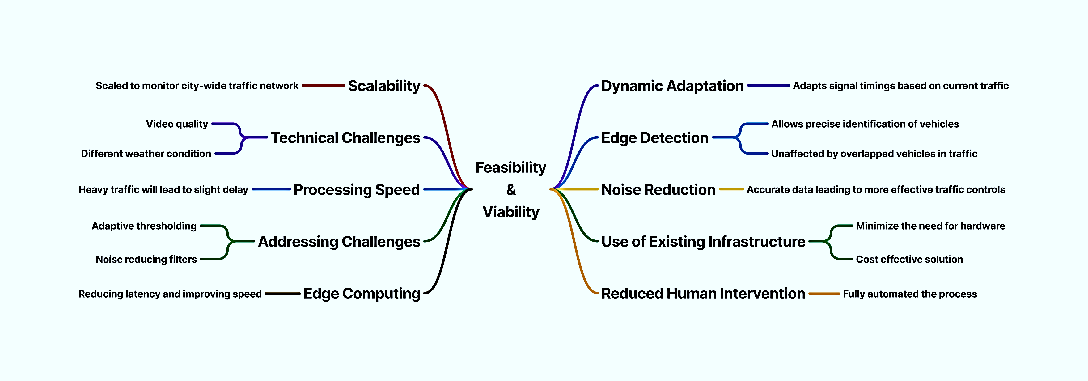
FEASIBILITY AND VIABILITY
NexSpy

Slide 5
IMPACT AND BENEFITS
NexSpy
Potential Impact
Reduced Travel Time: By optimizing traffic signals in real-time, the system reduces intersection wait times and shortens overall travel time
Benefits
Improved Safety: By effectively managing traffic flow, the system reduces congestion and lower the risk of accidents and road rage.
Increased Accessibility: Smoother traffic flow makes urban areas more accessible, particularly for those who rely on public transportation or need to compute long distances.
Community Well-Being: With fewer traffic jams, the overall stress levels in the community decrease, contributing to a more positive and healthy environments
Data Driven Decision Making: AI can collect and analyze traffic data, providing valuable insights for urban planners and transportation authorities
Improved Response Times: By reducing congestion, the system helps emergency vehicles reach destination faster, potentially saving lives.
Lower Emissions: Early numbers indicate a potential for up to 30% reduction in stops and 10% reduction in greenhouse gas emissions

Slide 6
RESEARCH AND REFERENCES
NexSpy
Research Paper | Link
AI- based Traffic Management System | Link
Intelligent Road Traffic Control System For Traffic Congestion | Link
An Adaptive Traffic Light Control Algorithm To Mitigate Traffic Congestion | Link
A Dynamic Traffic Light Control Algorithm To Mitigate Traffic Congestion | Link
Review Of Traffic Signal Control Methods | Link
Prototype [Demo] Link

