Slide 1

e-Krishi
REBOOTERS

Slide 2
Challenges…
Subsidies and welfare scheme announced by the central and state government does not reach the farmer
No information about water management
Absence of agriculture marketing
Lack of proper storage facilities
Knowledge of modern agriculture practices
Lack of awareness among farmers about the benefits of ICT in agriculture.

Slide 3
Solution
Our website is designed to provide farmers with a wealth of information and tools to optimize their crop yields and improve their farming operations.
With expert guidance on crop selection planting techniques irrigation, pest management and harvesting farmers can access the latest research and best practices to make informed decision about their crops
We provide farmers the valuable insights into the suitability of their land for specific land our website offers detailed information on soil type, p^{H} levels nutrients availability, drainage and other relevant factors that help the growth of crop.
Our user friendly interface and intuitive navigation make it easy for farmers to find information they need quickly and efficiently.

Slide 4
Solution
Pesticides management is crucial for sustainable for production and at e-Krishi will provide farmers with detail information on pesticides, include their types mode of action and application guidelines.
Farmers can access land sustainability maps and expert recommendation to help them select the right crop for their specific land condition, optimize their crop choices and increase the chances of successful harvesting.

Slide 5
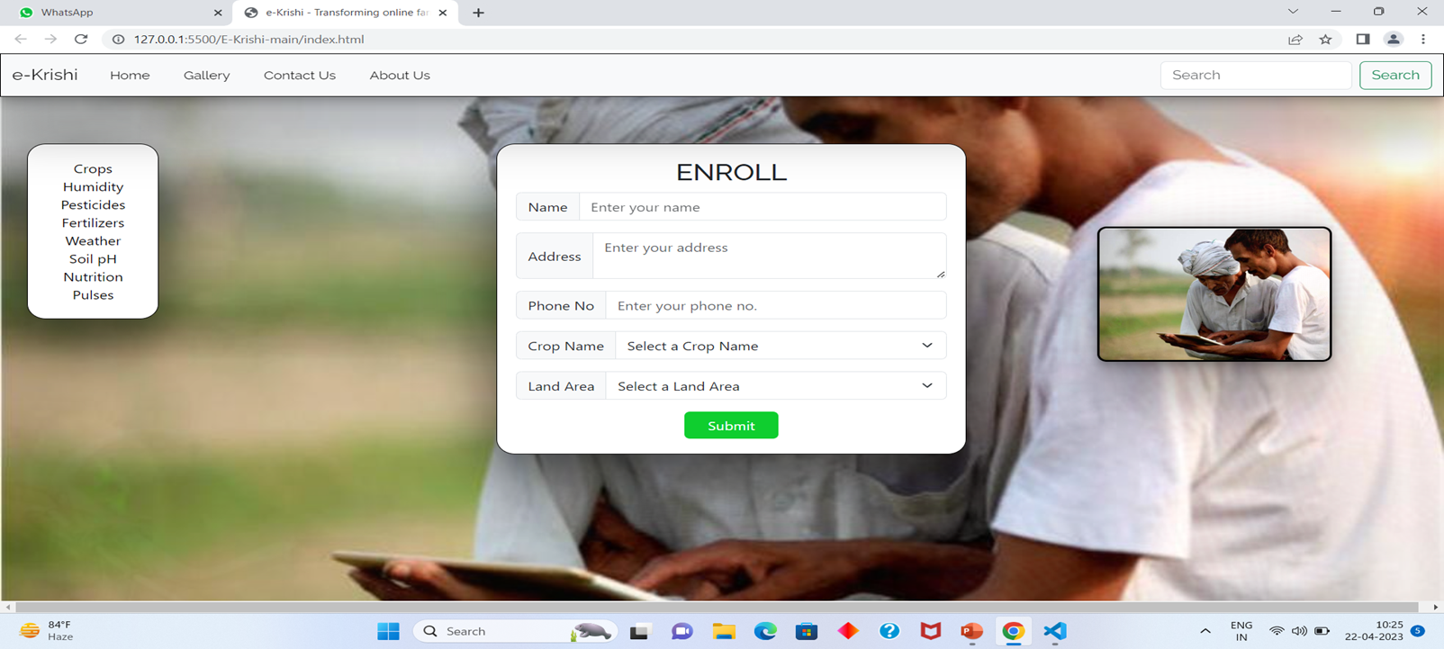
Design

Slide 6
Workflow
Nutrition
Start
User Details
Name
Crops
Analysis
Information
Desired Output
INPUT
Wheat
Phone Number
Address
Rice
Maize
Pulses
OUTPUT
Rainfall
Required Temperature
Humidity

Slide 7
Features
Provides service to farmers on their phones
We provide facilities to farmers in their regional languages
Provides all the service sought by farmer under one umbrella
Real time analysis using big data analytics and generate reports as required
Saves cost and time of everyone linked to the platform
1
2
3
4
5

Slide 8
Future Scope…
With advancements in technology, the website can become a one-stop-shop for farmers, offering personalized recommendations on what crops to cultivate based on their location, weather conditions, and soil quality. The website can leverage data analytics and machine learning algorithms to provide farmers with precise recommendations on the types and quantities of pesticides and fertilizers needed for their crops, taking into account factors such as pest and disease prevalence, crop stage, and environmental impact.
As the website gains traction among farmers, it can also serve as a platform for farmers to sell their crops to large markets. Farmers can create profiles and list their produce, attracting potential buyers from various regions. The website can facilitate the transaction process, including logistics and payment, making it convenient for farmers to sell their crops and reach a wider customer base.
Furthermore, the website can act as a knowledge-sharing platform, allowing farmers to exchange information, tips, and best practices for crop cultivation. This can foster a sense of community among farmers and enable them to learn from each other, ultimately improving their farming practices and increasing their yields

Slide 9
Thank You !!

