Slide 1

Rajiv Gandhi Proudyogiki Vishwavidyalaya, Bhopal (M.P.) ORIENTAL INSTITUTE OF SCIENCE TECHNOLOGY, BHOPAL Department of Computer science-AIML Session: 2021 -2025
PROJECT REPORT
Restaurant Management System Using Python
Submitted By:
Abhishek Bharti (0105AL223D01)
Nilesh Kumar (0105AL211075)
Shivam Kumar (0105AL223D03)
Submitted to:
Prof. Sarvagya Jain

Slide 2

LIST OF CONTENTS :
Introduction of project
Objective of project
Scope of project
Hardware and software requirement
Technology
Coding
Conclusion

Slide 3

INTRODUCTION OF PROJECT
Restaurant Management System Using Python’s built-in Tkinter library. Restaurant Management System Using Python is a software application that helps restaurant owners and managers manage various aspects of their business, such as orders, menus, tables, employees, and inventory.
A restaurant management system is a software tool that is used to keep records of sales, transactions, and other user data all in one place. This type of software helps in maintaining data and provides offers and real-time delivery details to the user.

Slide 4

OBJECTIVE OF PROJECT
The objectives of the system are- To reduce paperwork.
Reduced operational time.
Increased accuracy and reliability.
Increased operational efficiency.
Safe and Secure.
restaurant management system using Python Tkinter is a valuable tool for restaurant owners and managers to manage their operations efficiently. Python Tkinter provides an easy-to-use graphical interface that enables staff and customers to interact with the system effortlessly.

Slide 5

SCOPE OF PROJECT
The scope of a Restaurant Management System includes:
Order and Menu Management:
Efficient order processing.
Menu customization and pricing.
Inventory and POS System:
Inventory tracking and alerts.
Point of Sale for transactions.
Employee and Customer Management:
Staff scheduling and payroll.
Customer profiles and loyalty programs.
Reporting and Analytics:
Sales and performance reports.
Analytics for better decision-making.
Integration and Compliance:
Integration with external systems.
Security and compliance measures.
Online Presence and Accessibility:
Mobile apps and online ordering.
Accessibility and scalability.

Slide 6

HARDWARE AND SOFTWARE REQUIREMENT
Hardware
C.P.U. : Core 2 Due
Motherboard : Intel chip/ original based Pentium pc
RAM : 1 GB
Monitor : Color (SVGA)
Resolution : 800*600
HDD : 160 GB
Software
Operating system : Windows 7 and later
IDE : Visual Studio Code or any other ide
language : Python –Tkinter Library

Slide 7

TECHNOLOGY
Python
Python is a high-level, general-purpose programming language. Its design philosophy emphasizes code readability with the use of significant indentation.
Python is dynamically typed and garbage-collected. It supports multiple programming paradigms, including structured (particularly procedural), object-oriented and functional programming. It is often described as a "batteries included" language due to its comprehensive standard library.
Guido van Rossum began working on Python in the late 1980s as a successor to the ABC programming language and first released it in 1991 as Python 0.9.0.Python 2.0 was released in 2000. Python 3.0, released in 2008, was a major revision not completely backward-compatible with earlier versions. Python 2.7.18, released in 2020, was the last release of Python 2.
Python consistently ranks as one of the most popular programming languages.

Slide 8
Tkinter
Tkinter is a Python binding to the Tk GUI toolkit. It is the standard Python interface to the Tk GUI toolkit,and is Python's de facto standard GUI. Tkinter is included with standard Linux, Microsoft Windows and macOS installs of Python.
The name Tkinter comes from Tk interface. Tkinter was written by Steen Lumholt and Guido van Rossum, then later revised by Fredrik Lundh.
Tkinter is free software released under a Python license.
Tkinter is implemented as a Python wrapper around a complete Tcl interpreter embedded in the Python interpreter. Tkinter calls are translated into Tcl commands, which are fed to this embedded interpreter, thus making it possible to mix Python and Tcl in a single application.

Slide 9
VISUAL STUDIO CODE
Visual Studio is an Integrated Development Environment (IDE) developed by Microsoft to develop GUI(Graphical User Interface), console, Web applications, web apps, mobile apps, cloud, and web services, etc. With the help of this IDE, you can create managed code as well as native code. It uses the various platforms of Microsoft software development software like Windows store, Microsoft Silverlight, and Windows API, etc. It is not a language-specific IDE as you can use this to write code in C#, C++, VB(Visual Basic), Python, JavaScript, and many more languages. It provides support for 36 different programming languages. It is available for Windows as well as for macOS.
Visual Studio Code was first announced on April 29, 2015, by Microsoft at the 2015 Build conference. A preview build was released shortly thereafter.
On November 18, 2015, the source of Visual Studio Code was released under the MIT License, and made available on GitHub. Extension support was also announced. On April 14, 2016, Visual Studio Code graduated from the public preview stage and was released to the Web. Microsoft has released most of Visual Studio Code's source code on GitHub under the permissive MIT License, while the releases by Microsoft are proprietary freeware

Slide 10
Create a Restaurant Management System Using Python in Tkinter
Step 1: open any Python code Editor.
Step 2: Importing the Required Modules.
from tkinter import*
import random
import time
import datetime
Step 3: Copy the code for the Restaurant Management System using Python, which I provided Below in this article, and save it.
Step 4: Run this python file main.py to start the Restaurant Management System
Tkinter:- Tkinter is a standard Python library for creating graphical user interfaces (GUIs). It provides a set of tools for creating windows, buttons, menus, and other widgets

Slide 11
coding
The coding is the process of transforming the design of a system into a computer language format. This coding phase of software development is concerned with software translating design specification into the source code. It is necessary to write source code & internal documentation so that conformance of the code to its specification can be easily verified.
Coding is done by the coder or programmers who are independent people than the designer. The goal is not to reduce the effort and cost of the coding phase, but to cut to the cost of a later stage. The cost of testing and maintenance can be significantly reduced with efficient coding.

Slide 12
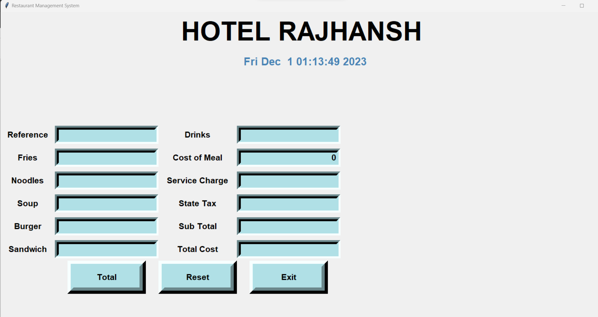
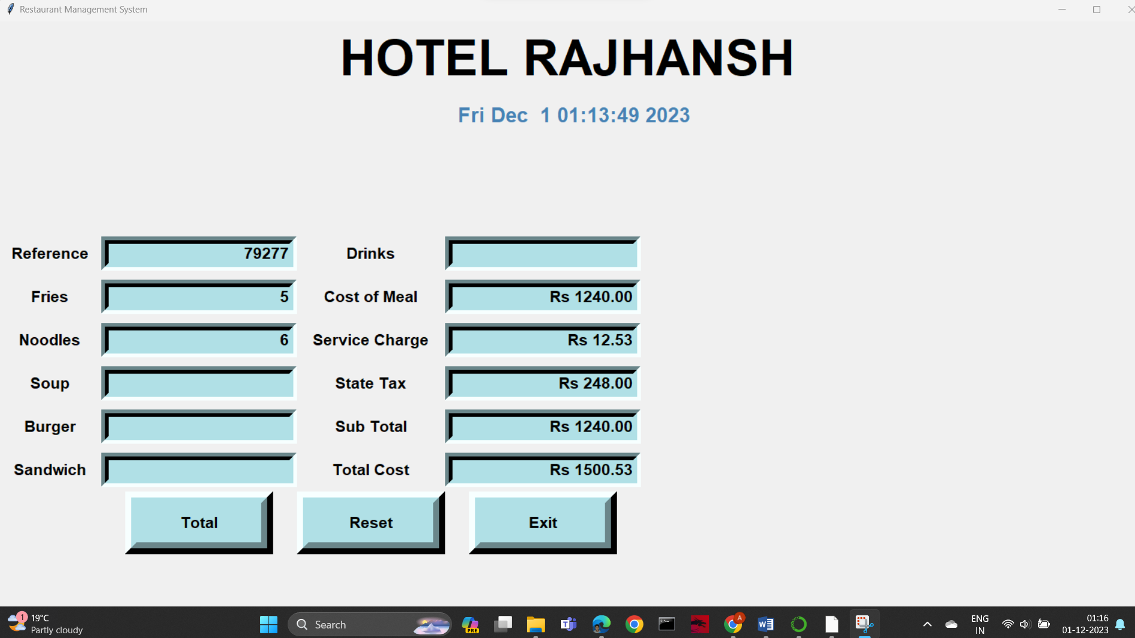
CONCLUSION

