Slide 1


Department of Information Science and Engineering
Department of Information Science and Engineering
Project Title
ABHISHEK ANAND 1NT18IS006
ABHISHEK SINGH 1NT18IS009
K.S.SAIVAIBHAV 1NT18IS074
SAHANA RAJ 1NT18IS132
MENTORED BY-
MR. KIRAN B R
ASST PROFESSOR,NMIT
26-12-2020

Slide 2

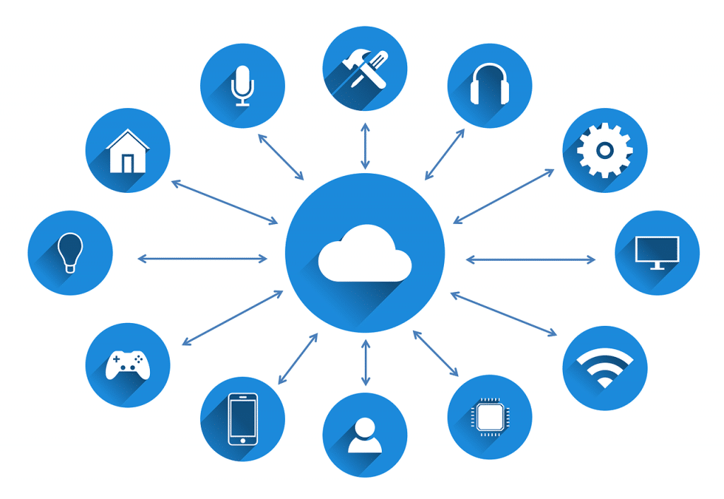
WHAT IS CLOUD COMPUTING?
Cloud Computing is the on demand delivery of computing services such as servers, storage, databases, networking, software analytics, and intelligence over the cloud.
Top benefits of cloud computing:
Pay-as-you-go Pricing
Data Security
Flexibility
Scalability
Mobility
Disaster Recovery
Project Title | Department of Information Science and Engineering

Slide 3
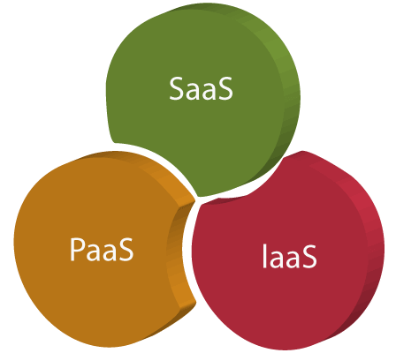
CLOUD SERVICE MODELS
IAAS [INFRASTRUCTURE AS A SERVICE]
IaaS is also known as Hardware as a Service (HaaS). It is a computing infrastructure managed over the internet.
eg:-DigitalOcean, Linode, Amazon Web Services (AWS), Microsoft Azure, Google Compute Engine (GCE) etc.
PAAS [PLATFORM AS A SERVICE]
PaaS cloud computing platform is created for
the programmer to develop,test, run, and
manage the applications.
Project Title | Department of Information Science and Engineering

Slide 4
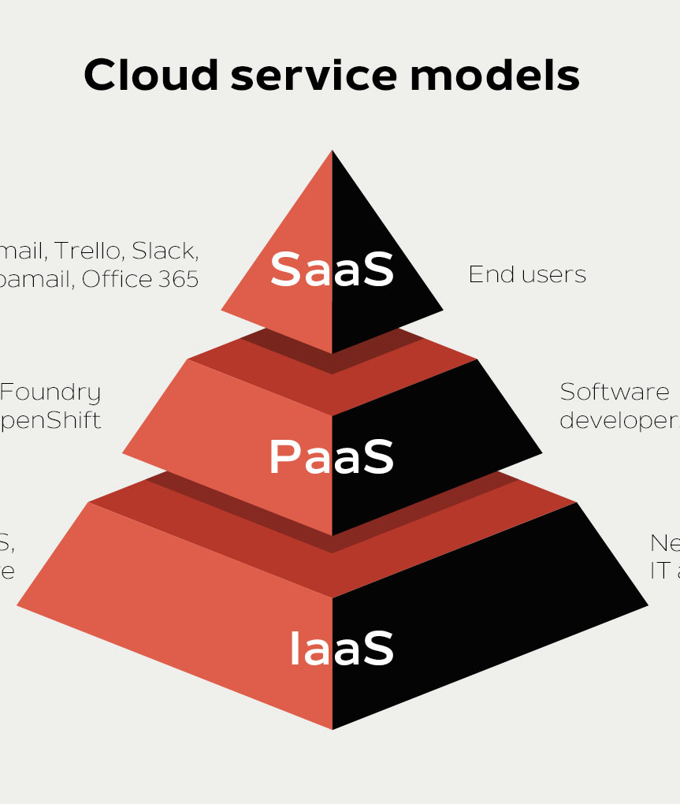
CLOUD SERVICE MODELS
eg of PAAS:-AWS Elastic Beanstalk, Windows Azure (various services provided by cloud providers)
SAAS [Software As A Service]
SaaS is also known as "on-demand software".
It is a software in which the applications are hosted
by a cloud service provider.
Users can access these applications with the help of internet connection and web browser.
eg:-GMAIL,Google Apps,Cisco WebEx,Dropbox etc.
Project Title | Department of Information Science and Engineering

Slide 5
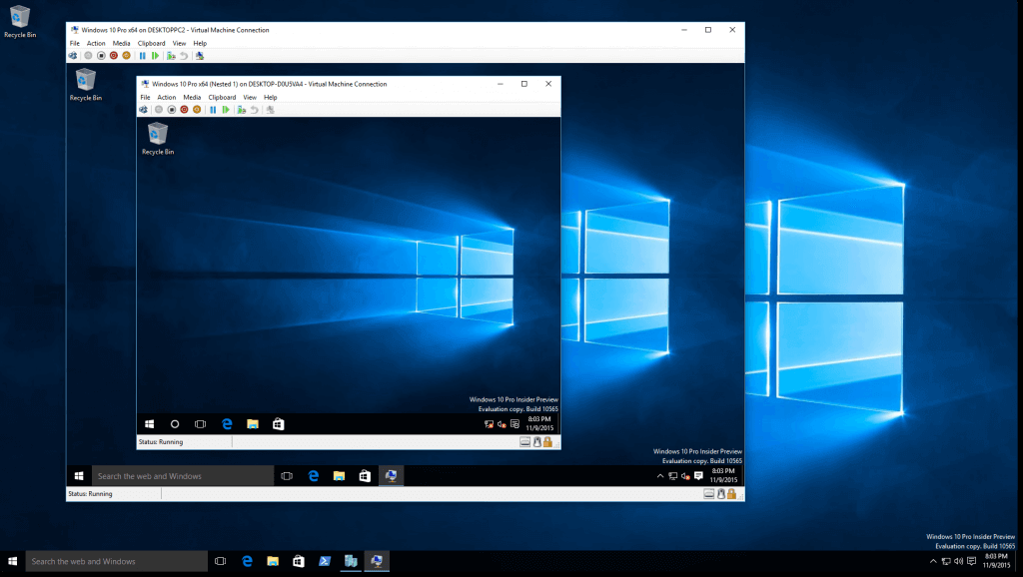
VIRTUAL MACHINES
A virtual machine is a virtual representation, or emulation, of a physical computer.
Virtualization makes it possible to create multiple virtual machines, each with their own operating system (OS) and applications, on a single physical machine.
A Virtual Machine (VM) is a compute resource
that uses software instead of a physical computer
to run programs and deploy apps.
*
| Department of Information Science and Engineering
*

Slide 6
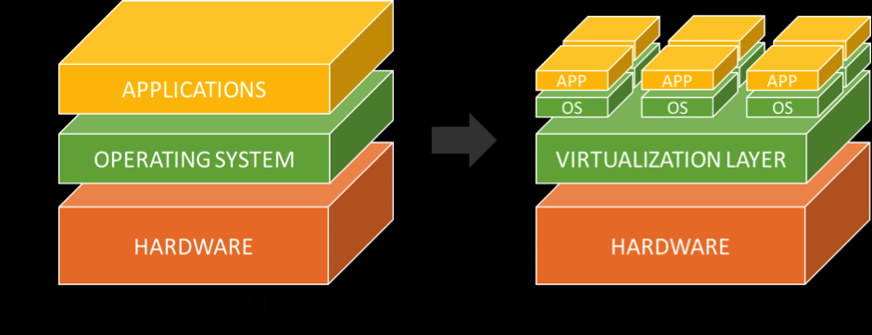
VIRTUALIZATION
Virtualization is the process of running a virtual instance of a computer system in a layer abstracted from the actual hardware.
Virtualization helps to run applications meant for a different operating system without having to switch computers or reboot into a different system.
It offers a way to segment a large system into many smaller parts, allowing the server to be used more efficiently by a number of different users or applications with different needs.
Project Title | Department of Information Science and Engineering

Slide 7
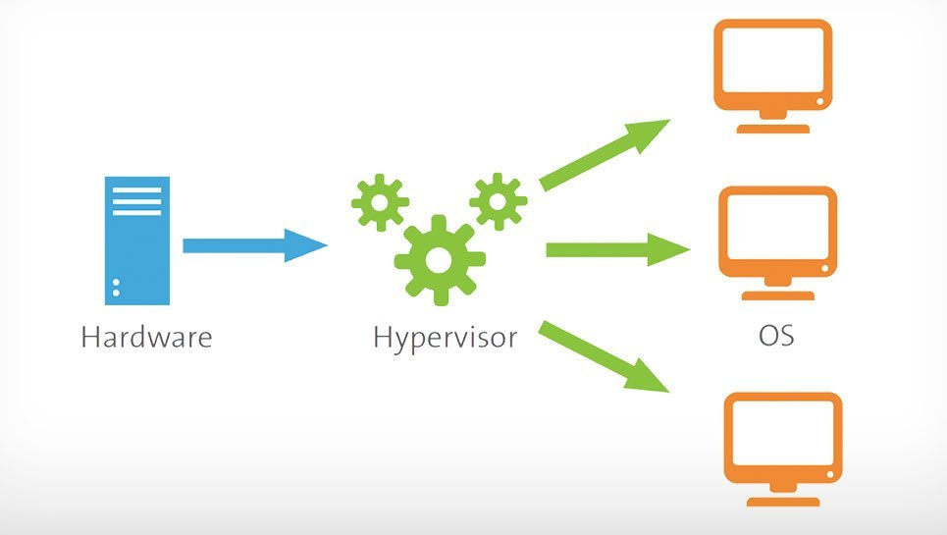
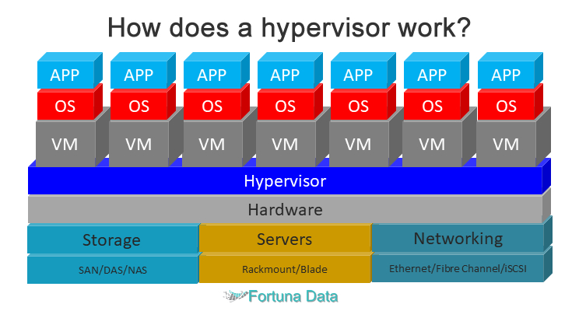
HYPERVISOR
A hypervisor is a program for creating and running virtual machines.
A hypervisor allows one host computer to support multiple guest VMs by virtually sharing its resources, such as memory and processing.
Hypervisors make it possible to use more of a system’s available resources and provide greater IT mobility since the guest VMs are independent of the host hardware
Project Title | Department of Information Science and Engineering

Slide 8
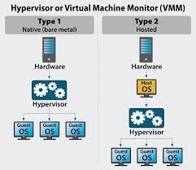
TYPES OF HYPERVISOR
There are two main hypervisor types, referred to as “Type 1” ( bare metal) and “Type 2” (hosted).
A Type 1 hypervisor acts like a lightweight
operating system and runs directly
on the host’s hardware.
A Type 2 hypervisor runs as a software layer
on an operating system, like other
computer programs.
Project Title | Department of Information Science and Engineering

Slide 9
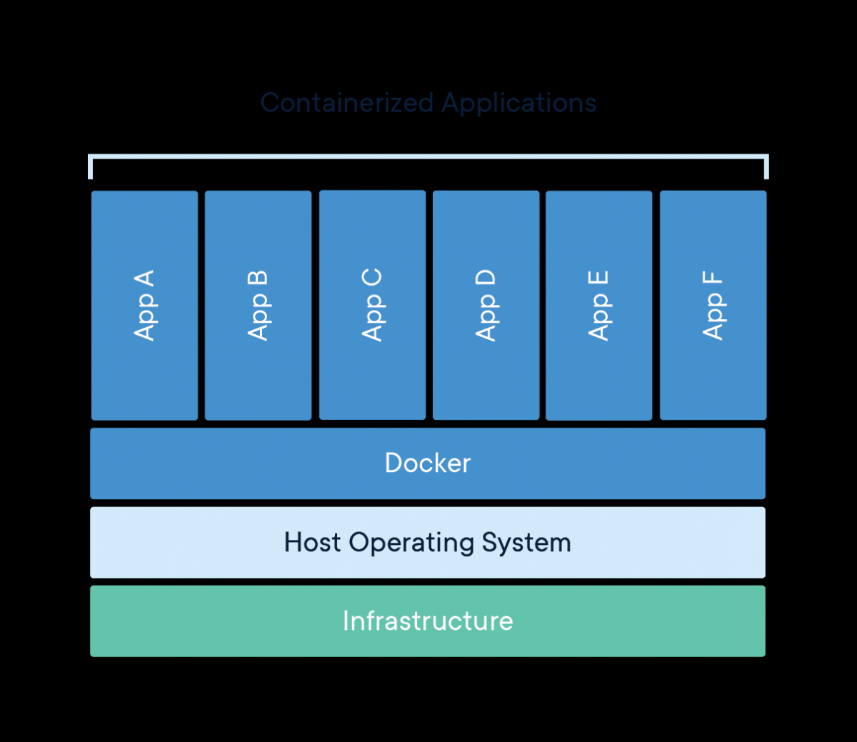
CONTAINERS
A Container in cloud computing is an approach to operating system virtualization.
Container in cloud computing is used to build blocks, which help in producing operational efficiency, version control,
developer productivity and environmental consistency
Containers give developers the ability to
create predictable environments that are
isolated from other applications.

Slide 10
CONTAINERS VS VIRTUAL MACHINE
VM | CONTAINERS
Provides complete isolation from the host operating system and other VMs. | Typically provides lightweight isolation from the host and other containers, but doesn't provide as strong a security boundary as a VM.
Runs a complete operating system including the kernel, thus requiring more system resources (CPU, memory, and storage). | Runs the user mode portion of an operating system, and can be tailored to contain just the needed services for your app, using fewer system resources.
Runs just about any operating system inside the virtual machine | Runs on the same operating system version as the host
Project Title | Department of Information Science and Engineering

Slide 11
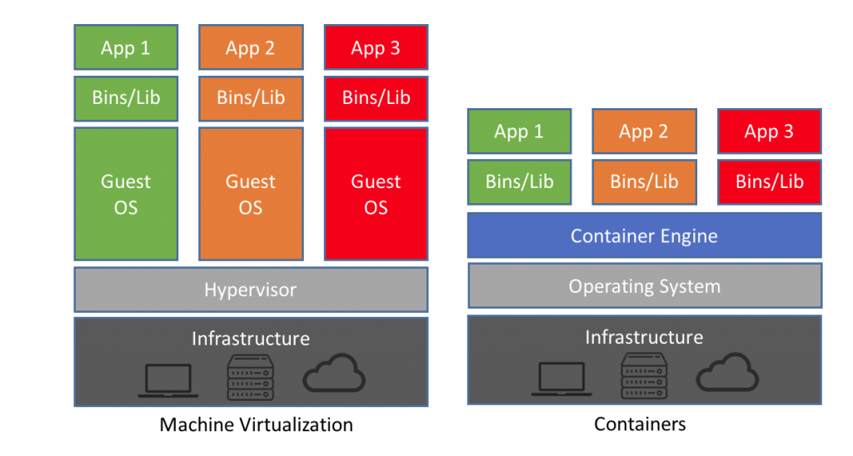
CONTAINERS VS VIRTUAL MACHINE
Project Title | Department of Information Science and Engineering

Slide 12
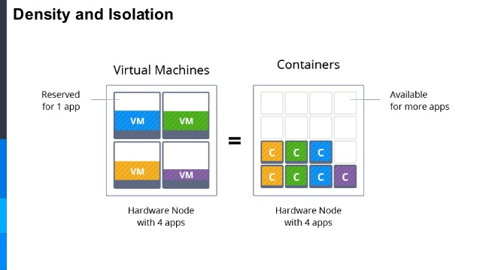
RECENT SHIFT
Shifting from virtual machines to Docker containers allows developers to deliver changes in a fraction of the time with increases portablity.
Prior to the modernization process, developers were deploying to production on a frequent basis. Once the application was modernized, they are now consistently deploying every two weeks, and getting new features into the hands of users twice as fast.
III. Running in a container, it is portable between on-premise and public cloud environments.
Project Title | Department of Information Science and Engineering

Slide 13
LITERATURE SURVEY
TITLE - An Analysis of Live VM Migration Based on OpenStack Cloud: A Survey
AUTHORS -
Pooja Tandel Prof.Abhijitsinh Parmar
Computer Science &Engineering Computer Science &Engineering
Parul university Parul university
Vadodara, India. Vadodara, India.
pdtandel09@gmail.com abhijitsinh.parmar2937@paruluniversity.ac.in
JOURNAL NAME - Proceedings of the Third International Conference on
Trends in Electronics and Informatics (ICOEI 2019)
Project Title | Department of Information Science and Engineering

Slide 14
LITERATURE SURVEY
Cloud provides a meaningful computing environment, however, there is an adequate pursuit of services.
The significant inconveniences are the best approach to manage the assets in distributed computing when heaps of the virtual machines have been ascended.
The live relocation (migration) of these VMs is acquainted with acquiring different advantages which primarily incorporate high accessibility, equipment maintenance, adaptation to internal failure and the remaining task at hand adjusting.
This paper solidifies different effective techniques of live VM movement (migration) along with their positive points and negative points.
Project Title | Department of Information Science and Engineering

Slide 15
LITERATURE SURVEY
TITLE - Building Modern Clouds:Using Docker, Kubernetes & GCP
AUTHORS -
Jay Shah Dushyant Dubaria
Telecommunication and Network Engineering Telecommunication and Network Engineering
Southern Methodist University Southern Methodist University
Dallas, TX. USA Dallas, TX. USA
jayashoks@smu.edu ddubaria@smu.edu
JOURNAL NAME - 2019 IEEE 11th International Conference on Cloud
Computing
Project Title | Department of Information Science and Engineering

Slide 16
LITERATURE SURVEY
This paper is divided into three sections . The first Section covers Docker:Containerization Using Docker, Docker for networking, The Docker hosting a Word Press website using Docker
In the Second Section, we have covered Kubernetes : The Role and Architecture of Kubernetes, basic concepts, features, Kubernetes clusters, scaling and deploying applications and hosting a WebServer Using Helm
In the Final Section, we have discussed Google Cloud Platform, its compatibility, services,features and how Kubernetes and GCP go hand in hand
Project Title | Department of Information Science and Engineering

Slide 17
LITERATURE SURVEY
TITLE - Using Containers to Execute SQL Queries in a cloud
AUTHORS -
David Holland and Weining Zhang
Department of Computer Science, The University of Texas at San Antonio
{david.holland,Weining.Zhang}@utsa.edu
JOURNAL NAME - 2018 IEEE/ACM International Conference on Utility and
Cloud Computing Companion (UCC Companion)
Project Title | Department of Information Science and Engineering

Slide 18
LITERATURE SURVEY
Container technology, such as Docker , has become uni-versally available on all kinds of cloud platforms.
While many new applications have been designed to run in containers,progress has been slow to adapt existing SQL database systems to take full advantage of container platforms
The use of many containers to evaluate a single query also allows distributed containers to load data into and keep intermediate results all-in-memory during the query’s lifetime
This paper presented a framework for containerizing a (SQL) query, using software, e.g.Docker and SQLite.
Project Title | Department of Information Science and Engineering

Slide 19
LITERATURE SURVEY
TITLE - Containerized Placement of High-Performance Computing in
Cloud
AUTHORS -
Manish Kumar Abhishek , D. Rajeswara Rao
Research Scholar, Department of Computer Science and Engineering, Koneru
Lakshmaiah Education Foundation, Vaddeswaram, India.
JOURNAL NAME - International Journal of Advanced Science and Technology
Vol. 29, No. 4, (2020), pp. 5678 - 5686
Project Title | Department of Information Science and Engineering

Slide 20
LITERATURE SURVEY
Virtualization in High Performance Computing .
Comparison of VMs and Containers , via analyzing their performance and computing resources.
Using Docker we will deploy an HPC application on already built infrastructure and analyze it.
For performance evaluation of HPC application using containers, we have used standard tools High Performance LinPack and Graph500
In this research work, the performance of HPC application is computed using the containerization technology. HPC application has been deployed using containers via Docker in private cloud infrastructure.
Project Title | Department of Information Science and Engineering

Slide 21

Thank you
Project Title | Department of Information Science and Engineering

