Slide 1
Teaching an LSTM to Compose
Neural piano generation from a procedurally generated dataset
Sai Abhishek Bhattiprolu · Shivam Sharma · Vansh Bharat Gala
APM 527 · Deep Neural Networks
Notes:
Opening (~45 s).
Hi everyone. Our project asks whether a small recurrent network can learn to write piano melodies.
The keys lighting up below are the opening of a melody our LSTM generated - nobody composed it.
Over the next 15 minutes: how we built the training data, the four models we compared, how well each one predicts and generates music, and what the LSTM still gets wrong.

Slide 2
The idea
⚙️
🎼
🧠
🎹
Rules
6,000 melodies
LSTM
New melody
random but structured
synthetic dataset
learns next note
sampled note by note
Can it learn the rules from examples alone?
Notes:
The pipeline (~1 min).
We wrote a rule-based melody generator - keys, scales, rhythms, motifs, cadences - and used it to make 6,000 training melodies.
An LSTM never sees those rules. It only sees the melodies, as sequences of tokens, and learns to predict the next one.
Then we sample from it to make new music.
(click) The question: can it recover the rules just from examples? Because we wrote the rules, we can measure exactly how close it gets.
The course required comparing against a linear model, so we also trained a linear model plus two count-based baselines.

Slide 3

A melody factory
one of the 6,000 generated training pieces
motif
echo
pause on V
motif returns
home ✓
🎹 12 keys × major / minor
🥁 13 rhythm patterns
📐 8, 12 or 16 bars
Notes:
The generator (~1.5 min).
This is a real training piece, 8 bars, drawn as a piano roll: time left to right, pitch bottom to top, grey lines are bar lines.
(click) Every piece opens with a one-bar motif, and bar 2 repeats it a step higher or lower.
(click) Inner phrases end on the dominant - a musical comma.
(click) The last phrase brings the motif back and ends on the tonic - the home note.
Pitches follow a random walk on the scale: mostly steps, occasional leaps, and after a leap it usually turns back.
(click) Key, mode, rhythm and length are all random, so the 6,000 pieces differ but share the same grammar.
We checked for duplicates with a transposition-invariant signature and found none.

Slide 4
From notes to tokens
START
NOTE_65
DUR_2
NOTE_62
DUR_2
NOTE_58
DUR_4
NOTE_53
DUR_4
…
END
pitch + length (in 16th notes)
48
token vocabulary: 37 pitches · 6 lengths · 2 rests · START / END / PAD
Notes:
Representation (~1 min).
Neural nets need sequences of symbols, so each note becomes two tokens: a NOTE token for pitch and a DUR token for length, counted in 16th notes. Rests get their own token.
(click) Watch the first four notes of the piece turn into tokens.
Every piece starts with START and ends with END.
(click) The whole vocabulary is just 48 tokens: 37 pitches from C3 to C6, 6 note lengths, 2 rest lengths, and three special tokens.
Generating music is now exactly like language modelling: predict the next token.

Slide 5
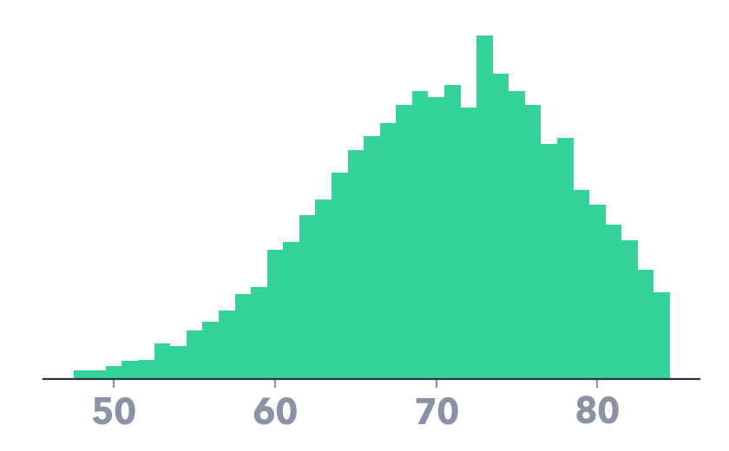
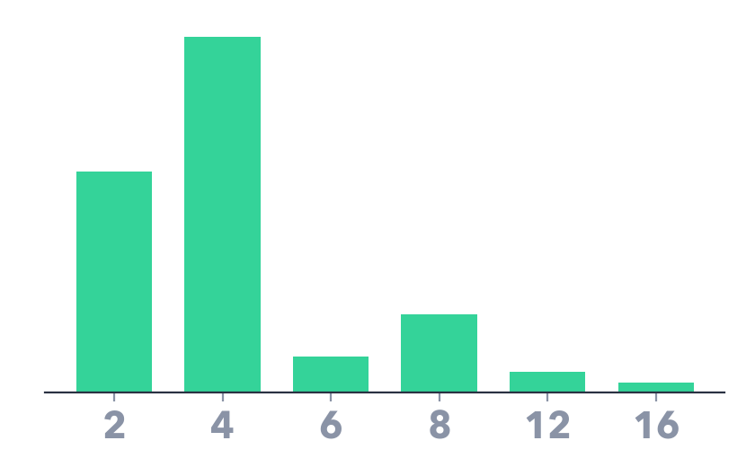
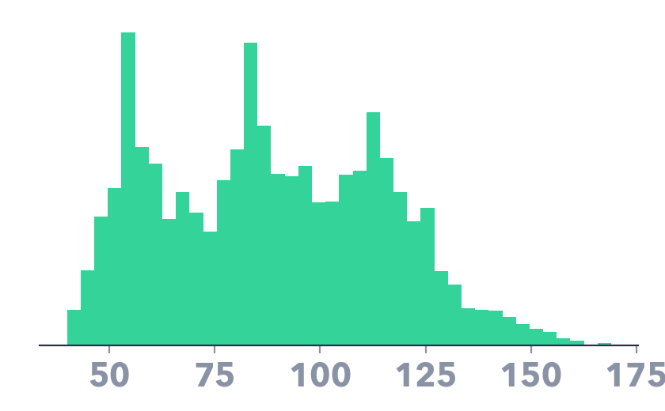
The dataset
6,000
531,926
≈ 89
melodies
tokens
tokens per melody
train 4,800
val 600
test 600
split by piece · no melody appears in two splits
pitch
note length
tokens per piece
Notes:
Dataset (~1 min).
6,000 melodies, about half a million tokens, roughly 89 tokens per melody.
(click) We split by piece: 4,800 train, 600 validation, 600 test. Validation drives early stopping; the test set is only for reporting.
(click) Distributions: pitches centre around MIDI 70, quarter and eighth notes dominate, and lengths cluster at 8, 12 and 16 bars.
Caveat: synthetic, diatonic, one note at a time, no dynamics. Whatever the model learns, it learns about this generator, not about Chopin.

Slide 6
Four contenders
same task: predict the next token
Unigram
Bigram
Linear
LSTM
46 parameters
2.2 k parameters
18.5 k parameters
507 k parameters
no context
last token
last 8 tokens
entire history
■ context used ■ token to predict
Notes:
Models (~1.5 min). Circle size is log of parameter count; the strip shows how much history each model sees.
(click) Unigram: just token frequencies, ignores context - a floor.
(click) Bigram Markov chain: predicts from the previous token only, add-alpha smoothing chosen on validation.
(click) Linear model, the course baseline: multinomial logistic regression on one-hot encodings of the last 8 tokens - 18 thousand weights, no hidden layer.
(click) LSTM: half a million parameters, and in principle it can use the whole history through its memory cell.
All four are evaluated on exactly the same test targets.

Slide 7
Inside the LSTM
memory carried across time ⟶
192
LSTM
192
LSTM
64
Embedding
48
Softmax
NOTE_72
DUR_4
feed the sample back in → repeat until END
507 k params
dropout 0.2
Adam
early stopping on val
Notes:
Architecture (~1.5 min).
(click) A token is embedded into 64 numbers, passes through two stacked LSTM layers of 192 units, and a softmax gives a probability for each of the 48 tokens.
(click) The key piece: each LSTM layer carries a hidden state and a cell state from one step to the next. That memory is what lets it keep track of where it is in the bar - something a fixed window struggles with.
(click) The output is a distribution; here it's confident the next token is a quarter-note duration.
(click) To generate, we sample a token, feed it back as the next input, and repeat until END.
(click) Training: cross-entropy loss, Adam, batch 64, gradient clipping at 1, dropout 0.2, early stopping with patience 3 on validation loss.

Slide 8
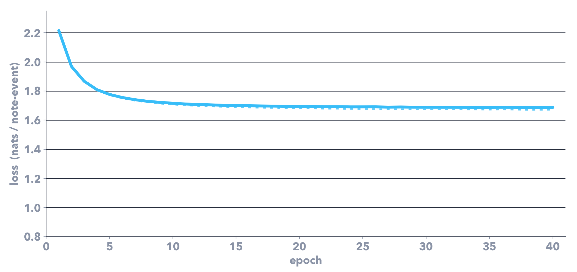
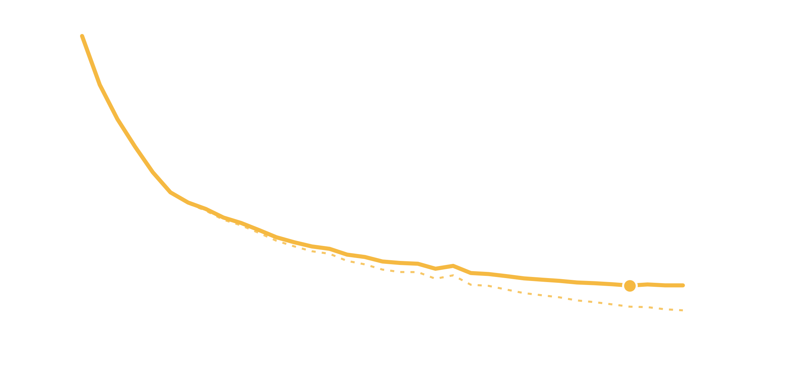
Learning curves
solid = test · dotted = train
Linear 1.69
train/test gap opens ⟶
mild overfitting after ~epoch 20
LSTM 1.02
best val · epoch 32
Notes:
Training (~1 min). Y-axis is cross-entropy per token on train and test sets - the plot the course asked for.
The linear model (blue) flattens within about 10 epochs at 1.69, and train and test lie on top of each other: it is capacity-limited, not overfitting.
(click) The LSTM keeps improving for 30+ epochs down to about 1.02 test loss. Early stopping on validation picked epoch 32 and stopped at 35. About 9 seconds an epoch on a laptop CPU.
(click) After roughly epoch 20 the train curve keeps falling while test flattens - mild overfitting, so more capacity alone wouldn't help much.
Test loss was only plotted; it was never used to pick the model.

Slide 9
How surprised is each model?
test perplexity · lower is better
≈ 2× sharper
than the linear model
21.7
10.5
5.4
2.8
Unigram
Bigram
Linear
LSTM
Notes:
Prediction quality (~1 min).
Perplexity is e to the cross-entropy: roughly how many tokens the model is choosing between at each step. Out of 48 tokens -
(click, bars build) unigram is effectively guessing among 22, bigram 10.5, linear 5.4, and the LSTM 2.8.
(click) That's about twice as sharp as the linear baseline and almost 8 times sharper than frequency counting.
Cross-entropy: 3.08, 2.35, 1.69, 1.02 nats.
Good next-token prediction is necessary but not sufficient - next we check what the samples actually look like.

Slide 10



Does each melody fill whole bars?
300 samples per model · T = 1.0
✓
✗
13%
16%
93%
Bigram
Linear
LSTM
training data: 100%
Notes:
Bar alignment (~1 min). We sampled 300 melodies from each model with no grammar constraints and asked: does the total length come out to a whole number of 4/4 bars? Every training melody does.
Doing this requires counting elapsed time across the whole piece.
(click) Bigram: 13%. Linear: 16% - its 8-token window covers only about 4 notes, so it can't know where in the bar it is.
LSTM: 93%. Its memory effectively learned to count beats.
Also: 96% of LSTM samples are fully grammatical (every NOTE followed by a DUR), and 97% of their notes fall in a single scale.

Slide 11
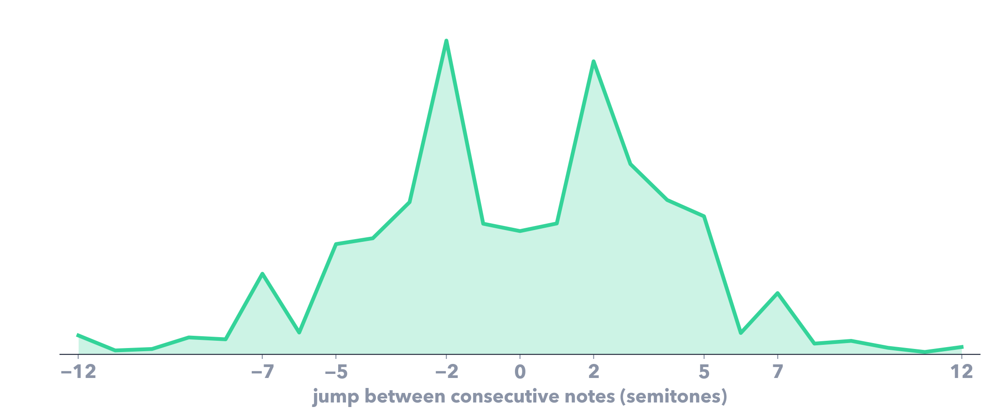
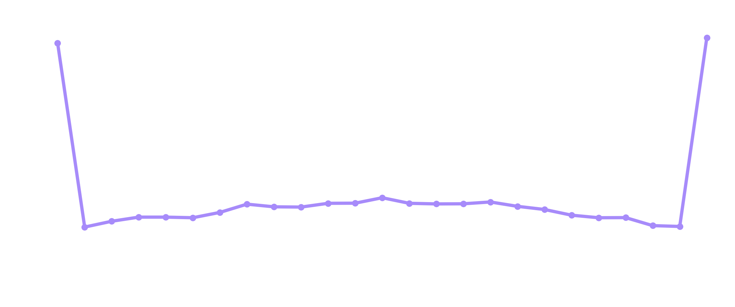
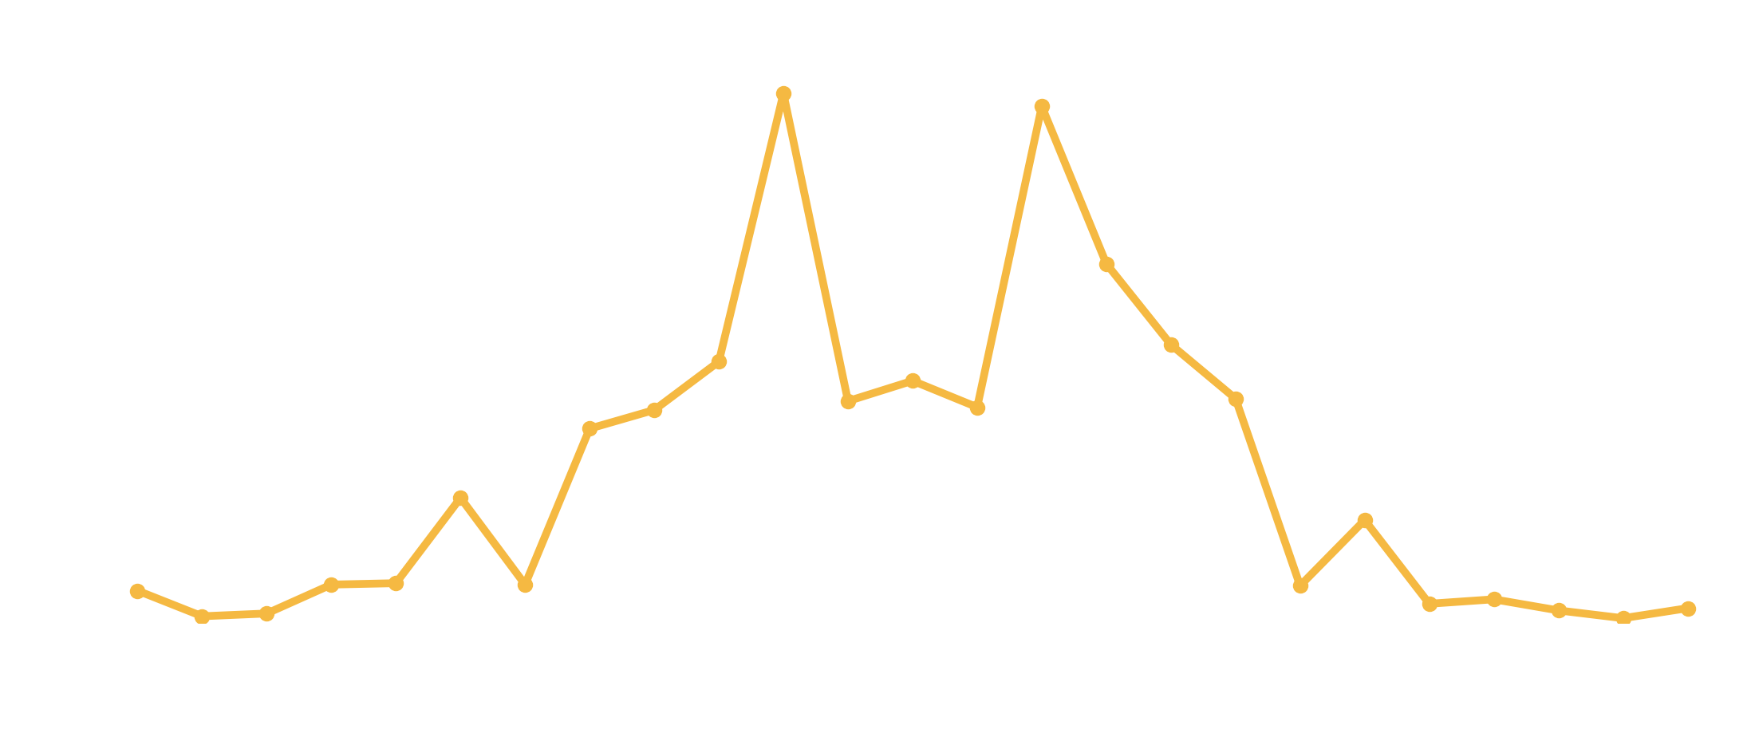
Melodic fingerprint
how big is the jump between consecutive notes?
Real data
reference
Bigram
distance 0.48
LSTM
distance 0.02
Notes:
Interval statistics (~1 min). Green is the distribution of melodic jumps in real test data: mostly steps of 1-2 semitones, few large leaps.
(click) The bigram chain works on absolute pitches, so it gets this badly wrong: nearly flat, with spikes at plus/minus an octave. Total-variation distance 0.48.
(click) The LSTM sits right on top of the data - distance 0.02. (The linear model also matches this, 0.025 - local statistics are easy; bar structure is what separates them.)
Pitch-class and duration histograms match just as closely. No generated sample copied a training piece.

Slide 12
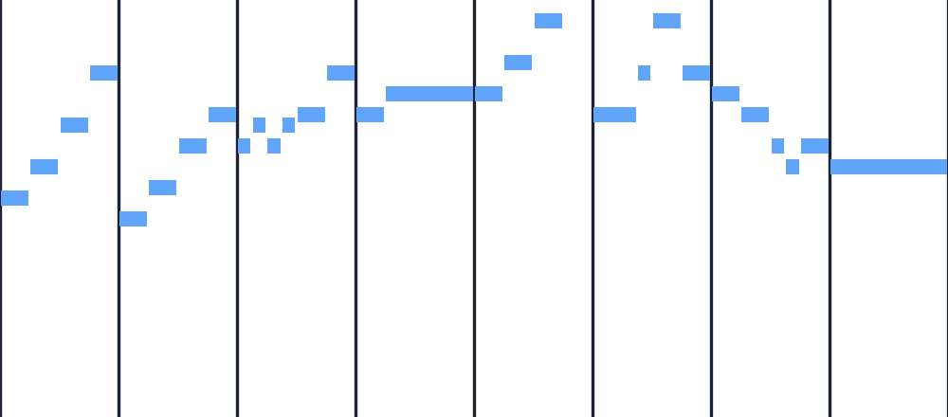
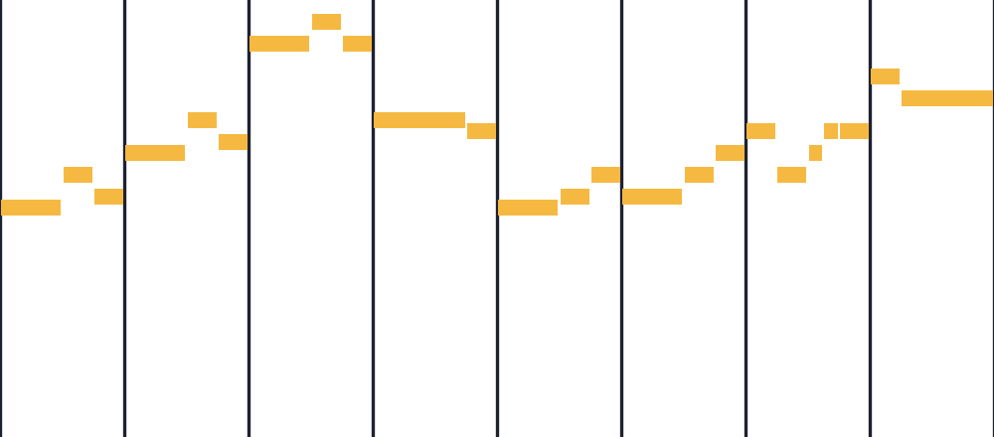
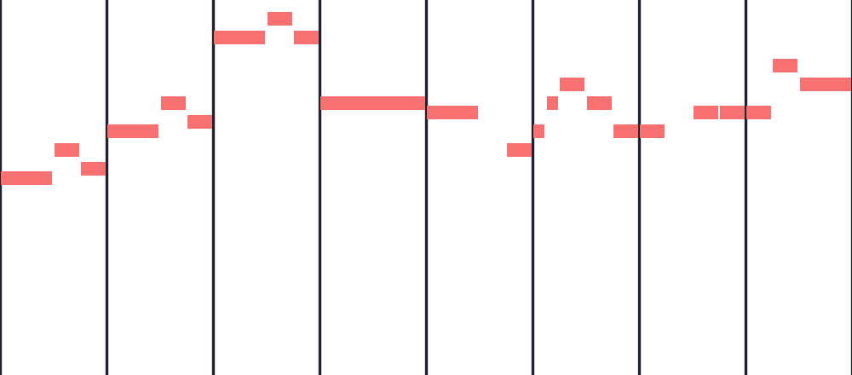
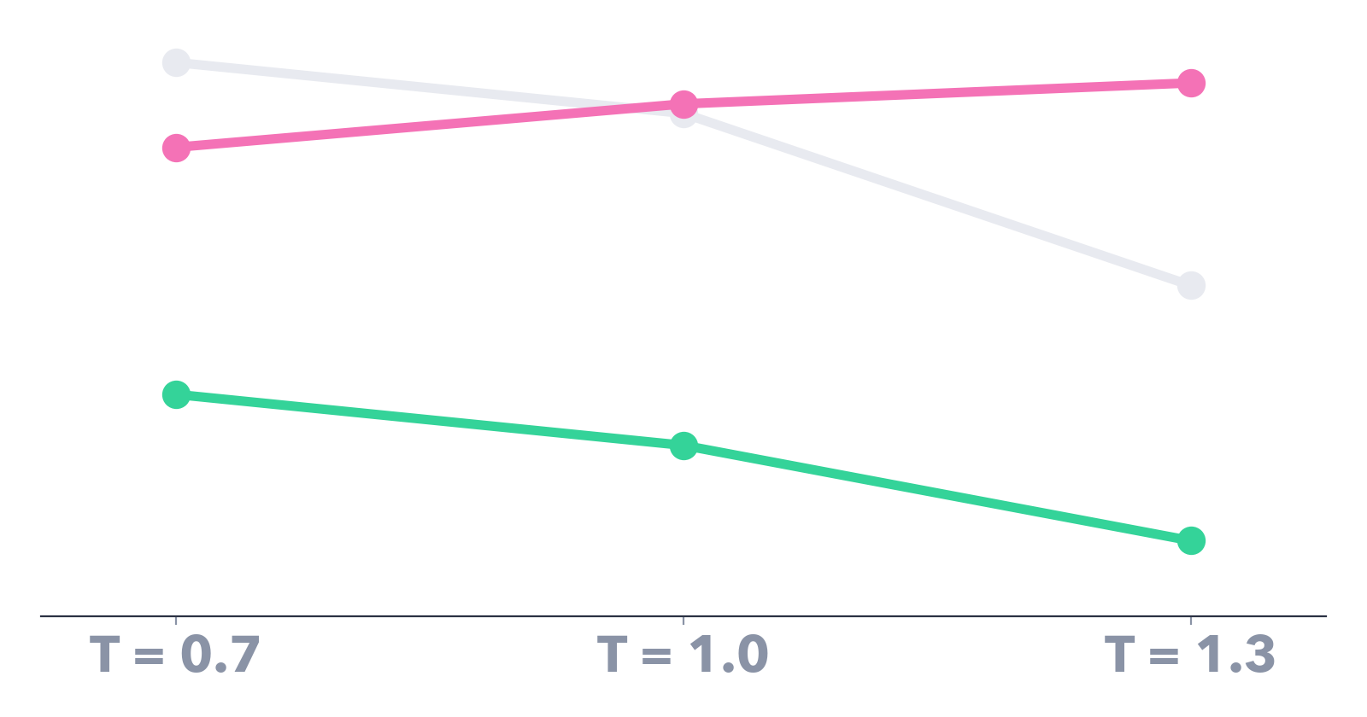
Turning the temperature dial
T = 0.7 🧊 cautious
T = 1.0 balanced
T = 1.3 🔥 adventurous
━━ bar fit 99% → 71%
━━ ends on tonic 58% → 39%
━━ variety 88% → 96%
Notes:
Temperature (~1 min). At sampling time we divide the logits by T. Below 1 the distribution sharpens, above 1 it flattens.
(click) First samples at each temperature: at 0.7 the melody is tidy and repetitive in register; at 1.3 it wanders.
(click) The trade-off: as T rises, bar fit drops from 99% to 71% and ending on the tonic from 58% to 39%, while variety - distinct 4-grams - goes up from 88% to 96%.
We used T = 1.0 as the honest setting: it samples from what the model actually learned.

Slide 13
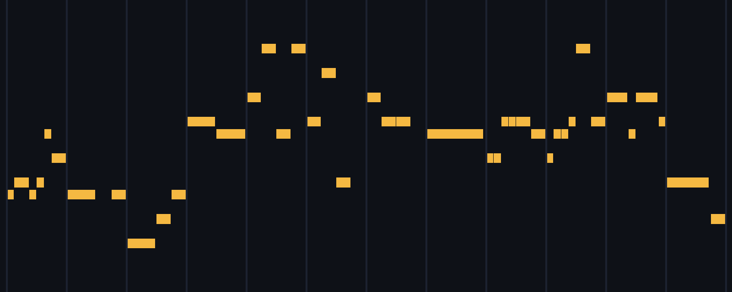
Listen 🎧
LSTM · T = 1.0 · click to play
43 notes
32 seconds
90 BPM
first valid sample · rule fixed in advance
Notes:
The music (~1 min incl. playback). Click the video to play - 32 seconds.
To avoid cherry-picking, we fixed the selection rule before listening: sample at T = 1.0 with a fixed seed and keep the first candidate that is grammatical, bar-aligned, 30-60 seconds long and not a training copy. The very first candidate passed (32 of 50 did).
Notice: it stays in key, phrases fall on bar lines, and rhythms sound like the training data. Listen for whether it 'goes home' at the end.
Rendered from MIDI with FluidSynth and a General MIDI grand piano soundfont.

Slide 14


What it hasn't learned yet
Ending on the home note
Repeating its own motifs
data
4.5%
100%
51%
LSTM
0.16%
data
LSTM
28× less
local rules ✓ long-range form ✗
Notes:
Limitations (~1.5 min). Two things the LSTM clearly hasn't got.
(click) Every training melody ends on the tonic. Only about half of LSTM samples do (51%). Ending correctly means remembering the key established many bars earlier.
(click) Motif repetition: in the data, about 4.5% of 4-note (interval, rhythm) patterns repeat inside a piece - the motif and its echo. In LSTM samples it's 0.16%: 28 times less. It writes plausible local lines but doesn't return to its own ideas.
(click) Summary: local rules yes, long-range form no.
Other caveats: synthetic data, single seed per model so no variance estimate, and these metrics measure conformity to our generator - not musical quality. No listening study.

Slide 15
Takeaways
🏆
🎼
🔭
2.8 vs 5.4
93%
next
LSTM perplexity vs linear baseline
samples fill whole bars (linear: 16%)
bar-position tokens · attention · real piano data
Notes:
Takeaways (~1 min).
(click) One: a half-million-parameter LSTM clearly beats linear and Markov baselines at predicting held-out melodies - perplexity 2.8 versus 5.4.
(click) Two: it learns the local rules - grammar, scale, interval and rhythm statistics, and above all metre: 93% of samples fill whole bars, versus 16% for the linear model.
(click) Three: phrase-level form is only partly learned. Next steps would be explicit bar-position tokens, attention to reach back to the opening motif, and moving from synthetic to real piano repertoire.
Everything - data, models, metrics, MIDI - comes from one seeded Python script.

Slide 16
Thank you
Questions?
Sai Abhishek Bhattiprolu · Shivam Sharma · Vansh Bharat Gala
Notes:
Thank you. The keys are playing the last bars of the generated piece. Happy to take questions.

