Slide 1



ELECTRICAL FAULTS ANALYSIS & CLASSIFICATION

Slide 2


TEAM MEMBERS
P. DIVESHWARAN - CB.EN.U4ELC22010
K. ABHIRAM REDDY - CB.EN.U4ELC22018
S. KARTHIK - CB.EN.U4ELC22049
K. ANIL KUMAR- CB.EN.U4ELC22066

Slide 3

OVERVIEW
Abstract
Problem Statement
Objective
Dataset Overview
Models & Methodology
Feauture Importance
Final Result
Conclusion

Slide 4
ABSTRACT
This project uses ML models like Random Forest to automate electrical fault detection, improving accuracy and response time. Evaluated using real-world data, the models are assessed through accuracy and classification reports. Feature importance analysis highlights key parameters, showcasing ML’s potential for real-time monitoring and predictive maintenance.

Slide 5

PROBLEM STATEMENT
Electrical faults in power systems are a major concern as they can cause:
✔ Equipment damage leading to high maintenance costs
✔ System downtime affecting industrial and domestic power usage
✔ Safety hazards such as short circuits and fire risks
✔ Inefficiencies in traditional fault detection methods requiring manual intervention

Slide 6

TYPES OF FAULT
LG (Line-to-Ground) Fault
LL (Line-to-Line) Fault
LLG (Double Line-to-Ground) Fault
LLL (Three-Line) Fault
LLLG (Three-Line-to-Ground) Fault

Slide 7

OBJECTIVE
Develop a Machine Learning-based fault classification system
Train ML model to classify different fault types based on electrical parameters
Conduct feature importance analysis to understand the key factors in fault detection

Slide 8

DATASET OVERVIEW
Real-world electrical fault data with multiple fault classes.
Features include voltage, current, and system parameters.
Preprocessing involves normalization.

Slide 9

METHODOLOGY
Data Preprocessing: Label Encoding
Train-Test Split: Dividing data for training and evaluation.
Model Training: Training Random Forest with optimized parameters.
Model Evaluation: Using accuracy, confusion matrices, and classification reports.
Feature Importance Analysis: Identifying key influencing factors for fault classification.

Slide 10
DATASET-1
classData.csv:
Columns:
G, C, B, A (Integer): Categorical indicators related to fault classification.
Ia, Ib, Ic (Float): Current values in three phases.
Va, Vb, Vc (Float): Voltage values in three phases.
Inference: This dataset likely represents different electrical fault conditions based on current and voltage measurements.
Effect of Columns on Output:
Categorical values (G, C, B, A) in classData.csv might represent specific fault types.

Slide 11
DATASET-2
detect_dataset.csv:
Columns:
Output (S) (Integer): The target output class, likely indicating fault classification.
Ia, Ib, Ic (Float): Phase currents.
Va, Vb, Vc (Float): Phase voltages.
Inference: This dataset is used for fault detection, where Output (S) is the classification label.
Effect of Columns on Output:
Current (Ia, Ib, Ic) and Voltage (Va, Vb, Vc) influence the classification of faults.

Slide 12
CODE OPERATION
Data Loading & Exploration:
Reads the dataset (classData.csv).
Displays dataset structure, including the number of rows, columns, and data types.
Checks for missing values.
Prints dataset dimensions (number of samples and features).
Correlation Analysis
Uses a heatmap to show relationships between different features.
Helps identify dependencies between current (Ia, Ib, Ic), voltage (Va, Vb, Vc), and fault indicators (G, C, B, A).

Slide 13
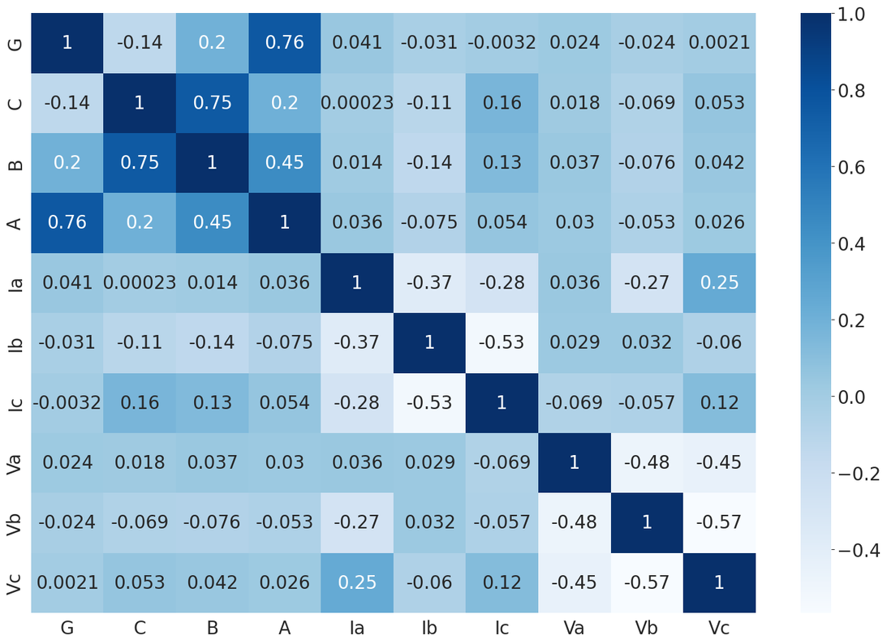
CORRELATION ANALYSIS

Slide 14
CODE OPERATION
Scatter Plots for Current vs Voltage
Visualizes the relationship between current and voltage in different phases.
Helps understand how phase currents affect phase voltages.
Distribution Analysis of Currents and Voltages
Plots distribution curves for phase currents (Ia, Ib, Ic) and voltages (Va, Vb, Vc).
Shows the spread of current and voltage values.

Slide 15
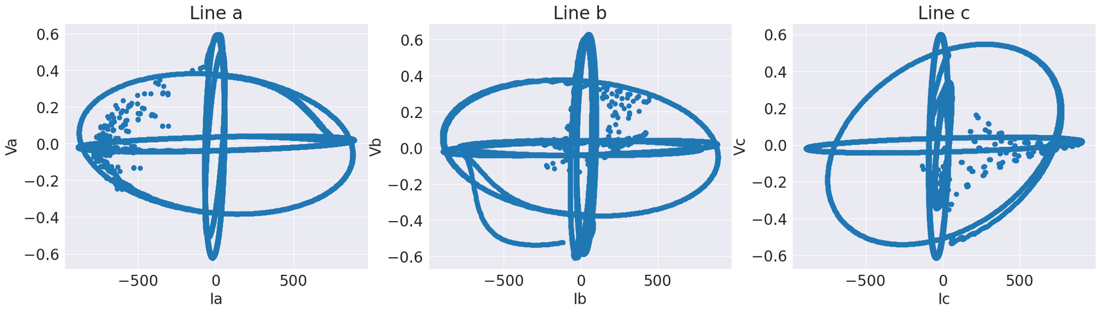
SCATTER PLOTS

Slide 16
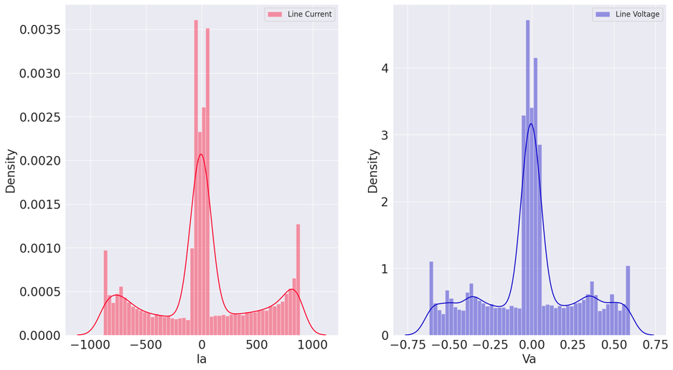
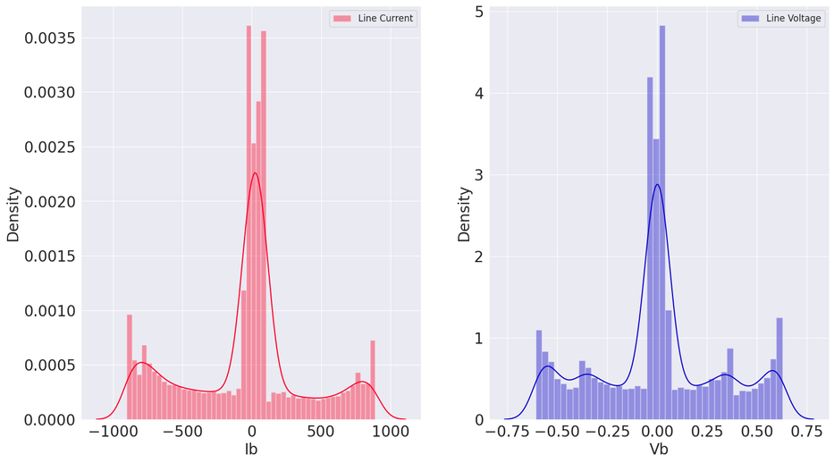
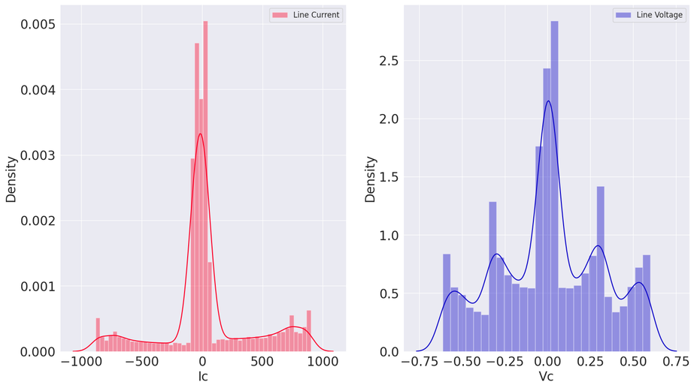
DISTRIBUTION ANALYSIS

Slide 17
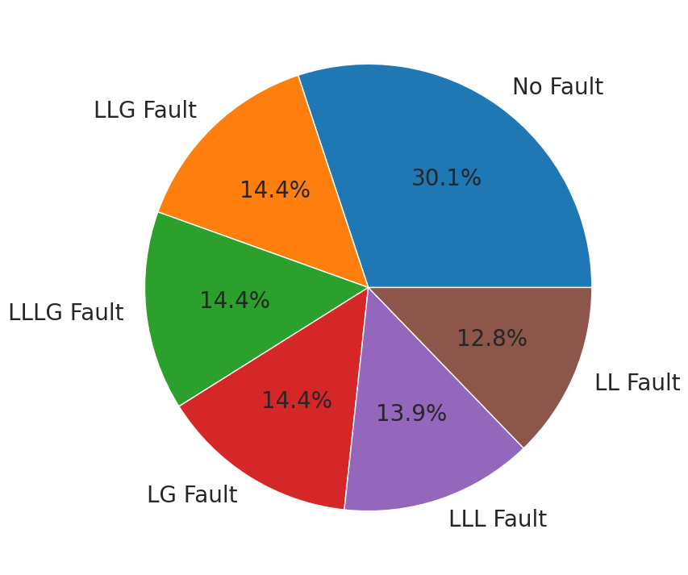
FAULT DISTRIBUTION

Slide 18
CODE OPERATION
Data Preprocessing for Machine Learning
Drops categorical fault indicators since they are now represented in faultType.
Encodes faultType as numerical labels using LabelEncoder.
Splits the data into training (80%) and testing (20%) sets for model evaluation.
Model Training and Prediction
Uses RandomForestClassifier to learn from training data.
Predicts fault types on the test dataset.

Slide 19
CODE OPERATION
Performance Evaluation
Displays a confusion matrix heatmap to analyze model predictions.
Prints the accuracy, precision, recall, and F1-score to measure model effectiveness.
Class-wise F1 Score Analysis
Extracts F1-scores for each fault type.
Converts results into a structured format for better understanding.
Visualizes F1-scores per class using a bar chart to identify which fault types the model predicts best

Slide 20

FEATURE IMPORTANCE
Identifies key electrical parameters contributing to fault detection
Helps in optimizing the model for real-world implementation
Improves interpretability & decision-making

Slide 21

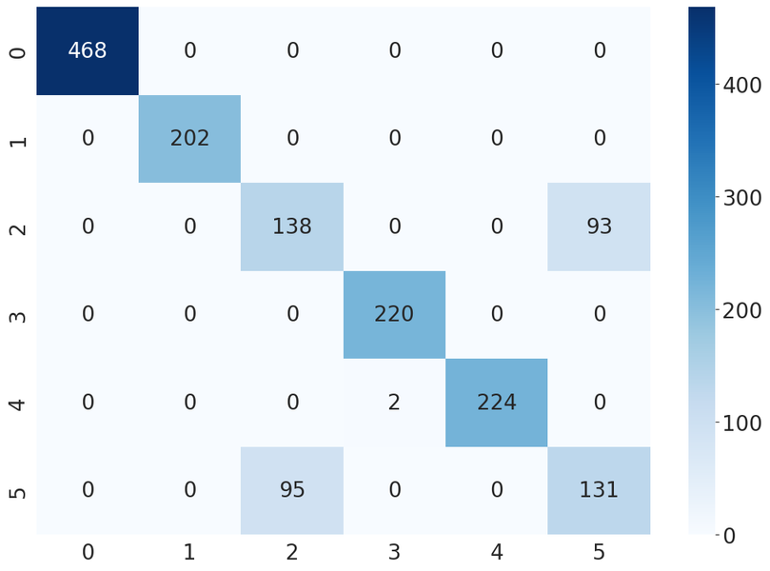
FINAL RESULT
Accuracy Scores: 87.921%

Slide 22

CONCLUSION
ML-based classification enhances fault detection speed and accuracy.
Based on the final result we got from our Machine Learning models “ Random Forest ” has the Highest Accuracy of 87.921%.

Slide 23
THANK YOU

